Slide 1



PROJECT – II 33-22-11
CME1251 Project Based Learning - I
by
2020510019 GÜRKAN BIYIK
2020510080 ERALP ÇOLAK
2021510040 AHMET KAĞAN KERVAN
IZMIR

Slide 2
Outline
INTRODUCTION
PROGRESS SUMMARY
Requirements
Task Sharing
Scheduling
Completed Tasks
ALGORITHMS AND SOLUTION STRATEGIES
PROBLEMS ENCOUNTERED
SCREENSHOTS
conclusıon
REFERENCES

Slide 3
33-22-11
33-22-11 is a game where you match same numbers in game board.
The game is played on 3x30 board.
In Begining , the board randomly filled with
30 numbers which are 1,2,3
Use Key arrows to move the cursor
Use ‘W,A,S,D’ to move the numbers.
If the numbers matches you get 10 points.

Slide 4
Requirements
Using C# Language and Visual Studio
Complete the fully playable game:
Creating game’s board and numbers.
Cursor movement and movement of numbers.
Matching and score.

Slide 5
Task Sharing
Ahmet Kağan Kervan: Game’s board and cursor movement.Creating variables and arrays.
Gürkan Bıyık: A and D movement,random number generator.
Eralp Çolak:W and S movement, matching.

Slide 6
Completed Tasks
First Week: Creating variables and arrays. Draw the Game Board . Cursor Movement.
Second Week: W and S movement. Generating random numbers.
Third Week: Matching and A and D movement.
Fourth Week: Testing,debugging.

Slide 7
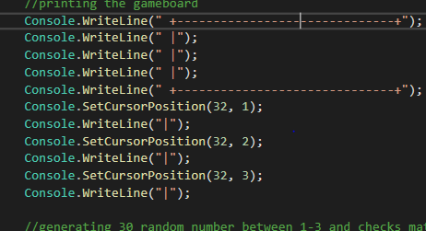
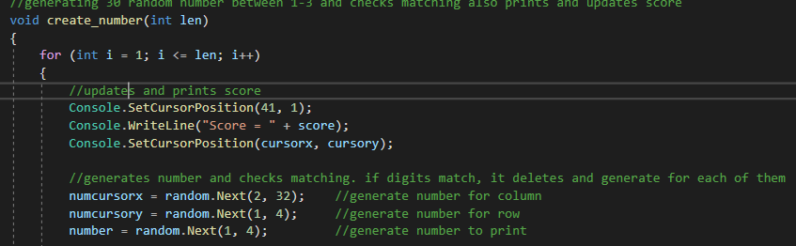
ALGORITHMS AND SOLUTION STRATEGIES
Game’s board and Generating random numbers.
Creates a 3x30 game board.
Generates 30 random numbers in board.

Slide 8
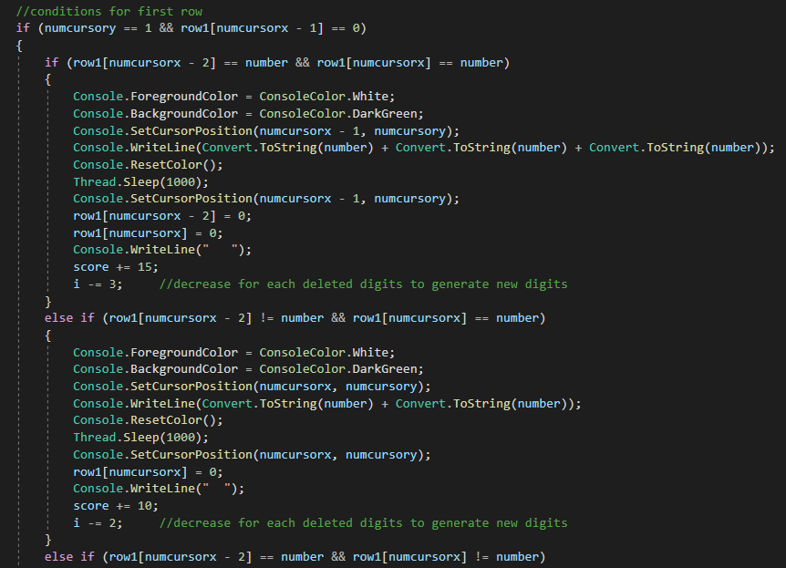
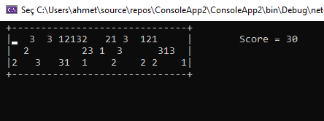
Game Board in Console

Slide 9
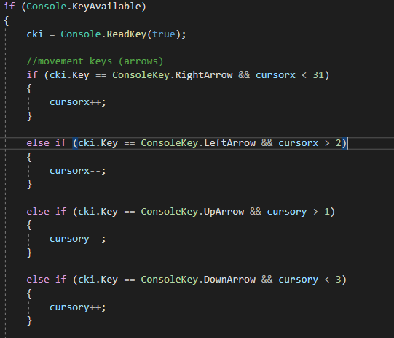
Cursor Movement:
Use Arrow keys to move
the cursor in Game Board.
Using ConsoleKeyInfo variable
Console.KeyAvailable command.

Slide 10
Using W-A-S-D in moving numbers:
Use ‘W-A-S-D’ keys to move the numbers.
IF:
Numbers are adjacent.
Numbers are in vertices of the board
They can’t move.

Slide 11
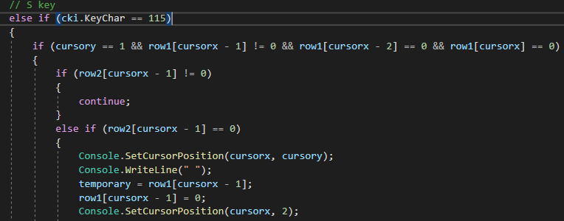
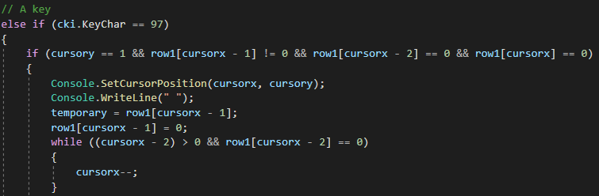

Slide 12
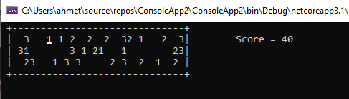
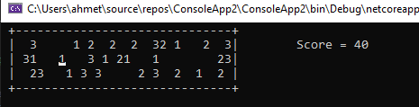
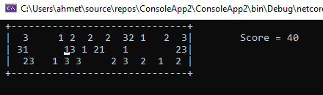
Moving 1 to up(With ‘W’ key)
Original board
Moving 1 to right ( With ‘D’ key)

Slide 13
Matching
If same numbers get adjacent in same row:
They are ‘Matching’
They disappear and creates two or three random numbers.
Then gives you score.(If 2 of them matches:10 ---- If 3 of them matches:15 points)

Slide 14
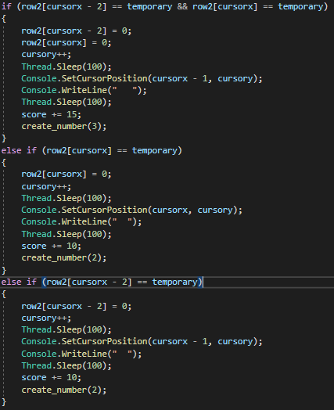
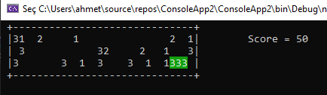
Matching shown in Console.

Slide 15
Problems Encountered
In cursor movement , we didn’t know how to read keys as a input. Then we found ReadKey command.
It came to us hard to figure out what write function to use after using SetCursorPosition.
We don’t know how to move the numbers with W-A-S-D keys.We found that by using ASCII table we made the program understand which letter is pressed.
At first, we created a while loop to generate another random number if the generator generates a number on a full index. Then we fixed with ‘for’ loop.

Slide 16
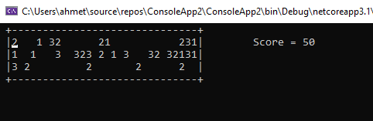
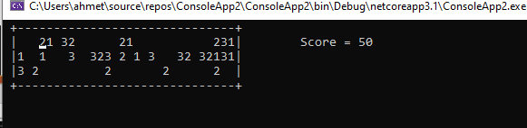
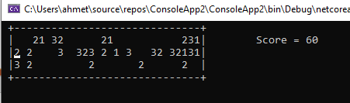
Screenshots
Game Board in the Beginning
Move ‘2’ to right.
Matching 1 and 1 in second row and generate two random numbers to board.

Slide 17
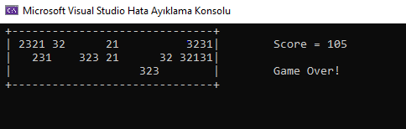
Game is over when there is no single number that can be move.

Slide 18
Conclusion
In this Project we learned:
How to use arrays
Using console.key function to use keys in keyboard
Cursor movement.
How to work as group.
It’s a great experience for us.

Slide 19
REFERENCES
https://stackoverflow.com/questions/2743260/is-it-possible-to-write-to-the-console-in-colour-in-net
https://online.deu.edu.tr/access/content/group/2f04482a-e33f-4c90-89c7-ff3fee465fc4/Ders%20%C4%B0%C3%A7erikleri/CursorMovement.doc
https://www.canva.com/tr_tr/
https://tr.wikipedia.org/wiki/ASCII

