Slide 1




Project-II STAR TREK WARP WARS PRESENTATION
Gürkan BIYIK
Mustafa İzzet YUMUŞAK
Eren ÇİÇEK
Abdulkadir ÖKSÜZ
2020510019
2020510075
2020510082
2020510083
Lecturers;
Assoc.Prof.Dr Semih UTKU
Res.Asst. Fatih DİLMAÇ
22.04.2022
2022 / Izmir

Slide 2
Outline
Introduction
Requirements
Task Sharing
Weekly Schedule
Algorithms & Solution Strategies
Problems Encountered
Screenshots
Conclusion
References
Questions

Slide 3
Introduction
The project aims to develop a software application for the «Star Trek Warp Wars» game.
Players aim to collect scores as much as possible by eating elements on the 23*55 space maze.
Computers in the game field chases the player to get his/her lives.
The game ends if the player loses all five lives.

Slide 4
Requirements
Java
Enigma
Classes
Functions/Procedures
Team-Work

Slide 5
Task Sharing
Gürkan BIYIK | Mustafa İzzet YUMUŞAK | Eren ÇİÇEK | Abdulkadir ÖKSÜZ
Designing public variables
Design of classes & variables
Printing Screen
General Functions
Timer
Backpack
Testing & Debugging
Game Field Filling
Printing Screen
Player movement
Design of classes
General Functions
Computer movement
Element inserting
Design of classes
File operations
Backpack
Computer movement
Design of class attributes
Game Speed
Filling the queue
Updating Game Info
Movement of 4&5
Trap&Warp devices

Slide 6
Weekly Schedule
Week-1 | Week-2 | Week-3 | Week-4 | Week-5
Design of classes | Player movements | Input queue implementation | Computer movements | Remaining parts of the game
Design of data structures | Timing | Static numbers (1-3) | Trap device | debugging/testing.
Design of menu and screen | Backpack implementation | Random moving numbers (4-5) | Warp device
Design of load operations

Slide 7

Algorithms and Solution Strategies

Slide 8
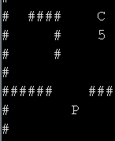
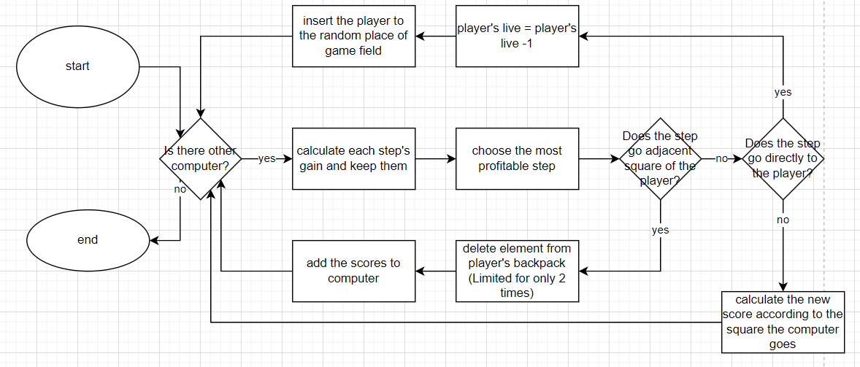

Algorithms and Solution Strategies
Computer Movement

Slide 9
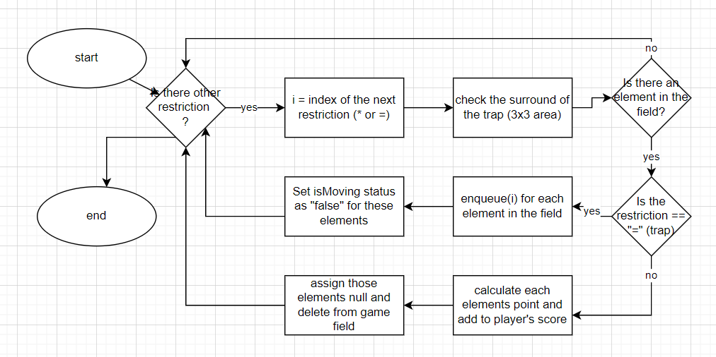
Algorithms and Solution Strategies
Trap & Warp Devices (Trapping procedure)

Slide 10
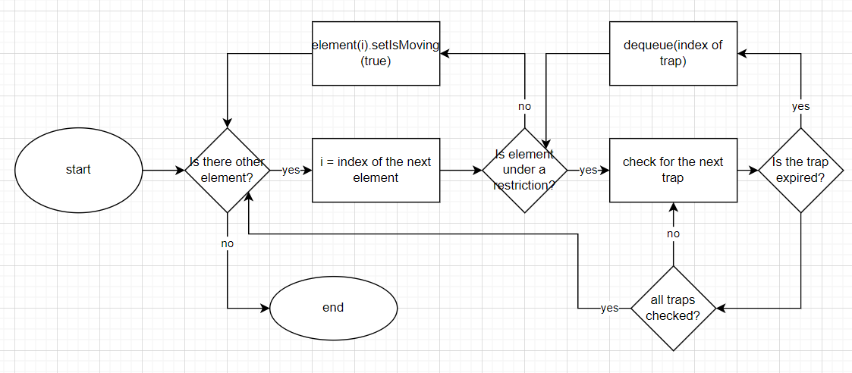
Algorithms and Solution Strategies
Trap & Warp Devices (Releasement procedure)

Slide 11
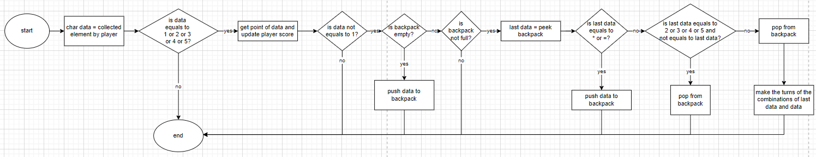
Algorithms and Solution Strategies
Backpack

Slide 12

Problems Encountered
Errors such as teleporting computers from one point to another were seen during computer movements.
Using excessive static variables.

Slide 13
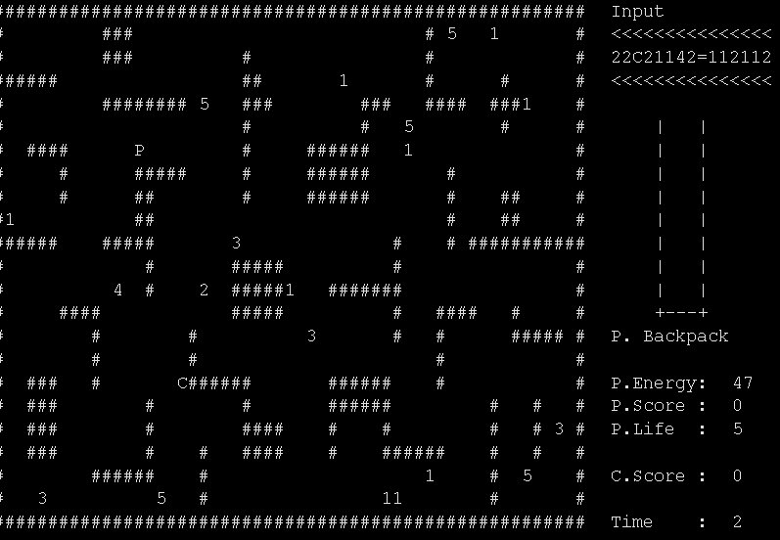
Screenshots

Slide 14
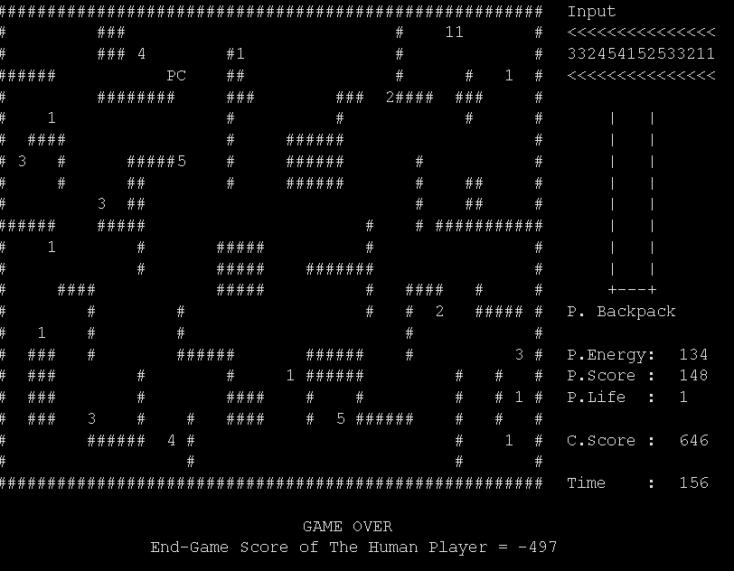
Screenshots

Slide 15
Conclusion
We have completed what was asked of us within a five-week timeframe.

Slide 16
References
W3 schools, https://www.w3schools.com/jsref/event_onkeypress.asp
(2022)
Tanzer Onurgil, https://online.deu.edu.tr/portal
Mouse & Keyboard Standart Code (25.02.2022)

Slide 17

Any Questions?

