Slide 1
Airflow Data Pipeline and ETL
Data Engineering
School of Data Science
University of Virginia

Slide 2
Updates/Comments
Docker Lab:
For those on Windows, use Docker Desktop Terminal
We’ll add a few more points about docker today.
Next quiz and lab should be released by tomorrow
Let us know if you don’t see the 2 week, and 2 tries on each.
Updates from Liz

Slide 3
Docker Part II
Revisiting: Docker containers leverage linux kernel.
So how do they run on Mac and Windows?
They load a linux VM
Great for development, but in operation you’d want a linux base system.

Slide 4
Docker Part II
Reminder of some useful flags
-v to map local folders
The v refers to ‘V’olumes and is like attaching a volume
-it is two flags, i for interactive, t for tty terminal
-p to map your ports
Note that a ‘container’ can be running, paused, exited or restarting

Slide 5
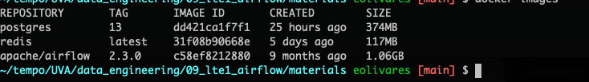
Docker-Compose
Docker is a command line utility.
On the other hand…
Docker-compose takes a yaml file to spin everything up
You’ll be provided with a docker-compose.yaml

Slide 6
Docker compose commands
The command relies on a file, and IS LOCATION sensitive
docker-compose up
Read the local docker-compose.yaml and bring up the containers and services
docker-compose down
Read the local docker-compose.yaml and shut down all the servers

Slide 7
Airflow, or more properly Apache Airflow
Airflow is workflow automation
Open source
Programmatically author
Schedule
Monitor
Three basic tasks of a pipeline, ETL
Extract
Transform
Load
Manage dependencies, logs, code, trigger and chain tasks

Slide 8
Manage details of a single pipeline
Single pipeline for ETL where every step uses different tool
Extract data via an API
Load data into database
Transform data
What happens if your API goes offline?
Or if the database access is down?
Or there is an error in the transform code?
Airflow allows you to manage this, and rerun steps

Slide 9
Manage multiple data pipelines
Once you set up one DAG, or sequence of tasks
Diverge at certain tasks to create different pipelines
Run similar pipelines in parallel
Railroad analogy, you can create a central origin with many destinations
Or create parallel and similar tracks

Slide 10
Some advantages of using Airflow
Ubiquitous Data Pipeline tool
Open source with a large community
Uses a dynamic language… python!
Scalable to large number of tasks
Comes with a UI for monitoring
Extensible - you can write your own plugins!

Slide 11
Airflow Components
Scheduler
Web Server
Metastore
Triggerer
Executor
Queue
Worker

Slide 12
Airflow: Core Concepts
DAG - no cycles permitted in our workflow
Operators (Encapsulate an action
Action - Execute an action, function, operation
Transfer - Move data between storage
Sensor - Monitor and execute on a trigger

Slide 13
Actions
Do something
BashOperator
PythonOperator
EmailOperator
Various executions available. This is where the core of your code for processing should go

Slide 14
Sensors
Wait for something to happen
Http request
File to transfer
They will pause execution and trigger downstream tasks when they find what they are looking for. Since they wait, they can be long running tasks

Slide 15
Transfer
Move data from one store to another
FTP to amazon S3
S3 to Redshift
They will pause execution and trigger downstream tasks when they find what they are looking for. Since they wait, they can be long running tasks

Slide 16
Airflow: What it is not…
Airflow is meant to manage tasks, workflows, but not do the heavy lifting.
Streaming, processing should be triggered by
But not done by Airflow
For example, let Airflow trigger a multi server pyspark deployment, and allow pyspark and EMR to do what they are best at.

Slide 17
Two Architectures
Single server - Runs everything, great for learning. This is what we’ll try out
Multiple server - Airflow can run on multiple servers, with separate components. For High Reliability we run a system of distributed servers, running systems of distributed servers!
We’ve installed Airflow docker for single server in last lab.

Slide 18
Lab Description
You’ll be provided the YAML we saw earlier today
Create a folder and place the file in it
From that folder run ‘docker-compose up’
Wait for the downloads and you’ll see the command line log… it won’t stop since it displays output from the web server
Navigate to localhost:8080
Use Airflow, Airflow to enter airflow
Explore…
Write a DAG with two or three tasks

Slide 19
Lab Description
What to explore
Airflow documentation for writing a dag
https://airflow.apache.org/docs/apache-airflow/stable/core-concepts/dags.html
Writing a DAG with tasks
Write files in the ‘dags’ folder
You’ll be extending the basic operators
Action, Transfer, Sensor
Use the overloaded operator to create dependency, as in Task1 >> Task2 >> Task3
Task1 >> Task3

Slide 20
Statement and other_statement
Statement & other_statement

Slide 21
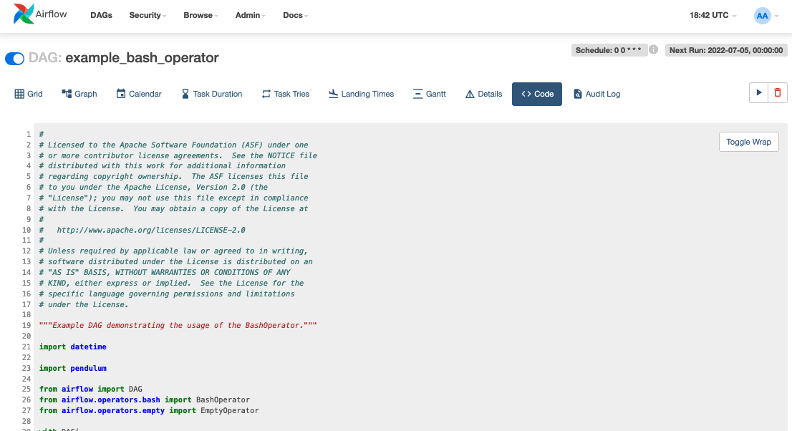
The Code View

Slide 22
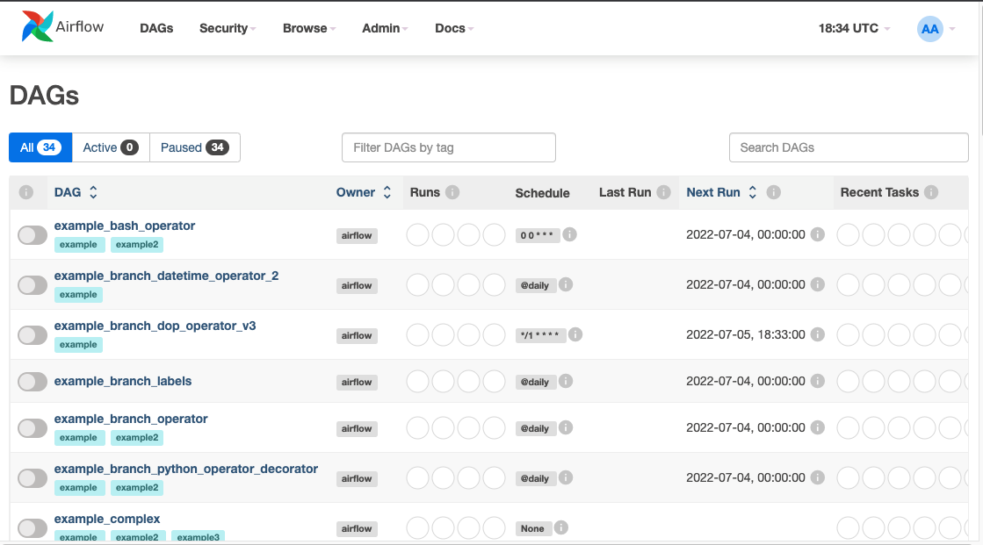
DAG View

Slide 23
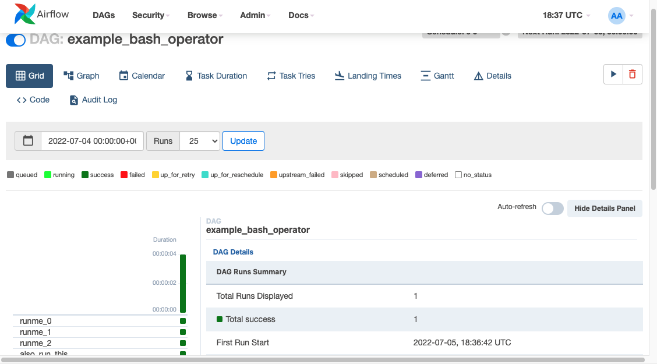
The GRID View

Slide 24
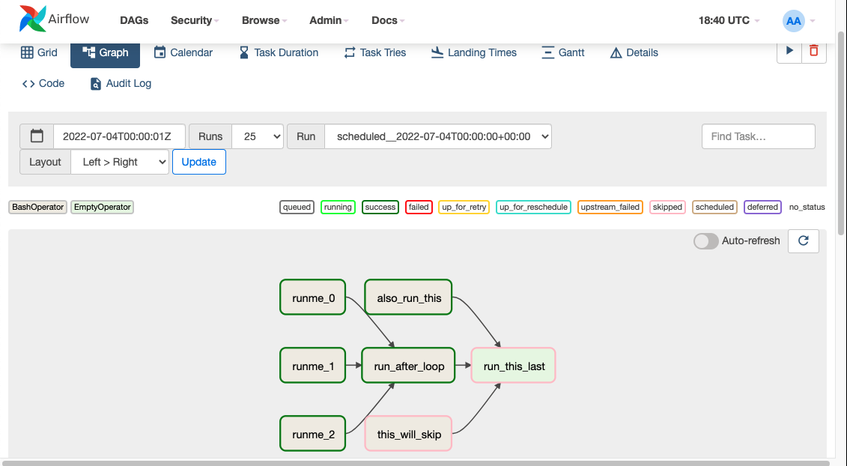
The Graph View

Slide 25
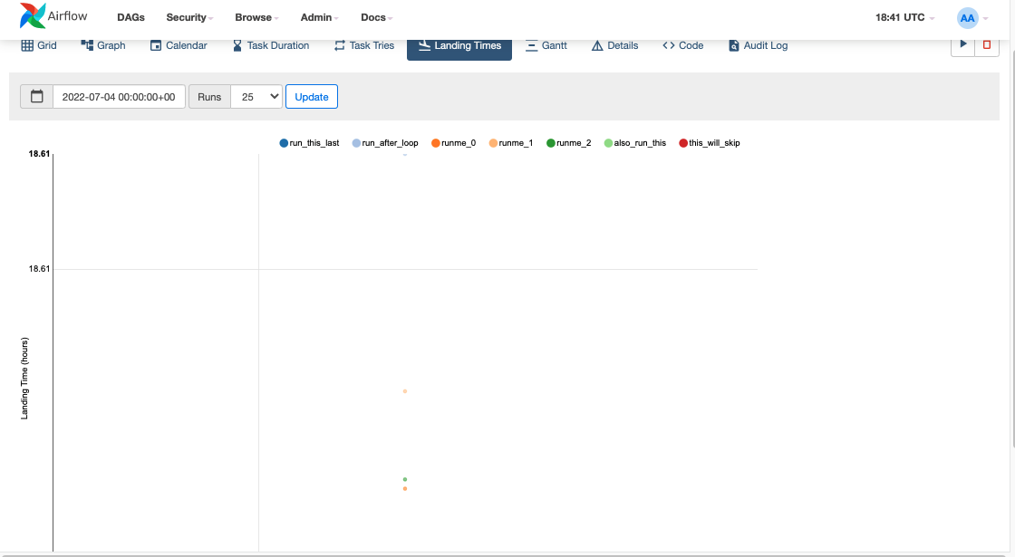
The Landing Time View

Slide 26
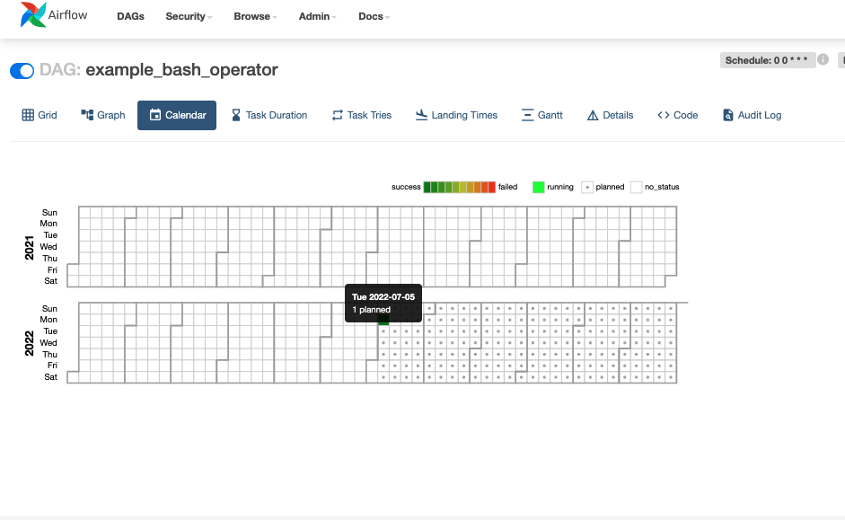
The Calendar View

Slide 27
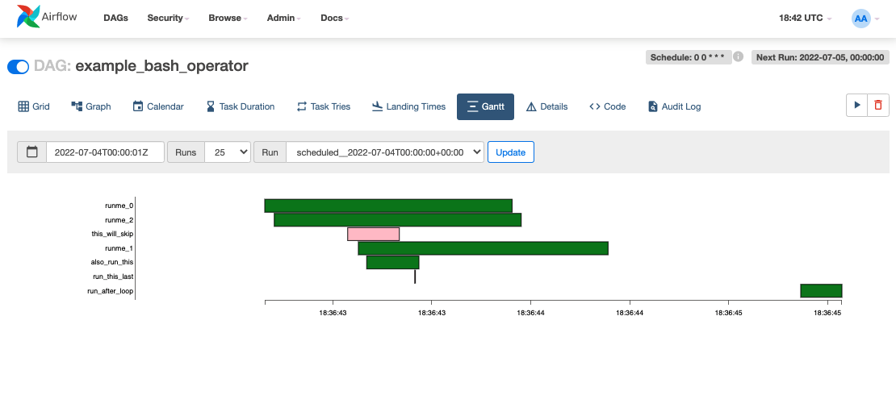
The Gantt View

