Slide 1
Software Skills Working efficiently with software
Data Engineering
School of Data Science
University of Virginia

Slide 2
Ultimate goal is efficiency
Common thread in practices: forward movement by avoiding doing anything more than once.
SOLID principles
Single Responsibility
Open Closed Principle
Lipskov Subsitution
Interface Segregation
Dependency Inversion
Design patterns
Template pattern
Singleton
Facade
Factory

Slide 3
SOLID principles
These follow from some of the previous points
Single Responsibility principle
Open for Extension, Closed for Modification
Lipskov Subsitution Principle
Dependency Inversion
Interface Segregation

Slide 4
Single Responsibility Principle
A class (function) should have only one reason to change.

Slide 5
OPEN CLOSED PRINCIPLE
Software entities (classes, modules, functions…) should be open for extension, but closed for modification
Notes:
Agile Software Development Chap 8

Slide 6
Liskov Subsitution Principle
Subtypes must be substitutable for their base types
Barbara Liskov, 1988

Slide 7
Dependency Inversion Principle
A: High level modules should not depend on low-level modules. Both should depend on abstractions
B: Abstractions should not depend on details. Details should depend on abstractions.

Slide 8
Interface Segregation
Clients should not be forced to depend on methods that they do not use

Slide 9
Design Patterns
What is a design pattern
It is NOT always inheritance
It’s a reusable solution
Example from biology
Birds have wings just like their dinosaur ancestors did, so it CAN be related to inheritance
BUT, a much clearer example, why do both bats and birds have wings!?

Slide 10
Patterns document `experience`
It is NOT a cookie cutter approach though. You must adapt a solution to the context.
Example: Many ways to implement Singleton
Access function returns same object
All objects refer to same internal object (resource)
Reference counting in some cases if clean up is needed

Slide 11
Language of Design patterns
Context = Where the pattern applies, what type of situation or problem does it solve
Forces = What specific requirements, expectations of the problem or solution characterize a solution pattern

Slide 12
Example: Windshield
Context: Driving in the rain while maintaining visibility
Forces:
Rain constantly impacting on a wind guard
Need to keep water from accumulating on wind guard
Wide variety of solutions.
Bottom up wiper, versus top-bottom wiper
Two wipers versus one wiper
Curvature to match glass shape
Although same solution, you can’t use car wipers on a bus for example

Slide 13
Closer look at some useful Design Patterns
Template: You have a sequence of steps to apply, but the details vary per type of processing/calculation
Singleton: When you only want ONE of something, like a database connection
Proxy: When you want to replace an object whose internals vary wildly but it’s interface is the same, like a classifier
Strategy: Select an algorithm at runtime
Factory: Create a set of related classes
Notes:
https://en.wikipedia.org/wiki/Strategy_pattern

Slide 14
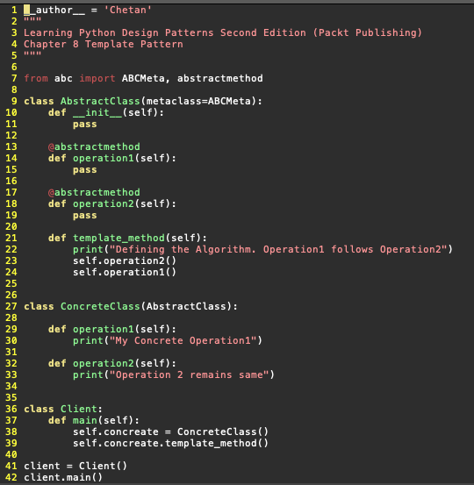
Template Design Pattern
Define the skeleton of an algorithm, delegating specifics to subclasses.

Slide 15
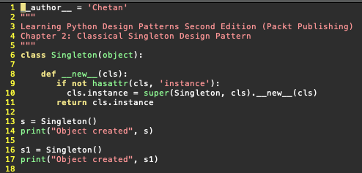
Singleton
Create a single instance of a resource, like a DB
Control setup and breakdown of a shared resource
Allow for importing a module without fear or ‘reload’
Various implementations, but all focus on a single global variable or object.

Slide 16
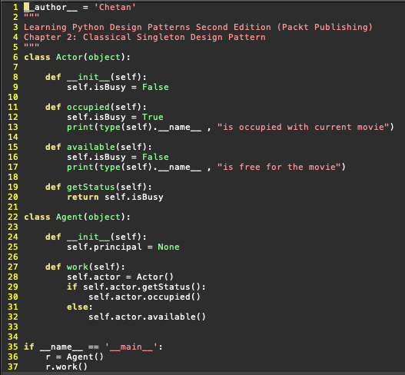
Proxy

Slide 17
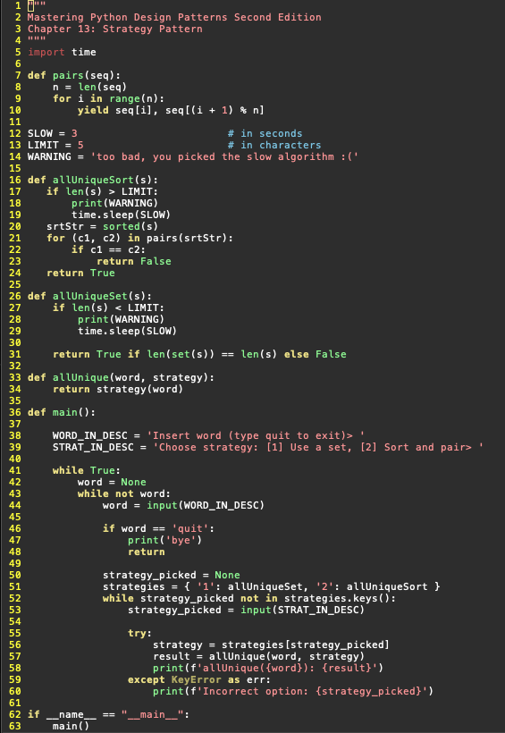
Strategy

Slide 18
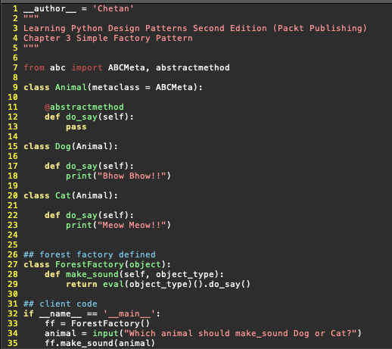
Factory

