Slide 1
Exploring the Predictive Power of On-chain Metrics in Bitcoin Price Forecasting
August 15th, 2023
Notes:
Good morning all. Welcome to my presentation: Exploring the Predictive Power of On-chain Metrics in Bitcoin Price Forecasting

Slide 2
Project Background
Name: Graham Comerford
Background: Expertise in NUI (Natural User Interfaces)
Passion: Trading and exploring potentials of open ledgers
Debate: Is there predictive value in on-chain metrics
Inspiration: Demonstrating the importance and value of on-chain metrics in the crypto world
Notes:
Before we get into the details of my project, I'd like to provide a brief background.
My name is Graham Comerford. It was my interest in trading that led me to this course.
In recent times, we've seen a surge of companies aiming to quantify and contextualise the activity on Bitcoin's blockchain. This has sparked debate: Do these on-chain metrics truly offer value for traders?
This is the question inspired me, and i set out to find a way to evaluate whether on-chain metrics hold any predictive power in relation to bitcoin price.

Slide 3
On-chain metrics Examples
HODL Waves
Exchange Deposit/Withdrawal Volume
Spent Output Profit Ratio (SOPR)
Net Unrealized Profit/Loss (NUPL)
Coin Days Destroyed
LTH/STH Supply in Profit/Loss
Notes:
HODL Waves This metric visualizes the age of Bitcoin UTXOs (unspent transaction outputs). It can provide insights into the behavior of long-term versus short-term holders.
Exchange Deposit/Withdrawal Volume: This tracks the amount of Bitcoin moving in and out of cryptocurrency exchanges. An increase in withdrawals can indicate a hodling behavior, while an increase in deposits might signify potential selling activity.
Spent Output Profit Ratio (SOPR): SOPR is the ratio of the profit/loss made by coins that are being spent. A value above 1 suggests that people are selling at a profit, while a value below 1 can imply selling at a loss.
Net Unrealized Profit/Loss (NUPL): This measures the difference between relative unrealized profit and relative unrealized loss. It can provide insights into market sentiment. Values above 0.75 typically denote euphoria/greed, and values below 0 typically indicate anxiety/capitulation.
Coin Days Destroyed (CDD): This metric multiplies the amount of Bitcoin in a transaction by the number of days it was held. Large spikes in CDD can signal that long-term holders are moving their Bitcoin.

Slide 4
Cryptocurrency in Hedge Funds: A Growing Trend
38% of traditional hedge funds are now investing in cryptocurrencies.
Over 300 specialized cryptocurrency hedge funds have been established due to the increasing demand.
Accurate Bitcoin price predictions: Crucial for trading, risk management, and strategic hedging.
Notes:
While researching a way to evaluate the impact of on-chain metrics, I came across the field of cryptocurrency price predictions.
In this field, machine learning models are trained using historical data in order to forecast future prices.
So you might wonder why is there so much research around price prediction?
Remarkably, 38% of traditional hedge funds have integrated cryptocurrencies into their portfolios.
This trend is underscored by the rise of over 300 specialized cryptocurrency hedge funds.
With this level of institutional participation, the precision of price predictions gains importance.
These forecasts don’t just guide buying and selling; they're instrumental in risk mitigation and the formulation of strategic hedges.

Slide 5
Cryptocurrency Market Overview
Cryptocurrency markets have evolved significantly over the past decade
Bitcoin represents 50% of the total market cap
Bitcoin's average volatility in 2021 was 4.56%, compared to gold's average of 1.2% and major currencies' averages between 0.5% and 1%
Notes:
Over the past decade, the cryptocurrency market has evolved at a pace few could have anticipated.
While there are thousands of cryptocurrencies out there, Bitcoin dominates the market representing half of the total market cap.
But its prominence does not protect it from volatility. To put things into perspective, Bitcoin's average volatility in 2021 stood at 4.56%.
In comparison, gold, a traditional store of value, averaged at just 1.2%, and major fiat currencies wavered between 0.5% and 1%.
This tells us that despite its potential, the Bitcoin market is still maturing and is subject to larger fluctuations.

Slide 6
Challenges in Bitcoin Price Prediction
Bitcoin's price movements are challenging to predict due to market volatility and complexity
Previous research methods focused primarily on price and volume data
Notes:
Predicting its price movements in such a volatile market is not easy..
The inherent volatility, combined with the multifaceted nature of the market, presents a complex challenge.
Previous studies and prediction models have primarily relied on price and volume data. Some have included sentiment analysis.
Although these are significant indicators, they provide a limited view of the broader market dynamics.

Slide 7
Research Objective
Investigate the value of on-chain metrics in forecasting Bitcoin prices
Notes:
There is a definite gap in the price prediction literature with relation to on-chain metrics.
My aim then was to evaluate the impact of incorporating on-chain metrics into models for bitcoin price prediction.
And in doing so taking a step towards settling the debate over whether they hold any predictive power for bitcoins price

Slide 8
Methodology Overview
The methodology is based on the 7 steps of machine learning which are:
Data collection
Data preparation
Model selection
Model training
Model evaluation
Hyperparameter tuning
Prediction
This structured approach ensures the reliability of the results and sets the stage for future research and applications in the field.
Notes:
The foundation of my approach is the tried and tested 7 steps of machine learning.
These steps, namely: Data Collection, Data Preparation, Model Selection, Model Training, Model Evaluation, Hyperparameter Tuning, and Prediction, serve as a structured roadmap to ensure the reliability and replicability of the results
paving the way for further research and practical applications

Slide 9
Data Collection
The process begins with the collection of two separate datasets, 'ta_df' and 'oc_ta_df', spanning from January 2nd, 2015 to December 30th, 2022.
'ta_df' contains Bitcoin's price and volume data from kaggle, and is enriched with 86 unique technical indicators.
'oc_ta_df' extends 'ta_df' by supplementing it with 123 Bitcoin on-chain metrics from Glassnode
Notes:
The first step is Data Collection
The analysis utilises two distinct datasets, 'ta_df' and 'oc_ta_df', spanning nearly 8 years from January 2nd, 2015 to December 30th, 2022.
'ta_df' comprises Bitcoin's price and volume data and 86 technical indicators calculated from these using pythons ta library
The 'oc_ta_df' dataset takes this a step further by layering on 123 on-chain metrics, offering a deep insight into the intricacies of Bitcoin's transactional landscape.

Slide 10
Data Preparation
The datasets are inspected for missing values and visualised to understand their nature.
A correlation analysis is performed to identify potentially significant features.
The features are standardized using MinMaxScaler.
The datasets are partitioned into training and testing sets in a 9:1 ratio.
A 60-day look-back period and a 1-day forecast period are used.
Notes:
Data Preparation
Raw data, as we know, isn't always ready for immediate analysisso they have to undergo preparation.
First i visualised each feature to get a better grasp of its nature
Then the datasets underwent screening for missing values
This is followed by a scaling operation, using the MinMaxScaler from the sklearn.preprocessing module
This standardise the features within a range of 0 and 1 to diminish the effect high magnitude features might have on the model.
Then the data was split into training and testing sets with a 9:1 ratio.
Finally the data was segmenting using the 60-day look-back period,
this allowed the models to leverage two months of past data to forecast the next day

Slide 11
Model Selection
The study focuses on two related models, BiRNN and BiLSTM.
Both models are capable of handling temporal dependencies, making them suitable for financial time series data.
BiLSTMs demonstrate superior ability in retaining past information over extended sequences.
In the preliminary exploration phase, bidirectional models of RNN and LSTM outperformed their unidirectional counterparts.
Notes:
Model Selection
Although i experimented with a few different models the choice gravitated towards the BiRNN and BiLSTM.
They seemed to perform better than the others perhaps due to their adeptness at managing temporal dependencies.
Especially the BiLSTM, which excels in preserving past information over extended sequences
Preliminary tests showed that the bidirectional architectures of RNN and LSTM outperformed their unidirectional counterparts.

Slide 12
Model Training
Training is performed on each dataset for a total of 50 epochs.
The learning rate is set at 0.001.
The training process employs the Adam optimizer.
During the training phase, 10% of the training set is set aside for validation.
The loss function utilized is the Mean Squared Error.
To ensure the robustness of the results, five models are trained for each dataset.
Notes:
Model Training
For each dataset, the models underwent a 50-epoch training process.
10% of our training set was set aside for validation
The chosen loss function was the Mean Squared Error
Five distinct models were trained for each dataset to make the results more robust

Slide 13
Model Evaluation
The models are evaluated using Mean Absolute Error (MAE), Mean Squared Error (MSE), Root Mean Squared Error (RMSE), Mean Absolute Percentage Error (MAPE), and the R-squared (R^2) statistic.
These metrics provide a comprehensive evaluation of the models' performance.
Notes:
Model Evaluation
Post-training, the models must be evaluated.
A comprehensive evaluation was conducted using Mean Absolute Error (MAE), Mean Squared Error (MSE), Root Mean Squared Error (RMSE), Mean Absolute Percentage Error (MAPE), and the R-squared (R^2) statistic
Each metric, with its unique lens, contributes to comprehensive overview of the models' performance

Slide 14
Hyperparameter Tuning
The performance of a machine learning model can be significantly influenced by its hyperparameters.
This study employs two approaches for tuning: manual experimentation and automated tuning via Keras Tuner.
The tuning process is conducted over ten trials, with each trial consisting of three executions.
Notes:
Hyperparameter Tuning
The nuances of a model's performance often lie in its hyperparameters.
Recognizing this, my study adopted a two-pronged approach to hyperparameter tuning.
On one hand, I embraced manual experimentation, and on the other, I harnessed the power of automated tuning with Keras Tuner RandomSearch
The automated process spanned ten trials, with each trial undergoing three executions.

Slide 15
Prediction
Upon finalising the model training and hyperparameter tuning phases, the models are put to the test with a rigorous evaluation process.
This process involves assessing the models' performance on the test set, providing an unbiased estimate of real-world performance.
The predictions are also plotted against actual values to illuminate any patterns in prediction errors.
Notes:
Prediction
After the models are trained their performance must be evaluated..
To do this the models are used to make predictions against the test set, providing an unbiased estimate of real-world performance.
The predictions are plotted against actual values to illuminate any patterns in prediction errors.

Slide 16
Overview of Experiment
The study was divided into two distinct experimental stages:
Initial stage: Models hyperparameters were manually tuned, 5 models trained on each dataset, evaluated on test set, and results across the 5 models averaged.
Second stage: Automatic hyperparameter tuning was performed using Keras Tuner on ta_df, 5 models trained on each dataset, evaluated on test set, and results across the 5 models averaged.
The purpose of the two stage approach was to confirm that improvements from including on-chain metrics were not merely a result of hyperparameter tuning.
Notes:
Overview of experiment
The study was divided into two experimental stages.
In the first stage, I manually tuned the hyperparameters of the models, then 5 models were trained on each dataset, the models were evaluated on the test set, and results across the 5 models averaged
Next I employed Keras Tuner's RandomSearch to automatically tune the hyperparameters, specifically targeting the 'ta_df' dataset. Then the same process as stage one was followed.
The reason for the automated tuning was not necessarily to increase model performance
but to highlight that any improvements observed with the inclusion of on-chain metrics, were intrinsic and not just a byproduct of the hyperparameter that i had selected

Slide 17
Averaged results of Experiment 1
DF | Model | MAE | MSE | RMSE | MAPE | R2
ta_df | bilstm | 1320.597 | 2.72e6 | 1589.691 | 6.313 | 0.831
oc_ta_df | bilstm | 1093.935 | 1.87e6 | 1360.423 | 5.267 | 0.884
ta_df | birnn | 3226.132 | 1.29e7 | 3435.640 | 15.631 | 0.194
oc_ta_df | birnn | 1824.639 | 5.25e6 | 2275.504 | 8.882 | 0.673
Notes:
So this table documents the averaged results of Experiment 1
When the bilstm is trained on the technical analysis dataset it has an average RMSE of 1589
When the onchain metrics are introduced the average RMSE is reduced to 1360
Likewise when the birnn is trained on tadf its rmse is 3435
And when the onchain metrics are introduced its reduced to 2275

Slide 18
Averaged results of Experiment 2
DF | Model | MAE | MSE | RMSE | MAPE | R2
ta_df | bilstm | 2053.921 | 5.47e6 | 2339.35 | 10.022 | 0.659
oc_ta_df | bilstm | 1856.462 | 5.18e6 | 2273.866 | 9.253 | 0.678
ta_df | birnn | 6183.143 | 9.19e7 | 6949.171 | 29.907 | -4.723
oc_ta_df | birnn | 3463.02 | 1.57e7 | 3775.827 | 17.136 | 0.023
Notes:
Then in Experiment 2
When the bilstm is trained on the technical analysis dataset it has an average RMSE of 2339
When the onchain metrics are introduced the average RMSE is reduced to 2273
Likewise when the birnn is trained on tadf its rmse is 6949
And when the onchain metrics are introduced its reduced to 3775

Slide 19
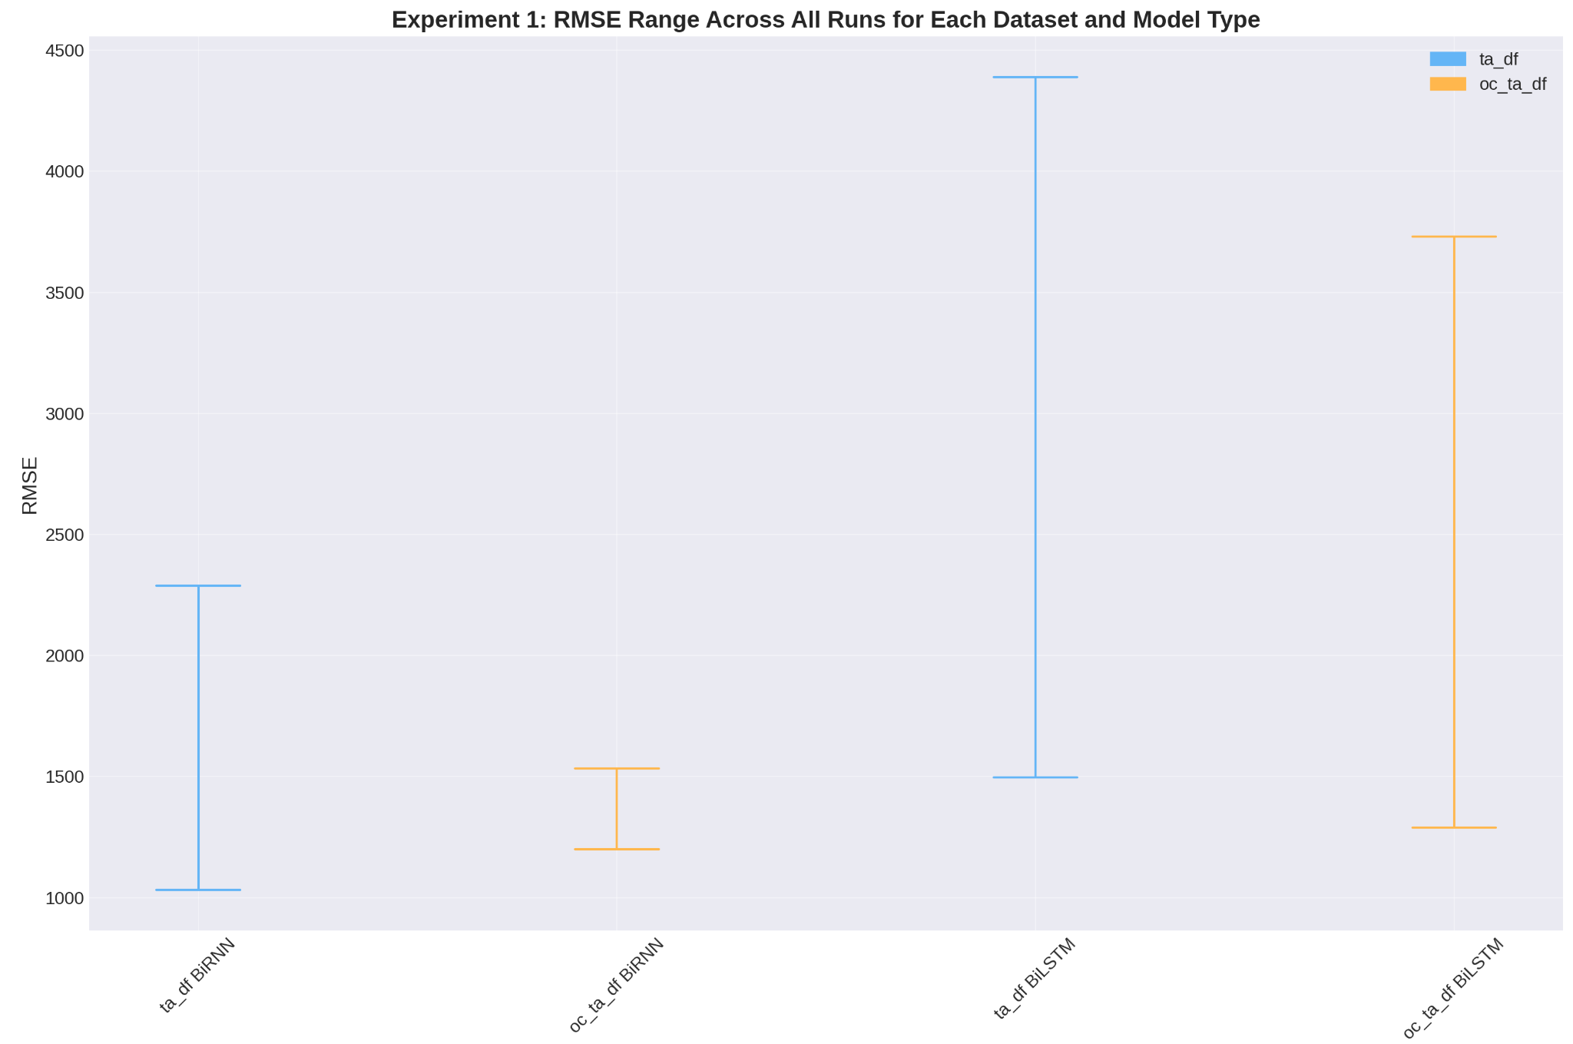
Experiment 1
Notes:
When we graph the ranges of rmse across the 5 models we get a more nuanced view of the increase in performance.
The birnns are much more consistent when the on chain metrics are introduced
While the bilstms are slightly more consistent and are more accurate

Slide 20
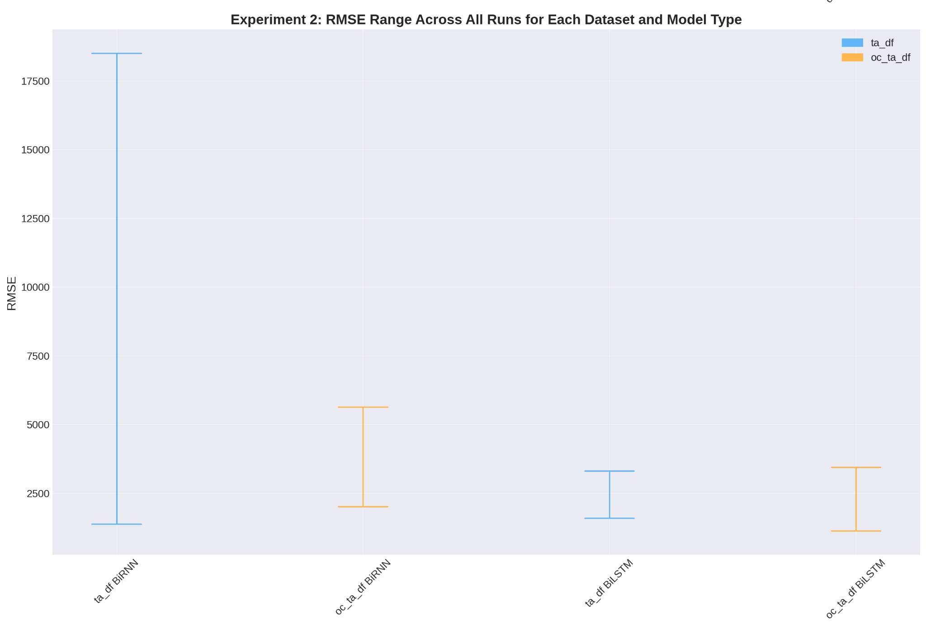
Experiment 2
Notes:
Similarly in Experiment 2
The birnns are much more consistent when the on chain metrics are introduced
While the bilstms are slightly a little less consistent but achieve a lower error

Slide 21
Results Summary
Although the models' hyperparameters were optimized for the 'ta_df' dataset, the 'oc_ta_df' dataset outperformed the 'ta_df' dataset.
This experiment provides compelling evidence of the value of incorporating on-chain metrics in models for predicting Bitcoin prices.
Notes:
In summary, even when optimizing the models' hyperparameters primarily for the 'ta_df' dataset, it was the models trained on the on-chain dataset that consistently outperformed.
This observation is profound as it underscores the value of on-chain metrics.
The experiments stand as compelling evidence of the potential role of on-chain metrics in predicting Bitcoin prices.

Slide 22
Discussion
Notes:
Now that the experiment has been covered i think it is important to discuss some important topics that came up during the practicum project

Slide 23
Prediction is challenging
Prediction of Bitcoin prices is complex due to high volatility of cryptocurrencies.
Complexity arises from numerous internal and external factors like regulatory news, technological advancements, macroeconomic environment, and social media sentiment.
Financial time series often exhibit non-stationarity and a high noise-to-signal ratio, which compound the complexity of prediction tasks.
Notes:
The prediction of Bitcoin prices represents a significant challenge primarily due to the volatility and complexity of cryptocurrency markets
This volatility stems from the interplay of multiple factors including regulatory news, advancements in technology, global macroeconomic shifts, and even sentiment trends in social media.
On top of this, the non-stationarity high noise-to-signal ratio of bitcoin price time series, exacerbates the difficulty of prediction tasks.

Slide 24
Trading Strategies
On-chain metrics boost predictive abilities, but their incorporation does not inherently guarantee the successful execution of trading strategies.
Accuracy levels needed for a model to be profitable in real-world scenarios surpass those achieved in academic studies
Notes:
While this research has shown that including on chain metrics can improve model performance,
We must ask are these models actually valuable for traders?
From my understanding almost none of the models covered in the literature, or the models in this study, could be used to implement a successful trading strategy.
While academic exploration of price prediction is an interesting field contributing to our understanding of market dynamics, translating these models into real-world trading applications remains a challenge.
The accuracy levels needed for a model to be reliably profitable in real-world scenarios often significantly surpass those achieved in academic studies. Even minor prediction errors can culminate in substantial financial losses over time.

Slide 25
Limitations of Traditional Evaluation Metrics
Traditional evaluation metrics might overlook the importance of correctly predicting the direction of price changes.
Use of alternate evaluation metrics that capture a model's success in predicting price direction or its profitability, is proposed.
Notes:
Traditional evaluation metrics such as the Mean Squared Error (MSE) and Mean Absolute Error (MAE) primarily focus on quantifying the deviation between predicted and actual values.
However, these metrics, while valuable, miss out on assessing the models directional accuracy, which is very important when dealing with financial predictions.
Imagine a scenario with two models.
If bitcoins price tomorrow rises €500, one of the models predicted it would rise €2000 and the other model predicted it would fall by €500.
The model that predicted rise has an error of €1500 while the model that predicted fall has an error of €1000.
If you had made a trading decision based on the technically more accurate model you would have possibly sold your position and lost out on some upside.
Therefore, there's a need to explore and integrate alternative evaluation metrics, such as mean directional accuracy in order to get a sense of how valuable these models actually are.

Slide 26
Future Research
Exploration of other on-chain metrics not covered in this study.
Development of models that can account for the non-stationarity and high noise-to-signal ratio typically observed in financial time series.
Development of ensemble techniques that leverage both classification models (for direction prediction) and regression models (for estimating the magnitude of price movements).
The leap from a theoretically sound prediction model to a practically profitable trading strategy remains a significant challenge that deserves further research.
Notes:
The study highlights several potential avenues for future research.
Firstly, the field of on-chain analysis is constantly evolving, so there are often new metrics that will warrant exploration.
Secondly, considering the inherent challenges of financial time series, like non-stationarity and high noise-to-signal ratios, the development of more robust models tailored to these challenges will be beneficial..
Additionally, the development of ensemble techniques, combining the strengths of classification (for directional prediction) and regression models (for magnitude estimation), could provide a more robust approach to prediction.
Finally transitioning from academic models, grounded in theory, to practical and consistently profitable trading strategies remains a challenge that deserves its own study.

Slide 27
Reflection
New to machine learning
Learned to use the main machine learning libraries in Google Colab enviroment
Learned about data preprocessing
Learned about model architectures
Learned about hyperparameter tuning
Segmentation of the dataset
Feature selection
Notes:
I had never done any machine learning prior to this so it was a real learning experience.
Although i learned so much about the various libraries, data preprocessing, model architecture and hyperparameter tuning, It was only towards the end of the practical side of things that i was really getting to grips with the machine learning process.
For that reason I have a lot of things that i would still like to try going forward to improve these models.
I believe that segmentation of the dataset in accordance with the bull/bear cycle may offer benefits.
A rigorous feature selection to eliminate unnecessary or autocorrelated features could improve model performance
Series of models trained on subsets of the features
Ensemble techniques combining classification and regression to try improve the models directional accuracy
I believe that implementing these changes will yield models far superior to the ones in this study

Slide 28
Conclusion
This study found that on-chain metrics, when combined with technical indicators, enhance the performance of both BiLSTM and BiRNN models in predicting Bitcoin prices.
The findings underscore the compelling potential of on-chain analysis as a tool for predicting Bitcoin prices, while also highlighting the challenges inherent to this task.
It is reasonable to anticipate enhancements in the accuracy and dependability of Bitcoin price prediction models in the foreseeable future.
Notes:
In conclusion, this research sought to evaluate the impact of integrating on-chain metrics into Bitcoin price prediction models.
To the best of my knowledge, this is the first such study.
The findings indicate that on-chain metrics improve consistency in birnns and accuracy in BiLSTM models
However, it's important to temper these findings with caution.
While on-chain analysis offers promising insights, there is still a lot of progress that needs to be made before these models can be used successfully in the real world.
As the fields of on-chain analysis and price prediction matures, i anticipate that the Bitcoin price prediction models will see vast improvements in the coming years.

Slide 29
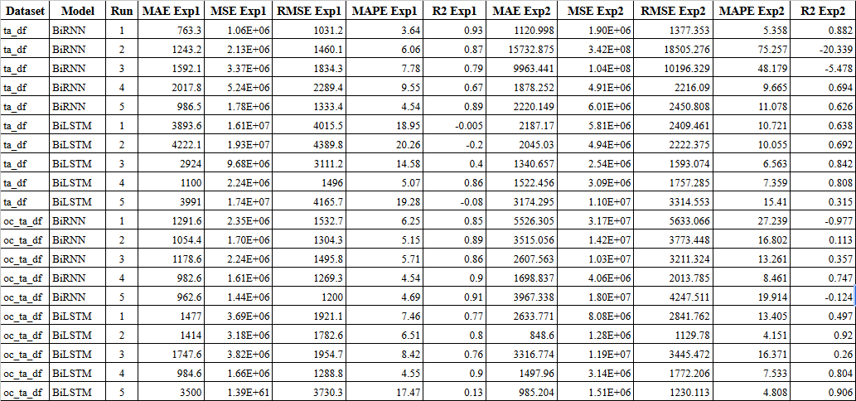
All Results

Slide 30
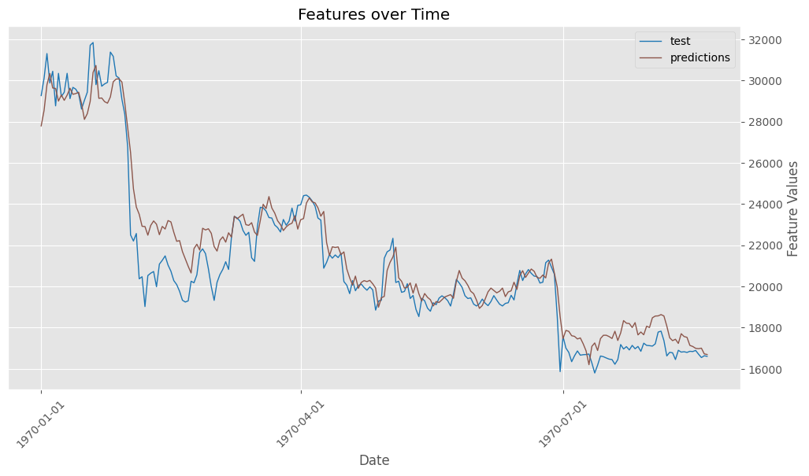
Notes:
Mean Absolute Error (MAE): 848.5996830105065
Mean Squared Error (MSE): 1276402.5983946547
Root Mean Squared Error (RMSE): 1129.7798893566192
Mean Absolute Percentage Error (MAPE): 4.151341032449443
R-squared (R2): 0.9204634309516907
Mean Directional Accuracy (MDA): 0.48484848484848486

Slide 31
BiRNN Architecture
Layer Type | Exp1 Units | Exp2 Units | Other Parameters
Bidirectional SimpleRNN | 384 | 512 | return_sequences=True
Dropout | - | - | rate=0.2
Bidirectional SimpleRNN | 128 | 256 | return_sequences=False
Dense | 25 | 90 | -
Dense | 1 | 1 | -

Slide 32
BiLSTM Architecture
Layer Type | Exp1 Units | Exp2 Units | Other Parameters
Bidirectional LSTM | 256 | 480 | return_sequences=True
Dropout | - | - | rate=0.2
Bidirectional LSTM | 128 | 96 | return_sequences=False
Dense | 25 | 10 | -
Dense | 1 | 1 | -

