Slide 1
Dynamic Memory

Slide 2
Assignments
• Reading for this class: 9.9-9.10 (Dynamic Memory).
• Reading on the horizon: 8.1-8.4 (Processes).
• Project 2 will be out this week
• Main skills: Floating point representation; bitwise operations.
• Recitation 4 covers Floating Point Representation.
• Quiz 3 (Integer Representation) is Tue-Thu this week.
• Quiz 4 (Float Point Representation) is next week.

Slide 3
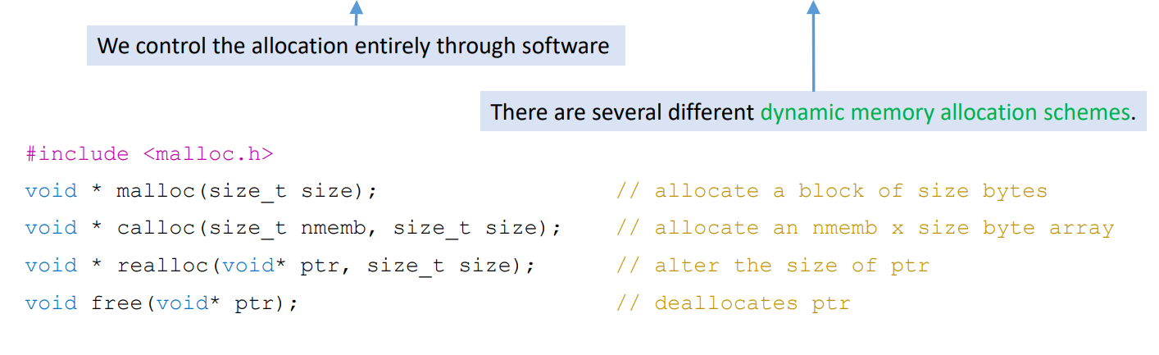
Dynamic Memory
Dynamic memory appears as if it is created/destroyed on request.
• Dynamic memory allocation is the process of reserving memory with a heap.

Slide 4
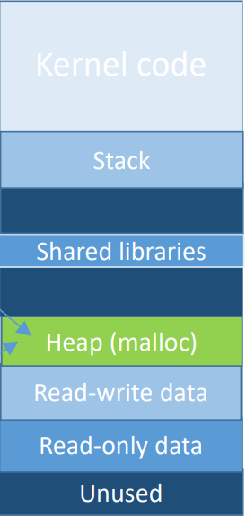
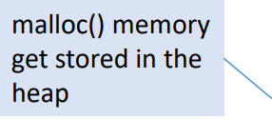

Heap and malloc
What happens when our program wants memory on-the-fly?
• We would use malloc() to request memory to be allocated for us.
• Where does malloc() memory come from?
The malloc() command doesn’t really create
new memory.
• It allocates new memory from an existing
virtual page.
• The memory is stored in a portion of the
process space called the heap.

Slide 5
Heap
The heap is part of the process’s memory.
The heap begins unused and unallocated.
Some of memory is controlled by hardware and the kernel.
However, we control how heap memory is used!

Slide 6
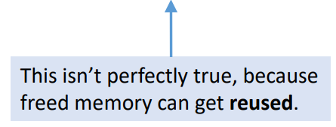
Heap Usage
The heap begins as a huge, unused chunk of memory.
• Our own code (and C libraries) decide how this memory is used.
• Typically, allocation starts at the bottom of the heap and works upwards.

Slide 7
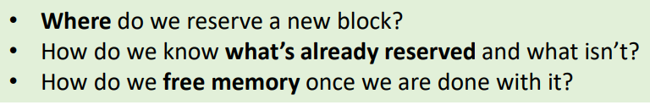
C Code vs True Picture
In C code:
• malloc() and free() look like they are creating and destroying memory.
In reality:
• These calls are reserving pieces of memory which are already available.

Slide 8
Using Dynamic Memory in a Program
Allocated (reserved) blocks are said to be used.
Unallocated blocks are free.
The malloc() and free() used in C are an example of an explicit allocator.
Some languages will use an implicit allocator for internal management.
A subsystem which automatically frees unused memory is a garbage collector.

Slide 9
Designing a Dynamic Memory Allocator
The purpose of a dynamic memory allocator:
• To allocate or deallocate blocks of memory on request.
Requirements:
• Allocation must take place on request, in a timely manner.
• Memory allocated must be from within the heap.
• Memory cannot be allocated a second time if it is already in use.
• Memory cannot be deallocated if it is not in use.
• Allocated memory cannot be moved once allocated.

Slide 10
Dynamic Memory Allocator Design Principles
While we do have design flexibility, we typically obey the following:
• Allocated blocks will typically be aligned, similar to structs.
• We add padding to an allocated block to make sure it fits to a size boundary.
• The alignment size is implementation dependent.
• On an x86-64, allocated blocks are typically aligned to 16 byte boundaries.
• Allocated space typically includes some metadata besides its payload.
• The metadata is for managing the state of used and available heap space.
• Examples: size of allocated block; whether a block is free or in use.
• The payload is only the data allocated to satisfy the request, without the overhead.

Slide 11
Dynamic Memory Allocator Design Goals
Some goals for an effective dynamic memory allocator strategy:
1. Time-efficient performance.
• The allocator should run quickly – as close to constant time as possible.
2. Space-efficient performance.
• We should minimize lost space due to overhead and fragmentation.
3. Robustness.
• We should be able to detect double-frees and double-allocations.
4. Locality.
• Nearby malloc() calls should allocate nearby in the heap.
• Helps take better advantage of the cache.

Slide 12
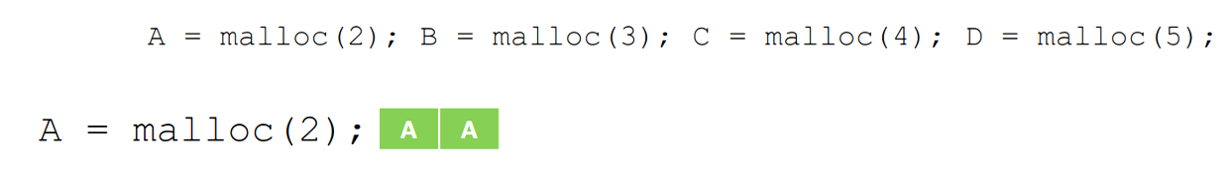
Sequential Allocator
What if we just allocate memory in order, like in a stack?

Slide 13
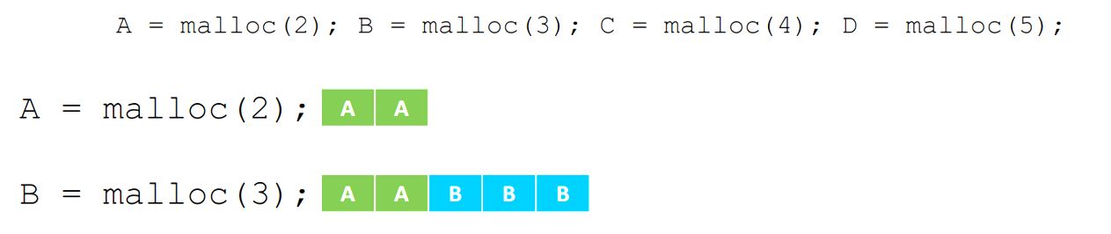
Sequential Allocator
What if we just allocate memory in order, like in a stack?

Slide 14
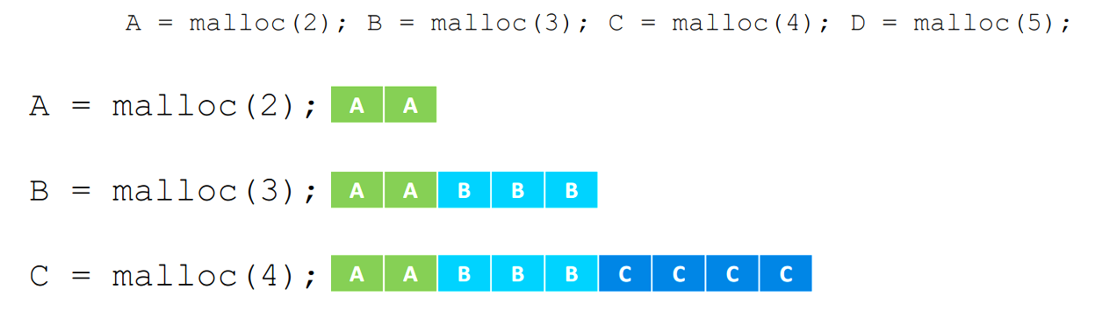
Sequential Allocator
What if we just allocate memory in order, like in a stack?

Slide 15
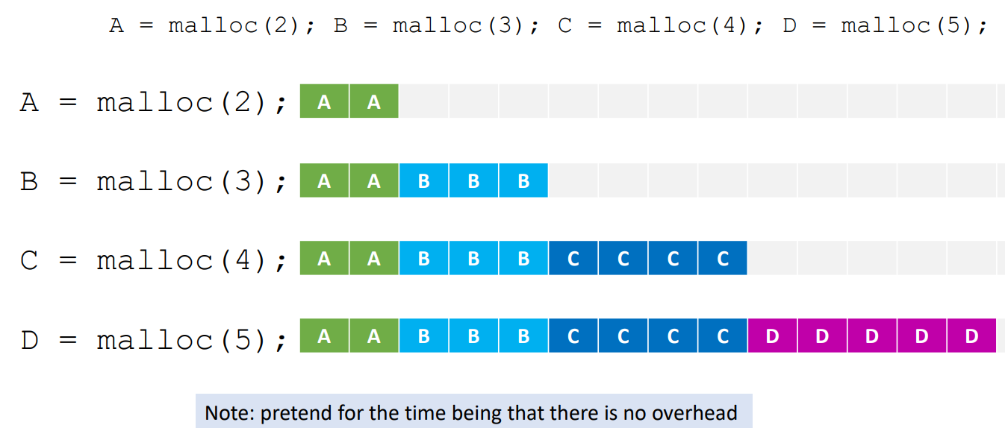
Sequential Allocator
What if we just allocate memory in order, like in a stack?

Slide 16
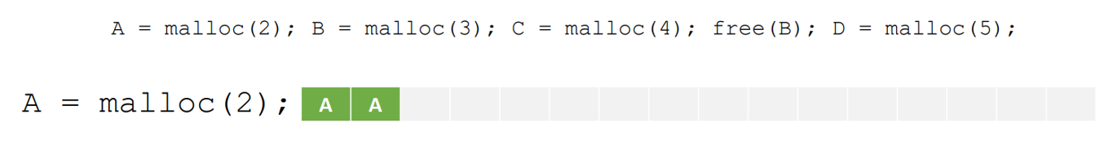

Slide 18



Slide 19


Slide 20



Slide 21
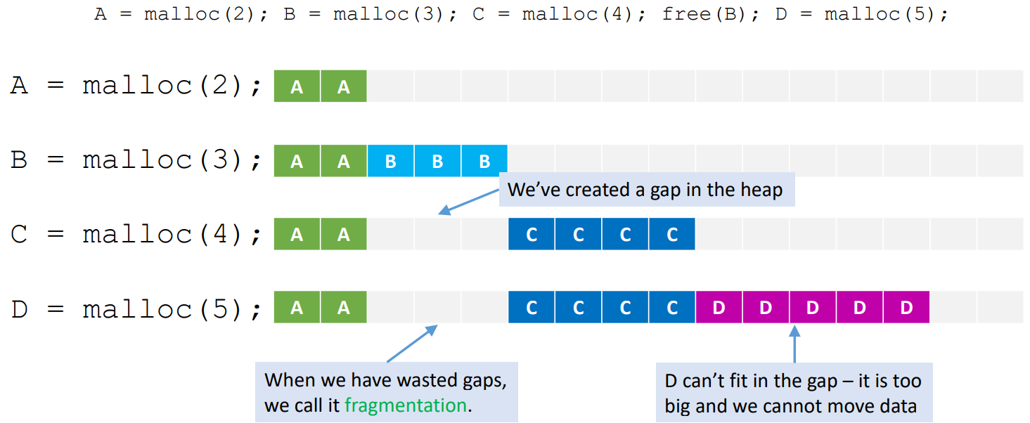

Slide 22
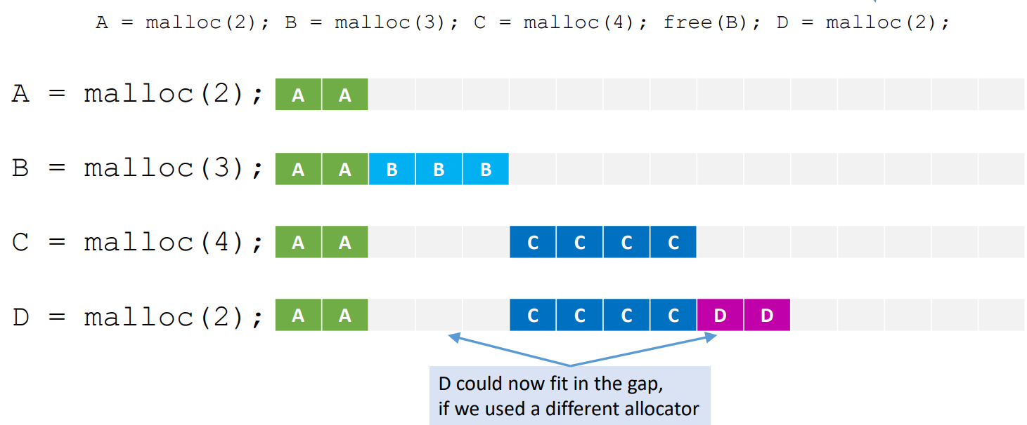

Slide 23
Fragmentation
When we waste space in the heap, we call that fragmentation.
• A fragment is a wasted free block.
• Fragmentation is unavoidable.
Internal fragmentation is due to overhead.
• Due to metadata and padding from byte alignment.
• A sunk cost: does not impact how we allocate future blocks
External fragmentation is due to the order we allocate and free data.
• Freeing data creates gaps in the heap.
• Our allocator determines how well we use this data.

Slide 24
Finding Free Blocks
Three strategies for finding a spot to allocate a new block.
First Fit: Search from the first free block until we find a block that fits.
• Easy and straightforward.
• Leads to many tiny fragments near the beginning of the heap (slow searches).
Next Fit: Begin with first fit, but continue from last search location next time.
• Avoids the “early fragmentation” problem of first fit.
• Leads to greater overall fragmentation.
Best Fit: Search the entire list for the closest-to-correct fit block.
• Most likely to find a good fit; likely to minimize wasted space.
• Longer search per allocation; not guaranteed to minimize fragmentation.

Slide 25
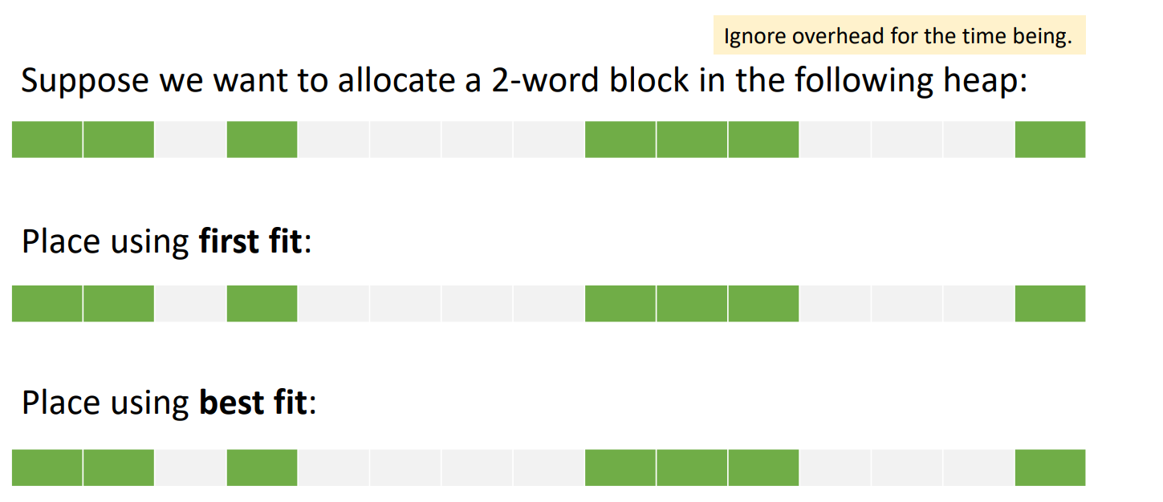
Finding Free Blocks, example

Slide 26
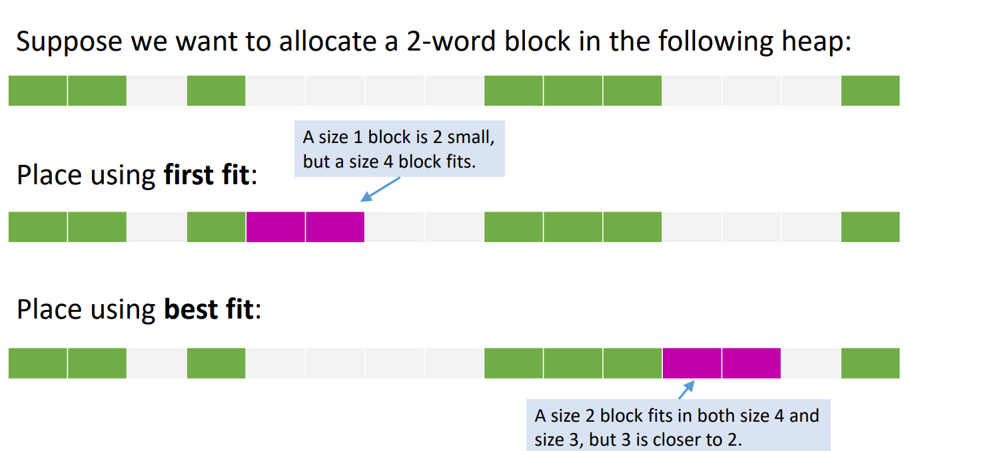

Slide 27
Free and Used Block Integrity
We need to know whether a block is used, and how big it is.
• Common strategy: include block size and used bit U as metadata.
• The metadata is at the start of the block, before the payload
If the block size is always even, then the lowest bit of the size is never used.
• We can use it for something else.
• Specifically, we can use it to store bit U (whether the block is used).
Knowing block size and used bit makes it easy to free memory.
• We know how much to free and whether we are allowed to free it.
Optionally, we can include the (Size | U) at the end of each block as well.
• Allows bi-directional searches (and makes it easier to merge consecutive blocks).
Malloc returns to a pointer to here

Slide 28
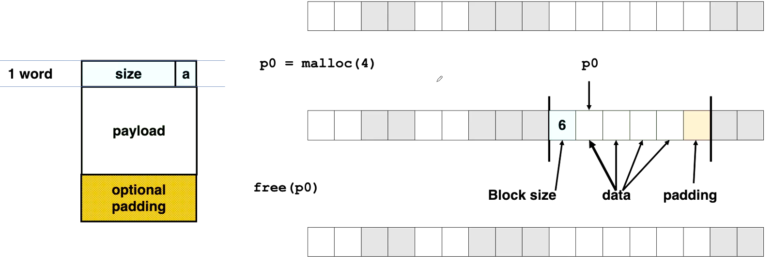

Slide 29
Maintaining Blocks
There are several strategies for maintaining and locating free blocks.
Implicit List: use block sizes to search blocks for a free block.
Explicit List: each free block has a pointer to the next free block.
Segregated List: multiple explicit lists, categorized by size.
Sorted by Size: balanced tree with pointers struct used to quickly locate
blocks of the best size.

Slide 30

Implicit Free List
The implicit free list searches the blocks by counting the size of each.
Each block starts with the block size.
The used blocks are odd numbers which don’t match the actual size.
• The actual size is (size & ~1).
• The extra one just shows that it is a used block.
Suppose we want to allocate a block of size 3. Start from the beginning.
• Size = 3 – 1 = 2; skip to index 2.
• Size = 2 (unused; too small); skip to index 4.
• Size = 3 – 1 = 2; skip to index 6.
• Size = 4 (unused; good size).

Slide 31
Handout

Slide 32
Implicit Free List, freeing
Consider the following case:
We now call free(A);
Block A is now free, leaving three free blocks spanning 10 words.
• Great, but could we allocate a block of size 5 now?

Slide 33
Implicit Free List, freeing
Consider the following case:
We now call free(A);
Block A is now free, leaving three free blocks spanning 10 words.
• Great, but could we allocate a block of size 5 now?
Simply freeing a block may not be enough!
• We should merge – or coalesce – neighboring free blocks to make the best use of them.
• Coalescing takes place after freeing a block, and only if one or both neighbors are free.

Slide 34
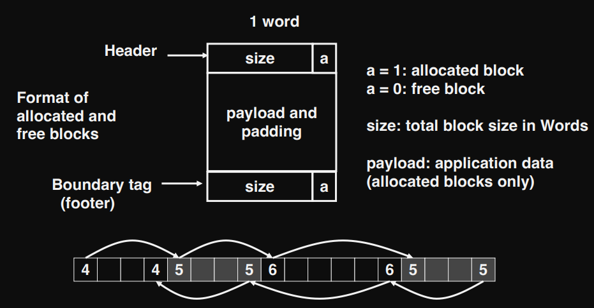
Bidirectional Coalescing
Coalescing adjacent Free Blocks
We can put a size on both ends of a block allowing us to check backwards easy

Slide 35
Explicit Free List
The explicit free list searches blocks one by one like the implicit list.
• However, it speeds things up using by using pointers to the next free block.
• This saves time on arithmetic.
• More importantly, it lest us skip past used blocks.
• We can use two pointers per block to create a bidirectional list (for coalescing).

Slide 36
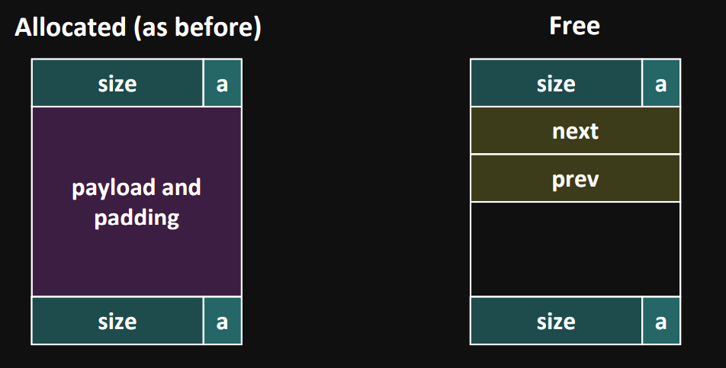
Maintain list(s) of free blocks, not all blocks

Slide 37
Handout

Slide 38
Garbage Collection
Some languages (Java, Python, etc) have automatic garbage collection.
• They free memory if it is not being used.
Keep track of all pointers in use accessible from root pointers
Mark-and-sweep algorithm (McCarthy, 1960)

Slide 39
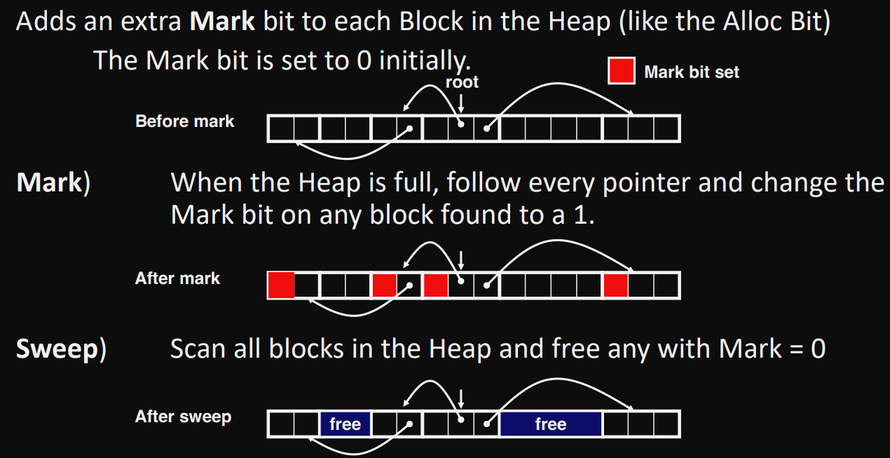
Mark-and-sweep algorithm (McCarthy, 1960)

Slide 40
For Next Class
• Finish reading 9.9-9.10.
• Start reading 8.1-8.4 (Exceptional Flow and Processes).
• The second project will be announced towards the end of the week.

