Slide 1
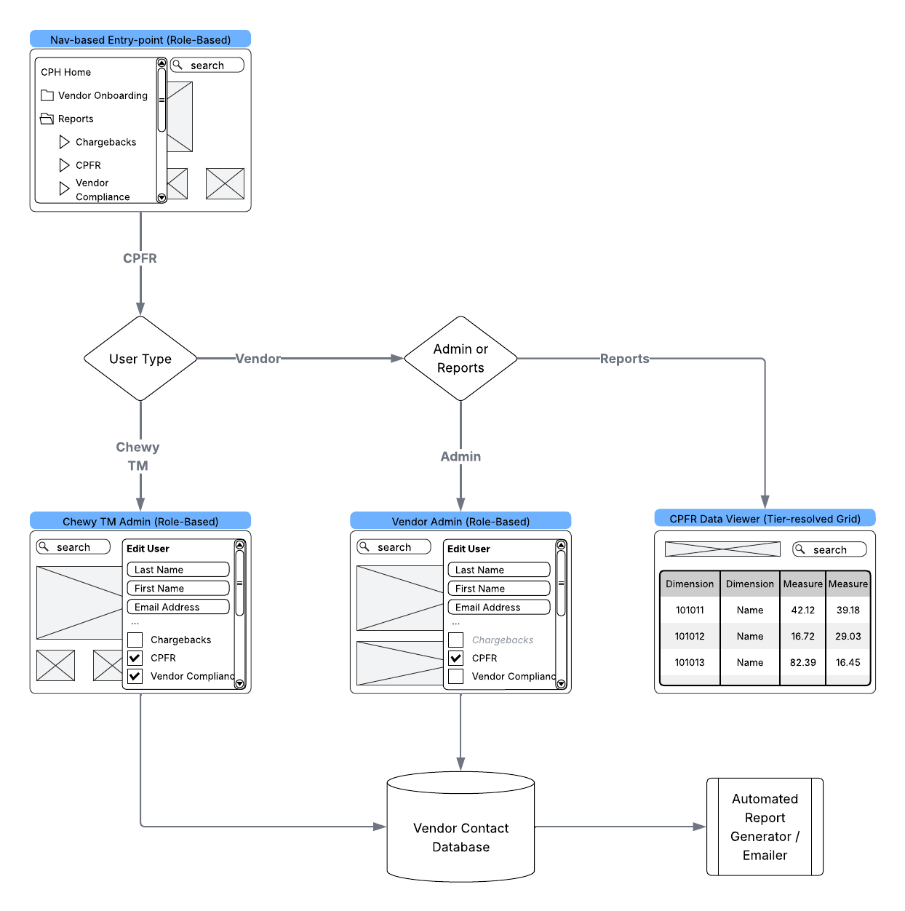
CPFR components in CPH:
Most CPFR integrations will leverage existing CPH modals:
CPH standard navigation—Entry point for CPFR / VC
SSUA (Self-service User Admin)—Vendor contact admin
SSUA—Chewy TM administration of overall vendor (MVP: external tools)
Key new component:
iFrame data viewer leveraging embedded Tableau

Slide 2
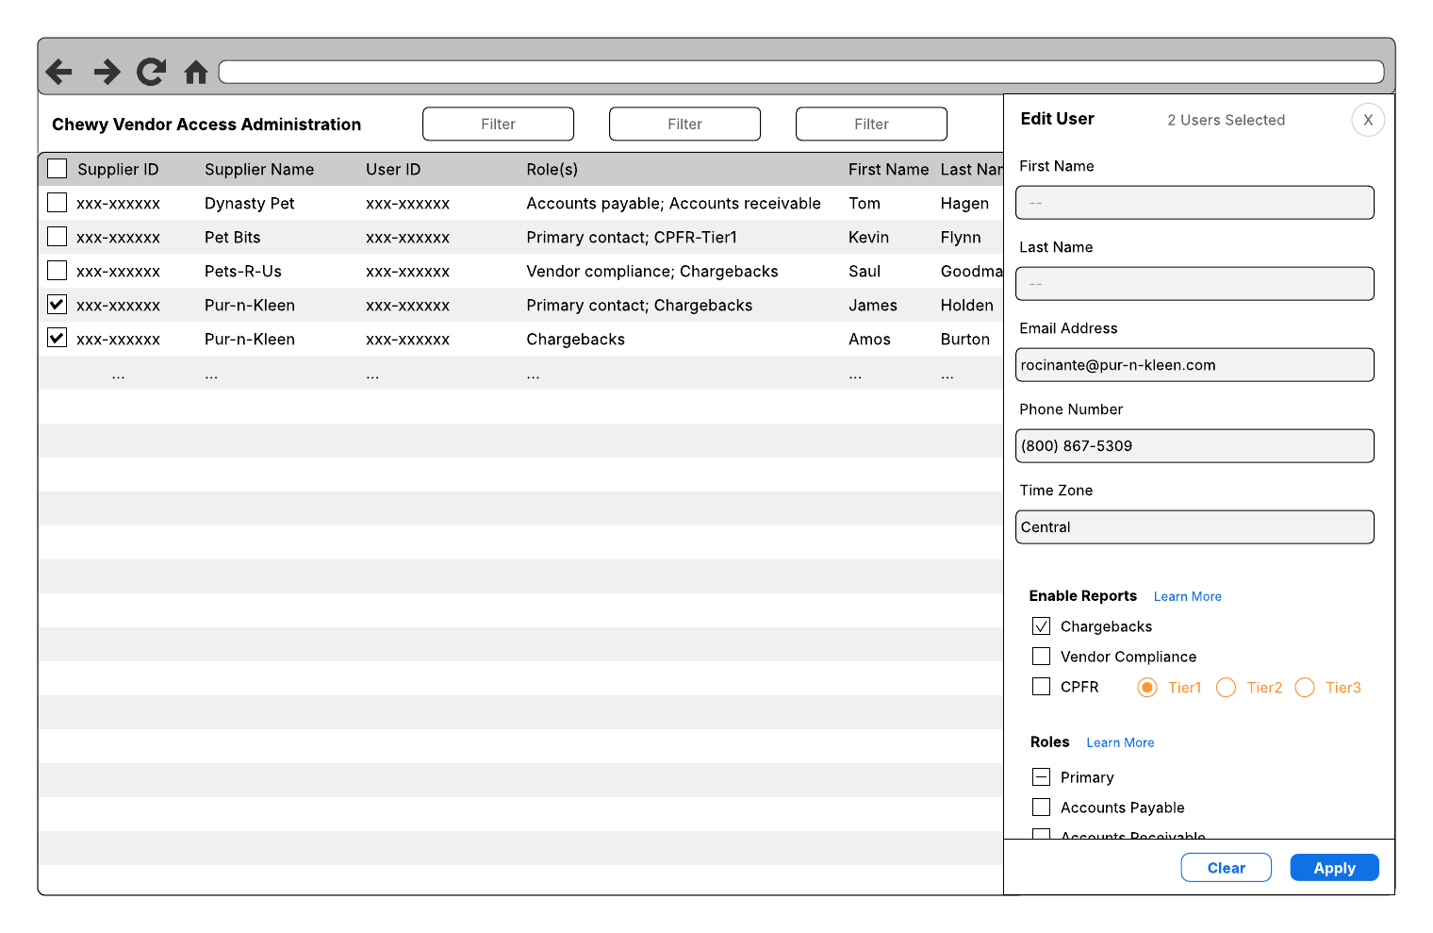
Vendor Administration
—Chewy TM View
Uses SSUA Supplier Information Screen
Report Selector or Role-based is TBD
Under MVP: Tier selection is external

Slide 3
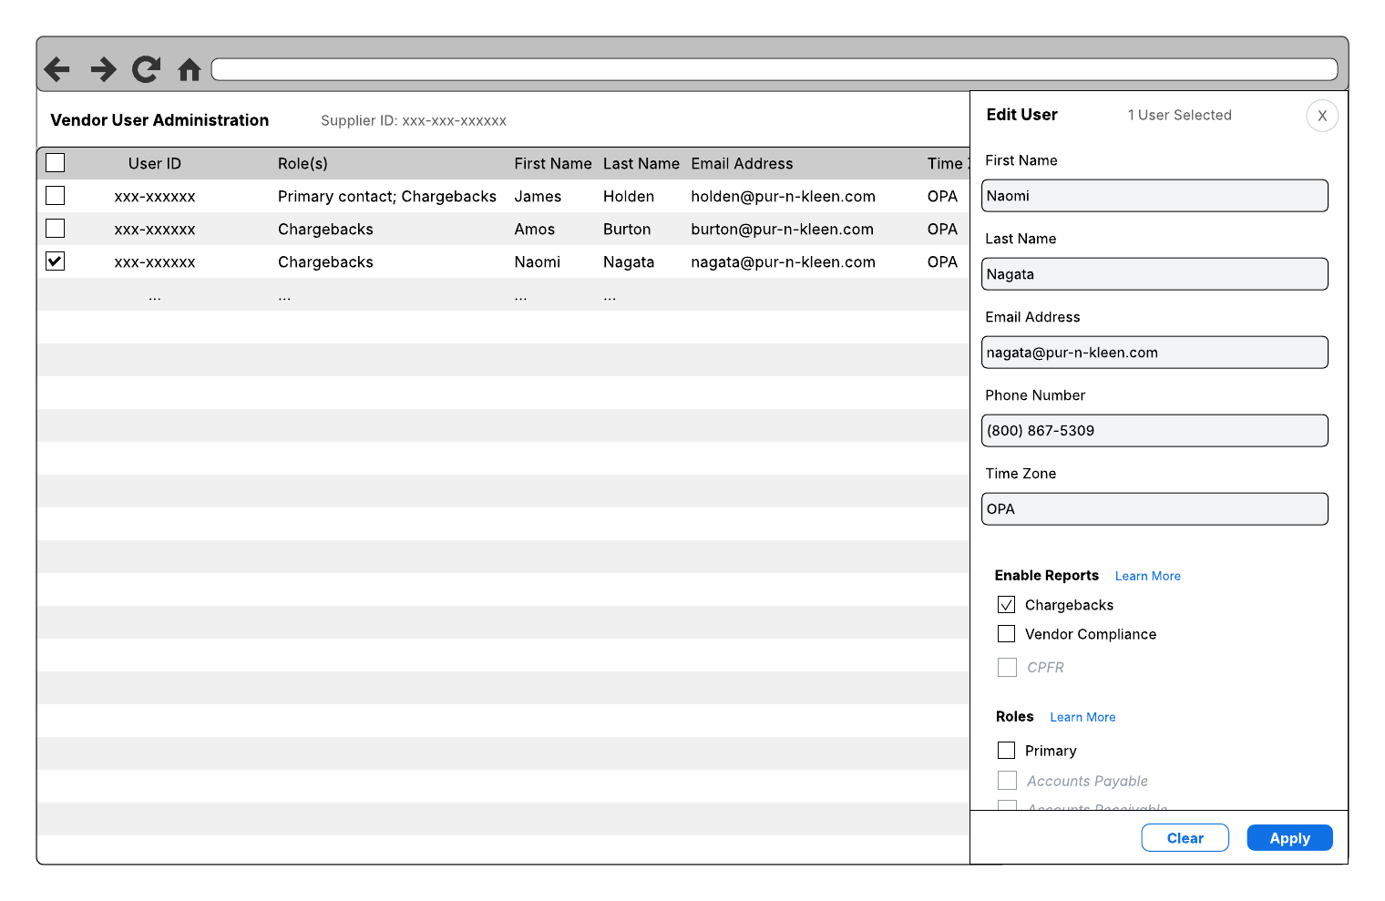
Vendor Administration
—Vendor View
Uses SSUA Supplier Information Screen
Report Selector or Role-based is TBD
Options are a subset of those selected by Chewy TMs

Slide 4
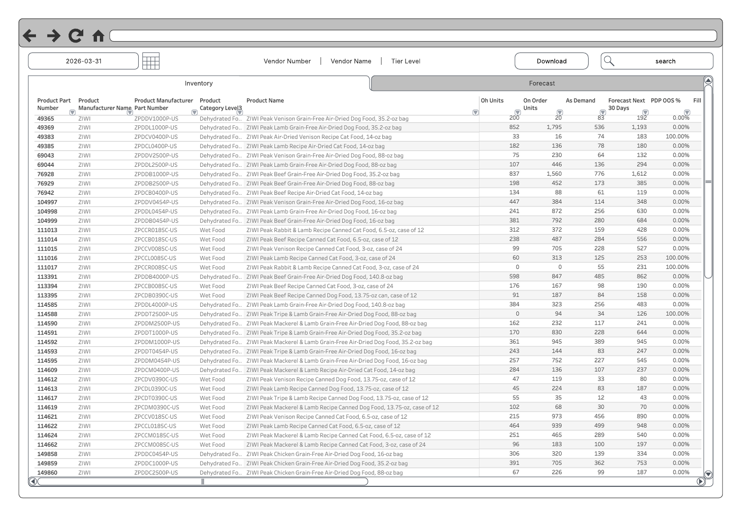
Vendor CPFR Data Viewer
iFrame port is only CPH engineering requirement
Build commitment from Supply Chain BIE
Draws from Supply Chain Single Source of Truth (SSOT) data
Leverages CPH’s existing vendor data isolation controls
Leverages Tableau’s built-in options for:
Sort and search
Tier-based visibility
Data range controls
Download (WSIWYG)

