Slide 1
java.time.format.DateTimeFormatter
Formatter for printing and parsing date-time objects.
Predefined constants and custom patterns.
formatter
Wed, 23 Jul 2021 00:00:00 -0300
Wednesday, July 23, 2021
July 23, 2021
ZoneDateTime zdt

Slide 2

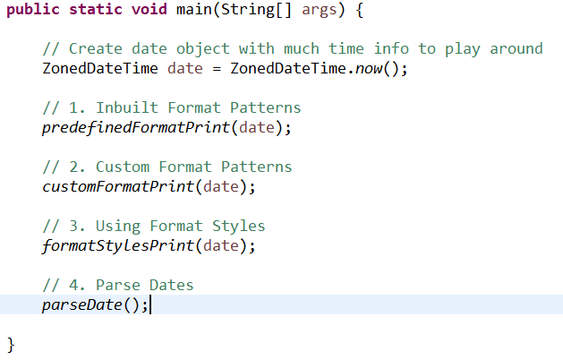
Class DateTimeFormatter Examples

Slide 3
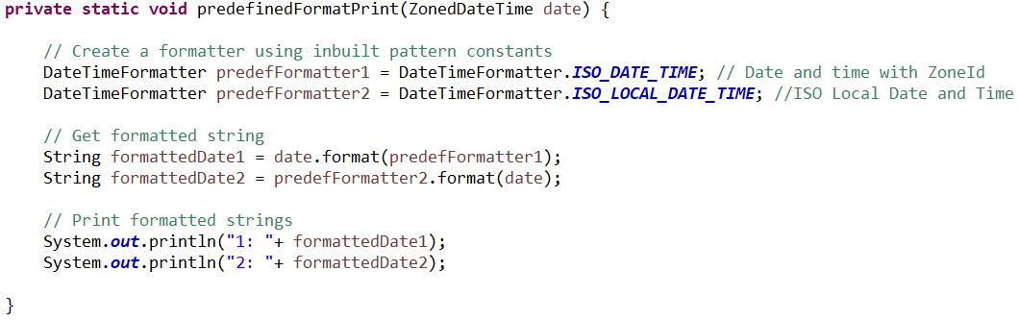

1. Predefined Formatters (1/2)

Slide 4
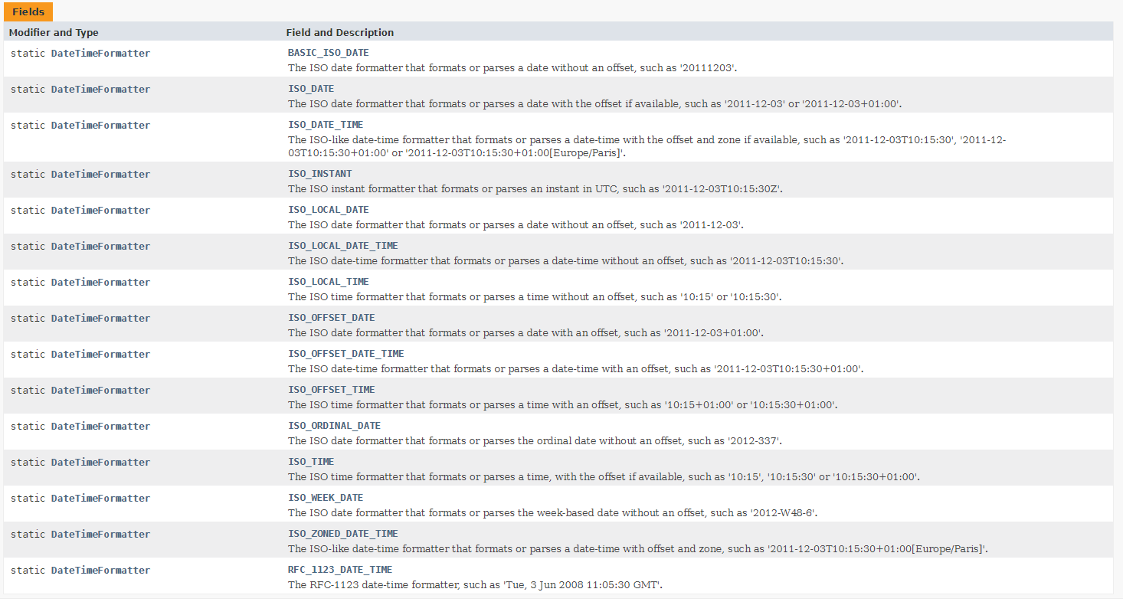
1. Predefined Formatters (2/2)
This is a headline set in Graphik with Bold formatting.
This is a sub-headline set in GT Sectra Fine.
This is your body copy text in Graphik.

Slide 5
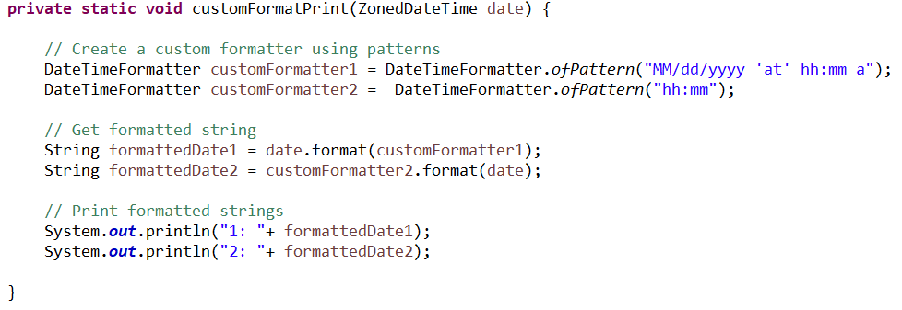

2. Custom Formatters (1/2)

Slide 6
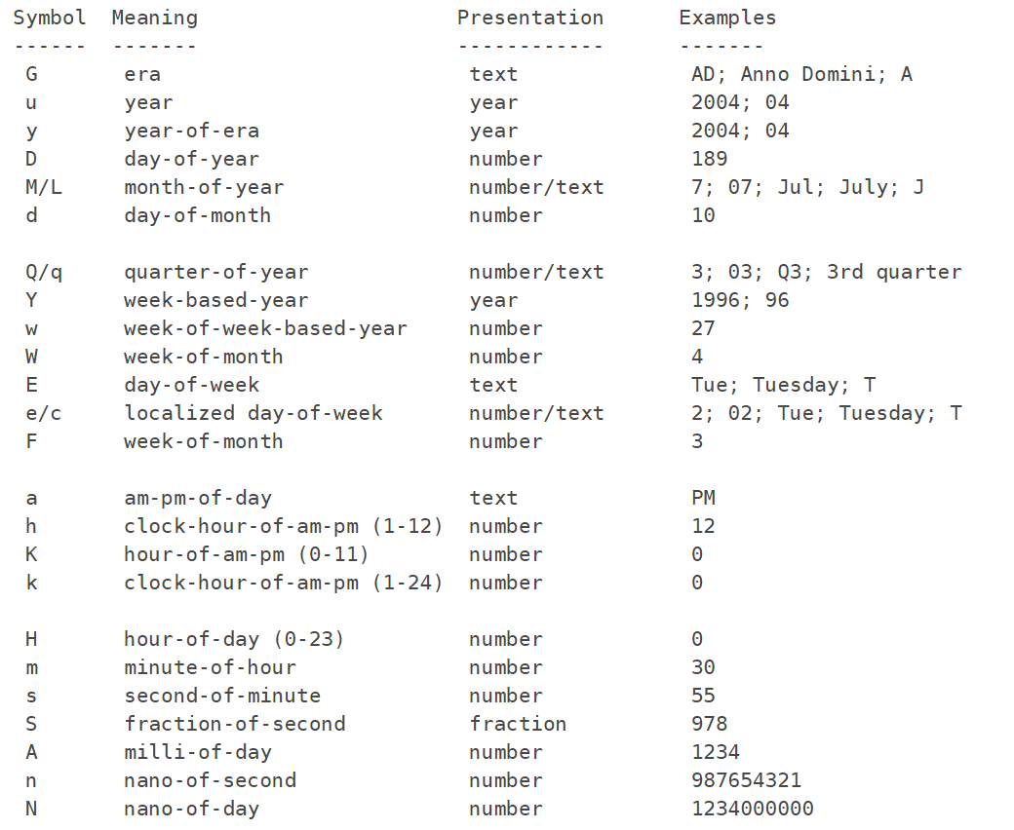
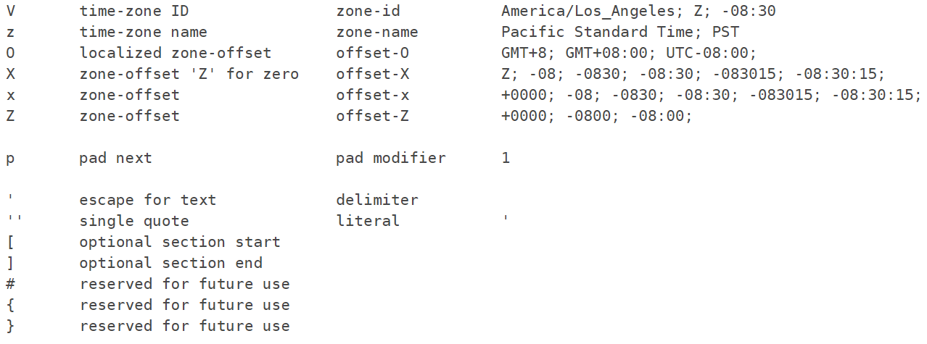
2. Custom Formatters (2/2)

Slide 7
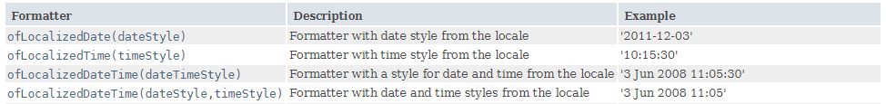
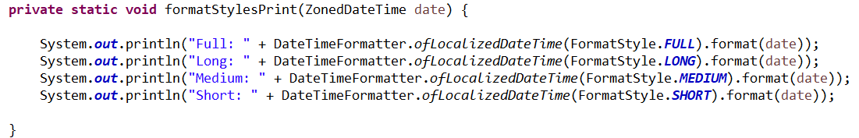

3. DateTimeFormatter with FormatStyle

Slide 8
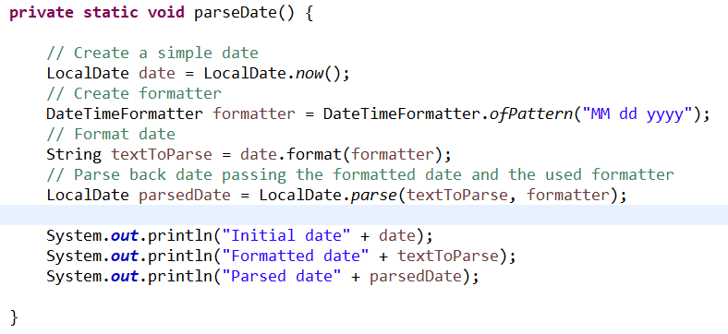

4. Parsing Dates using Formatters

Slide 9
Thank You => DateTimeFormatter (Java Platform SE 8 ) (oracle.com)

