Slide 1
How to debug with eclipse
Shahriyar Mustafa
Thillai Subramanian

Slide 2
Agenda
1
Overview of Debug
2
Debug Buttons
3
Debug Demo

Slide 3
Overview of Debug
Launching and Debugging a Java Program
Breakpoints
Debug Perspective
Stepping Commands
Notes:
To prevent incorrect operation of a software or system, debugging is used to find and resolve bugs or defects. When the bug is fixed, then the software is ready to use. Debugging tools (called debuggers) are used to identify coding errors at
various development stages.

Slide 4
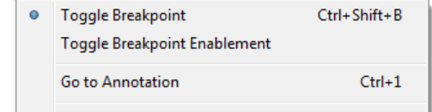
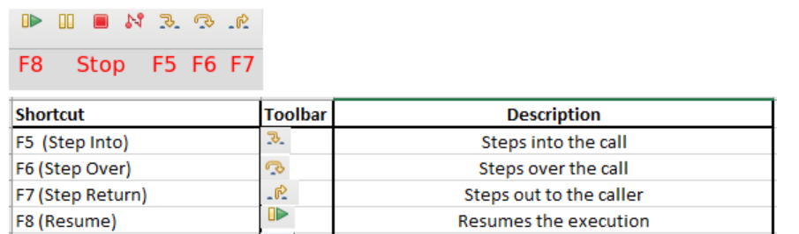
Debug Buttons
Setting Breakpoint
Stepping Commands
Notes:
Eclipse will connect to the target platform VM and switch to the Debug Perspective when the breakpoint will have been hit. To stop the remote debugging, select the “Disconnect” button from the Debug Perspective.

Slide 5
Debug Demo

Slide 6
Thank You

