Slide 1
Wrapper Class vs. Primitive: Double vs. double
Jan Könekamp and Annemarie Schmidt

Slide 2
Differences
Wrapper Class: Double (Java.lang.Double) | Primitive: double
Used to create an object | Is no object, ergo belongs to no class
Allows null values | Does not allow null values
Required memory is higher | Required memory is lower
Can be used with collections | Can not be used with collections
Methods to convert double into Double and vice versa | Is a predefined data type in java

Slide 3
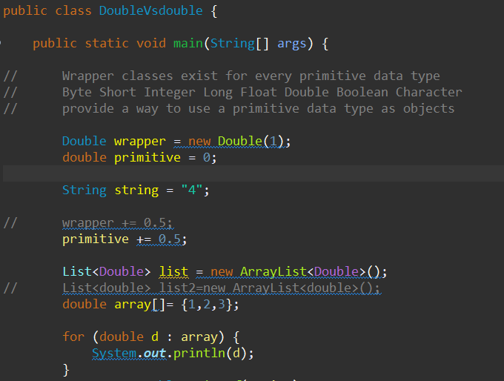
Double objects can be null
double primitive can only be 0
Collections (like ArrayList) need objects (Double)
Primitives can only be used with Arrays

Slide 4
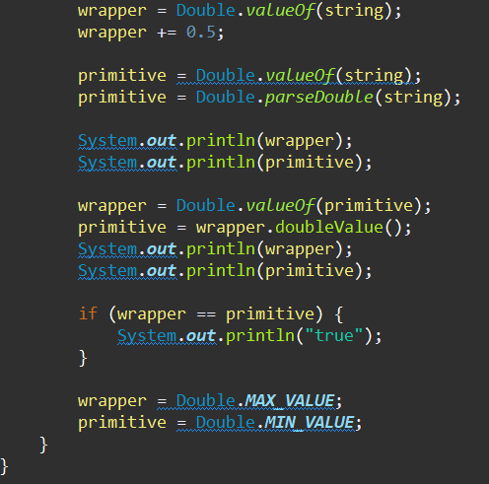
Strings can be converted to Doubles or doubles
Methods to convert:
valueOf
parseDouble
doubleValue
Check the java doc for all the methods!

