Slide 1

Spinal Cord Function and Protection
Function: 2-way conduction pathway to & from brain, & major reflex center
Protection: bone, meninges & CSF
  Spinal dura matter- 1 layer, not attached to bones
  Epidural space- between vertebrae & dural sheath- filled with soft padding of fat & network of veins
  Dural & archanoid go down much farther than spinal cord, extends to S2 (spinal cord ends around L1 or L2)

Slide 2
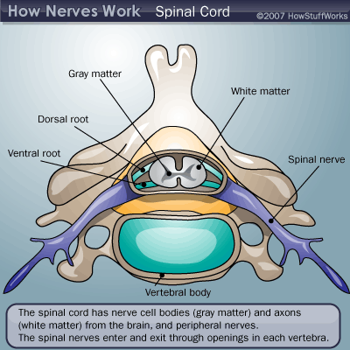
Spinal Cord Structure
31 pairs of spinal nerves attach to cord by paired roots
  each nerve exits vertebral column by passing superior to corresponding vertebra via intervertbral foramina
  Cauda equina- nerve roots & inferior end collectively
Spinal cord tapers of inferiorly into cone-shape structure
  Filum terminale- fibrous extensions of inferior end, covered in pia matter- extend to coccyx, anchor spinal cord
Spinal cord somewhat flattened with grooves down either side in middle
  Gray commissure- gray masses (encloses central canal)
  Dorsal (posterior) horns– posterior projections
  Ventral (anterior) horns- anterior projections

Slide 3
Gray Matter and Nerve Roots
All neurons whose cell bodies are in spinal cord are multipolar
Dorsal horns- all interneurons
  Dorsal roots- posterior (sensory) root- afferent fibers carry impulses from PNS sensory receptors
  Dorsal root ganglion- enlarged region of dorsal root where cell bodies of associated sensory neurons are found
Ventral horns- mainly house cell bodies of somatic motor neurons
  Ventral roots- anterior (motor) root- axons from spinal cord to skeletal effector muscles
Lateral horns- ANS (sympathetic) motor division- motor neurons to visceral organs, axons also leave with those of somatic motor neurons

Slide 4
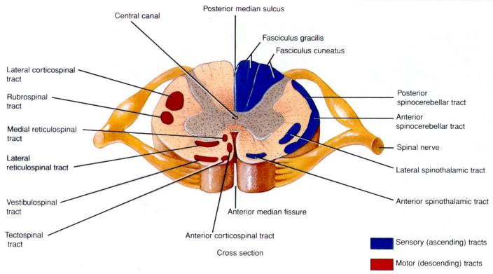
6-200
A
H
B
C
G
D
F
E
Blue- Ascending Tracts
Red- Descending Tracts

Slide 5
White Matter & Ascending Tracts
Myelinated & unmyelinated nerve fibers allow communication between dif parts of spinal cord & between cord & brain
Ascending- sensory inputs to higher centers- chains of neurons
  Nonspecific- receive inputs from many dif types of receptors, make multiple synapses in brain stem
    Lateral & anterior spinothalamic tracts- transmit pain, temp, course touch
  Specific- mediate precise, straight-through, transmission of inputs from single type of sensory receptor, can be localized precisely in body
    Fasciculus cuneatus & fasciculus gracilis- paired tracts of dorsal white column
  Spinocerebellar tracts- anterior & posterior- convey info about muscle or tendon stretch to cerebellum

Slide 6

White Matter- Descending Tracts
Descending- down to cord from brain or w/in cord to lower levels (motor outputs)
2 groups- direct & indirect pathways
  direct- pyramidal system- originate from pyramidal cells in precentral gyri- neurons send impulses through brain stem via pyramidal (cortispinal) tracts
    regulates fast, skilled movements
  Indirect-includes brain stem motor nuclei & all other motor pathways
    involved in balance, posture, coarse limb movements, & head, neck & eye movements that follow objects in visual field

