Slide 1
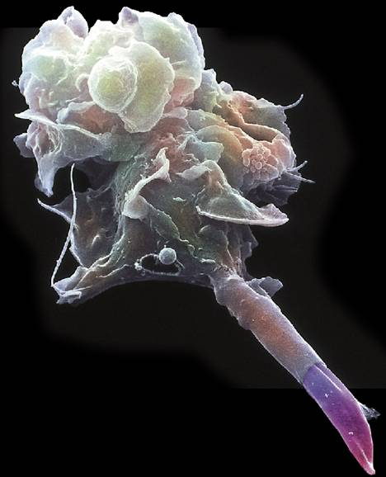
40-1 Infectious Disease
Copyright Pearson Prentice Hall
Notes:
Photo Credit: © Juergen Berger/Max-Plank Institute/Science Photo Library/Photo Researchers, Inc.

Slide 2
Disease
A disease is any change, other than an injury, that disrupts the normal functions of the body.
Disease-causing agents are called pathogens.
Diseases caused by pathogens are called infectious diseases.
Copyright Pearson Prentice Hall

Slide 3
The Germ Theory of Disease
The Germ Theory of Disease
    In the mid-nineteenth century, Louis Pasteur and Robert Koch concluded that infectious diseases were caused by germs.
    This idea is now known as the germ theory of disease.
Copyright Pearson Prentice Hall

Slide 4
Agents of Disease
Agents of Disease
    Pathogens that can cause disease include:
      viruses
      bacteria
      protists
      worms
      fungi
Copyright Pearson Prentice Hall

Slide 5
Fighting Infectious Diseases
Fighting Infectious Diseases
    Antibiotics are compounds that kill bacteria without harming the cells of the human or animal hosts. They work by interfering with cellular processes of microorganisms.
    Antibiotics have no effect on viruses.
    Antiviral drugs have been developed to fight certain viral diseases.
Copyright Pearson Prentice Hall

Slide 6
40-2 The Immune System
The immune system includes two general categories of defense mechanisms against infection:
    nonspecific defenses
    specific defenses
Copyright Pearson Prentice Hall

Slide 7
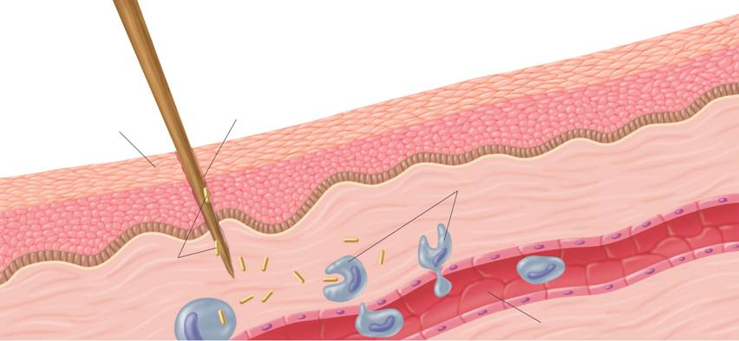
Nonspecific Defenses
    The Inflammatory Response
Wound
Skin
Phagocytes move into the area and engulf the bacteria and cell debris
Bacteria enter the wound
Capillary
Copyright Pearson Prentice Hall
Notes:
The inflammatory response is a nonspecific defense reaction to tissue damage caused by injury or infection. When pathogens enter the body, phagocytes move into the area and engulf the pathogens. In addition, platelets and clotting factors leak from the capillaries.

Slide 8
Nonspecific Defenses
  Interferon
    Sometimes, virus-infected cells produce proteins that help other cells resist viral infection.
    These proteins are named interferons because they “interfere” with the growth of the virus.
Copyright Pearson Prentice Hall

Slide 9
Specific Defenses
The cells of the immune system that recognize specific antigens are:
    B lymphocytes (B cells)
    T lymphocytes (T cells)
Copyright Pearson Prentice Hall

Slide 10
Specific Defenses
B cells defend the body against antigens and pathogens in body fluids. This process is called humoral immunity.
T cells defend the body against abnormal cells and pathogens inside living cells. This process is called cell-mediated immunity.
Copyright Pearson Prentice Hall

Slide 11
Specific Defenses
  Humoral Immunity
    Humoral immunity produces antibodies.
    An antibody is a protein that recognizes and binds to an antigen.
    An antibody is shaped like the letter “Y” and has two identical antigen-binding sites.
Copyright Pearson Prentice Hall

Slide 12
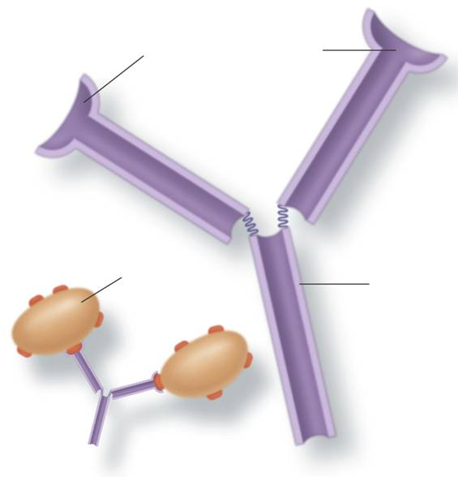
Specific Defenses
Antibody Structure
Antigen-binding sites
Antigen
Antibody
Copyright Pearson Prentice Hall
Notes:
An antibody molecule has two identical antigen-binding sites. It is at these sites that one or two specific antigens bind to the antibody.

Slide 13
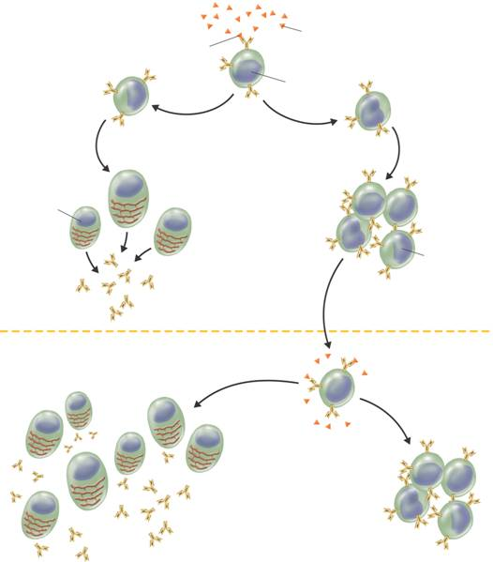
Specific Defenses
Antigen binding to B cell
Antigen
    Humoral Immunity
B cell
Plasma cell
Memory B cell
Second exposure to same antigen
Production of many more cells and antibodies
Production of memory B cells
Copyright Pearson Prentice Hall
Notes:
Once the body has been exposed to a pathogen, it remains capable of producing specific antibodies to that pathogen. The reaction to a second infection by the same pathogen is much faster.

Slide 14
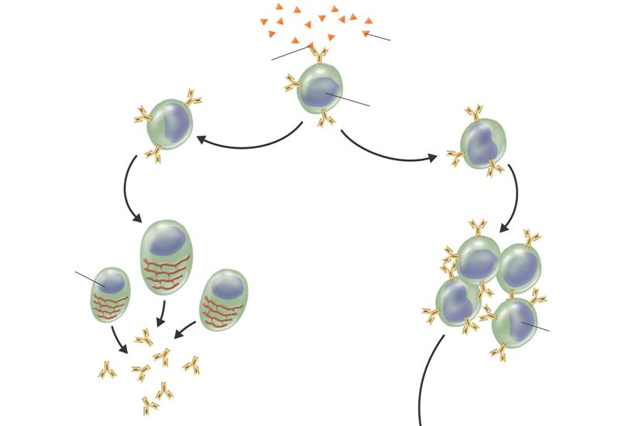
Specific Defenses
Antigen binding to B cell
Antigen
B cell
B cells grow and divide rapidly
Plasma cell
Memory B cell
Copyright Pearson Prentice Hall

Slide 15
Specific Defenses
  Cell-Mediated Immunity
    Cell-mediated immunity is the response against abnormal cells and pathogens.
    When viruses or other pathogens get inside living cells, antibodies alone cannot destroy them.
Copyright Pearson Prentice Hall

Slide 16
Copyright Pearson Prentice Hall

Slide 17
Specific Defenses
In cell-mediated immunity, T cells divide and differentiate into different types:
    Killer T cells destroy foreign tissue containing the antigen.
    Helper T cells produce memory T cells.
    Suppressor T cells shut down killer T cells when done.
    Memory T cells cause secondary response.
Copyright Pearson Prentice Hall

Slide 18
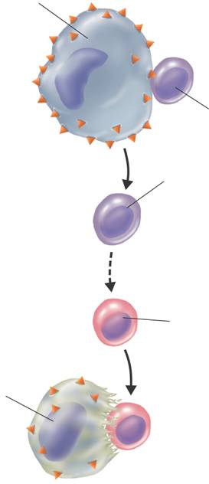
Specific Defenses
Macrophage
    Cell-Mediated Immunity
T cell
Helper T cell
Killer T cell
Infected cell
Copyright Pearson Prentice Hall
Notes:
During the cell-mediated immune response, T cells provide defense against abnormal cells and pathogens inside living cells.

Slide 19
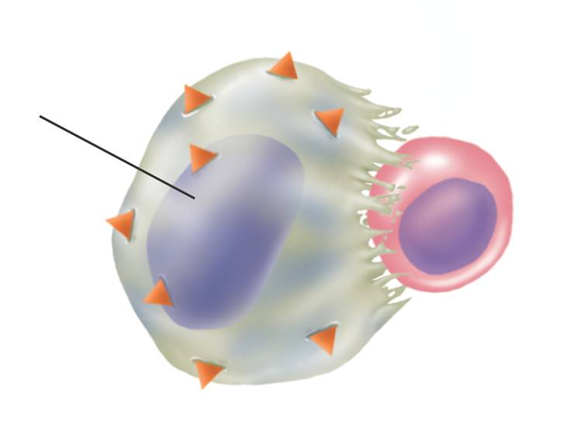
Specific Defenses
Killer T cells bind to infected cells, disrupting their cell membranes and destroying them.
Infected cell
Copyright Pearson Prentice Hall

Slide 20
Specific Defenses
  Transplants
    Killer T cells make acceptance of organ transplants difficult.
    Cells have marker proteins on their surfaces that allow the immune system to recognize them.
    The immune system would recognize a transported organ as foreign and attack it. This is known as rejection.
Copyright Pearson Prentice Hall

Slide 21
Acquired Immunity
  Active Immunity
    Injection of a weakened or mild form of a pathogen to produce immunity is known as a vaccination.
    Vaccines stimulate the immune system to create millions of plasma cells ready to produce specific types of antibodies.
    Immunity produced by the body's reaction to a vaccine is known as active immunity.
Copyright Pearson Prentice Hall

Slide 22
Acquired Immunity
  Passive Immunity
    The body can also be temporarily protected against disease.
    If antibodies produced by other animals are injected into the bloodstream, the antibodies produce a passive immunity.
    Passive immunity is temporary because eventually the body destroys the foreign antibodies.
Copyright Pearson Prentice Hall

Slide 23
Allergies
Histamines increase the flow of blood and fluids to the area.
They increase mucus production in the respiratory system, which induces sneezing, watery eyes, and runny nose.
Antihistamines are drugs that counteract histamines.
Copyright Pearson Prentice Hall

Slide 24
Autoimmune Diseases
Some examples of autoimmune diseases include:
    Type I diabetes attacks insulin-producing cells.
    Rheumatoid arthritis attacks connective tissues around joints.
    Myasthenia gravis attacks neuromuscular junctions.
    Multiple sclerosis (MS) destroys functions of brain and spinal cord neurons.
Copyright Pearson Prentice Hall

Slide 25
AIDS
    In 1983, researchers identified the cause of AIDS—a virus that is caused by the HIV for human immunodeficiency virus.
    HIV is a retrovirus—a virus that carries its genetic information in RNA, rather than DNA.
Copyright Pearson Prentice Hall

Slide 26
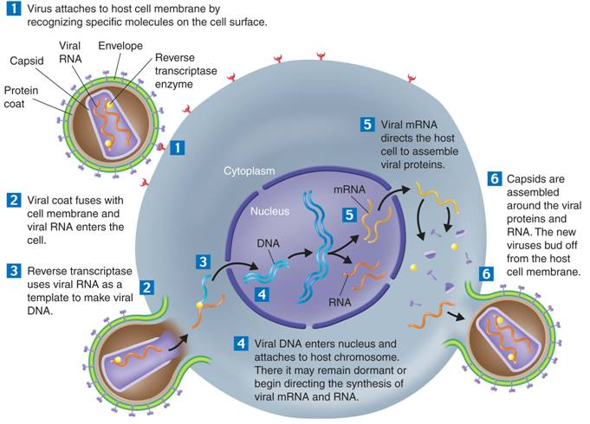
AIDS
HIV Infection
Copyright Pearson Prentice Hall
Notes:
HIV travels through the bloodstream, where it binds to receptors on helper T cells. Once inside the cell, the virus directs the cell to produce many new viruses. These new viruses are quickly released back into the bloodstream, where they travel to new cells and destroy them.

Slide 27
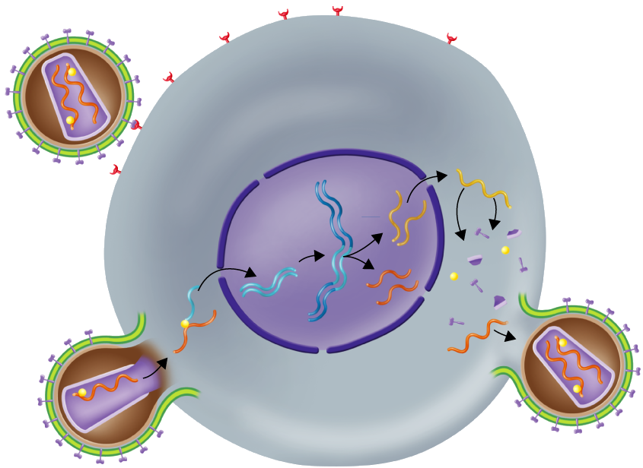
AIDS
Envelope
Viral RNA
Reverse transcriptase enzyme
Capsid
Protein coat
1
1
Virus attaches to host cell membrane by recognizing specific molecules on the cell surface.
Copyright Pearson Prentice Hall

Slide 28
AIDS
6
Capsids are assembled around the viral proteins and RNA. The new viruses bud off from the host cell membrane.
6
Copyright Pearson Prentice Hall

Slide 29
Copyright Pearson Prentice Hall

Slide 30
Copyright Pearson Prentice Hall

