Slide 1
Heart Sounds
2 distinct sounds associated with closing of valves
  1st- AV valves open in response to atrial contraction, blood flows through, they close
  2nd- SL valves snap shut after ventricular contraction
Heart murmurs- abnormal heart sounds
  Obstructions in blood flow
  Thin walls vibrating due to blood flow
  Valve problems

Slide 2
Cardiac Cycle
Events associated with blood flow through the heart during one complete heartbeat
  Systole- contraction, diastole- relaxation
    Atrial systole & diastole followed by ventricular systole & diastole
Mechanical events follow events of EKG
  Ventricular filling: mid-to-late diastole
  Ventricular systole: ventricles begin to contract, isovolumetric contraction phase, expel blood
  Isovolumetric relaxation: early diastole

Slide 3
Cardiac Output
Amount of blood pumped by each ventricle in 1 min.
  Cardiac Ouput= Heart Rate x Stroke Volume
  Stroke volume- V of blood pumped out per ventricle per beat
Ave CO= 75beats/min x 70mL/beat= 5.25L/min

Slide 4
Abnormalities and Disorders
Angina pectoris- thoracic pain from deficiency of blood to myocardium
Myocardial infarction- “heart attack”- prolonged coronary blockage- cells die, replaced by noncontractile scar tissue
Atheroscleorsis- patchy thickenings “plaques” intrude vessels
Congestive heart failure- CHF- pumping efficiency of heart is so low that blood circulation is inadequate to meet tissue needs
  progressively worsening condition

Slide 5
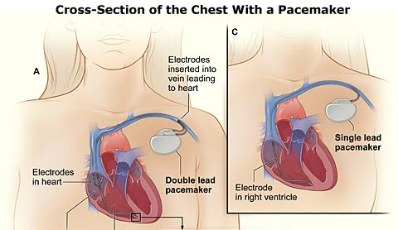
Irregularities and Disorders
If SA node becomes nonfunctional other slower “pacemakers” dominate contraction speed
  Slower impulse through myocardium allows some muscle fibers to contract well before others, resulting in reduced pumping effectiveness
Arrhythmias- irregular heart rhythms
  Fibrillation- condition of rapid, irregular out-of-phase contraction in heart, rhythm is taken away from the SA node by rapid activity in other heart regions
Heart block- interferences with ability of ventricles to receive impulses- damage to AV node
  If no impulses get through (total heart block), ventricles beat at own pace, far too slow to maintain adequate circulation
  “Pacemakers” are used to recouple the activities of the atria and ventricles

Slide 6
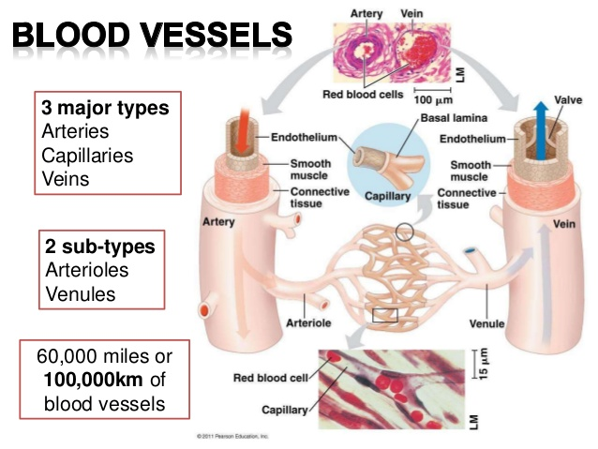
http://image.slidesharecdn.com/ar-141204080734-conversion-gate01/95/blood-vessels-arteries-veins-and-capillaries-2-638.jpg?cb=1417680755

Slide 7
Vascular System
Arteries- blood away from heart
  Run deep, well protected by body tissues
Veins- blood to heart
  Superficial & deep, deep run with arteries
Capillaries- exchange of materials (diffusion)
3 layers (tunics) of walls of blood vessels
  Tunica intima- innermost, endothelium, reduce friction of blood flowing through lumen
  Tunica media- middle, mostly circular smooth muscle & sheets of elastin
    Arteries- vasoconstriction & vasodilation
  Tunica externa- outmost- loosely woven collagen fibers that protect & reinforce

Slide 8
Blood Vessels- Arterial System
Elastic (conducting) arteries- thick-wall, near heart, largest & most elastic (most elastin)
  Conduct blood from heart to medium-sized arteries
Muscular (distributing) arteries- deliver blood to specific body organs
  Vasoconstriction & vasodilation
Arterioles- smallest arteries
  little more than 1 layer of smooth muscle tissue around endothelium- go into capillary beds

Slide 9
Blood Vessels- Capillaries and Venous System
Capillaries- microscopic vessels, tunica intima only, very porous
Venus System
  Venules- form when capillaries unite, all endothelium, very porous, largest have 1-2 layers of smooth muscle cells & thin externa
  Veins- 3 distinct tunics, thinner walls with larger lumens than arteries

Slide 10
Blood Flow, Pressure and Resistance
Blood flow- V of blood flowing through vessel/ organ/entire circulation, in a given period (mL/min)
Blood Pressure (BP)- force per unit area exerted on vessel wall by contained blood (mmHg)
  Generally refer to systemic arterial pressure in largest arteries near heart
  P gradient keeps blood moving from areas of high to low P
(Peripheral) Resistance- opposition to flow, measure of friction blood encounters as it passes through vessels, 3 sources:
  Blood viscosity (thickness/stickiness of blood), blood vessel length, blood vessel diameter
Relationship between flow, pressure & resistance:
F= ∆P/R

Slide 11
Systemic Blood Pressure
Arterial pressure- 2 factors- elasticity of elastic arteries & V of blood forced into them at any time
  Systolic P= ave 120mmHg
  Diastolic P= ave 70-80mmHg (enough P to continue flow into smaller vessels)
  Difference between systole & diastole Ps= pulse P
Capillary Blood Pressure- low is better for fragile, extreme permeable walls
Venous Blood Pressure- too low for adequate return, needs help!
  Respiratory pump, muscular pump & smooth muscle (sympathetic nervous system)
    Valves and wide lumen

Slide 12
Maintaining Blood Pressure
Cooperation of heart, blood vessels & kidneys (under control of brain/hormones)
Factors: cardiac output (CO), peripheral resistance (PR) & blood volume (BV)
  ∆P= CO x R
  (CO= F)
  CO also affected by venous return
Short term controls alter R & CO
  Blood vessel diameter & distribution of blood

Slide 13
Vasomotor Center and Input from Higher Brain Centers
Medulla contains vasomotor center- oversees changes in diameter of blood vessels
  Sympathetic ↑ caused overall vasoconstriction & ↑ BP (& vice versa)
Higher Brain Centers- cerebral cortex & hypothalamus can modify arterial Ps via relays to medulla
  exp- hypothalamus- fight-or-flight response

Slide 14
Vasomotor Center and Input from Baroreceptors and Chemoreceptors
  Receptors located in major arteries (internal carotid artery (to brain), aortic arch & most thoracic & cervical arteries)
Baroreceptors- respond to changes in arterial P/stretch
  Inhibit vasomotor center→ vasodilation (↓R→↓P, ↓venous reservoirs, ↓CO)
  Rapid response, protect circulation from short-term, acute changes in BP
Chemoreceptors- respond to changes in levels of blood O₂, CO₂, & H⁺
  if pH ↓s or CO₂ ↑s, impulses to cardioacceleratory center (to ↑CO) & to vasomotor center (vasoconstriction)

Slide 15
Major/Specific Blood Vessels
Note thymus and phrenic nerve
Label:
  Aorta (arch)
  Coronary arteries
  Vena cavae (sup and inf, in cat= precava and postcava)
  Pulmonary trunk
  Pulmonary arteries
  Pulmonary veins
Veins
  Brachiocephalic
  External and intenral jugulars
  Subclavian
  Axillary
  Brachial
  Long thoracic vein- blood from chest muscles and lungs
  Adrenolumbar
  Renal veins
  Common iliac veins
  External and internal iliac
  Femoral
  Great saphenous
Arteries
  Brachiocephalic trunk
  R and L Common carotids
  R and L Subclavians
  Axillary
  Brachial
  Decending aorta (thoracic and abdominal)
  Renal
  External and internal iliac
  Femoral
  Saphenous

Slide 16
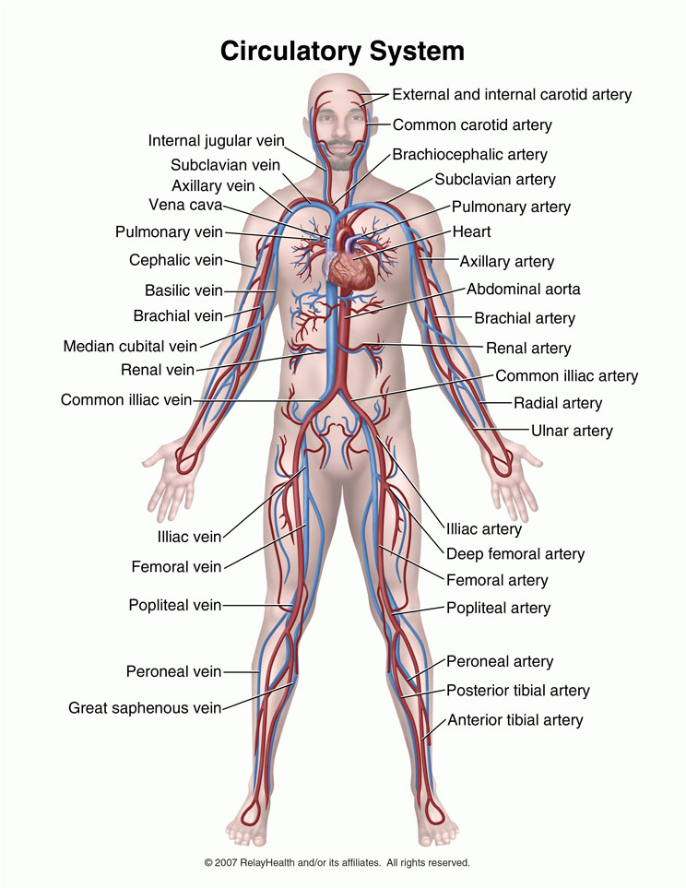
http://www.pharmaworld.pk/products/gallery/gal865_t61.jpg

Slide 17
Blood Facts
Varies in color from scarlet (O₂ rich) to dark red (O₂poor)
More dense & about 5x as viscous as H₂O
pH 7.35-7.45
Temp 38˚C (100.4˚F)
8% of body weight (ave V= 5-6L males, 4-5L females)
Connective tissue, has cellular & liquid components

Slide 18
Functions of Blood
Distribution- carries O₂ & nutrients to, & picks up metabolic wastes (CO₂, NH₃, etc) from, all cells in body, transports hormones
Regulation- maintain body temp, pH, & adequate fluid V in circ sys
Protection- prevents own loss (clotting) & infection

Slide 19
Plasma
55% of blood volume
Straw colored sticky fluid, 90% water
  8% plasma proteins by V
    Albumin- (60%) main protein contributor to osmotic P (Na⁺ other), shuttles other molecules through circulation, acts as buffer
    Globulins- (36%) mostly transport lipids, metal ions, & fat soluble vitamins, some also act as antibodies in immune response
    Fibrinogen- (4%) forms fibrin threads of blood clot

Slide 20
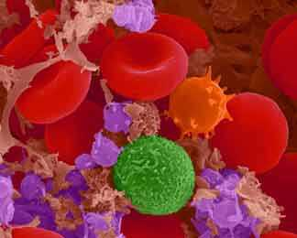
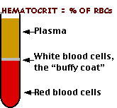
Formed Elements
45% of blood volume
  Erythrocytes~ 45%= hematocrit
  Leukocytes & platelets ‹1%= buffy coat
Odd features-
  2 of 3 aren’t true cells
  Most survive only a few days in blood stream
  Most do not divide (made from cell division in bone marrow)
Hematopoiesis- blood cell formation by hematopoietic stem cells in red bone marrow

Slide 21
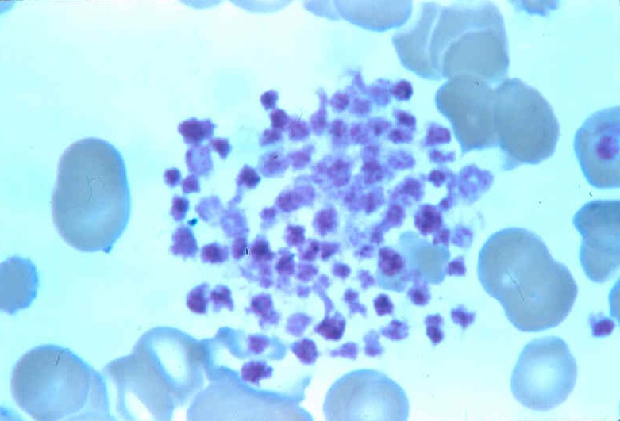
Platelets
Platelets- cell fragments
  essential for clotting process occurring in plasma when vessel or lining is ruptured

Slide 22
Hemostasis- Stoppage of Bleeding
Fast, localized, carefully controlled, complex series of reactions
3 steps:
  Vascular spasms- immediate response (vasoconstriction)
    Injury to smooth muscle→ chem..s released by endothelial cells & platelets, reflexes initiated by nociceptors
  Platelet plug- temporarily seals break
    Stick to collagen fibers of damaged endothelial lining
    Once activated, release chemicals
      exp. Serotonin- enhances vascular spasm
  Coagulation (blood clotting)- blood transformed from liquid to gel, 3 phases:
    1) prothrombin activator forms
    2) converts prothrombin (plasma protein) to thrombin (enzyme)
    3) thrombin catalyzes joining of fibrinogen molecules into a fibrin mesh
      Over 30 substances involved!- procoagulants, anticoagulants

Slide 23
Disorders in Hemostasis
Thrombus- clot in unbroken blood vessel
Embolus- thrombus breaks away for the wall & floats freely in the blood stream
Embolism- embolus becomes trapped

Slide 24
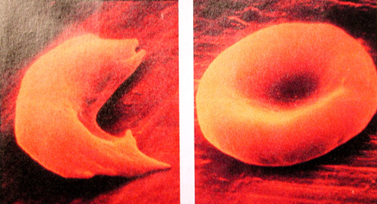
Erythrocytes- RBCs
Carry O₂ & CO₂, hemoglobin (Hb)- protein easily & reversibly binds with gasses
  Oxyhemoglobin or deoxyhemoglobin
Mature have no nuclei or organelles
  No mito= don’t use O₂
Life span ~100-120 days
  Trapped by circulatory channels (especially spleen), fragmented, engulfed by macrophages, destroyed
Blood doping- athletes draw off RBCs & inject a few days before an event, ↑s O₂ carrying capacity
Anemia- abnormally low O₂ carrying capacity
  Insufficient #RBCs, low hemoglobin content, abnormal hemoglobin

Slide 25
Blood Transfusions and Blood groups
Whole blood transfusion- routine when blood loss is rapid & substantial
Packed RBCs (most plasma removed)- restore O₂ carrying capacity
Human blood groups- RBC plasma membranes have highly specific glycoproteins (antigens) at external surfaces
  If transfused blood is recognized as foreign transfused cells may become agglutinated (clumped together) & destroyed by immune cells
  Agglutinogens- RBC antigens

