Slide 1
Circulatory System and the Heart
Transports gasses, nutrients & wastes for exchange for all tissues
Heart, blood vessels (& blood)
    Heart= pump, vessels= routes, blood= medium
Vessels- arteries, arterioles, veins, venules & capillaries
  Artery- from heart (away), veins- to heart
Heart
  About size of a fist, hollow & cone shaped, weighs 250-350g
  In mediastinum, thorax, extends obliquely between 2nd & 5th rib, rests on superior surface of diaphragm

Slide 2
Coverings
Pericardium- double-walled sac- encloses heart
  Superficial- loose fibrous pericardium
  Deep- thin two-layered serous pericardium
    Parietal layer lines fibrous pericardium, at superior end attaches to large arteries leaving heart, then continues inferiorly to cover external surface of heart (visceral layer, or epicardium)
    Pericardial cavity- between parietal & visceral (epicardial) layers
3 layers of heart wall
  epicardium- visceral layer of pericardium
  myocardium- mostly cardiac muscle, bulk of heart
  endocardium- glistening white sheet of endothelium resting on a thin connective tissue layer on inner myocardial surface

Slide 3
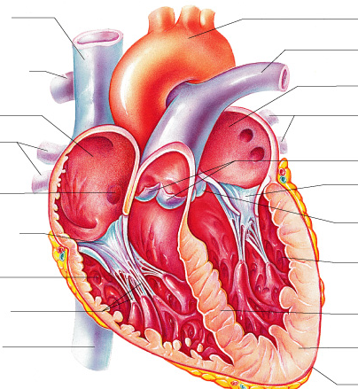
Chambers and Associated Great Vessels
4 Chambers- 2 atria (superior), 2 ventricles (inferior)
  R ventricle forms most of anterior surface, L ventricle most of inferoposterior
Atria- receiving chambers- major veins lead to atria
  Blood enters R through superior & inferior vena cavas and coronary sinus
  Blood enters L through 4 pulmonary veins
  Pectinate muscles-small bundles of muscle tissue form a ridge in R atria

Slide 4
Chambers and Associated Great Vessels Cont’d
Ventricles- discharging chambers- blood pumped into arteries
  Blood leaves R through pulmonary trunk to lungs
  Blood leaves L through aorta to body
    largest artery in body
  Trabeculae carneae- irregular ridges of muscle
  Papillary muscles- conelike muscle fibers that project into ventricular cavities- role in valve function

Slide 5
Cardiac Muscle
Striated
  Typical sarcomeres, uses sliding filament mechanism
  Filaments differ in diameter and branch a lot
Cells- short, fat, and branched
  Space filled with connective tissue, fibers interlock→ intercalated discs (desmosomes and gap junctions)
Usually only 1 nucleus (at most 2)
Large mitochondria
Ca²⁺ delivery system less elaborate

Slide 6
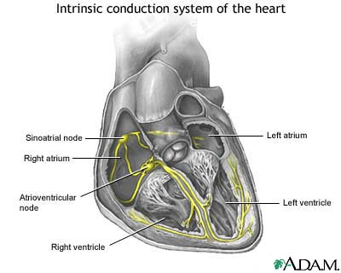
Heart Anatomy and Independent Coordination (Intrinsic Conduction)
Gap Junctions
Intrinsic Conduction System
  Noncontractile, autorhythmic cells
  Sinoatrial node- R atrial wall
  Atrioventricular node- inferior portion of interatrial septum
  Bundle of His- superior part of interventricular septum
  R and L branches- bundle of His splits
  Purkinje fibers – long strands of cells from inferior interventricular septum to apex, then up ventricular walls

Slide 7
Pathways through the heart
Pulmonary circuit- blood vessels carry blood to and from lungs for gas exchange
  R side of heart- blood returning into R atria is O₂ poor (CO₂ rich), passes to R ventricle, pumps to lungs
Systemic circuit- blood vessels carry blood to and from all body tissues
  L side of heart- blood returns to L atria O₂ rich (CO₂ poor), passes to L ventricle, pumps to body
Coronary circuit- shortest circulation in body, supplies myocardium
  R & L coronary arteries come off base of aorta, branch and encircle heart, collect into cardiac veins and return to R atria through coronary sinus

Slide 8
Valves
Valves- enforce 1-way flow of blood through heart
Atrioventricular (AV) valves- prevent back flow from ventricles to atria when ventricles contract
  R= tricuspid valve, L= mitrial (bicuspid) valve
    when ventricles contract P↑, forcing blood supply against valves, flap edges meet, closing valve
  Chordae tendineae- white collagen cords anchor AV valve cusps to papillary muscles
    anchor cusps in closed position so don’t go upward into atria
Semilunar (SL) valves- guard bases of largest arteries (aorta and pulmonary trunk) and prevent backflow into associated ventricles
  R= pulmonary valve, L= aortic valve

Slide 9
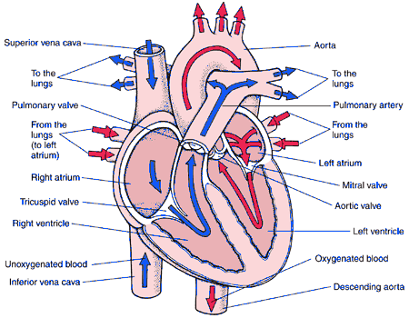
Pulmonary & System Circulatory Review
R ventricle pumps O₂-poor (CO₂-rich) blood to the lungs for gas exchange
  Through pulmonary trunk (pulmonary valve)
O₂-rich (CO₂-poor) blood returns from the lungs to the L atrium
  Through pulmonary veins
Blood is pumped from the L atrium to the L ventricle
  Through mitral (bicuspid valve)
L ventricle pumps O₂-rich blood to the body
  Through aorta (aortic valve)
O₂-poor blood returns to the R atrium
  Through superior and inferior vena cavas
R atrium pumps O₂-poor blood to the R ventricle
  Through tricuspid valve

Slide 10
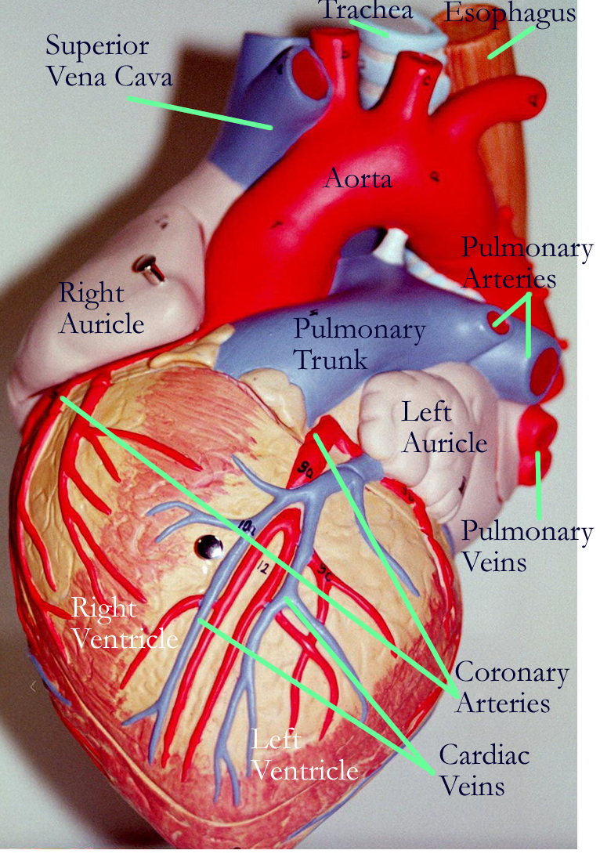
Coronary Circulation Review
L ventricle pumps O₂-rich blood to the body
R & L coronary arteries come off the base of the aorta
  Encircle the heart, branch into capillaries
  Capillaries recombine into cardiac veins
O₂-poor (CO₂-rich) blood returns to R atria
  Through the coronary sinus
R atrium pumps O₂-poor blood to the R ventricle
R ventricle pumps O₂-poor (CO₂-rich) blood to the lungs
O₂-rich (CO₂-poor) blood returns from the lungs to the L atrium
Blood is pumped from the L atrium to the L ventricle

Slide 11
Mechanism of Contraction
Dif.s from skeletal muscles
  Some cells are self-excitable
  Whole heart contracts
  Longer absolute refractory period
Sim.s to skeletal muscles
  Contraction triggered by APs sweeping across membrane
  Depolarization- Na⁺ enters→ positive feedback cycle
  Transmission of depolarization down T tubules causes SER to release Ca²⁺ into cytoplasm
  Excitation-contraction coupling- Ca²⁺ provides signal for cross-bridge activation, sliding filaments
Energy requirement
  Can switch supplies (glucose, fatty acids, lactic acid)
  More mitochondria (more O₂ dependent)

Slide 12
Intrinsic and Extrinsic Cardiac Control
Intrinsic- ability to depolarize & contract does not depend on nervous system
  Gap junctions & Intrinsic cardiac conduction system
    Autorhythmic cells
      Unstable resting potential causes rhythmic depolarizations
Extrinsic- ANS fibers can alter basic rhythm of heart
  Cardioacceleratory & cardioinhibibtory centers in medulla oblongata

Slide 13
Sequence of Excitation
1) Sinoatrial (SA) node- typically generates impulses about 75x/min, Fastest part of conduction system→ “pacemaker”
2) Atrioventricular (AV) node- Depolarization spreads from SA to AV via gap junctions, impulse is delayed about 0.1s
3) Bundle of His (atrioventricular bundle)- electrical connection between atria & ventricles
4) R & L bundles
5) Purkinje fibers- complete pathway and begin depolarization of ventricular muscle cells (assisted by cell-to-cell transmission of impulse)
  Also supply papillary muscles, which are excited before the rest of the ventricular muscles

Slide 14
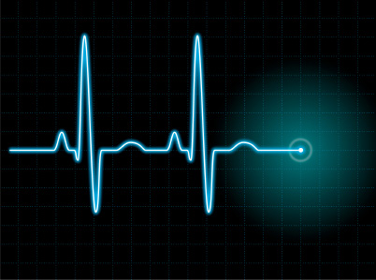
Sequence of Excitation Cont’d
Ventricular contraction starts at apex
Total time between start of impulse by SA node & depolarization of last ventricular muscles ~0.22s
Electrical currents of heart can be detected with electrocardiograph→ electrocardiogram (EKG)

