Slide 1
Nerves and Their Parts
Nerve- cordlike organ part of PNS
  Parallel bundles of peripheral axons enclosed by successive wrapping of connective tissue
    Endoneurium- wraps each individual nerve cell
    Fascicles- groups of fibers bound together by perineurium
    Epineurium- tough fibrous sheath around fascicles to form nerve
Sensory (afferent) nerves- only to CNS
Motor (efferent) nerves- only from CNS
Mixed nerves- contain both sensory & motor fibers (transmit to & from CNS)
  Most are mixed

Slide 2
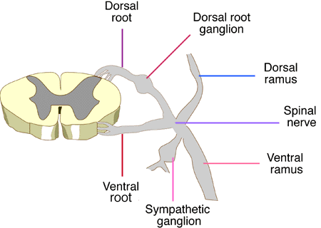
Spinal Nerves
Ganglia- collections of neuron cell bodies associated with nerves in PNS
  Afferent- contain cell bodies of sensory neurons (dorsal root ganglia)
  Efferent- mostly contain cell bodies of automonic neurons (why? Where are somatic?)
31 pairs- arise from spinal cord & supply all parts of body except head & some areas of neck- all are mixed nerves
Named according to point of issue from spinal cord
  Each connects by dorsal (sensory) & ventral (motor) root, arising from dorsal & ventral horns
Length of spinal roots increase progressively superior to inferior
  Except for T2-T12, all ventral rami branch & join together lateral to vertebral column→ nerve plexuses

Slide 3
Cranial Nerves
I Olfactory- sensory- sensory filaments of smell, run from nasal mucosa to synapse with olfactory bulbs & tracts
II Optic- sensory- develops as outgrowth of brain, carry afferent impulses for vision
III Oculomotor- motor- “eye mover” supplies 4 of 6 extrinsic eye muscles & parasympathetic motor fibers to sphincter
IV Trochlear- motor- “pulley”- innervates extrinsic eye muscle that loops through a pulley-shaped ligament in orbit
V Trigeminal- mixed- largest of cranial nerves, “3 branches” spring from it, supplies sensory fiber to face & motor fibers to chewing muscles
VI Abducens- motor- controls extrinsic eye muscles that abduct eyeball (turns laterally)

Slide 4
Cranial Nerves Cont’d
VII Facial- mixed- controls muscles of facial expression & lacrimal, nasal, palantine & salivary glands, & conveys impulses from taste buds
  Splits to 5 main motor branches- temporal, zygomatic, buccal, mandibular and cervical
VIII Vestibulocochlear- sensory- hearing & balance
  “auditory nerve”
IX Glossopharyngeal- mixed- some somatic motor fibers, carries impulses from receptors for muscle that elevates pharynx during swallowing- also helps innervate salivary glands

Slide 5
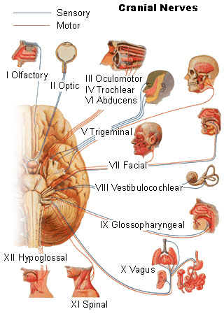
Cranial Nerves Cont’d
X Vagus- mixed- most motor= parasympathetic (except ones for swallowing), sensory= impulses from thorax, abdominal viscera & taste buds
  only cranial nerve to extend beyond head & neck
XI Accessory- motor- pharynx, larynx & soft palate, some muscles that move head & neck
XII Hypoglossal- motor- runs inferior to tongue & innervates tongue moving muscles

