Slide 1
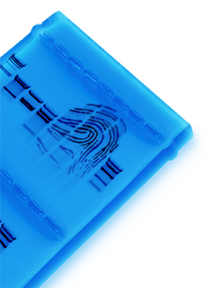
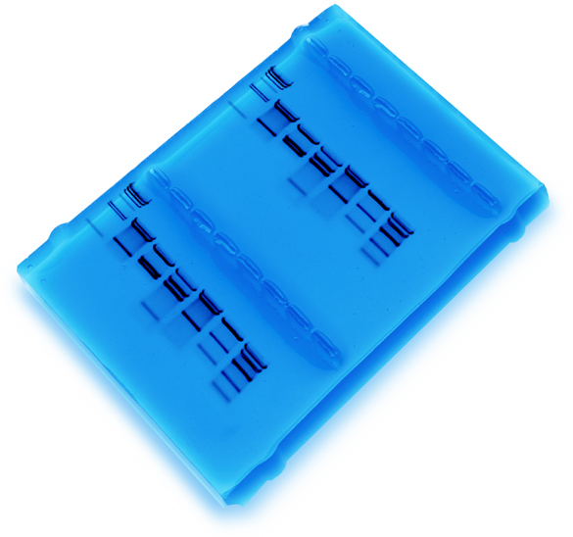
Forensic DNA- Profiling (Fingerprinting):
Using Restriction Enzymes

Slide 2
DNA Profiling
Fingerprinting Real World
Applications
• Crime scene
• Human relatedness
• Paternity
• Animal relatedness
Anthropology studies
Disease-causing organisms
Food identification
Human remains
Monitoring transplants

Slide 3
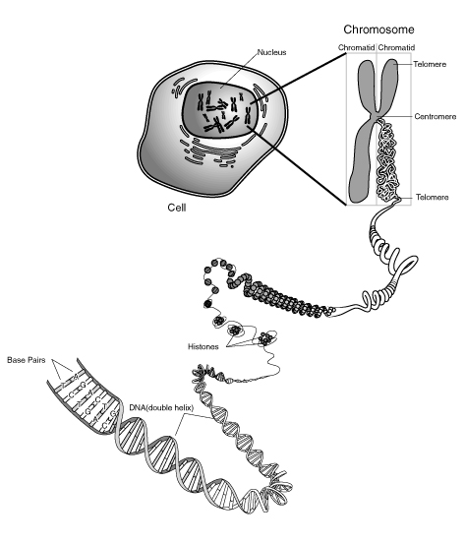
DNA is Tightly Packaged into Chromosomes Which Reside in the Nucleus

Slide 4
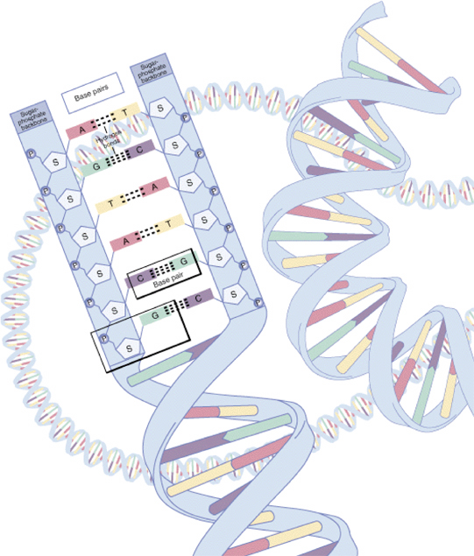
Model of DNA
DNA is Comprised of Four Base Pairs

Slide 5
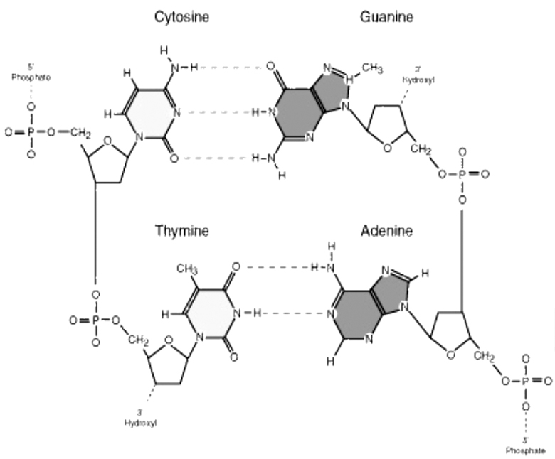
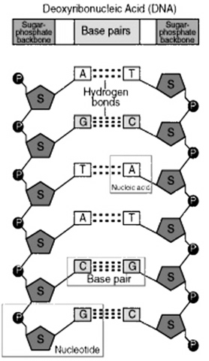
Deoxyribonucleic Acid (DNA)

Slide 6
DNA Schematic
O
Phosphate
O
P
O
Base
O
O
CH₂
Sugar
O
Phosphate
O
P
O
Base
O
CH₂
O
Sugar
OH

Slide 7
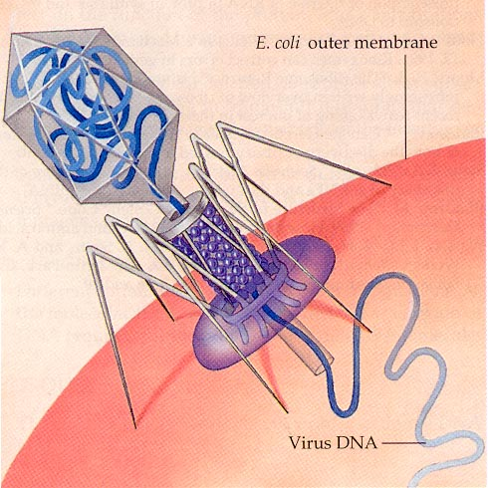
DNA Restriction Enzymes
• Evolved by bacteria to protect against viral DNA infection
• Endonucleases = cleave within DNA strands
• Over 3,000 known enzymes

Slide 8

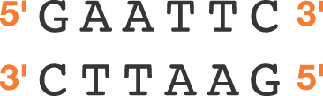

5 vs 3 Prime Overhang
Enzyme cuts
• Generates 5 prime overhang

Slide 9

Enzyme Site Recognition
Restriction site
Palindrome
• Each enzyme digests (cuts) DNA at a specific sequence = restriction site
• Enzymes recognize 4- or 6- base pair, palindromic sequences
(eg GAATTC)
Fragment 1
Fragment 2

Slide 10
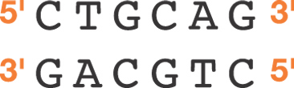
Common Restriction Enzymes
EcoRI
– Eschericha coli
– 5 prime overhang
Pstl
– Providencia stuartii
– 3 prime overhang

Slide 11
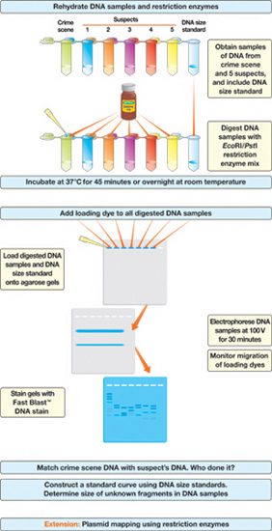
DNA Fingerprinting
Procedure
Overview

Slide 12
Animations & Videos
Videos:
How restriction enzymes work to create DNA profiles:
http://highered.mcgraw-hill.com/sites/0072437316/student_view0/chapter16/animations.html#
How micropipets work:
http://www.youtube.com/watch?v=kCm2t1SO2IU
How electrophoresis works
http://learn.genetics.utah.edu/content/labs/gel/
PCR: modern method of DNA profiling http://highered.mcgraw-hill.com/sites/0072437316/student_view0/chapter16/animations.html#

Slide 13
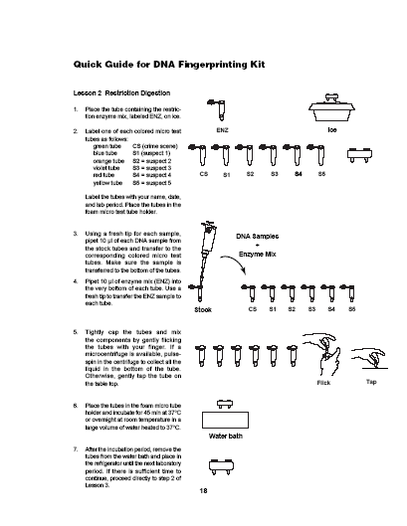
Laboratory
Quick Guide

Slide 14
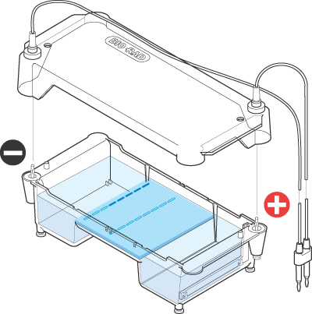

Agarose
Electrophoresis
Loading
• Electrical current carries negatively-charged DNA through gel towards positive (red) electrode
Buffer
Dyes
Agarose gel
Power Supply

Slide 15
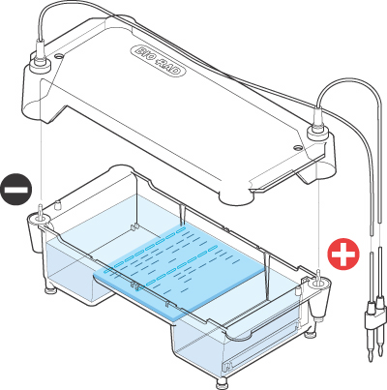
Agarose
Electrophoresis
Running
• Agarose gel sieves DNA fragments according to size
– Small fragments move farther than large fragments
Gel running
Power Supply

Slide 16
Analysis of Stained Gel
Determine
restriction fragment
sizes
• Create standard curve using DNA marker
• Measure distance traveled by restriction fragments
• Determine size of DNA fragments
Identify the related
samples

Slide 17
DNA Digestion
Temperature
Why incubate at 37°C?
• Body temperature is optimal for these and most other enzymes
What happens if the temperature is too hot or cool?
• Too hot = enzyme may be denatured (killed)
• Too cool = enzyme activity lowered, requiring
longer digestion time

Slide 18
Restriction Fragment Length Polymorphism
RFLP
PstI
EcoRI
CTGCAG
GAGCTC
GAATTC
GTTAAC
Allele 1
1
2
3
CGGCAG
GCGCTC
GAATTC
GTTAAC
Allele 2
Fragment 1+2
3
Different
Base Pairs
No restriction site
M
A-1
A-2
Electrophoresis of restriction fragments
M: Marker
A-1: Allele 1 Fragments
A-2: Allele 2 Fragments
+

Slide 19
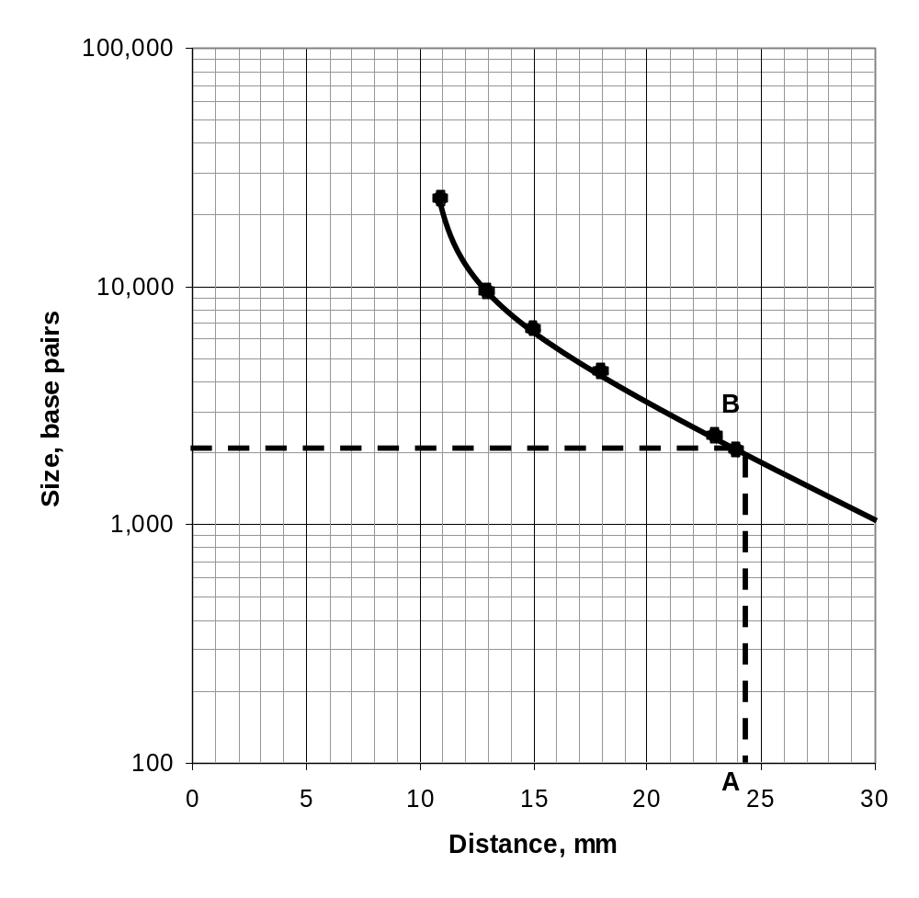
Molecular Weight Determination
Fingerprinting Standard Curve: Semi-log
Size (bp) Distance (mm)
23,000 11.0
9,400 13.0
6,500 15.0
4,400 18.0
2,300 23.0
2,000 24.0

