Slide 1
Crime Scene DNA Profiling Lab

Slide 2
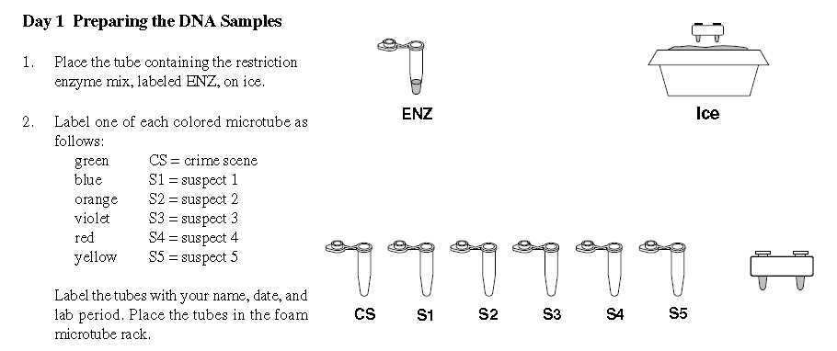
Label microtubes with sharpie on the top of the cap. (period-table, example P3/T4)
Pay attention to the colors.

Slide 3
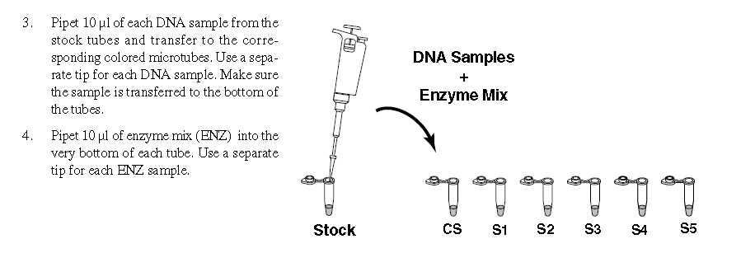
Set micropipet to 10 microliters (uL), the window should read 010.
Put a clean tip on the end
Remember to just push down to first stop before putting into tube with enzymes.
Put on ice, and come up and get DNA from teacher each time for each sample. Make sure cap is tightly clicked down.

Slide 4
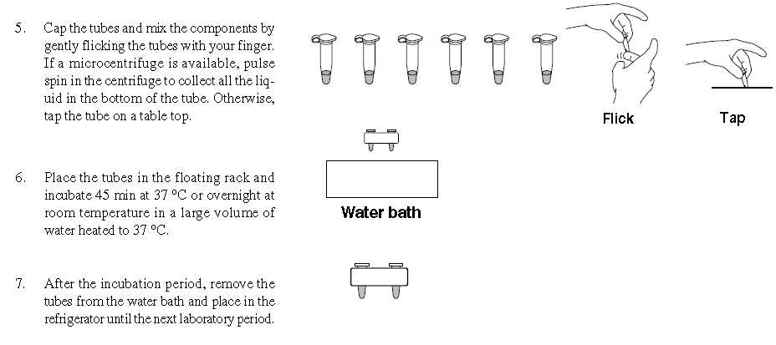
Mix gently, spin down in centrifuge (pulse, up to speed and let slow down) if splashed all over sides. Put in floating rack, in water bath between lab table 2 & 3. Clean up for the next class.

Slide 5
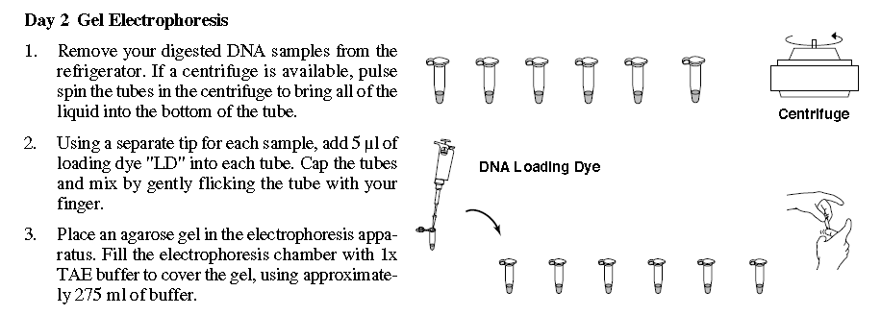
You are going to add 5 microliters (uL) of loading dye* to each of your 6 tubes. You must use a DIFFERENT new tip for each sample. *(loading dye makes the sample visible and much denser to sink into the gel well)

Slide 6
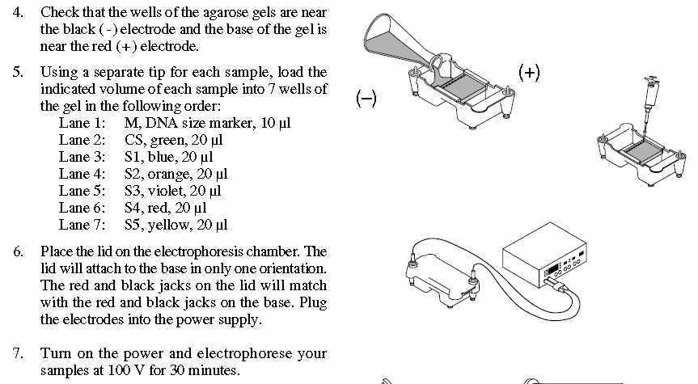
load from left to right
Lane 1 is the control, no need to add loading dye (dye already in tube).
200 Volts for 20 minutes.

Slide 7
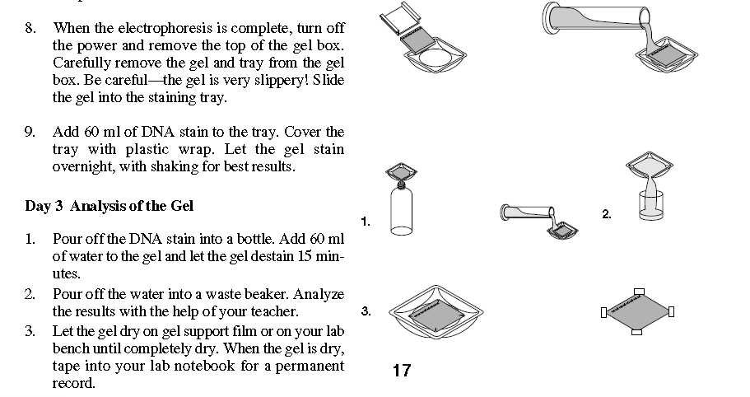
After 20 minutes...
dye works overnight,
see bands tomorrow

