Slide 1
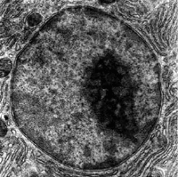

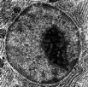
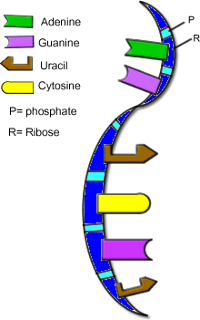
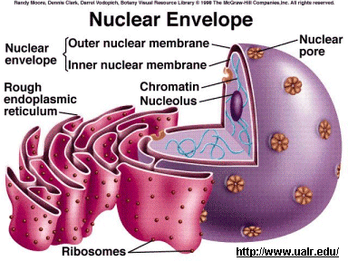
facebook
Wall
Photos
About Me
Sources
John F. Kennedy
Logout
NUCLEUS is “The Boss of the Cell”
Wall
Info
Photos
Boxes
Write something…
o
Share
View photos of NUCLEUS
FROM DNA I have condensed my chromatin form into chromosomes for easy movement! Prophase here we go.
September 15, 2011
Send the NUCLEUS a message
Poke message
NUCLEUS is preparing for mitosis. Good bye to the nucleolus and nuclear envelope. Hello condensed chromosomes !
September 15, 2011
Information
NUCLEUS to NUCLEAR PORES Thanks for controlling what comes in and allowing the RNA messages to leave for the cytoplasm
Networks:
EUKARYOTES.
HOME MOVIIES:
Inner life of a cell
Hometown:
Cytoplasm
September 15, 2011
FROM RNA No problem. Taking your message to the ribosomes is my job. .
September 15, 2011
Friends
NUCLEUS to TO mRNA Thanks for transcribing my info.
September 15, 2011
NUCLEUS. to NUCLEOLUS
I can see your dark spot. Keep making that ribosomal RNA
September 15, 2011
Ribosomes
Nuclear Pores
NUCLEUS Don’t look for me in prokaryotes. I’m only in animals , plants, fungi, and protists.
Bacteria have a free floating circular chromosome in their cytoplasm instead.
September 15, 2011
NUCLEUS Being in charge of everything is pretty cool, but it sure keeps me busy!
September 15, 2011
Rough ER
DNA
RNA

Slide 2
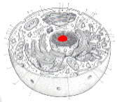
facebook
Wall
Photos
About Me
Sources
John F. Kennedy
Logout
NUCLEUS is “The Boss of the Cell”
Wall
Info
Photos
Boxes
Basic Information
Networks: EUKARYOTES.
Sex: Asexual: mitosis Sexual: meiosis
Made of: Nucelear membrane: phospholipids & proteins
Genetic material:: DNA & proteins
Hometown: Cytoplasm
Relationship Status:
View photos of NUCLEUS
Send NUCLEUS a message
Poke message
Personal Information
Information
Activities: “Boss” of cell; making RNA; maintaining homeostasis ; cell division
Interests: Mitosis, meiosis, gene regulation
Favorite Music: Regulatin' genes Cell rap Organelle song Cell Rap 2
Favorite Movies: Inner life of a cell DNA wrapping
Favorite TV Shows: Big Bang Theory, Who’s the Boss?
Favorite Books: Genome by Matt Ridley
Networks:
EUKARYOTES.
HOME MOVIIES:
Inner life of a cell
Hometown:
Cytoplasm
Phone Number 1-800 –CELL
Photos
2 Albums
Nucleus profile image http://upload.wikimedia.org/wikipedia/commons/5/57/Micrograph_of_a_cell_nucleus.png
mRNA image:
http://uncyclopedia.wikia.com/wiki/File:MRNA.gif
:
My Friends
Updated last Tuesday
My Family
Updated two months ago

Slide 3
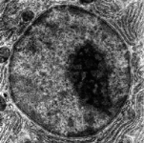
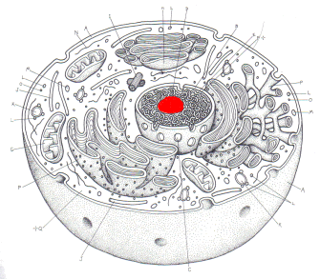
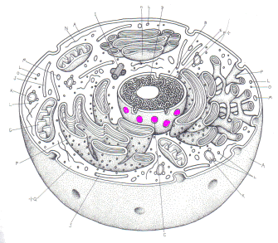
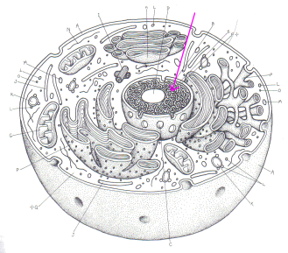
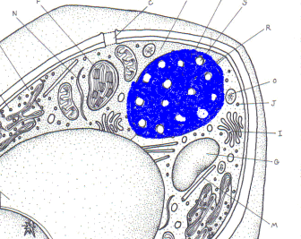
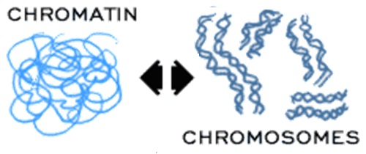
facebook
Wall
Photos
About Me
Sources
John F. Kennedy
Logout
NUCELUS is “The Boss of the Cell”
Wall
Info
Photos
Boxes
FAMILY 7 Photos
Nucleolus
Nuclear pores
DNA
(Chromatin)
Nuclear
Envelope
Photo Albums

Slide 4
WHAT YOU SHOULD KNOW ABOUT ME
MADE OF:
Surrounded by DOUBLE membrane called Nuclear Envelope
Nuclear pores control what enters/leaves
Contains genetic material (DNA)
Nucleolus- makes RNA for ribosomes
DNA condensed tightly into CHROMOSOMES during cell division
DNA is loosely packed into CHROMATIN when cell is “doing its job”
FUNCTION:
Control center of cell
MISCELLANEOUS:
Only in eukaryotes
Prokaryotic DNA is circular & free floating in cytoplasm
RESOURCES USED:
Nucleus profile image http://upload.wikimedia.org/wikipedia/commons/5/57/Micrograph_of_a_cell_nucleus.png
mRNA image:
http://uncyclopedia.wikia.com/wiki/File:MRNA.gif
Nucleus image
http://www.etap.org/demo/grade7_science/instruction2tutor.html

