Slide 1
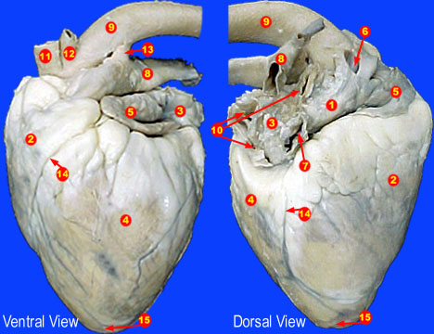

Slide 2
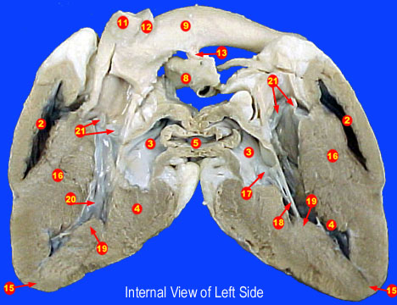

Slide 3
Answers
Base
Right Ventricle
Left Atrium
Left Ventricle
Right Atrium
Precava (Superior Vena Cava)
Postcava (Inferior Vena Cava)
Pulmonary Trunk
Aorta (Aortic Arch)
10. Pulmonary Veins
11. Brachiocephalic Trunk
12. Left Subclavian Artery
13. Ligamentum Arterosus
14. Coronary Vessels
15. Apex
16. Interventricular Septum
17. Bicuspid/Mitrial Valve
18. Chordae Tendinae
19. Papillary Muscle
20. Trabeculae Carnae
21. Aortic Semilunar Valve

