Slide 1
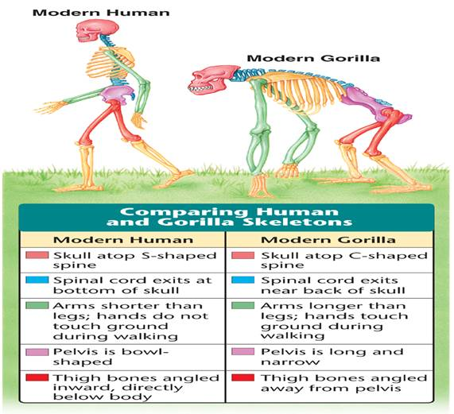
32-3 Primates and Human Origins

Slide 2
What Is a Primate?
  In general, primates have binocular vision, a well-developed cerebrum, relatively long fingers and toes, and arms that can rotate around their shoulder joints.

Slide 3
Evolution of Primates
Evolution of Primates
  The two main groups of primates are prosimians and anthropoids.

Slide 4
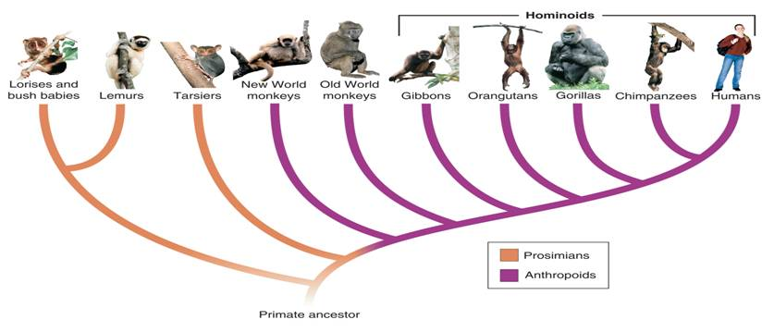

Evolution of Primates
Hominoids
New World monkeys
Lorises and bush babies
Old World monkeys
Lemurs
Gibbons
Gorillas
Tarsiers
Orangutans
Chimpanzees
Humans
Prosimians
Primate ancestor
Anthropoids
Notes:
The diagram illustrates the phylogeny of modern primates. The two main groups of primates are prosimians and anthropoids.

Slide 5
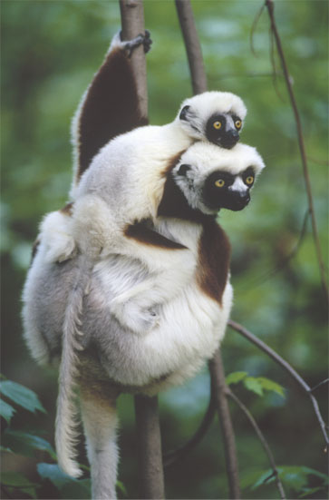
Evolution of Primates
  Prosimians
    Most prosimians alive today are small, nocturnal primates with large eyes that are adapted to seeing in the dark.
    Living prosimians include bush babies, lemurs, lorises, and tarsiers.

Slide 6
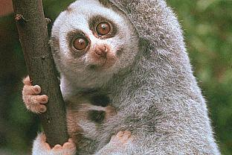
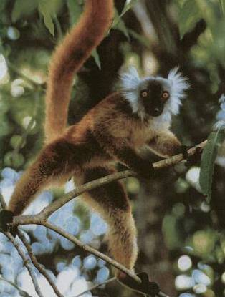
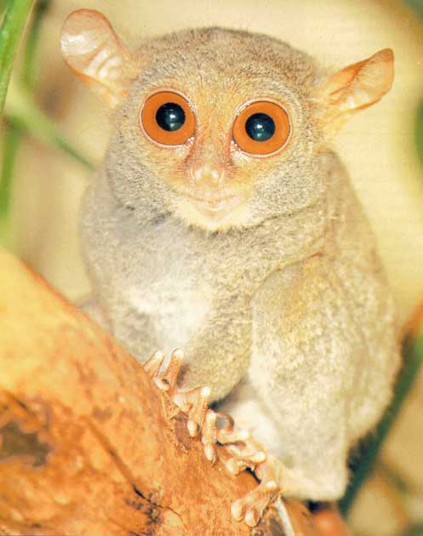
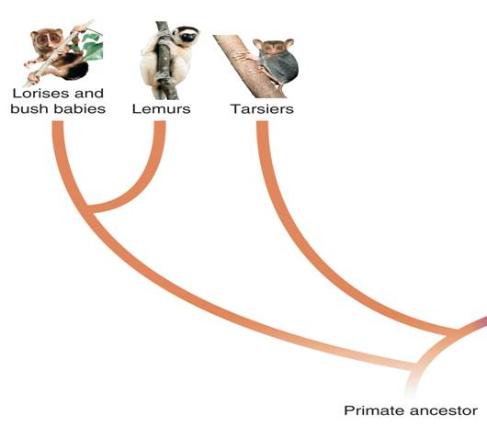
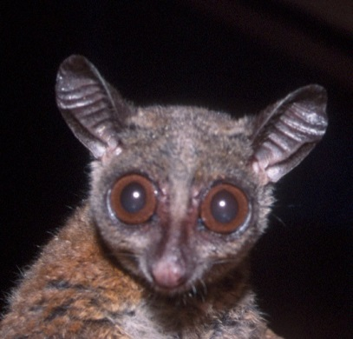
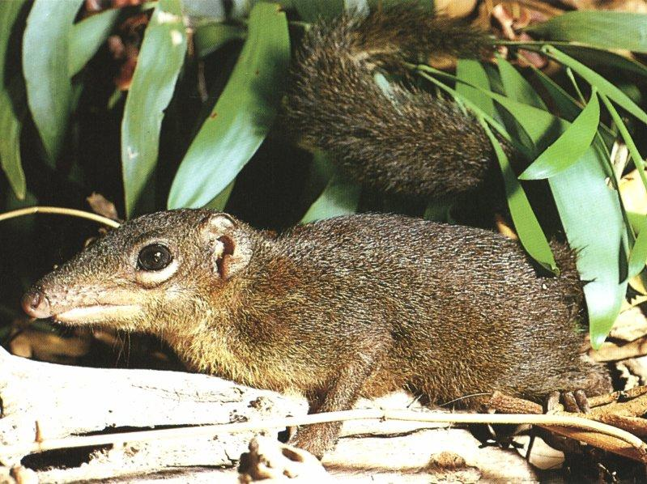
Evolution of Primates
Lorises and bush babies
Lemurs
Tarsiers
Prosimians
Primate ancestor
Tree Shrew

Slide 7
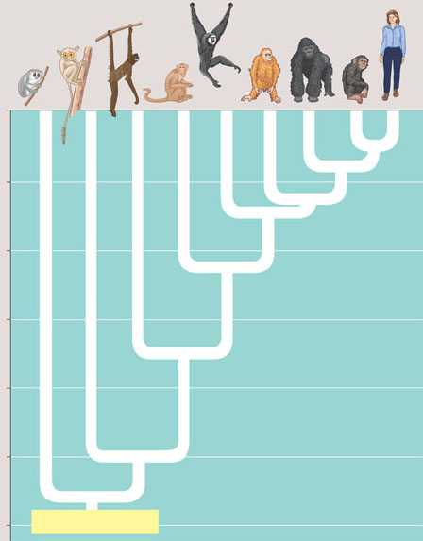
Figure 34.38 A phylogenetic tree of primates
Anthropoids
0
Tarsiers
Gibbons
Orangutans
Gorillas
Chim-
panzees
Humans
Old World monkeys
New World monkeys
10
Lemurs, lorises, and pottos
20
Millions of years ago
30
40
50
60
Ancestral primate

Slide 8
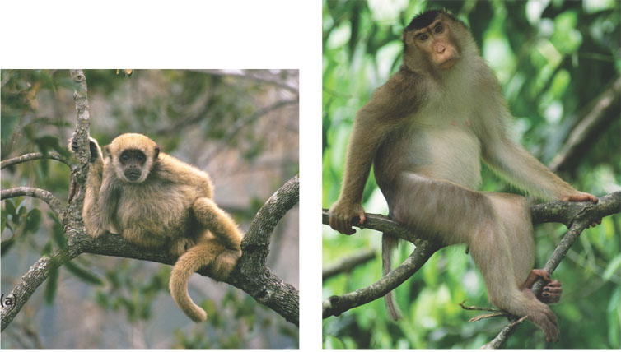
Figure 34.39 New World monkeys and Old
World monkeys
(a) New World monkeys, such as spider
monkeys (shown here), squirrel monkeys, and
capuchins, have a prehensile tail and nostrils
that open to the sides.
(b) Old World monkeys lack a prehensile tail, and their nostrils
open downward. This group includes macaques (shown here),
mandrills, baboons, and rhesus monkeys.

Slide 9
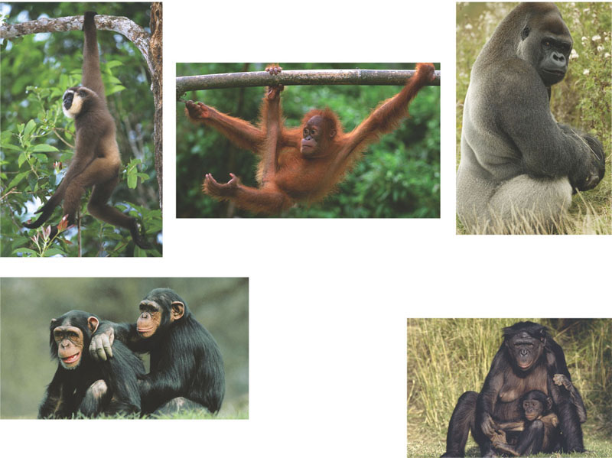
Figure 34.40 Hominoids (apes)
(a) Gibbons, such as this Muller's gibbon, are
found only in southeastern Asia. Their very
long arms and fingers are adaptations for
brachiation.
(b) Orangutans are shy, solitary apes that live in the rain
forests of Sumatra and Borneo. They spend most of
their time in trees; note the foot adapted for grasping
and the opposable thumb.
(c) Gorillas are the largest apes: some
males are almost 2 m tall and weigh
about 200 kg. Found only in Africa, these
herbivores usually live in groups of up to
about 20 individuals.
(e) Bonobos are closely
related to chimpanzees
but are smaller. They
survive today only in the
African nation of Congo.
(d) Chimpanzees live in tropical Africa. They
feed and sleep in trees but also spend a
great deal of time on the ground. Chimpanzees
are intelligent, communicative, and social.

Slide 10
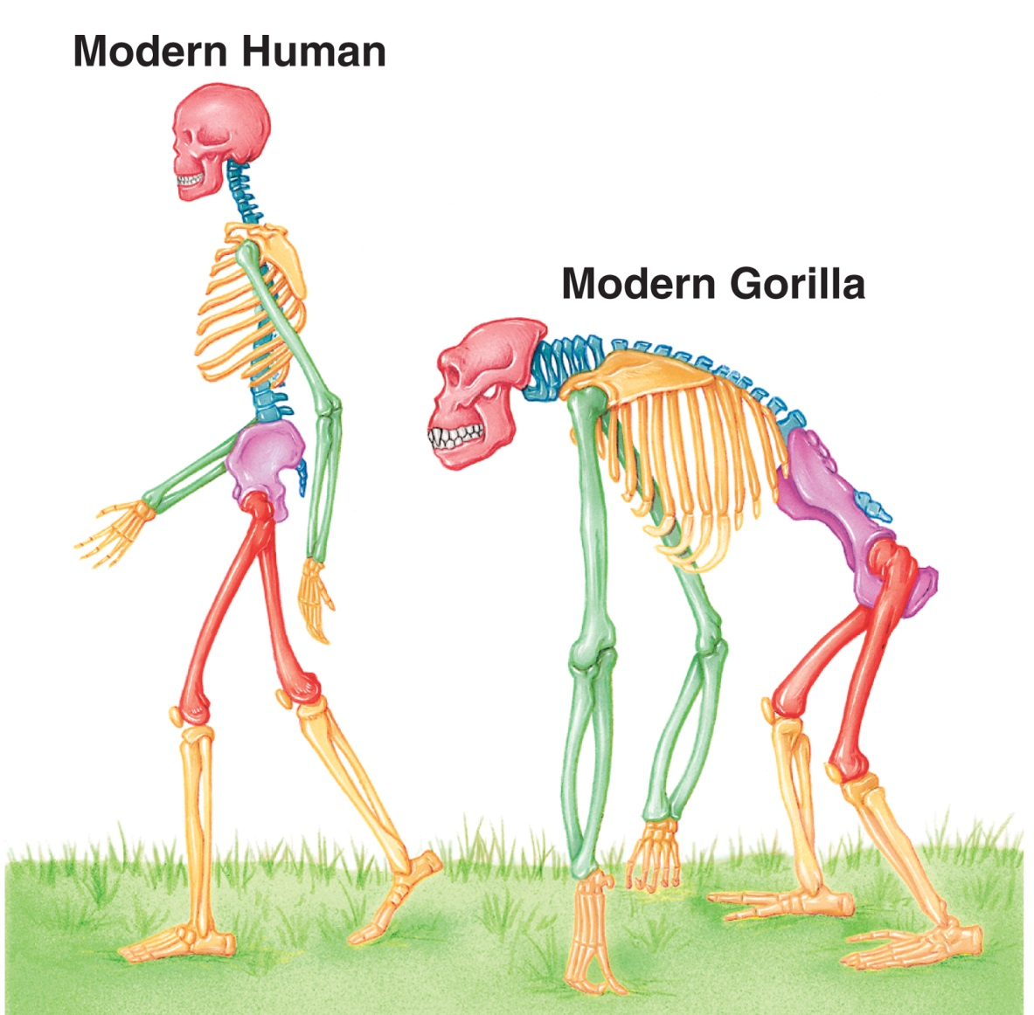
Hominid Evolution
Modern human

Slide 11

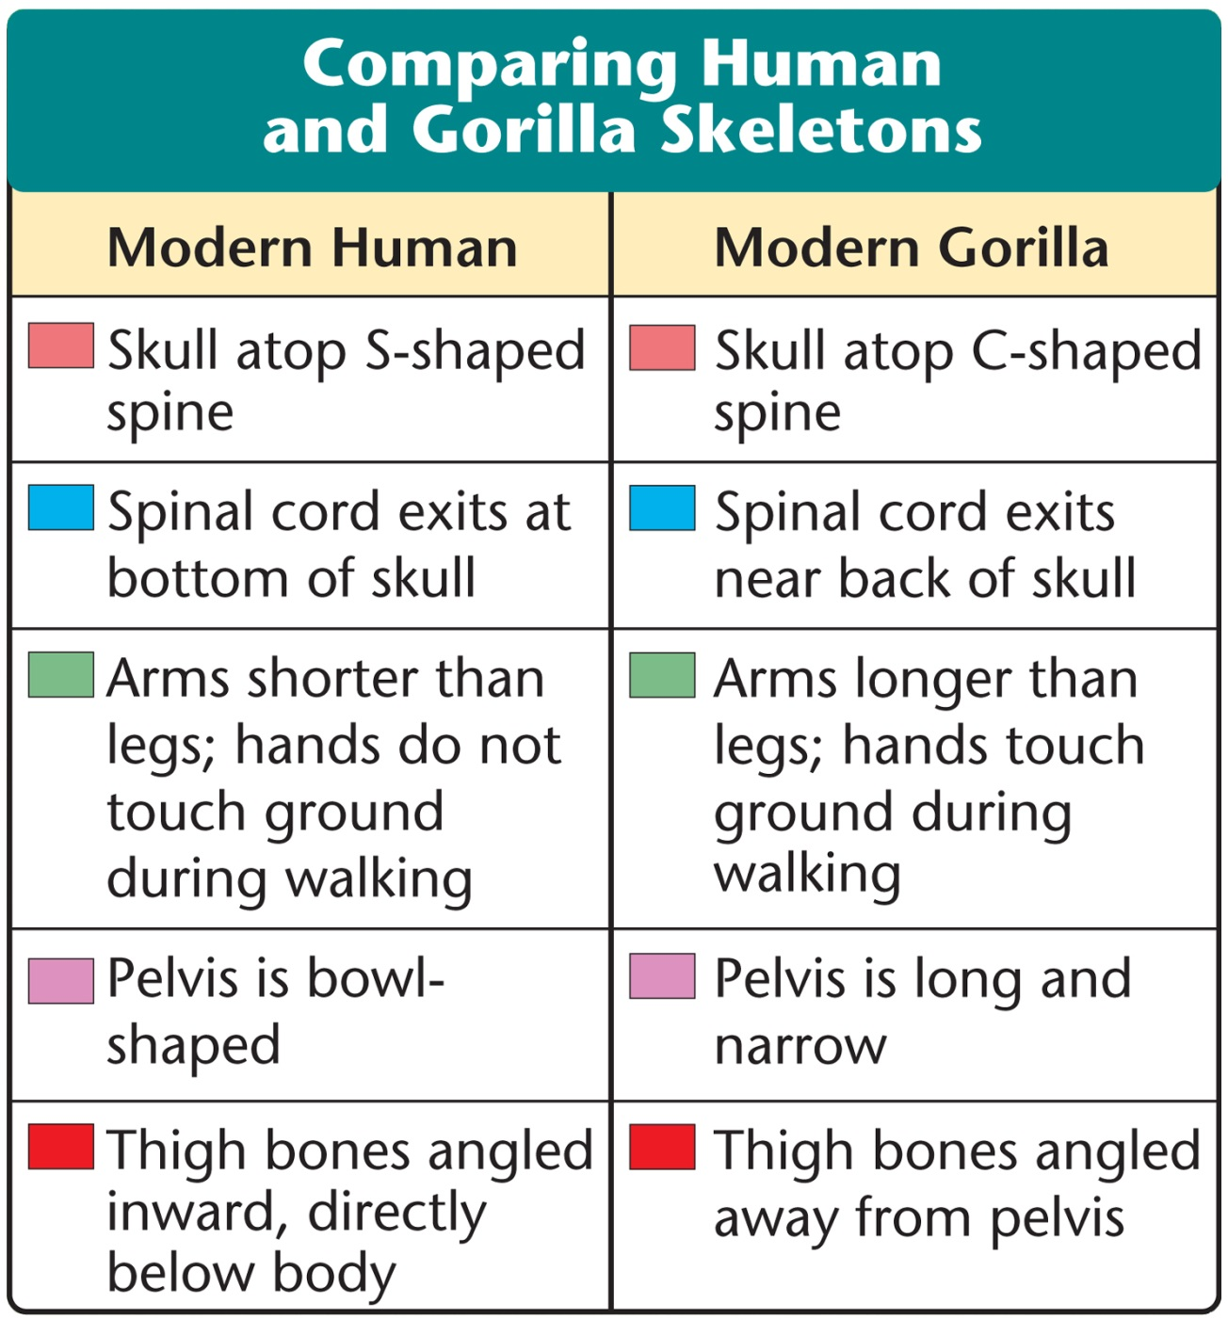
Hominid Evolution

Slide 12
Hominid Evolution
  Early Hominids
    At present, the hominid fossil record includes these genera:
      Ardipithecus
      Australopithecus
      Paranthropus
      Kenyanthropus
      Homo

Slide 13
Hominid Evolution
  Recent Hominid Discoveries
    In 2001, a team had discovered a skull in Kenya.
      Its ear resembled a chimpanzee’s.
      Its brain was small.
      Its facial features resembled those of Homo fossils.
      It was put in a new genus, Kenyanthropus, which lived at the same time as A. afarensis.

Slide 14
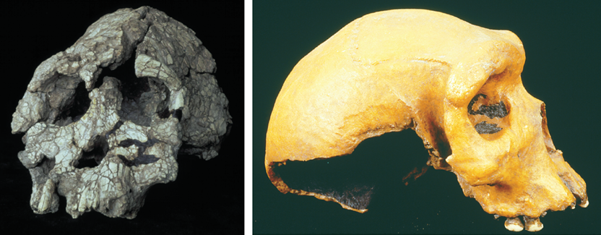
Hominid Evolution
Kenyanthropus platyops
Homo erectus
Notes:
Photo Credit: left: Fred Spoor, copyright National Museum of Kenya; right: Animals Animals/©E.R. Degginger

Slide 15
Hominid Evolution
  In 2002, paleontologists working in the desert in north-central Africa discovered another skull.
    Called Sahelanthropus, it is nearly 7 million years old.
    If it is a hominid, it would be a million years older than any hominid previously known.
    It had a brain like a modern chimp and a flat face like a human.

Slide 16
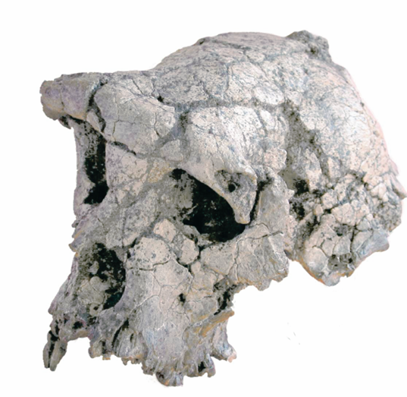
Hominid Evolution
Sahelanthropus tchadensis
Notes:
Photo Credit: copyright M.P.F.T.

Slide 17
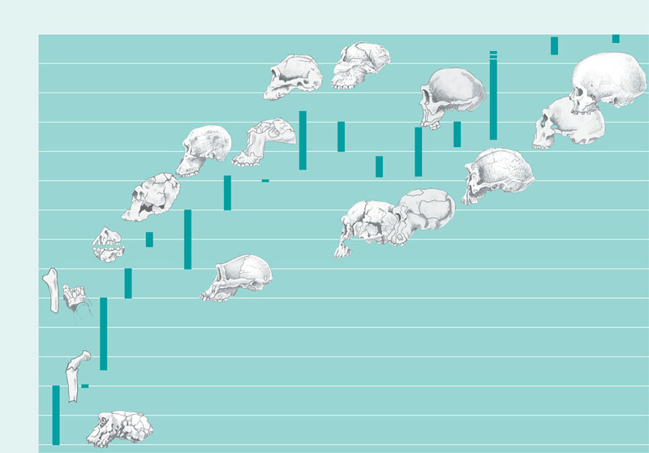
Figure 34.41 A timeline for some selected hominid species
Paranthropus
robustus
Homo
neanderthalensis
Homo
sapiens
0
Paranthropus
boisei
Homo
ergaster
?
0.5
1.0
Australopithecus
africanus
1.5
2.0
Kenyanthropus
platyops
2.5
Australopithecus
garhi
3.0
Homo
erectus
Millions of years ago
Australopithecus
anamensis
3.5
Homo
rudolfensis
Homo
habilis
4.0
4.5
Ardipithecus
ramidus
Australopithecus
afarensis
5.0
5.5
6.0
Orrorin tugenensis
6.5
Sahelanthropus
tchadensis
7.0

Slide 18
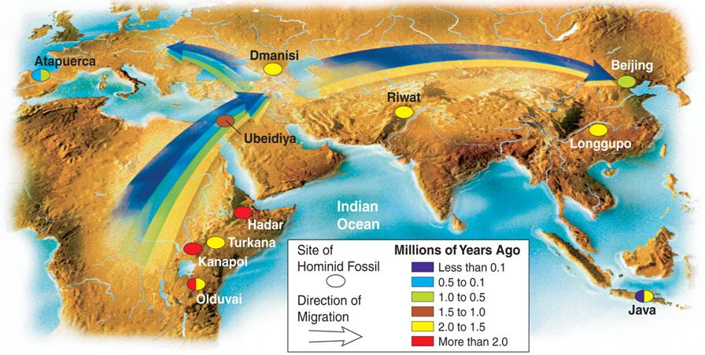
The Road to Modern Humans
Notes:
Data show that relatives and ancestors of modern humans left Africa several different times. But when did early hominids leave Africa, and how far did they travel? By comparing the mitochondrial DNA of human populations around the world and by continuing to study the fossil record, scientists hope to improve our understanding of the complex history of Homo sapiens.

Slide 19
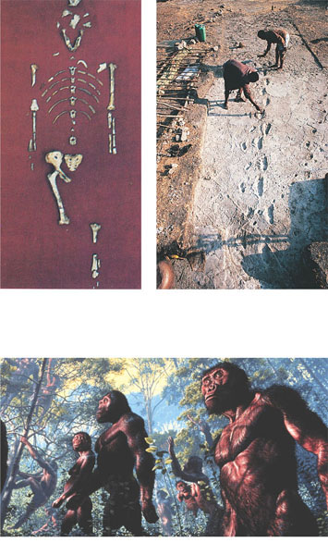
Figure 34.42 Upright posture predates an enlarged brain in human evolution
(b) The Laetoli footprints, more than
3.5 million years old, confirm that
upright posture evolved quite early
in hominid history.
(a) Lucy, a 3.24-million-year-old skeleton,
represents the hominid species
Australopithecus afarensis.
(c) An artist’s reconstruction of what
A. afarensis may have looked like.

Slide 20
Ledi-Geraru a new Homo species 2.8 mya
Fifty years after the recognition of the species Homo habilis as the earliest known representative of our genus (1), the origin of Homo remains clouded. This uncertainty stems in large part from a limited fossil record between 2.0 and 3.0 million years ago (Ma), especially in eastern Africa. Some taxa from this time period, such as Australopithecus africanus (~2.8 to 2.3 Ma) and the less well known A. garhi (~2.5 Ma) and A. aethiopicus (~2.7 to 2.3 Ma), appear too specialized cranially and/or dentally to represent the probable proximate ancestral conditions for Homo species known in Africa by ~2.0 Ma (H. habilis and H. rudolfensis). This leaves a thin scatter of isolated, variably informative specimens dated to 2.4 to 2.3 Ma as the only credible fossil evidence bearing on the earliest known populations of the genus Homo (2, 3).

Slide 21
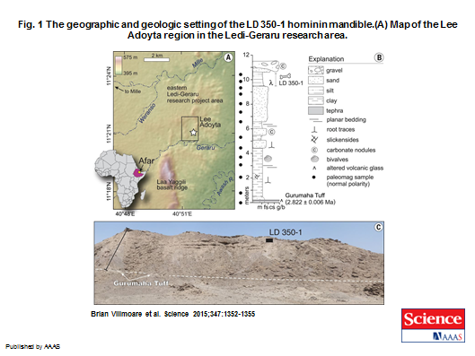

Slide 22
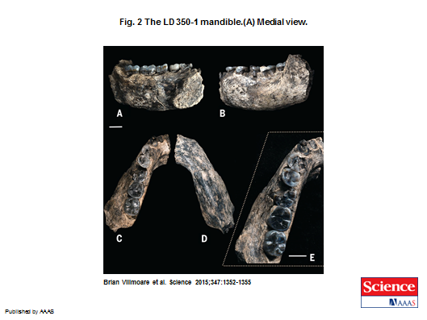
Ledi-Geraru mandible

Slide 23
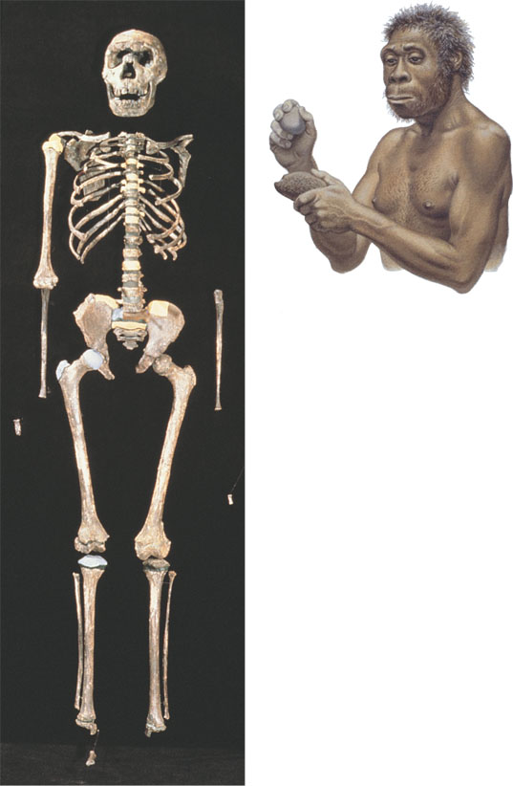
Figure 34.43 Fossil and artist’s reconstruction of Homo ergaster

Slide 24
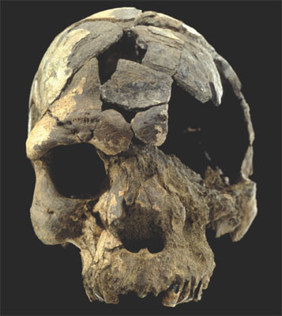
Figure 34.44 Oldest known fossil of Homo sapiens

Slide 25
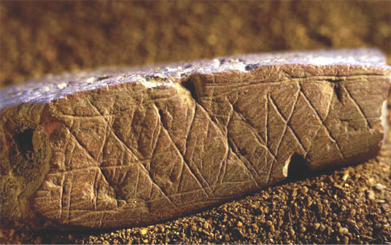
Figure 34.45 Art, a human hallmark

