Slide 1
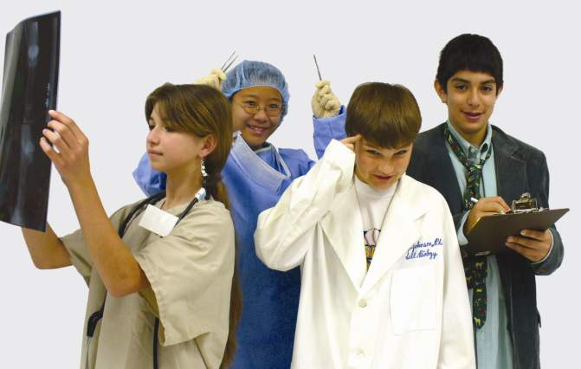




Partnership for Environmental Education and Rural Health (PEER)
Supported by the National Institutes of Health ORIP

Slide 2
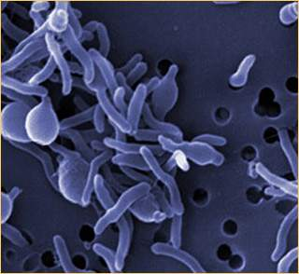
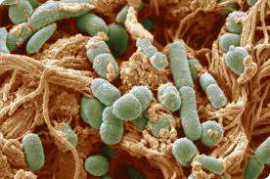

Don’t let the bugs bite!
Our battle against the microbes that want to eat us.
Dr. Ian Tizard Director of Schubot Exotic Bird Health Center Professor of Immunology and Pathobiology

Slide 3
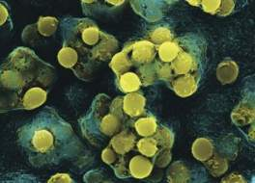
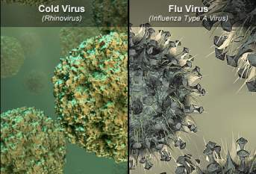
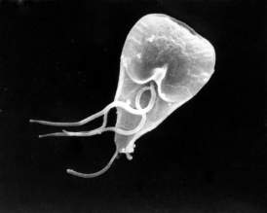
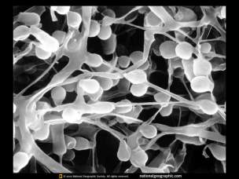
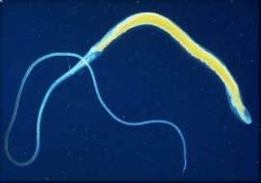
We are under attack!
The microbes want our bodies!
What microbes?
BACTERIA
VIRUSES
FUNGI
PARASITIC WORMS
PROTOZOA
Streptococcus pyogenes bacteria
Giardia protozoa
Whipworm
Athlete’s foot fungus
Notes:
Virus picture: http://www.webmd.com/cold-and-flu/ss/slideshow-cold-or-flu
Bacteria picture from: http://strep-symptoms.com/strep-throat-streptococcus-pyogenes-bacterium/
Athlete’s foot fungus picture from: http://photography.nationalgeographic.com/photography/enlarge/athletes-foot-fungus_pod_image.html
Giardia picture from: http://leeuwenhoek.wordpress.com/2010/02/14/a-valentine-from-leeuwenhoek/

Slide 4
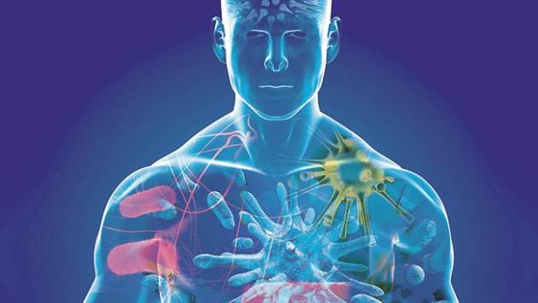
Why do they want to harm us?
They don’t!
It’s just that we are good to eat!
Our bodies provide food and shelter for many microbes-
- if they get the chance!!
Notes:
Picture from: http://www.adelaidenow.com.au/ipad/something-bugging-you/story-fn3o6wog-1226045725907

Slide 5
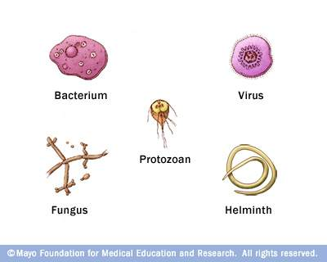
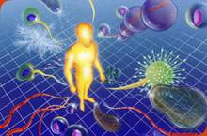
If we are to stay healthy then….
We must keep the invaders out!
We have a constant battle that begins the day we are born and ends when we die.
They are constantly trying to invade – we are fighting to keep them out!
Notes:
Picture from: http://www.microbiologyonline.org.uk/about-microbiology/microbes-and-the-human-body
Picture from: http://www.riversideonline.com/health_reference/Infectious-Disease/ID00002.cfm

Slide 6
Think Army!
We have to defend our base (our body).
We need to set up barriers to keep the enemy at bay. - PHYSICAL BARRIERS.
We need to attack and destroy any microbes that get in. - INNATE IMMUNITY
We need a fully automatic mechanism to keep all invaders out permanently. - ADAPTIVE IMMUNITY

Slide 7
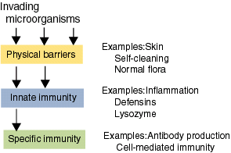

Slide 8
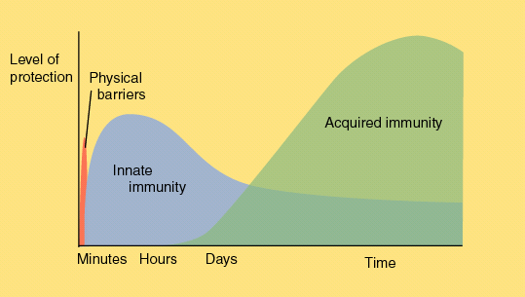

Slide 9
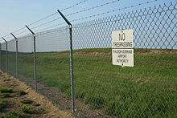

PHYSICAL BARRIERS
Skin,
Intestine, and Airways

Slide 10
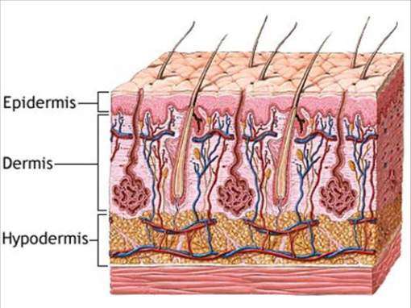
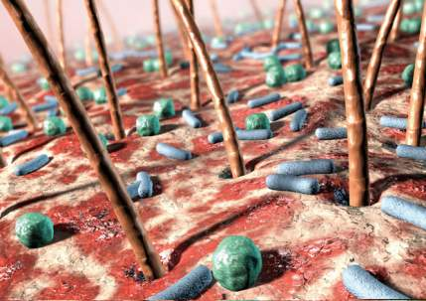
The skin
Tough
Self healing
Full of antimicrobial proteins
Has its own resident bacteria that help to keep the invaders out
Notes:
Bottom picture from: http://www.telegraph.co.uk/health/healthpicturegalleries/8523602/Meet-some-of-the-bacteria-that-make-up-90-per-cent-of-the-living-cells-in-your-body.html

Slide 11
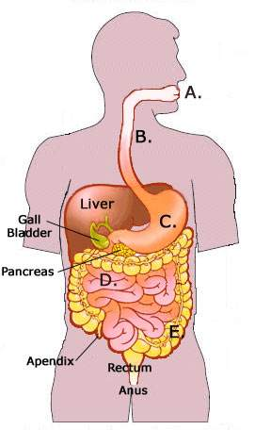
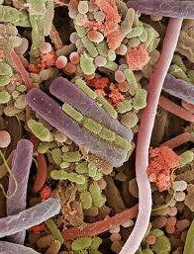
The intestine
Full of normal bacteria
Vomiting and diarrhea
Antimicrobial chemicals and
compounds

Slide 12
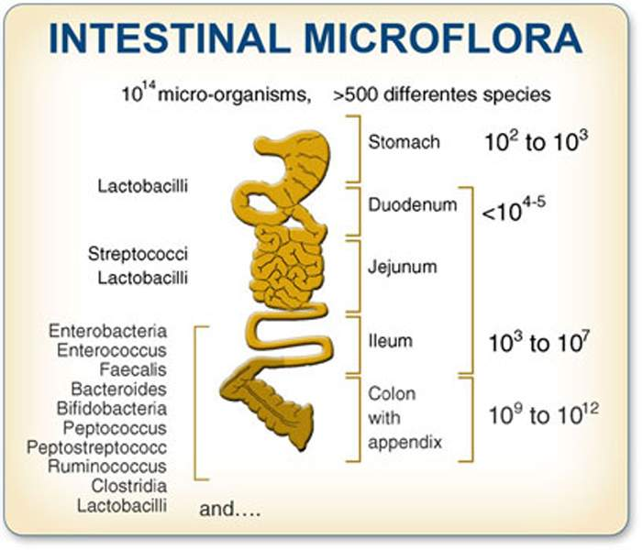

Slide 13
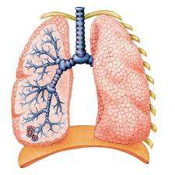
The respiratory tract
Coughing
Sneezing
Mucous secretion
Antibacterial chemicals

Slide 14
INNATE IMMUNITY
Hardwired rapid defenses centering on inflammation

Slide 15
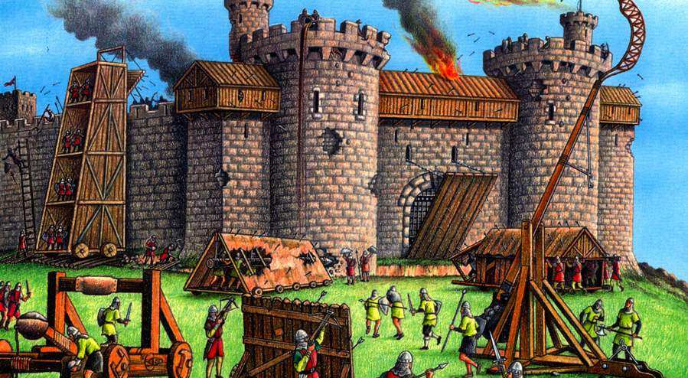

Slide 16
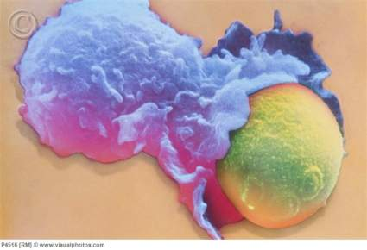
INFLAMMATION
Analogous to having a physical fight with invaders.
The body’s white cells try to eat and kill invading microbes.
Lots of collateral damage!
Someone has to tidy up after.
White blood cell engulfing yeast cell
Notes:
Photo from: http://www.visualphotos.com/

Slide 18
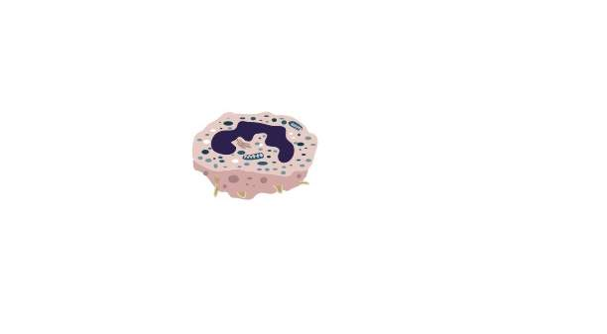
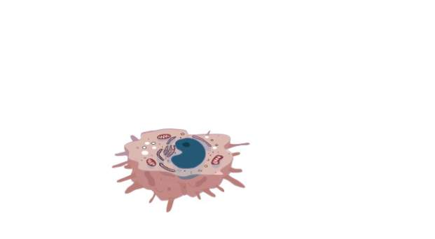
White cells (Leukocytes)
Normally circulate in the blood.
Several different types
Neutrophils, the bacterial killers
Macrophages, bacterial killers and cleaner uppers
Lymphocytes, viral killers
Are attracted to two things.
Damaged tissues
Bacterial products

Slide 19
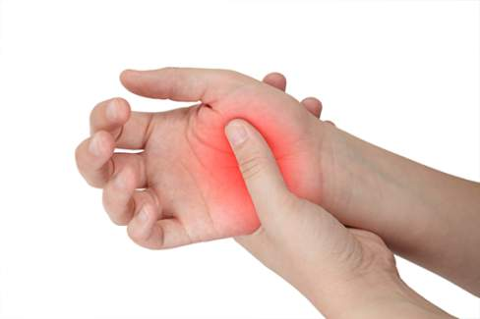
More inflammation
Increased blood flow brings cells and protective chemicals to the tissues under attack.
Swelling is secondary to increased blood flow
Pain die to protective, antimicrobial chemicals
Damaged tissues also produce protective and inflammatory chemicals

Slide 20
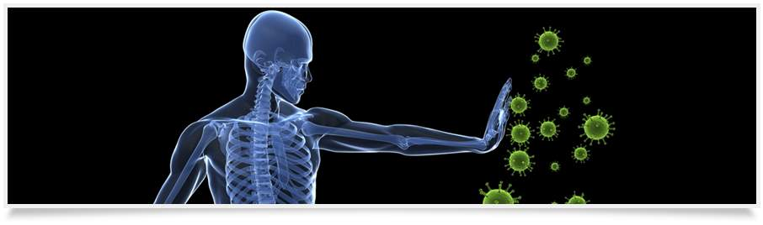
If successful!
The invaders are killed.
The dead and dying tissues are removed
Everything returns to normal.

Slide 21
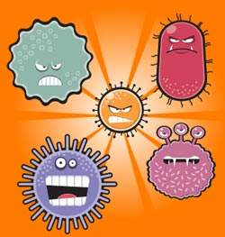
BUT
Inflammation is uncomfortable
Inflammation is damaging
Inflammation is not always effective
The microbes fight back!
They can kill leukocytes
They can hide in dead tissues
They can hide inside cells

Slide 22
So – innate immunity cannot be the long-term answer.
What we need is a:
Fully Automatic
Non Damaging
Painless
Highly Effective
Smart
System that improves with experience.
We call this the ADAPTIVE IMMUNE SYSTEM

Slide 23
ANTIGEN
A foreign molecule that triggers an immune response

Slide 24
It must work against
Bacteria that live outside cells
Viruses that live inside cells
Large fungal organisms
Even larger parasitic worms.
ITS COMPLICATED!
These all consist of multiple antigens.

Slide 25
A REMINDER!
Viruses and bacteria are distinctly different microbes.
Do not confuse the two!

Slide 26
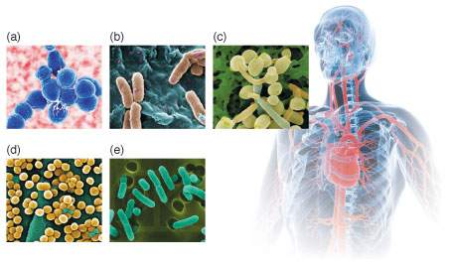
HOW TO ELIMINATE BACTERIA
Kill them with leukocytes
Punch holes in them with complement
Kill any that hide within cells
Neutralize their toxins
This is mainly done using proteins called antibodies
Streptococcus pneumonia,
(b) Pseudomonas aeruginosa,
(c) Candida (a fungi)
(d) Staphylococcus aureus, and (e) Escherichia coli.
Notes:
Picture from: https://str.llnl.gov/JanFeb10/dzenitis.html

Slide 28
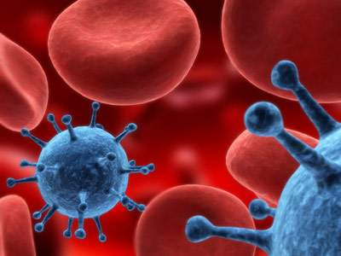
HOW TO ELIMINATE VIRUSES
Destroy any circulating viruses in the bloodstream.
Detect and kill any virus-infected cells.
This is mainly done using cell-mediated immunity.

Slide 30
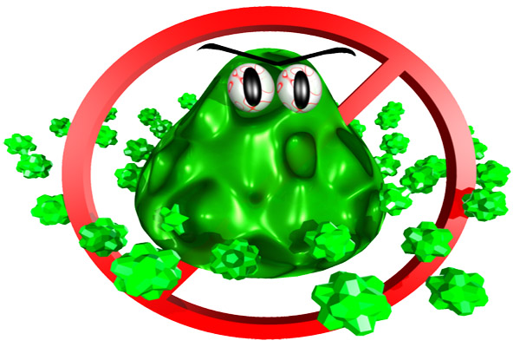
Adaptive immunity
Antibacterial
Antiviral
Antibody mediated
Also called humoral
Antibodies are produced by B cells
T cell mediated
Also called cell-mediated
Kills virus-infected cells
Notes:
Picture from: http://mamagazette.com/wahm-talk/cooking-safety-in-your-kitchen-keeping-bacteria-away/

Slide 31
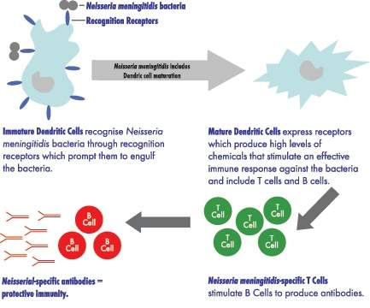
So what happens in a bacterial infection
Bacteria invade the body.
They are recognized by dendritic cells
Dendritic cells tell the B cells
B cells make antibodies
Antibodies kill the bacteria
But the body also remembers this experience!!

Slide 32

What happens in a viral infection
Viruses invade the body and enter their target cells.
Circulating T cells patrol throughout the body and can recognize these virus-infected cells.
T cells kill the infected cells, and thus the virus is eliminated
But the body remembers this experience

Slide 33
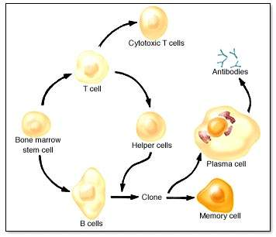
When an immune response occurs memory cells are produced
Memory B and T cells live for a long time (years).
When they encounter the invader for a second time they respond faster and more effectively so the invader is rapidly eliminated.
The more often the invader is encountered the more effective is the immune response.
Notes:
Picture from: http://www.mhhe.com/biosci/esp/2001_gbio/folder_structure/an/m10/s3/anm10s3_1.htm

Slide 35
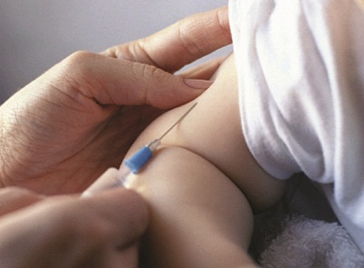
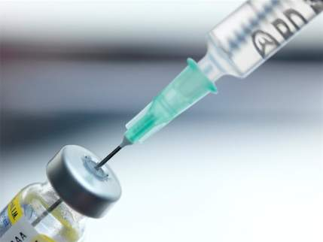
The secret of success!
Adaptive immunity just gets better and better as we defeat invaders. We draw “strength” from each encounter.
We can adapt this for our benefit by the process of vaccination
Notes:
Photo from: http://hbot4u.blogspot.com/2011/10/vaccination-news-site.html

Slide 37
Vaccine
A preparation containing antigens from a bacterium or virus that is used to trigger a protective immune response.

Slide 38
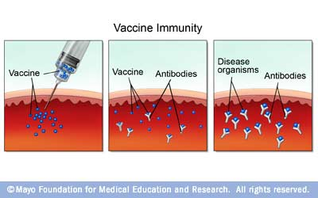
Vaccination
This mimics a natural infection by fooling the immune system into thinking the body is under attack!
The patient develops an immune response.
This can be enhanced by booster shots or bay natural infections.
The key is to keep the process safe and effective
Notes:
Picture: http://www.riversideonline.com/health_reference/Infectious-Disease/ID00023.cfm

Slide 39
Vaccines
Two general types – Live and dead.
Must be SAFE and effective.
The most effective way of preventing infectious diseases.
Critically important in preventing virus diseases especially.
Mainly responsible for the reduced importance of infectious diseases in our society.

Slide 40
Conclusions
Immunity, both innate and adaptive is what keeps you from being killed by microbial invaders.
Sickness reflects a battle within your body between its defenses and microbial invaders.
Vaccines are a highly effective way of enhancing that immunity and ensuring that we win the battle.

Slide 41
Partnership for Environmental Education and Rural Health (PEER)
Supported by the National Institutes of Health ORIP

