Slide 1
Nervous System Functions
1) Sensory input- uses millions of sensory receptors to monitor changes inside & outside body
2) Integration- processes & interprets sensory input & decides what should be done
3) Motor output- causes a response by activating effector organs

Slide 2
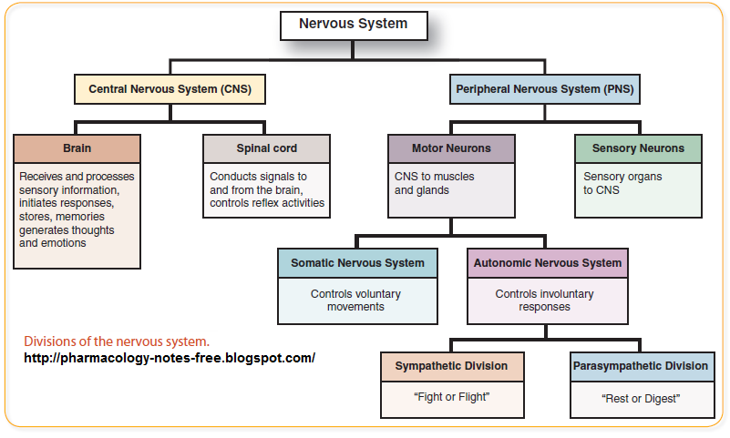

Slide 3
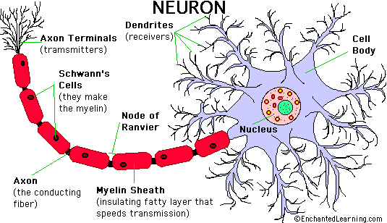
Neurons
Also= nerve cells, excitable- transmit electrical signals
Characteristics-
  Extreme longevity
  Amitotic- lose ability to divide
  High metabolic rate- require continuous supplies of O₂ & glucose

Slide 4
Neurons and The Cell Body
Cell body (also= perikaryon or soma)
  Contains nucleus, cytoplasm, & other organelles
  Receives info from other neurons (stimulus)
    Neurofibrils- intermediate filaments that maintain cell shape & form a network in the cell body
  Most cell bodies are in CNS
  Clusters of nerve bodies in CNS= nuclei, in PNS= ganglia

Slide 5
Processes of Neurons
Most of PNS
Bundles of nerve processes in CNS= tracts, in PNS= nerves
Dendrites- short branched extensions carry impulse from environment or other neurons to the cell body
Axon- long fiber that carries info from cell body
  axon hillock- part of cell body that axon comes off of
  axon collaterals- branches of axon
  terminal branches- telodendria
    end in axon terminal
    synaptic knobs- boutons

Slide 6
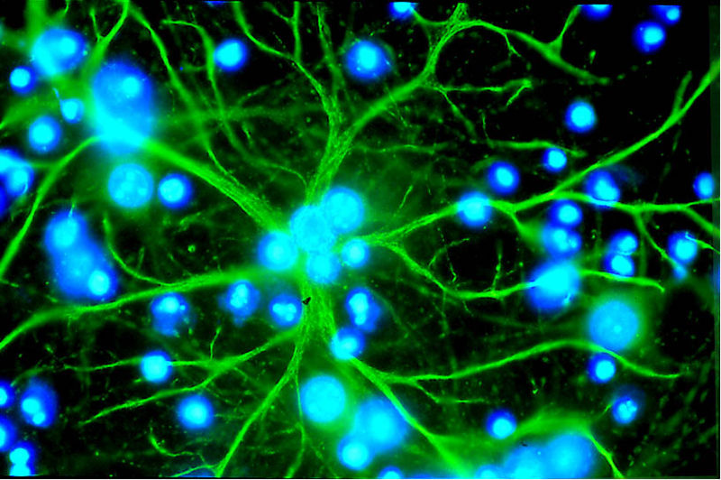
6 types of Neuroglia (Glial Cells)
CNS (4)
  Astrocytes- branch & help make exchanges between capillaries & neurons
  Microglia- long processes that reach out to neurons to monitor health & sense trouble or injury to a neuron
  Ependymal cells- make barrier between cerebrospinal fluid & tissue fluid of cells of CNS
  Oligodendrocytes- line up & wrap around thicker neuron fibers→ myelin sheath
PNS (2)
  Satellite cells- surround neuron cell bodies, function largely unknown
  Schwann cells- surround & form myelin sheath around large nerve fibers

Slide 7
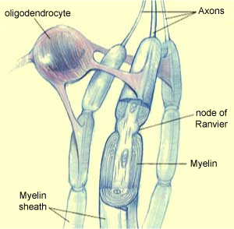
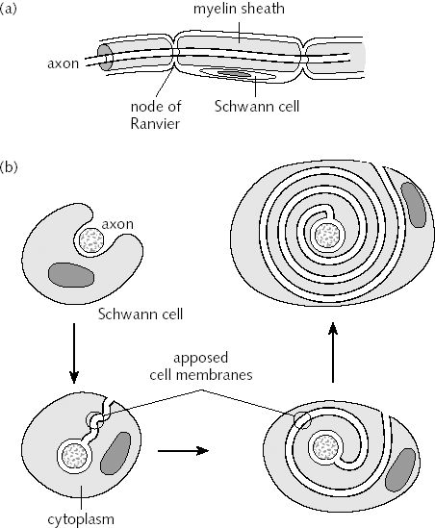
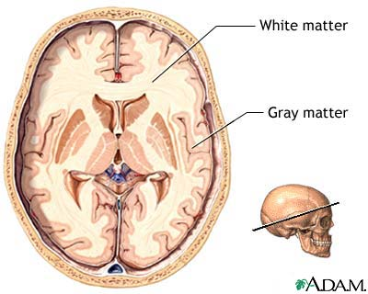
Myelin Sheath and Neurilemma
Myelin Sheath- protects & electrically insulates fibers
  Speeds transmission of nerve impulses
  Whitish, fatty, segmented sheath
  Myelinated (fast & thick) vs unmyelinated (slow & thin) axons
  Dendrites always unmyelinated
  PNS- formed by Schwann Cells
    Neurilemma- exposed membrane with nucleus & most of cytoplasm
  CNS- formed by oligodendrocytes
    Form one segment & have flat processes that can coil around 60 axons at a time
    White matter- dense collections of myelinated fibers
    Gray matter- mostly nerve cell bodies & unmyelinated fibers

Slide 8
Structural Classification of Neurons
# of processes
Multipolar- 3 or more processes, most common in humans
Bipolar- 2 processes- 1 axon, 1 dendrite-rare but are in special sense organs
Unipolar- single process divides into T, most distal branch associated with sensory receptor, other enters CNS

Slide 9
Functional Classification of Neurons
Direction in impulses are carried
  Sensory (afferent) neurons- transmit impulses from skin/internal organs toward or into CNS
    most= unipolar with cell bodies in ganglia outside CNS, most distal parts act as impulse receptor sites
  Motors (efferent) neurons- carry impulses away from CNS to effector organs
    Multipolar
    Cell bodies in CNS
  Interneurons (association neurons)- between motor & sensory neurons in neural pathways and shuttle signals through CNS
    Multipolar
    Over 99% of neurons in body, most of CNS

Slide 10
Electricity and Potential Energy
Potential energy- stored energy
  Opposites attract, when opposites are separated they can potentially come together
Voltage (V or mV)- measure of uneven distribution of charge (potential E)
  In human body: difference in #s of + & – ions on 2 sides of plasma membranes
Current- flow of electrical charge from 1 point to another
  In human body: flow of ions across cellular membranes following electrochemical gradients
    Chemical= diffuse passively from area high to low concentration
    Electrical= toward area opposite charge
Resistance- hindrance of charge flow provided by substances through which the current must pass
  In the body- cellular membranes

Slide 11
Ion Channels
Large membrane proteins all over & through plasma membranes
Chemically-gated (ligand-gated): open/close when appropriate chemical binds
Voltage-gated: open/close in response to changes in membrane potential
Mechanically gated: open/close in response to physical deformation of receptor

Slide 12
Resting Potential
Resting Membrane Potential: -70mV, cytoplasm inside negative compared to outside (polarized)
Cytosol contains lower [Na⁺] & higher [K⁺] than outside
Large anionic proteins are in cytosol
  K⁺ diffuses out of cell along concentration gradient more easily than Na⁺ and others can diffuse in, but electrical gradient pulls it back in
Resting membrane potential
Outside the cell
K⁺
Na⁺
K⁺
K⁺
K⁺
K⁺
Na⁺
Na⁺
K⁺
-
Na⁺
K⁺
-
-
-
Na⁺
Na⁺
-
Membrane
Cytoplasm
K⁺
Na⁺
-
-
K⁺
Na⁺
-
-
K⁺
Na⁺
K⁺
Na⁺
K⁺
-
K⁺
K⁺
K⁺
-
-
-
-
-
-
-

Slide 13
Changes in Potentials
Neurons use changes in membrane potentials as communication signals
  Depolarization- reduction in membrane potential (exp. -70 to -65mV)
    ↑s probability of producing a nerve impulse
  Hyperpolarization- potential ↑s
    ↓s probability of producing nerve impulse
2 types of signals produced:
  Graded Potentials – usually incoming signals operating over short distances
  Action Potentials- long distance signals of axons
Action potential
More action potential

Slide 14
Graded Potentials
Short-lived, localized changes in membrane potential
  Magnitude varies with stimulus strength
  Causes current flows that ↓ in magnitude with distance
Stimulus causes gated channels to open
  Receptor potential- receptor of sensory neuron is excited by some form of E
  Postsynaptic potential- stimulus = neurotransmitter released by another neuron at synaptic cleft
As current moves, + ions move to – areas (1st inside the cell, then back out)
  Charge quickly lost through leaky channels, useful for only short messages
Action potential
More action potential

Slide 15
“All-or-None” Phenomenon and Threshold
Action potential- self-propagating depolarization
  How neurons (& muscle cells) send signals over long distances
  Must be started by a graded potential
“All-or-None”- an action potential is either generated or its not
  Magnitude DOES NOT varies with stimulus strength NOR DOES it ↓ with distance
Threshold- depolarization necessary to start action potential
  15-20mV from initial resting voltage
  subthreshold stimuli- produce depolarizations ≠ action potential
  threshold stimuli- produce depolarizations that push membrane beyond threshold value

Slide 16
Action Potentials (APs or Nerve Impulse)
Action potential- brief depolarization (-70 to +30mV) followed by repolarization (& often a short hyperpolarization)
  Whole event takes a few ms
Channels open & close in response to changes in membrane potential, activated by local currents (graded potentials)
  Spread toward axon
  Transition of local graded potential to action potential happens at axon hillock
  Spread down telodendria to synaptic bulbs & cause release of neurotransmitters

Slide 17
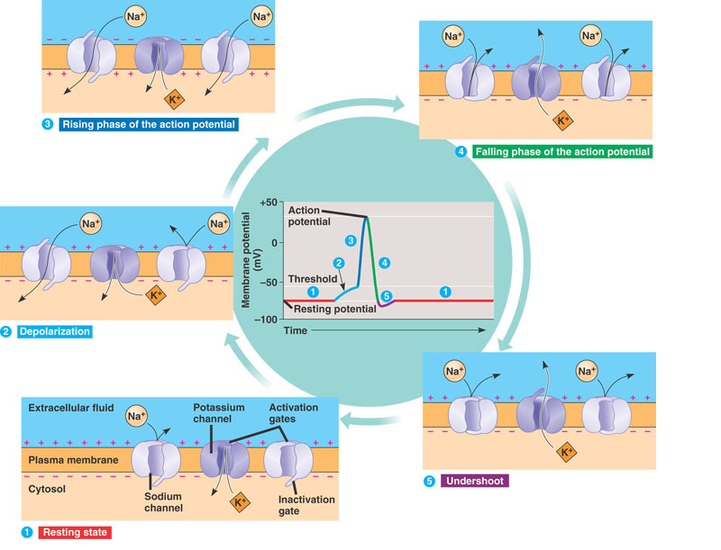

Slide 18
Generating an Action Potential
Resting state- voltage-gated channels are closed
  Na⁺ channels have 2 gates, 1 voltage-sensitive activation gate (closed at rest) & an inactivation gate (blocks the channel once it opens)
Depolarization- ↑ in Na⁺ permeability & reversal of membrane potential
  positive feedback
  spike in action potential
Repolarization- ↓ in Na⁺ permeability (gates of Na⁺ channels begin to close) & ↑ permeability of K⁺ (slow voltage-gated K+ channels begin to open)
  Hyperpolarization- K+ permeability tends to last longer than it needs too
  Na-K pump redistributes ions

Slide 19
Refractory Periods
Absolute refractory period- when patch is generating AP its voltage-gated Na⁺ channels are open, neuron CANNOT respond to another stimulus
  Ensure all or none event & enforces one-way transmission of AP
Refractory period- Na⁺ closed, some K⁺ still open (repolarizing), but IF stimulus is strong enough can reopen Na⁺ channels & allow another AP to be generated

Slide 20
Stimulus Intensity and Conduction Velocity
Stimulus Intensity- stimulus strength does not ↑ strength (amplitude) of impulse, but strong stimuli cause nerve impulses to be generated more quickly in a given time interval (↑ frequency)
Conduction velocity- 2 factors:
  axon diameter- larger diameter = faster impulse
  degree of myelination
    continuous conduction- unmyelinated fibers- APs generated at sites immediately adjacent to each other- slow
    salutatory conduction- myelinated fibers- impulse can pass only at nodes of Ranvier, local depolarization is maintained & moves rapidly node to node

Slide 21
Multiple Sclerosis (MS)
Autoimmune disease affects mostly young adults
Immune system attacks myelin proteins, myelin sheaths in CNS gradually destroyed, reduced to nonfunctional hardened lesions
Loss of myelin sheath causes “short-circuiting” of current
  Axons ↑ #Na⁺ channels (increases continuous condution)
    may account for cycles of relapse & remission for patients
  Common symptoms: visual disturbances, problems controlling muscles, speech disturbances, urinary incontinence

Slide 22
CNS
Basic pattern- central cavity surrounded by gray matter with external white matter
  Brain has some additional external gray matter
Structure of Brain
  Ventricles- hollow chambers filled with cerebrospinal fluid & ependymal cells
    in centers of each portion of brain, continuous with central canal of spinal cord
  Regions: cerebral hemispheres, diencephalons, brain stem (midbrain, pons & medulla) & cerebellum
  Cortex- outer layer of neuron cell bodies (gray matter) on cerebral hemispheres & cerebellum

Slide 23
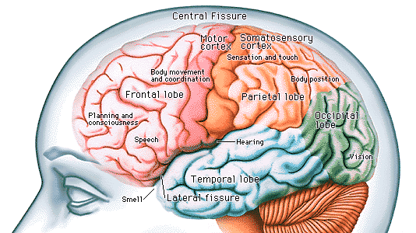
Cerebral Hemispheres
Superior part of brain, most conscious parts
Gyri (gyrus)- elevated ridge
Sulci (sulcus)- shallow grooves
Fissures- deep groves

Slide 24
Cerebral Hemispheres
Hemisphere into 5 lobes (frontal, parietal, temporal, occipital (and insula))
Sulci
  Central sulcus
    Precentral & postcentral gyrus
  Parieto-occipital suclus
  Lateral sulcus
Fissures
  Longitudinal fissure
  Transverse cerebral fissure

Slide 25
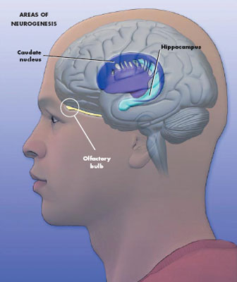
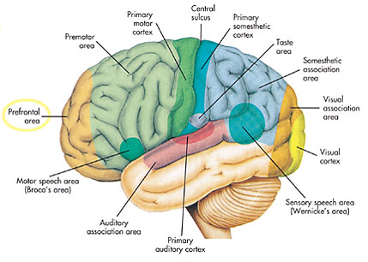
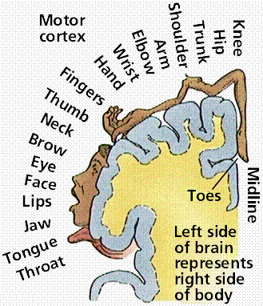
Cerebral Cortex (Lateral view)

Slide 26
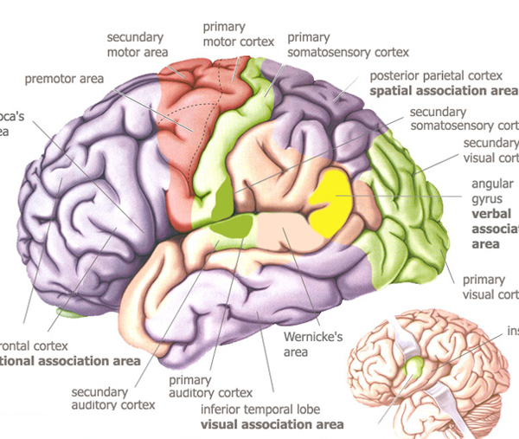
Q
3-400
A
B
C
P
O
D
N
E
M
F
L
R
K
J
I
G
H

Slide 27
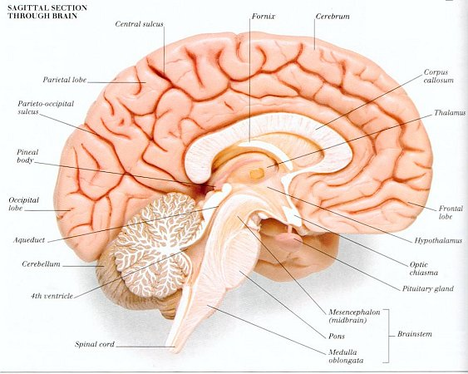
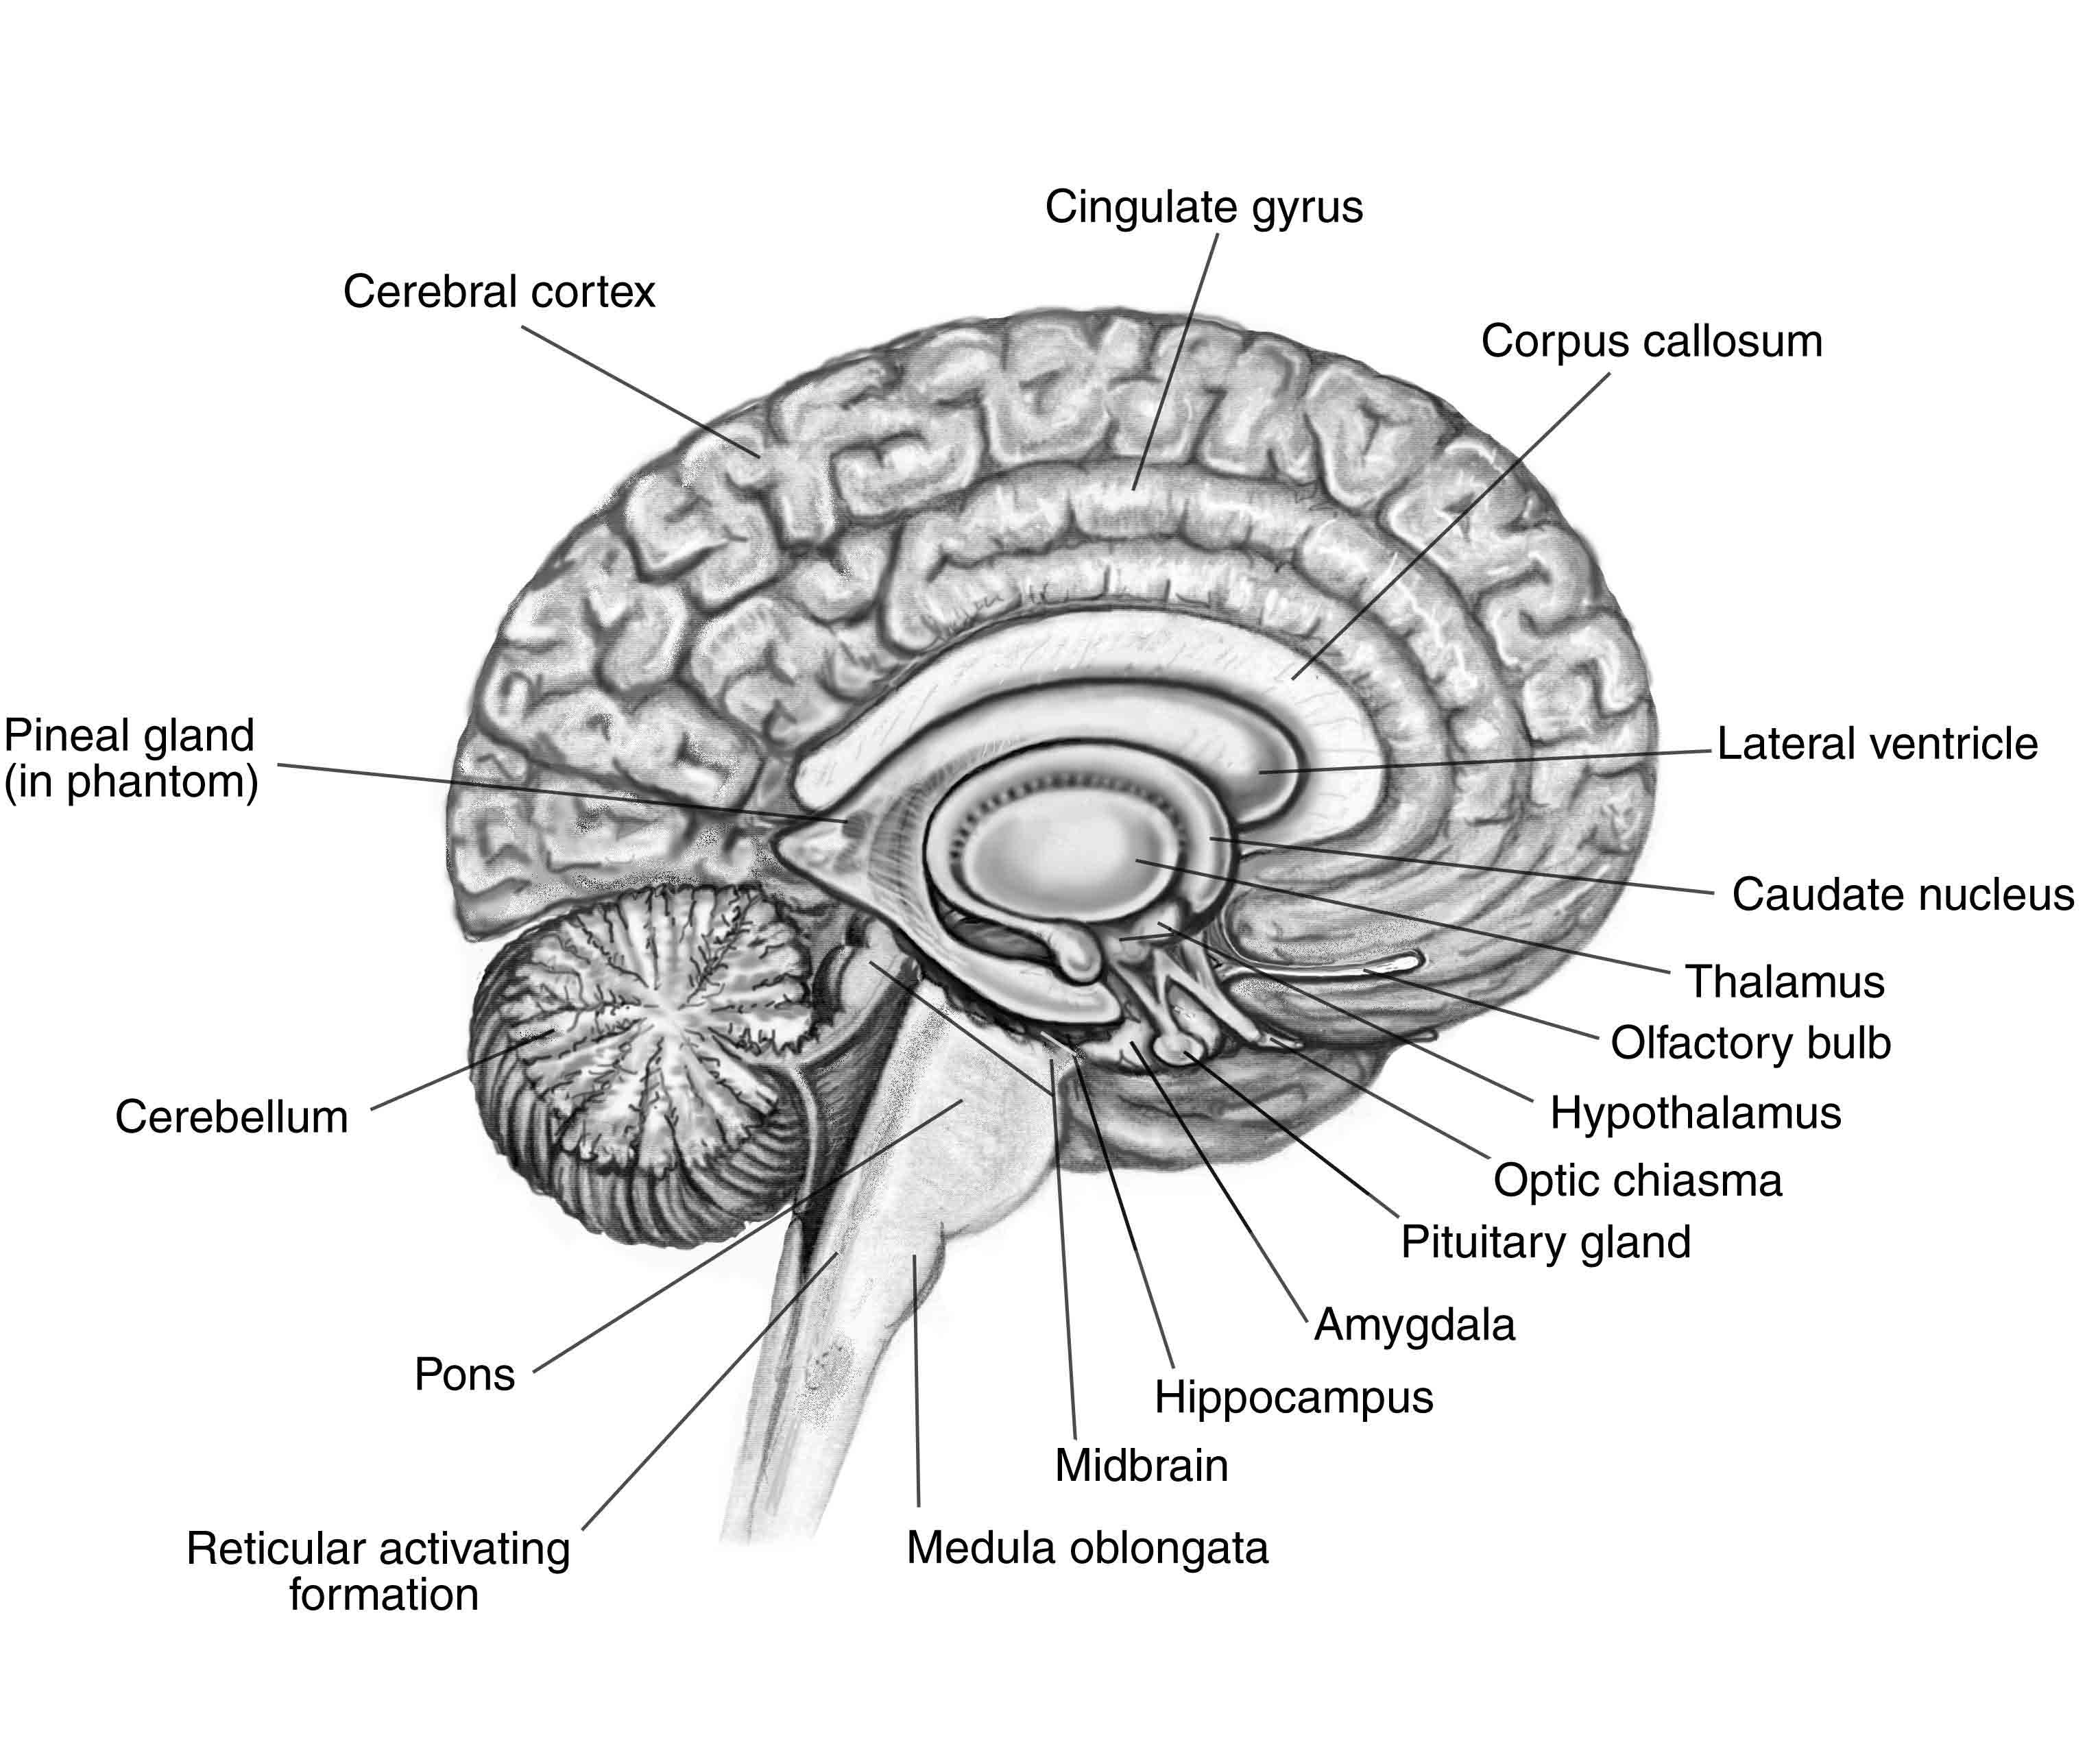
Cerebral Cortex and Cerebellum Midsagittal View)

Slide 28
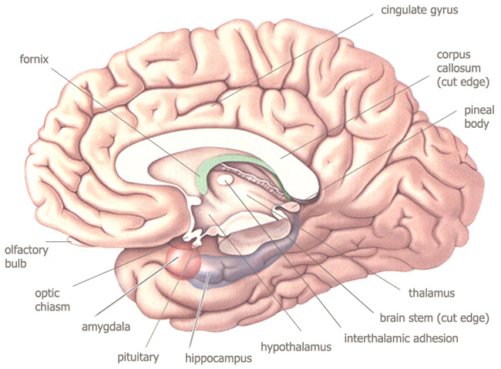

Diencephalon (Midsagittal View)

Slide 29
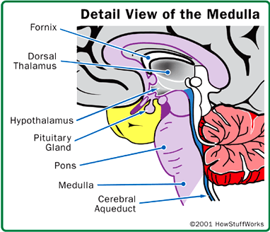
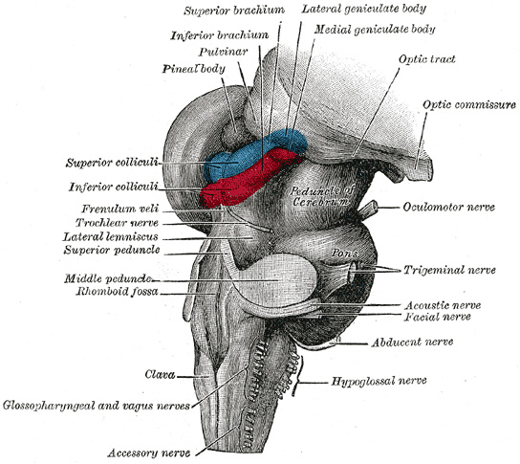
Brain Stem- Midbrain, Pons and Medulla

Slide 30
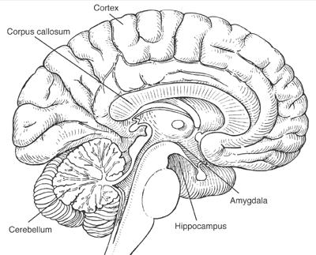
B
A
4-400
C
U
D
E
T
F
S
G
R
H
Q
I
K
P
J
M
L
O
N

Slide 31
Limbic System
Emotional/feelings brain- recognizes facial expressions & helps process potential danger
  links prefrontal lobe & can allow emotions to override logic
Fornix & other fiber tracks link limbic system regions together
Hippocampus, amygdala, hypothalamus
  Hippocampus- transfers emotion to memory
  Amygdala- almond-shape nucleus, fear-perceiving

Slide 32
Hypothalamus
ANS control center, regulates by controlling activity of brain stem & spinal cord
  Blood pressure, pupil size, digestive tract motility, etc
Emotional response center- “heart” of limbic system- nuclei involved in fear, pleasure, rage
Regulation center for:
  Body temp
  Food intake
  Water/thirst
  Sleep/wake cycle
  Endocrine system- paraventricular & supraoptic nuclei

Slide 33
Reticular Formation and Basal Nuclei
Reticular Formation- Governs stimulus of brain
  Loose cluster of neurons in spinal cord, medulla, pons & midbrain with axons extending through central core of brain stem, diencephalons & cerebrum
  Reticular activating system (RAS)- reticular neurons that send continuous impulses to cerebral cortex, keeping it alert & conscious
    Filters input to cortex, filters 99% of sensory input as unimportant
    Must be inhibited to sleep
Basal nuclei- deep in cerebral white matter- coordination
  Monitoring, starting, stopping of stereotyped motor movement via premotor cortex

Slide 34
Protection of CNS- 4 parts
1) Bone- skull (vertebrae)
2) Membranes- meninges- cover & protect CNS, blood vessels & enclose sinuses
  Contain cerebrospinal fluid (CSF)
  Form partitions in skull
  3 layers:
    Dura matter- 2 layer sheet of fibrous connective tissue surrounds brain
      Strongest meninx
      Continues into vertebral column as dural sheath of spinal cord
    Arachnoid- loose covering, fine & elastic
      Subarachnoid space- wide space below arachnoid membrane filled with CSF & large blood vessels serving brain
    Pia mater- clings tightly to brain, delicate connective tissue

Slide 35
Protection of CNS- 4 parts Cont’d
3) Watery cushion- CSF found in/around brain & spinal cord
  floating lets brain reduce weight by 97%!
  helps nourish brain
4) Blood brain barrier- protects brain from harmful substances in blood
  Continuous endothelium on internal & relatively thick basal lamina on external capillary walls
  “Feet” of astrocytes clinging to capillaries
  Selective
    In- nutrients & substances that can easily diffuse plasma membranes
    Out- metabolic wastes, proteins, certain toxins & most drugs

