Slide 1
Letter to Darwin
Common core activity for biology
(from Joseph Walsh (2012) The American Biology Teacher, Vol. 74, pages 111-113.)

Slide 2
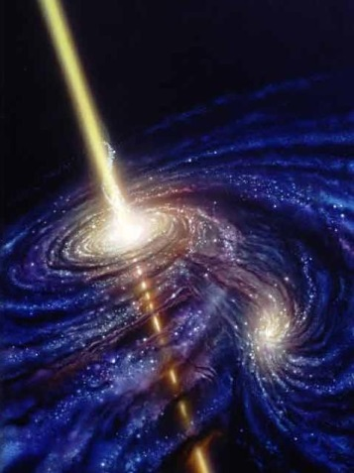
What are some scientific ideas that have passed their due date?
Aristotle’s ideas of motion
Newton’s ideas of motion and gravity
Einstein’s ideas of motion and gravity
Hawking’s ideas of black holes
Talk for a few minutes in your group…
How do you think these ideas have changed and why have they changed over time?

Slide 3
P. 184 On Origin of Species 1859
In North America the black bear was seen by Hearne swimming for hours with widely open mouth, thus catching, like a whale, insects in the water. Even in so extreme a case as this, if the supply of insects were constant, and if better adapted competitors did not already exist in the country, I can see no difficulty in a race of bears being rendered, by natural selection, more and more aquatic in their structure and habits, with larger and larger mouths, till a creature was produced as monstrous as a whale.

Slide 4
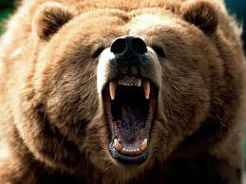
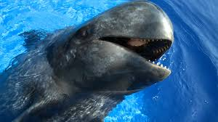
What was he talking about?
In your group:
What did the passage say?
What evidence did Darwin provide for his idea?
Is this idea still valid?
BYOD time…

Slide 5
The Assignment
You and your partner will draw a topic from a bowl full of Darwin’s ideas.
You and your partner will write a letter to Darwin from the future in the voice of the researcher who overturned Darwin’s idea.
The slip provides a probable author but YOU can find another source if even the assigned author is out of date.

Slide 6
How your letter will be evaluated…
Compose this letter in a Google Doc so you can both edit together.. Don’t forget to SHARE the file.
Did you use appropriate “letter” format? (see sample)
Is this letter written by you or is the letter in the voice of the author disputing Darwin’s claim?
Remember to use parenthetical or superscript citations at the end of sentence where you provide other people’s paraphrased thoughts!
Avoid, Avoid, Avoid pronouns without antecedents.
Provide APA references.

