Slide 1
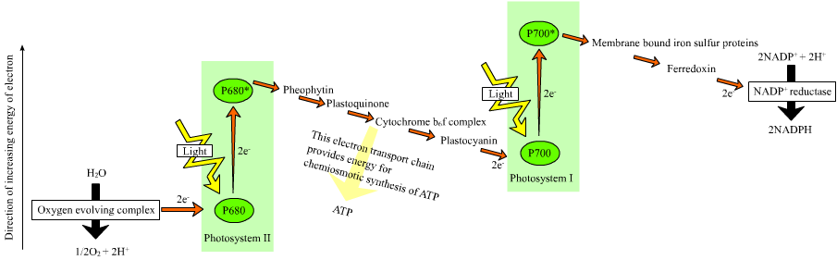
Adapted from Mark D Little

Slide 2
DPIP

Slide 3
DPIP

Slide 4
DPIP

Slide 5
DPIP

Slide 6
DPIP

Slide 7
DPIP

Slide 8
DPIP

Slide 9
DPIP

Slide 10
DPIP

Slide 11
DPIP

Slide 12
DPIP

Slide 13
DPIP

Slide 14
DPIP

Slide 15
Table 4.2: Setup for photosynthesis experiment
Contents | Cuvette 1 Blank (no DPIP) | Cuvette 2 Unboiled chloroplasts (Dark) wrap with foil | Cuvette 3 Unboiled chloroplasts (Light) | Cuvette 4 Lab Group Choice chloroplasts (Light) | Cuvette 5 Lab Group choice (Light)
Phosphate buffer | 1 mL | 1 mL | 1 mL | 1 mL | 1 mL
Distilled water | 4 mL | 3 mL | 3 mL | 3 mL | 3
DPIP | None | 1 mL | 1 mL | 1 mL | 1 mL
Unboiled chloroplasts | 3 drops | 3 drops | 3 drops | 3 drops | 3 drops

