Slide 1
The Lymphatic System
Lymphatic System- lymph, lymphatic vessels, lymphoid cells (tissues), & organs
Lymph- fluid once enters lymphatic capillaries from circulatory capillaries
  Nutrients, wastes, gases, etc exchanged between blood & interstitial fluid
  Must be carried back to blood
Lymphatic vessels- system of vessels that collect lymph & return it to blood stream
  1-way system (“blind-ended”)
    Lymph flow: collects in lymphatic capillaries→ flows through larger & thicker walled channels→ collecting vessels→ trunks (named after regions they collect from)→ 2 large ducts (R lymphatic duct & thoracic duct)→ Join at junction of internal jugular & subclavian veins

Slide 2
Lymphoid Cells, Tissues and Organs
Cells= lymphocytes- warriors of immune system
Tissues- reticular connective tissue
Lymphoid Organs-
  Lymph nodes- clustered in lymph vessels, filter lymph
  Spleen- left side of abdomen- lymphocyte proliferation & immune surveillance/response
    Also extracts aged/defective blood cells & platelets, macrophages remove debris
  Thymus- secretes hormones→ B & T cell function, highly active 1st year of life, begins to atrophy after puberty
  Tonsils- ring around entrance of pharynx (throat)

Slide 3
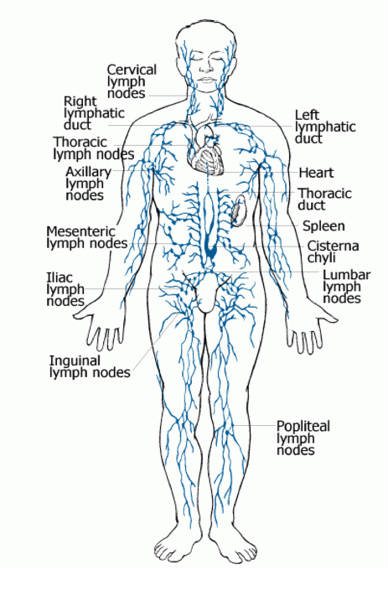
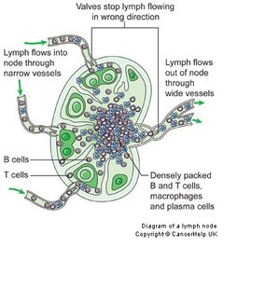
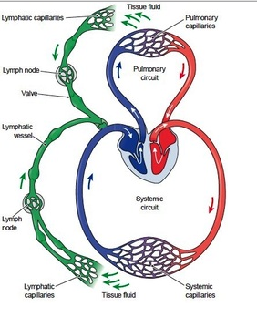

Slide 4
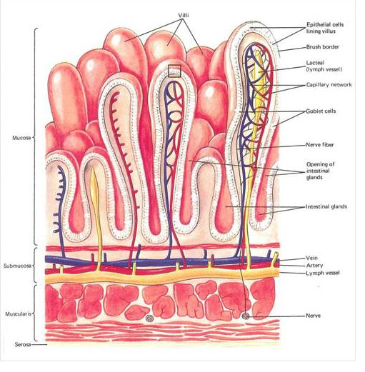
Lacteals… lymph vessels that pick up digested lipids from the digestive system delivered to thoracic duct – heart back into circulatory system…

Slide 5
Disease and The Immune System
Disease- any change (except injury) that disrupts normal body functions
  Pathogens cause disease, vectors spread disease
Immune System- defense against harmful organisms & substances
    Antigen- substance or part of a substance recognized by the immune system as foreign, activates the immune system
Antibiotics
  Interfere with cellular processes of microorganisms
  NO effect on viruses!

Slide 6

Immune System Cells- Leukocytes
Gather at site of infection
Phagocytes- Neutrophils & Monocytes- nonspecific defenses
  engulf & digest unwanted pathogens
  Monocytes can engulf 100s of bacteria cells
Eosinopils & Basophils also nonspecific!
Lymphocytes- specific defenses
  B cells- divide into plasma cells and secrete antibodies specific for certain invaders
  T cells- recognize & destroy body cells that have been infected by specific pathogens

Slide 7
Leukocytes- WBCs- Never Let Monkeys Eat Bananas
Granulocytes- Round
  Neutrophils- 50-70%, chemically attracted inflammation & active phagocytes
  Eosinophils- 2-4%, counterattack against parasitic worms
  Basophils- rarest, contain histamine granules
    Histamine- inflammatory chemical, makes blood vessels dilate (note Mast cell are fixed in place basophils)
Agranulocytes- Not round
  Lymphocytes- 25%+, in lymphoid tissue, immunity cells
    T cells, B cells (give rise to plasma cells)
  Monocytes- 3-8%- differentiate into highly mobile macrophages

Slide 8
The 1st line of Defense- Nonspecific
Skin/epithelial tissue- block pathogens
Mucus- coats openings, traps pathogens
Tears & sweat- salty & acidic, stops growth of some harmful bacteria
  Sweat has enzyme that destroys some bacteria
Harmless bacteria- live on skin, preventing harmful ones from growing there

Slide 9
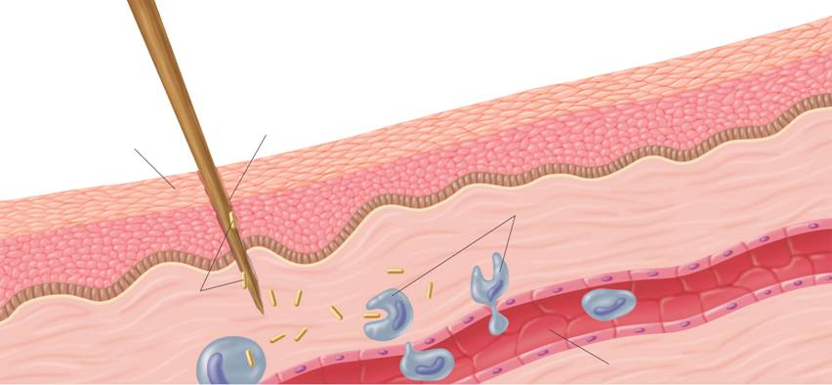
The 2nd line of Defense- Nonspecific
Inflammatory response- reaction to tissue damage caused by injury/infection
  Basophils release histamine at site of damage– triggers inflammatory response
  Capillaries in injured/infected area expand →
  ↑ blood flow to area & amount of plasma with phagocytes & clotting factors that leak out
Wound
Phagocytes move into the area and engulf the bacteria and cell debris
Skin
Bacteria enter the wound
Capillary

Slide 10
The 2nd line of Defense Cont’d
Fever- some macrophages release pyrogens-stimulate brain to ↑ body temp
  Higher body temp → phagocytes become more active & more difficult for pathogens to grow
Natural killer attack cells that have been infected by viruses
Interferon- (protein) released when host cells are infected by a virus, help nearby cells resist infection (stops protein synthesis)

Slide 11
The 3rd line of Defense- Specific Defenses
Immune Response
  Lymphocytes recognize specific antigens
3 characteristics:
  Specific
  Most effective against a pathogen an organism has previously encountered
  Works throughout entire body

Slide 12

Humoral Immunity
  B cells & plasma cells make Antibodies (also called immunoglobins)
    Y-shaped proteins that bind to specifc antigens to fight disease
As B cells develop, they each develop slightly differently
  When development complete, there are
  millions of different B cells
  When an antigen enters body, some B
  cells recognize it & start dividing into plasma cells
    Plasma cells release antibodies
    Activation of plasma cells is regulated by helper T cells

Slide 13
Cell-mediated Immunity
T cells recognize and directly attack cells that are foreign to body
3 Types of T cells
  Cytotoxic T cell (killer T cell)- attacks dangerous cells by making a protein that ruptures cell membrane
  Helper T cells- stimulate killer T cells to divide
    T4 cells
      T4 cells have a specific role in HIV-AIDS
  Suppressor T cells- stop activity of other T cells when no longer needed

Slide 15
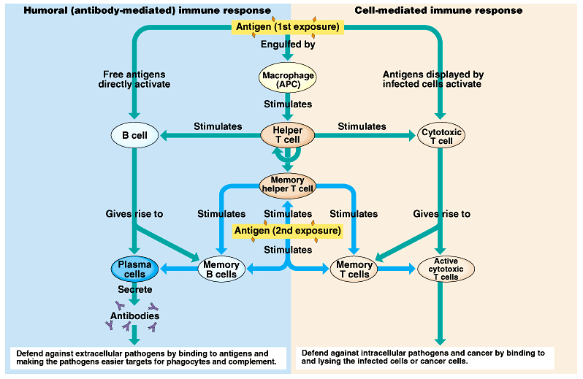

Slide 16
Acquired Immunity
Body’s resistance to previously encountered pathogens
Permanent immunity-
  1st immune response- immune sys encounters new pathogen, antigen-specific B &/or T cells are found & begin to multiply
    Infection can spread & become serious illness
    Memory B & T cells also made- can live decades/ lifetime
  2nd (+) immune response- next time immune sys sees same pathogen, response is faster
    Often so fast pathogen destroyed before illness occurs

Slide 17
Acquired Immunity Cont’d
Active immunity
  Vaccination- injection of weakened/mild form of pathogen to produce immunity
Passive immunity
  Antibodies made by other animals
  Maternal immunity

Slide 18
Allergies
Allergy- response of immune sys to harmless substance as if it were an antigen
  Allergens = Allergy-causing “antigens”
    bind to mast cells (basophils) & cause them to release histamines
  Anaphylactic shock- blood vessels open so wide, blood P drops so low, breathing can be difficult
  Asthma- smooth muscle contractions reduce size of air passageways

Slide 19
Autoimmune Disorders
Autoimmune disease- immune sys attacks tissues of body
  Immune sys mistakes body cells for pathogens
    Example: MS - immune sys attacks myelin sheaths of nerve cells in CNS
  Can be invoked by a bacterial infection
    Strep throat/ rheumatic fever
  Some scientists think Type 1 diabetes may be caused by immune system attacking insulin-producing cells of pancreas

Slide 20
AIDS
Acquired Immune Deficiency Syndrome
  Not a specific disease, a condition in which body’s immune sys can’t protect body from any pathogen
AIDS is caused by HIV (human immunodeficiency virus)
  HIV replicates inside helper T cells (T4 cells)
  HIV is a retrovirus- RNA instead of DNA→ more mutations

Slide 21
Stopping the Immune System
How do we do an organ transplant without the immune system attacking the foreign tissue?
  After someone gets a new organ, Killer T cells rapidly multiply to attack the new tissue
  Doctor’s can stop patient’s body from rejecting new organ by giving drugs that suppress patient’s immune system
    Drugs interrupt mitosis, immune system can’t multiply in response to new tissue

