Slide 1
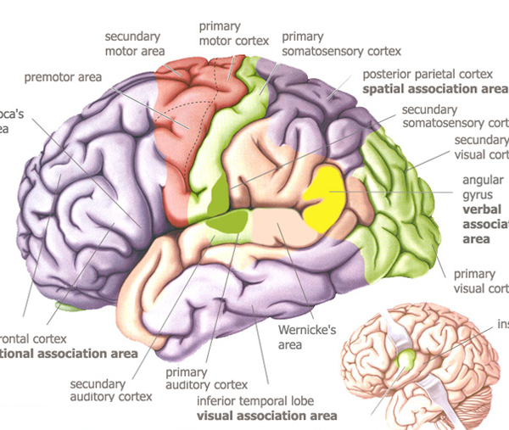
P
3-400
A
B
C
O
N
D
M
E
L
F
K
Q
J
I
G
H

Slide 2
Answers- Also know the function of each! (see study guide)
A- precentral gyrus- primary motor cortex
B- postcentral gyrus- primary somatosensory cortex
C- somatosensory association area
D- Wernicke’s area
E- Visual Association area
F (ab)- Primary visual cortex
G (ac)- Auditory association area
H (ad)- Primary auditory cortex
I (ae)- Prefrontal cortex
J (bc)- Solving complex, multitask problems area
K (bd)- Working memory for object-recall tasks
L (be)- Broca’s area
M (cd)- Executive area for task management
N (ce)- Working memory for spatial tasks
O (de)- Frontal eye field
P (abc)- premotor cortex
Q (abd)- gustatory cortex

Slide 3
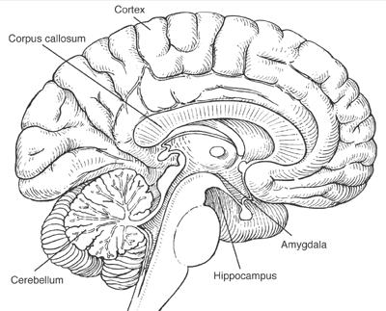
B
A
4-400
C
U
D
E
T
F
S
G
R
H
Q
I
K
P
J
M
L
O
N

Slide 4
Answers- Also know the function of each! (see study guide)
A- Corpus callosum
B- Septum pellucidum
C- Third ventricle
D- Lateral ventricle
E- Thalamus
F (ab)- Hypothalamus
G (ac)- Optic chiasma
H (ad)- Pituitary gland
I (ae)- Mammilary body
J (bc)- Cerebral aquaduct
K (bd)- Substantia nigra
L (be)- Pons
M (cd)- Cerebral peduncle
N (ce)- Medulla oblongata
O (de)- Forth ventricle
P (abc)- Arbor vitae
Q (abd)- Inferior colliculi (Corpora quadrigemina)
R (abe)- Superior colliculi (Corpora quadrigemina)
S (acd)- Pineal gland
T (ace)- Epithalamus
U (ade)- Fornix

Slide 5
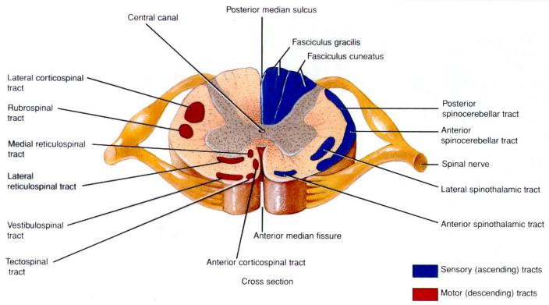
6-200
A
H
B
C
G
D
F
E

Slide 6
Answers- Also know the function of each! (see study guide)
A- central canal
B- dorsal horn
C- lateral horn
D- ventral horn
E- gray commissure
F (ab)- ventral root
G (ac)- dorsal root ganglia
H (ad)- dorsal root

