Slide 1
Nervous System Overview
  Nervous tissue
    Neuron: nerve cell specialized for carrying signals from one location in the body to another
    Nerve: bundle of neuron extensions wrapped in connective tissue
    Brain and Spinal Cord : Central Nervous System
    Peripheral Nervous System (outside spinal cord)

Slide 2
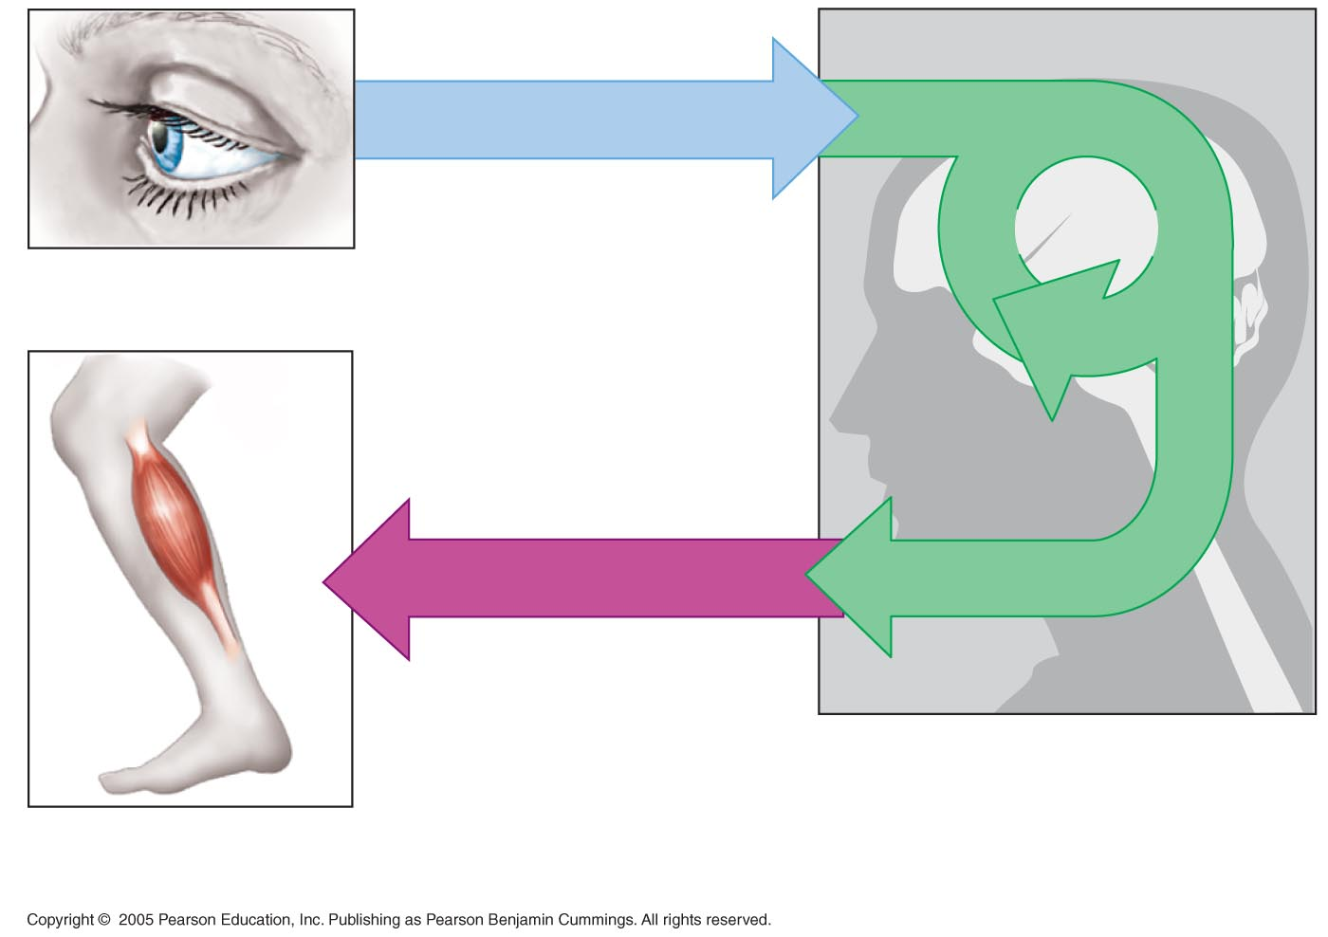
LE 28-1a
Sensory input
Integration
Sensory receptor
Motor output
Brain and spinal cord
Effector cells
Peripheral nervous
system (PNS)
Central nervous
system (CNS)

Slide 3
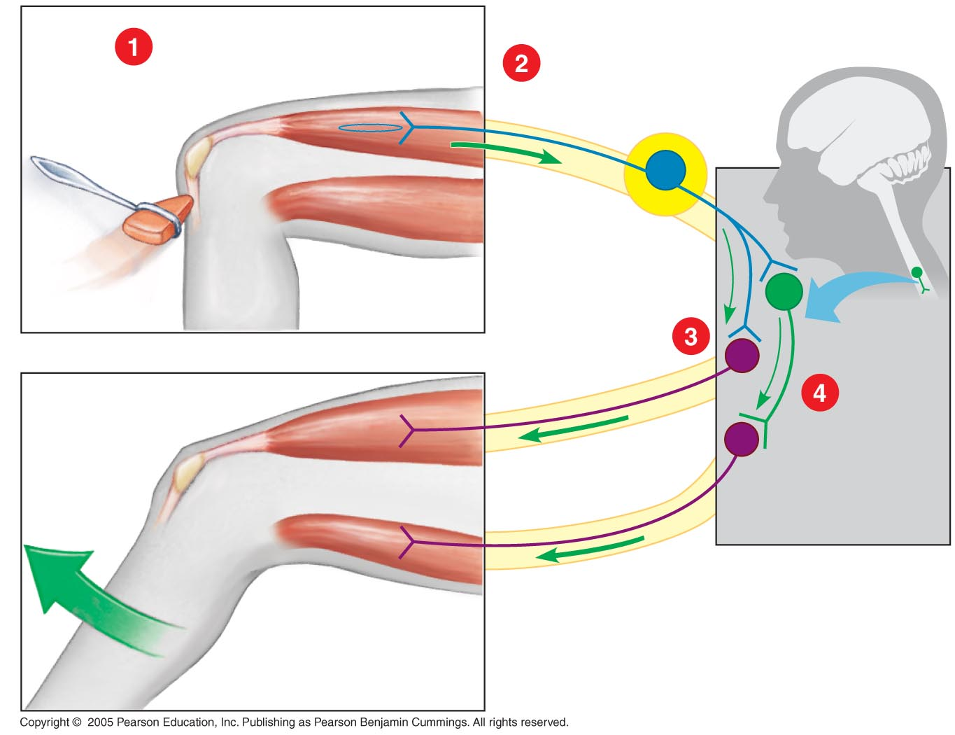
LE 28-1b
  A reflex is an automatic response to stimuli
Sensory
receptor
Sensory neuron
Brain
Ganglion
Motor
neuron
Spinal
cord
Quadriceps
muscles
Interneuron
CNS
Nerve
Flexor
muscles
PNS

Slide 4
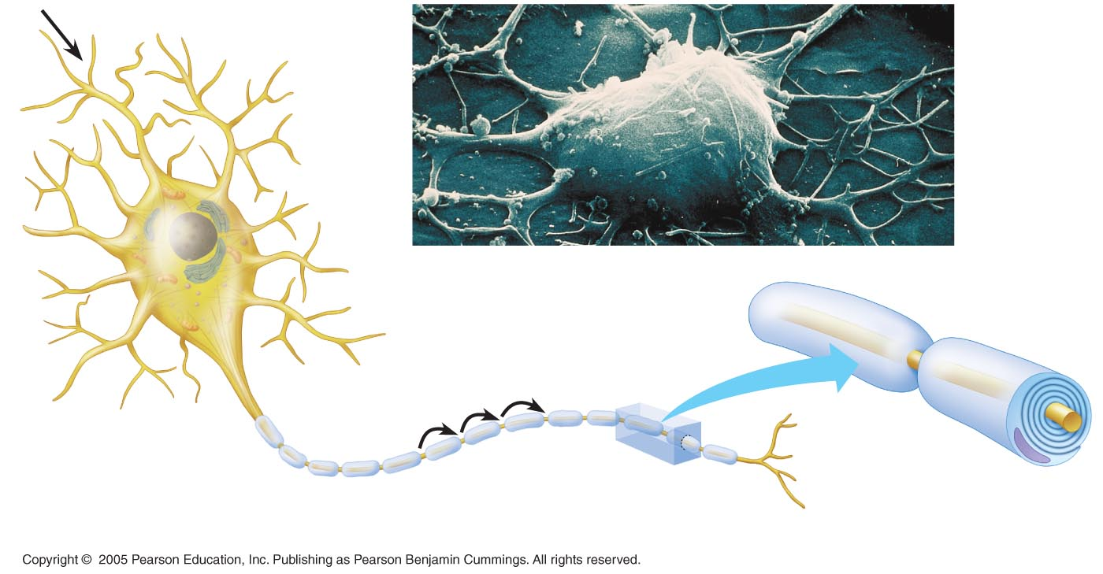
LE 28-2
Neurons are the functional units of nervous systems
Signal direction
Dendrites
Cell body
Cell Body
SEM 3,600×
Node of Ranvier
Layers of myelin
in sheath
Signal
pathway
Axon
Schwann cell
Nucleus
Nucleus
Nodes of
Ranvier
Schwann cell
Myelin sheath
Synaptic terminals

Slide 5
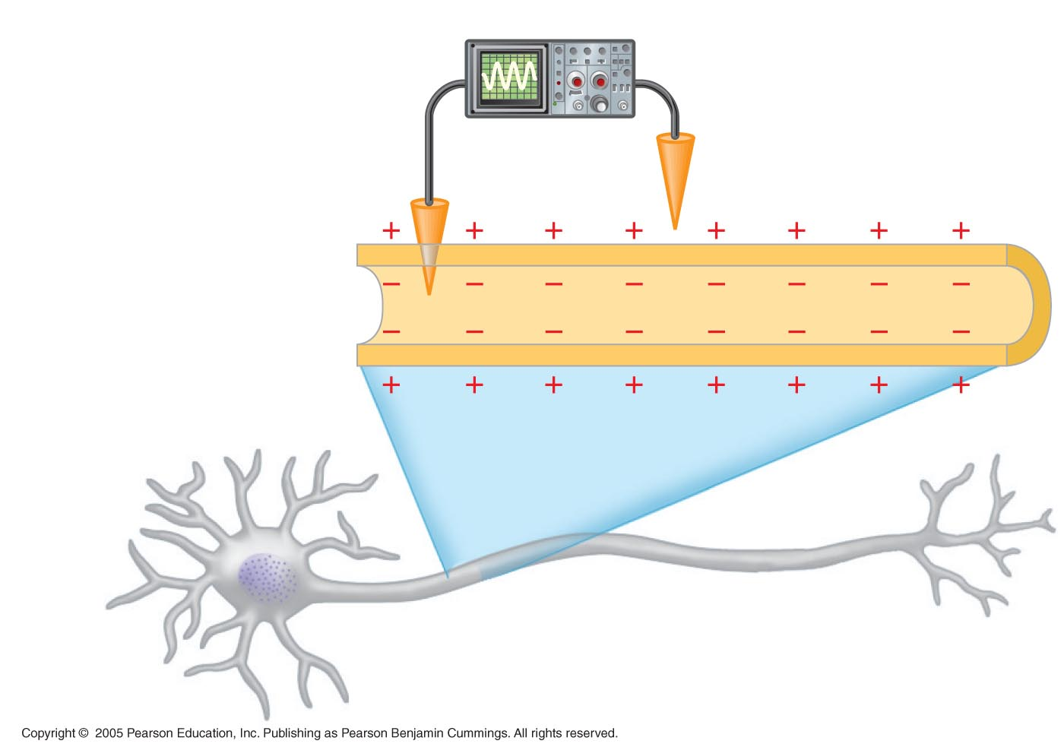
LE 28-3a
Voltmeter
Plasma
membrane
Microelectrode
outside cell
–70 mV
Microelectrode
inside cell
Axon
Neuron

Slide 6
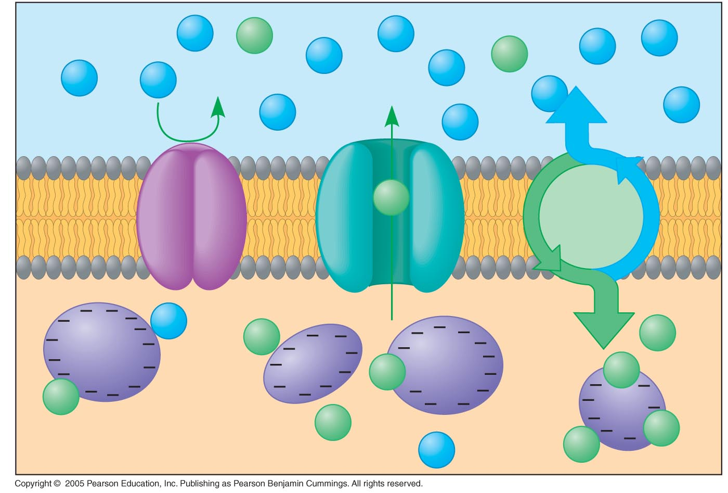
LE 28-3b
Outside of cell
Na⁺
K⁺
Na⁺
Na⁺
Na⁺
K⁺
Na⁺
Na⁺
Na⁺
Na⁺
Na⁺
Na⁺
channel
Na⁺
Na⁺
Na⁺
Plasma
membrane
K⁺
Na⁺-K⁺
pump
K⁺ channel
Na⁺
K⁺
K⁺
K⁺
Protein
K⁺
K⁺
K⁺
K⁺
Inside of cell
Na⁺
K⁺

Slide 7
  Cause of electrical changes of an action potential
    Movement of K+ and Na+ across the membrane
    Controlled by the opening and closing of voltage-gated channels
Animation: Action Potential

Slide 8
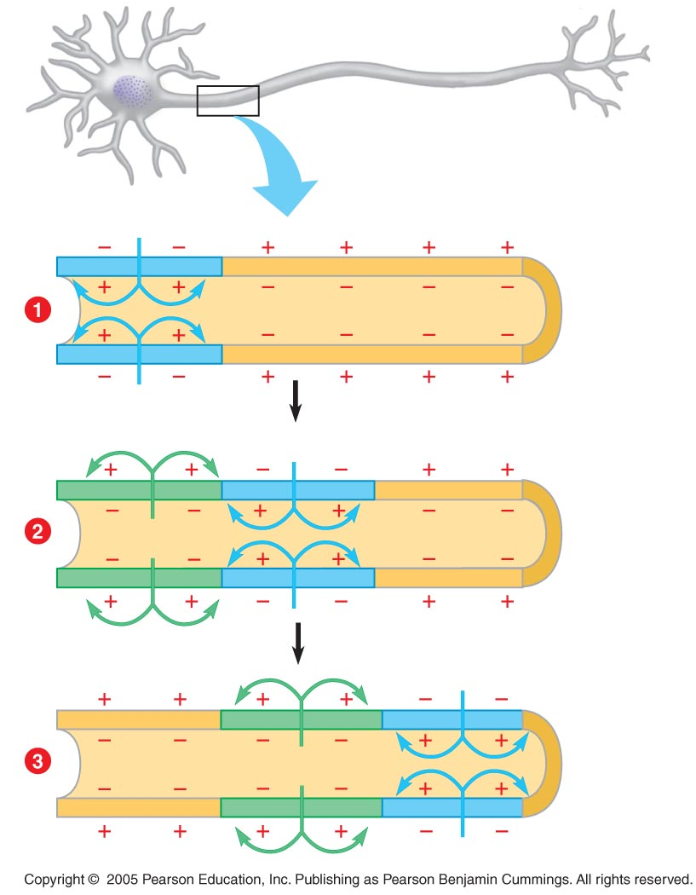
LE 28-5
Axon
Action potential
Na⁺
Axon
segment
K⁺
Action potential
Na⁺
K⁺
K⁺
Action potential
Na⁺
K⁺

Slide 9
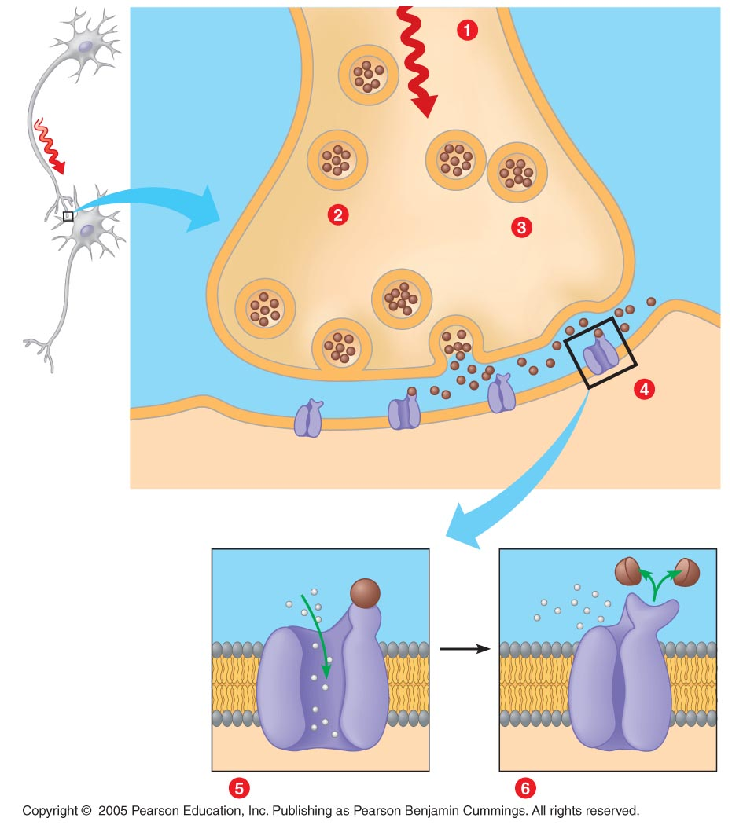
LE 28-6
Sending neuron
Action
potential
arrives
Vesicles
Axon of
sending
neuron
Synaptic
terminal
Synapse
Vesicle fuses
with plasma
membrane
Neurotransmitter
is released into
synaptic cleft
Synaptic
cleft
Receiving
neuron
Neurotrans-
mitter binds
to receptor
Receiving
neuron
Neurotransmitter
molecules
Ion channels
Neurotransmitter
Neurotransmitter broken
down and releases
Receptor
Ions
Ion channel opens
Ion channel closes

Slide 10
Animation: Synapse

Slide 11
28.7 Chemical synapses make complex information processing possible
  A neuron may receive information from hundreds of other neurons via thousands of synaptic terminals
  Some neurotransmitters excite the receiving cell
  Other neurotransmitters inhibit the receiving cell's activity by decreasing its ability to develop action potentials
  If excitatory signals are strong enough to initiate an action potential, a neuron will transmit a signal

Slide 12
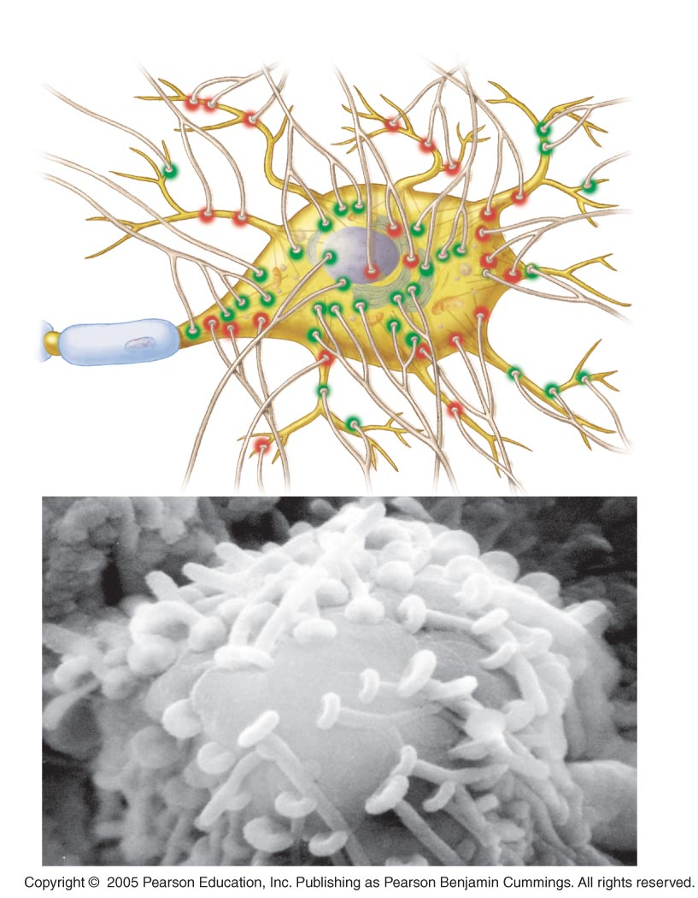
LE 28-7
Synaptic terminals
Dendrites
Inhibitory
Excitatory
Myelin
sheath
Receiving
cell body
Axon
Synaptic
terminals
SEM 5,500×

Slide 13
28.8 A variety of small molecules function as neurotransmitters
  Many small, nitrogen-containing molecules serve as neurotransmitters
    Acetylcholine
  Important in brain and at synapses between motor neurons and muscles
    Biogenic amines
      Important in central nervous system
      Seratonin, dopamine

Slide 14
  Amino acids
    Important in central nervous system
  Peptides
    Substance P, endorphins influence perception of pain
  Dissolved gases
    NO functions during sexual arousal

Slide 15
CONNECTION
28.9 Many drugs act at chemical synapses
  Many psychoactive drugs act at synapses and affect neurotransmitter action
    Caffeine
    Nicotine
    Alcohol
    Psychoactive prescription drugs
    Stimulants
    THC (marijuana)
    Opiates

Slide 16
28.11 Vertebrate nervous systems are highly centralized and cephalized
  Peripheral nervous system (PNS) includes cranial and spinal nerves and ganglia
  Central nervous system (CNS) made up of spinal cord and brain
    Spinal cord
      Inside vertebral column
      Conveys information from brain
      Integrates simple responses

Slide 17
    Brain, the master control center
      Homeostatic centers keep body functioning smoothly
      Sensory centers integrate data from sense organs
      Can include centers of emotion and intellect
      Sends motor commands to muscles

Slide 18
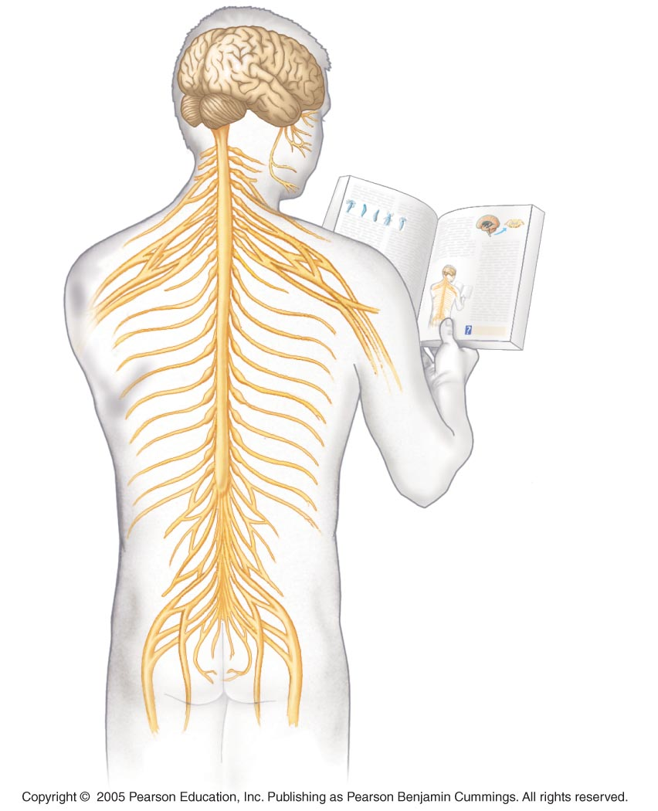
LE 28-11a
Central nervous
system (CNS)
Peripheral
nervous
system (PNS)
Brain
Cranial
nerves
Spinal cord
Ganglia
outside
CNS
Spinal
nerves

Slide 19
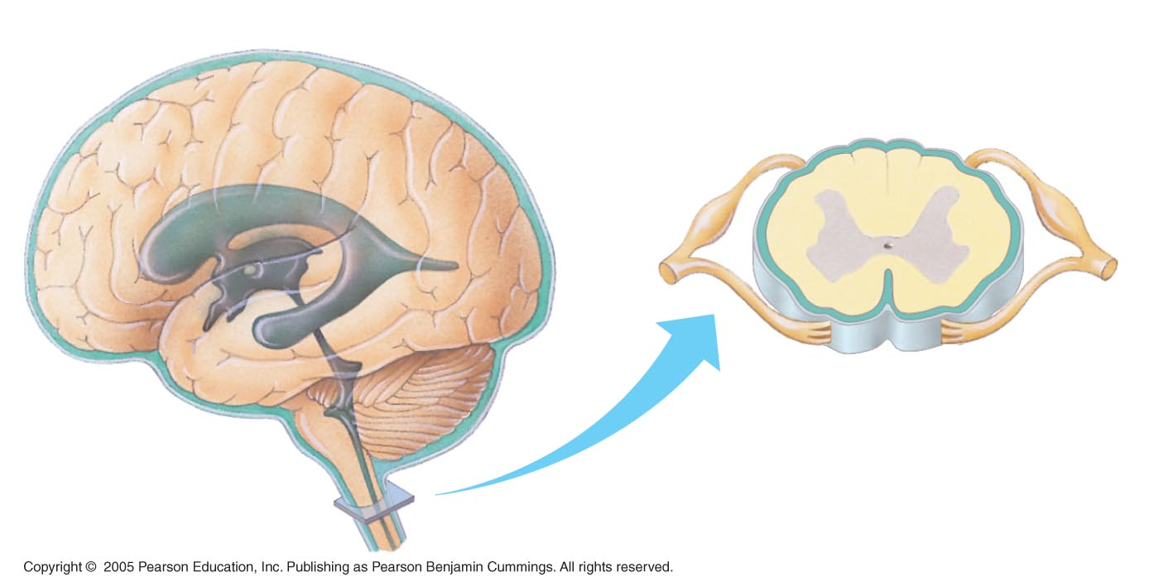
LE 28-11b
Cerebrospinal fluid
Dorsal root
ganglion
(part of PNS)
Brain
Meninges
Gray matter
White matter
Spinal nerve
(part of PNS)
Central canal
Ventricles
Central canal
of spinal cord
Spinal cord
(cross section)
Spinal cord

Slide 20
28.12 The peripheral nervous system of vertebrates is a functional hierarchy
  The PNS has two functional components
    Somatic nervous system
      Carries signals to and from skeletal muscles
      Responds mainly to external stimuli
    Autonomic nervous system
      Regulates internal environment
      Controls smooth and cardiac muscle, various organs; involuntary

Slide 21
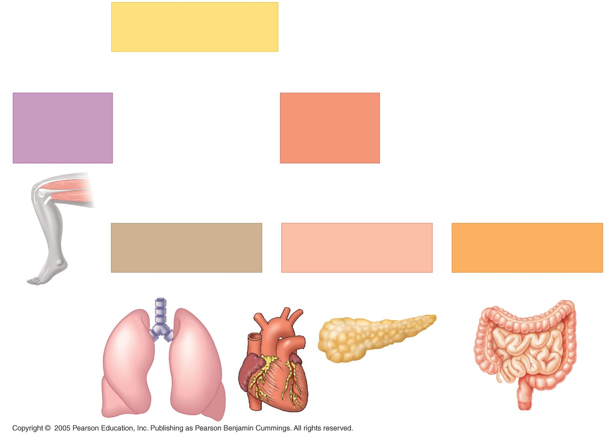
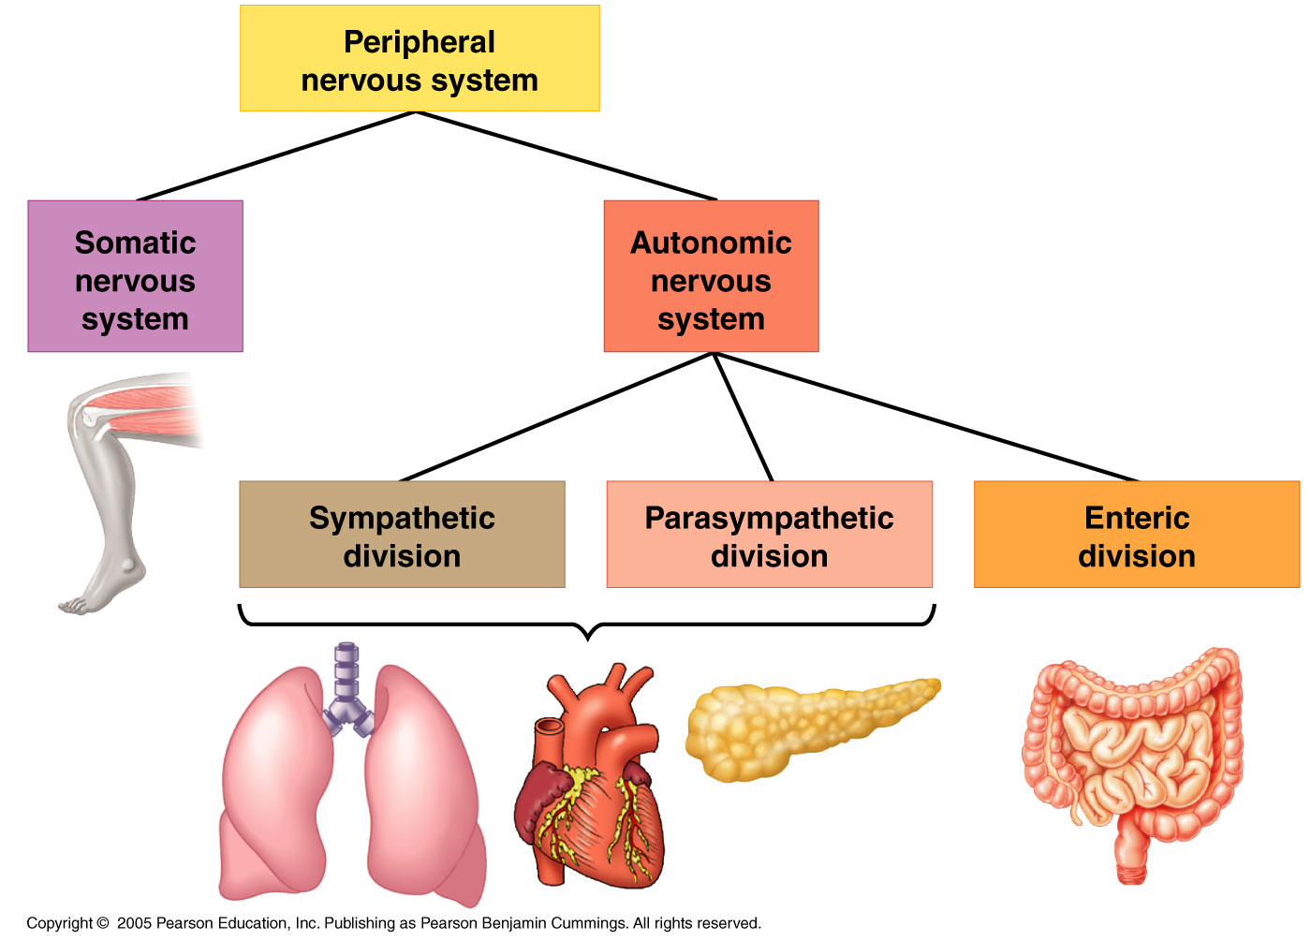
LE 28-12
Peripheral
nervous system
Somatic
nervous
system
Autonomic
nervous
system
Sympathetic
division
Parasympathetic
division
Enteric
division

Slide 22
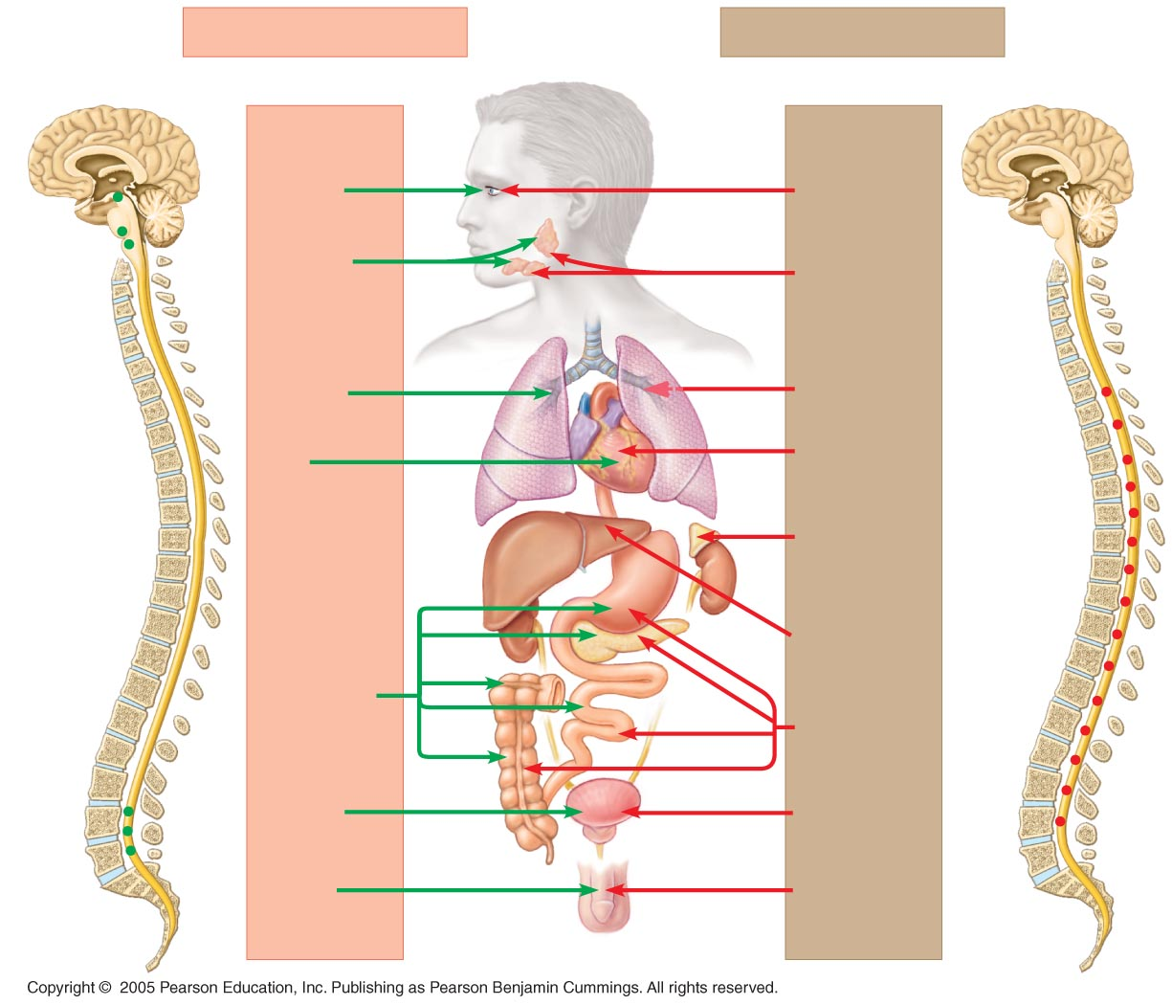
LE 28-13
Parasympathetic division
Sympathetic division
Brain
Eye
Constricts
pupil
Dilates
pupil
Salivary
glands
Stimulates
saliva
production
Inhibits
saliva
production
Lung
Constricts
bronchi
Dilates
bronchi
Slows
heart
Accelerates
heart
Heart
Adrenal
gland
Spinal
cord
Stimulates
epinephrine
and norepi-
nephrine release
Liver
Stomach
Stimulates
stomach,
pancreas,
and intestines
Pancreas
Stimulates
glucose release
Inhibits
stomach,
pancreas,
and intestines
Intestines
Bladder
Stimulates
urination
Inhibits
urination
Promotes
erection of
genitals
Promotes ejacu-
lation and vaginal
contractions
Genitalia

Slide 23
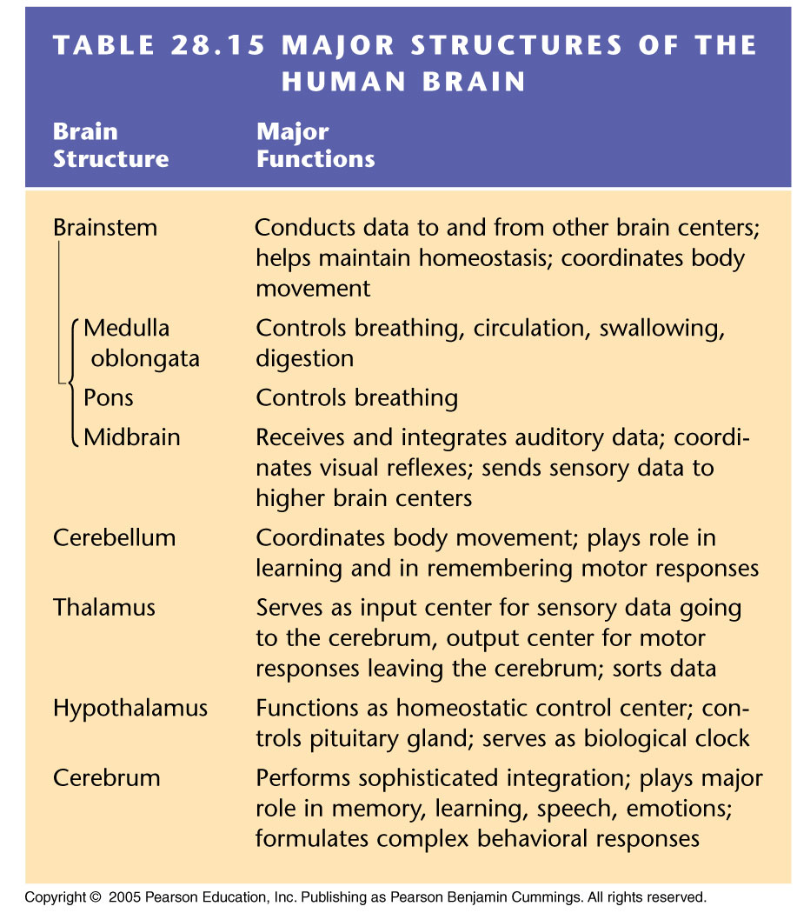

Slide 24
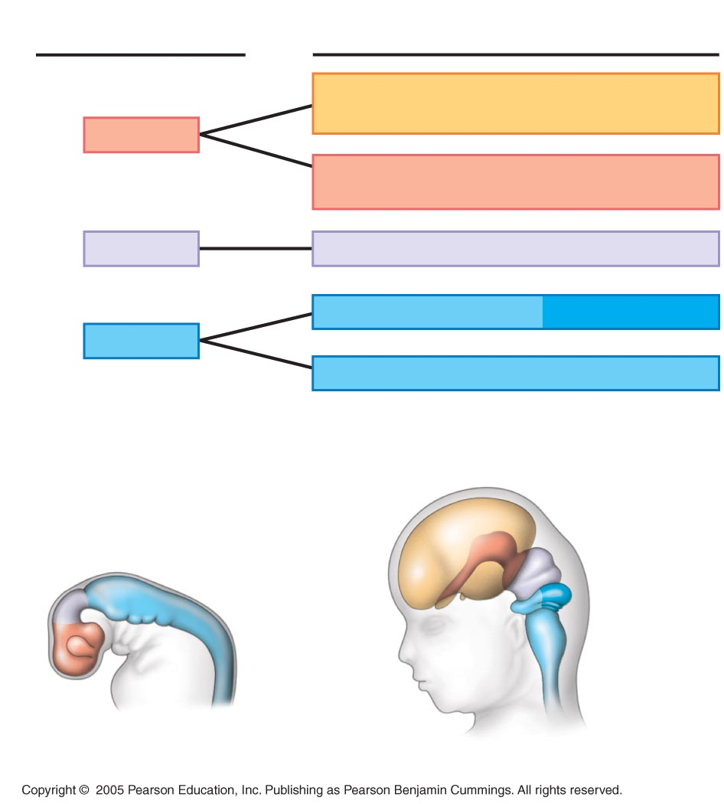
LE 28-14
Embryonic
Brain Regions
Brain Structures
Present in Adult
Cerebrum (cerebral hemispheres; includes
cerebral cortex, white matter, basal ganglia)
Forebrain
Diencephalon (thalamus, hypothalamus,
posterior pituitary, pineal gland)
Midbrain
Midbrain (part of brainstem)
Pons (part of brainstem), cerebellum
Hindbrain
Medulla oblongata (part of brainstem)
Cerebral
hemisphere
Diencephalon
Midbrain
Midbrain
Hindbrain
Pons
Cerebellum
Medulla
oblongata
Forebrain
Spinal cord
Embryo (one month old)
Fetus (three months old)

Slide 25
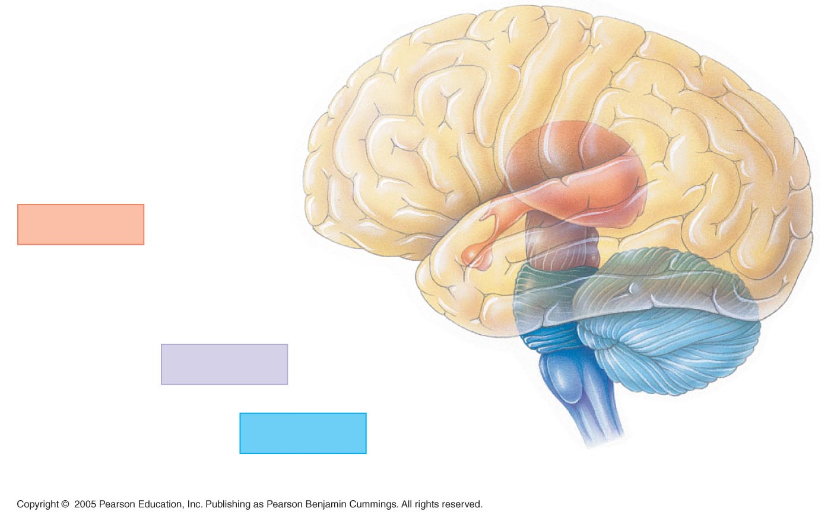
LE 28-15a
Cerebral
cortex
Cerebrum
Forebrain
Thalamus
Hypothalamus
Pituitary gland
Midbrain
Pons
Spinal
cord
Hindbrain
Medulla
oblongata
Cerebellum

Slide 26
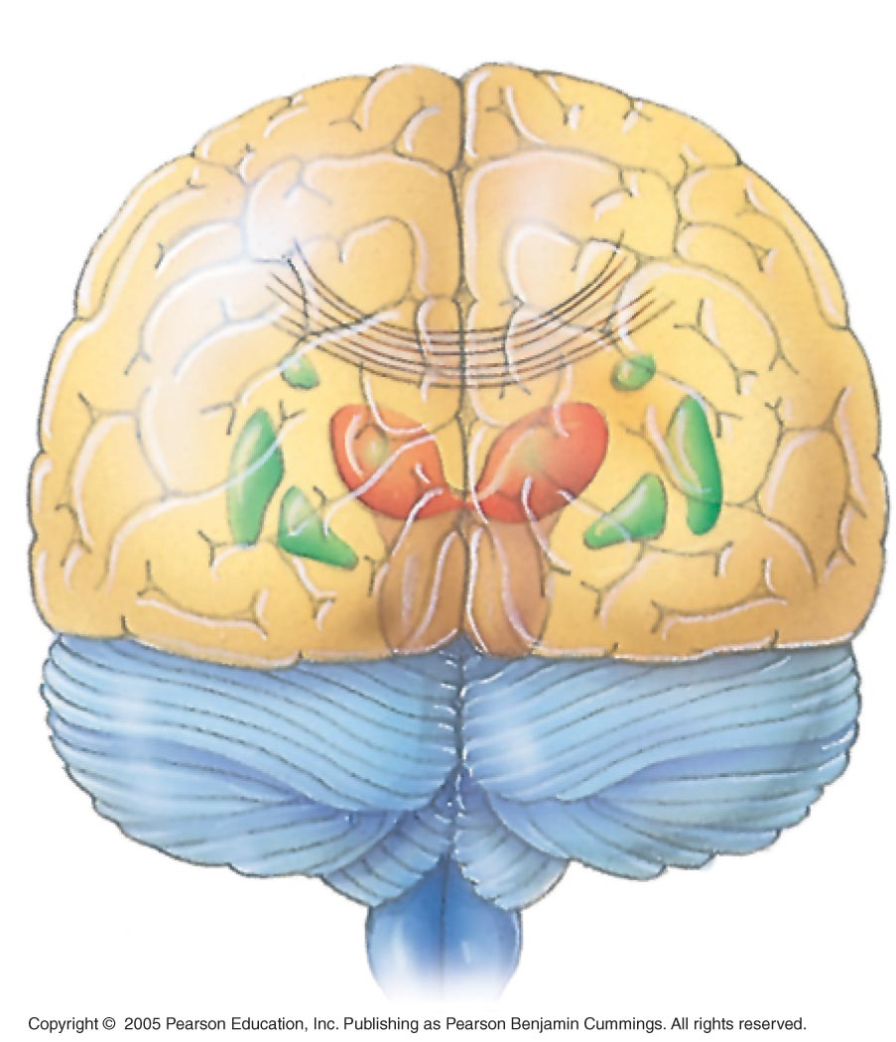
LE 28-15b
Left cerebral
hemisphere
Right cerebral
hemisphere
Corpus
callosum
Basal
ganglia

Slide 27
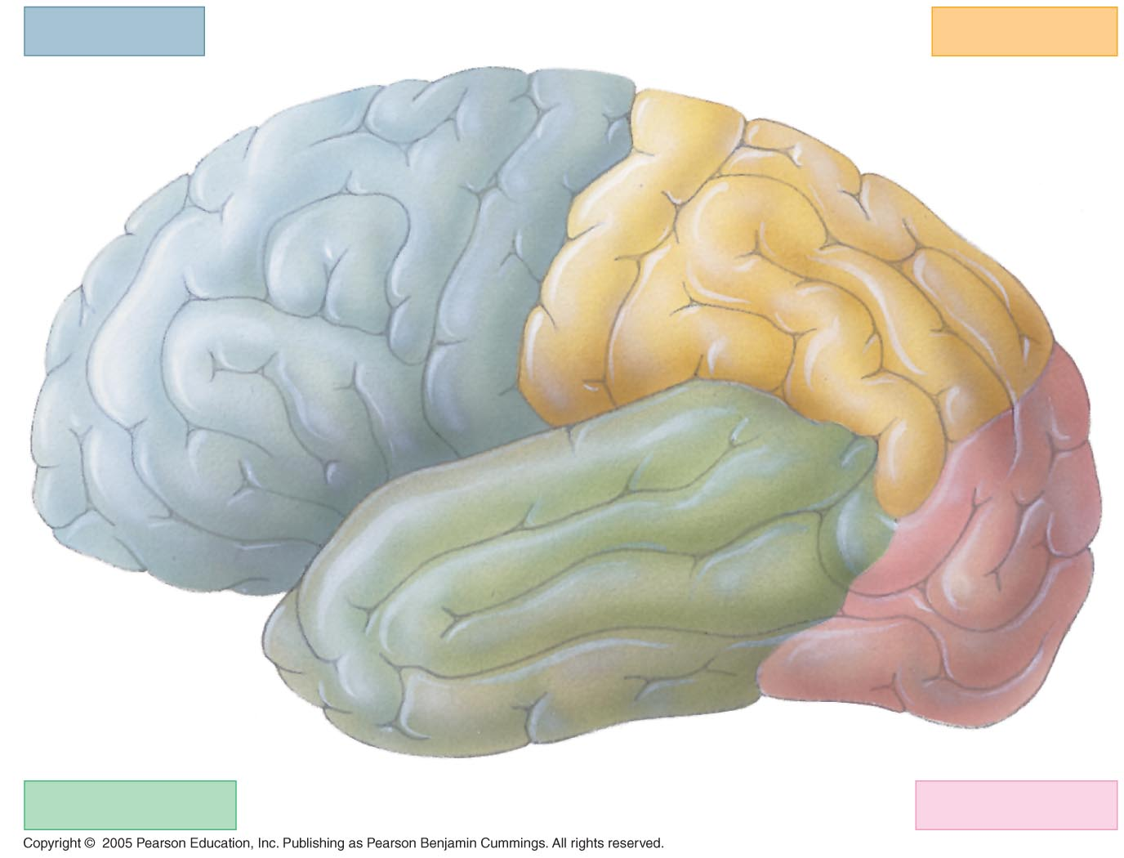
LE 28-16
Frontal lobe
Parietal lobe
cortex
cortex
Somatosensory
association
area
Frontal
association
area
osensory
Motor
Speech
Somat
Taste
Reading
Speech
Hearing
Smell
Visual
association
area
Auditory
association
area
Vision
Temporal lobe
Occipital lobe

Slide 28
28.18 Several parts of the brain regulate sleep and arousal
  Hypothalamus, medulla oblongata, and pons help regulate our sleep/wake cycles
  Sensory information sent from reticular formation to cortex makes us alert and aware
  EEG measures electrical activity in the brain during arousal and sleep
    In REM sleep, brain waves are similar to the awake state; most dreams occur

Slide 29
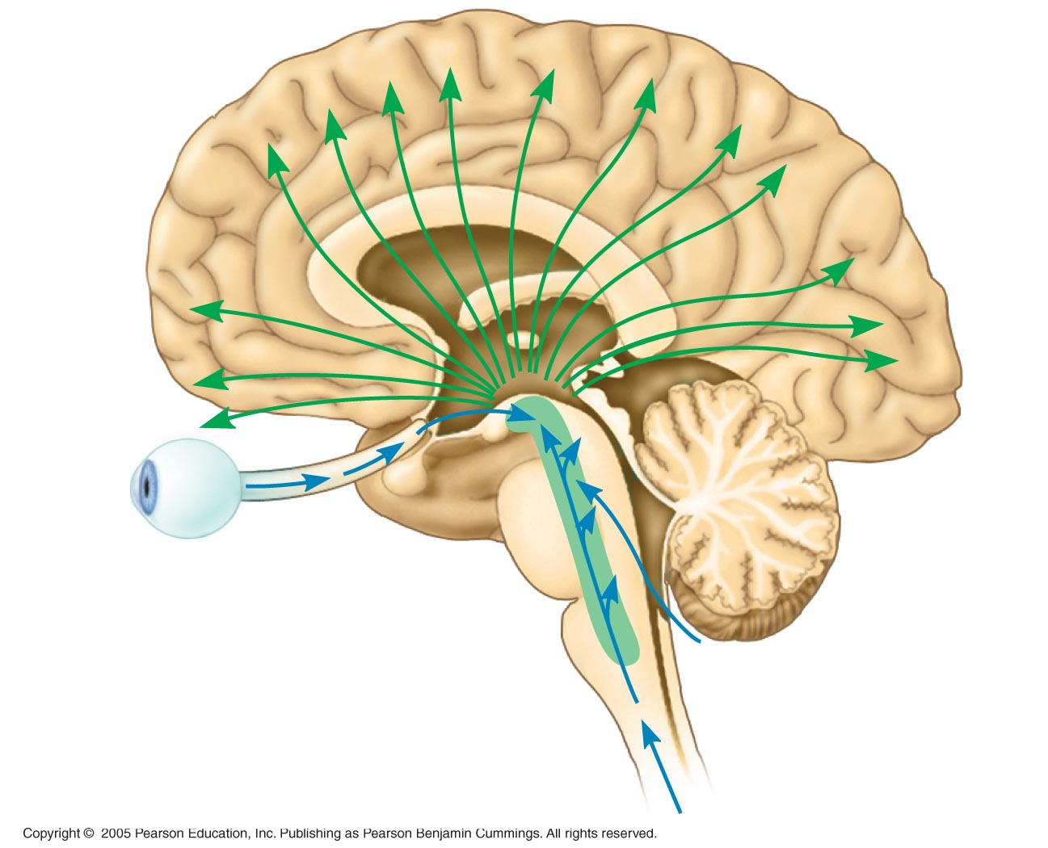
LE 28-18a
Data to cerebral
cortex
Input from
ears
Eye
Reticular formation
Input from touch, pain,
and temperature receptors

Slide 30
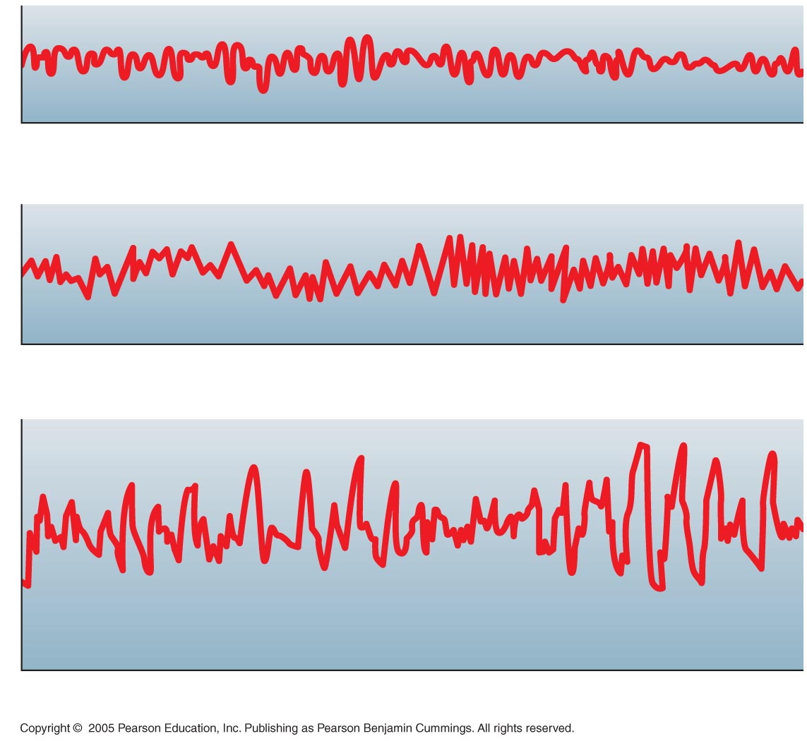
LE 28-18c
Awake but quiet (alpha waves)
Awake during intense mental activity (beta waves)
Delta waves
REM sleep
Delta waves
Asleep

Slide 31
28.19 The limbic system is involved in emotions, memory, and learning
  The limbic system is a group of integrating centers in the cerebral cortex, thalamus, and hypothalamus
    Amygdala
      Lays down emotional memories
      Acts as a memory filter
    Hippocampus
      Involved in formation and recall of memories

Slide 32
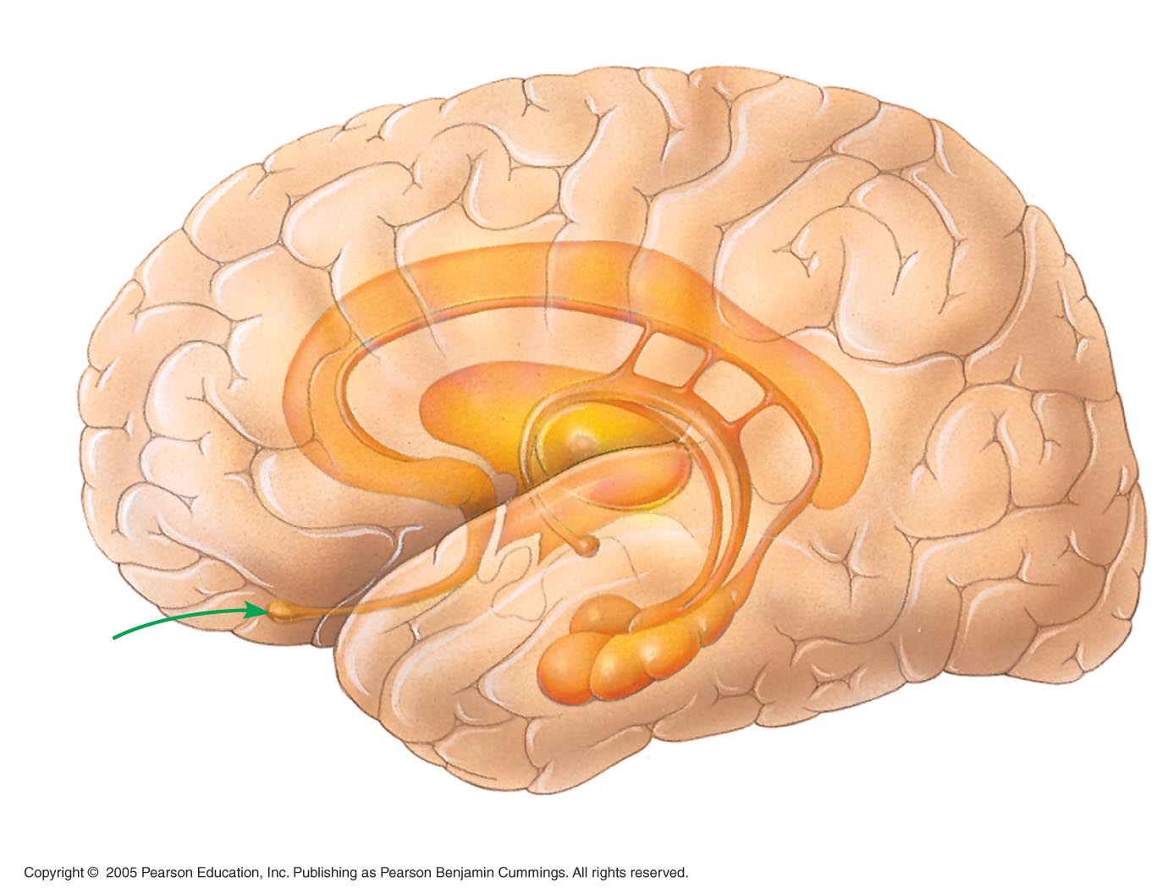
LE 28-19
Thalamus
Hypothalamus
Cerebrum
Prefrontal
cortex
Smell
Olfactory
bulb
Amygdala
Hippocampus

Slide 33
  Memory is the ability to store and retrieve information derived from experience
    Short-term memory: lasts only a few minutes
    Long-term memory: lasts weeks or longer
    Information can be transferred from short-term to long-term memory
    Factual memories are different from skill memories
  Information processing by the brain involves complex interplay of integrating centers

Slide 34
28.20 Changes in brain physiology can produce neurological disorders
  Schizophrenia is a severe mental disturbance
    Characterized by psychotic episodes in which patients lose the ability to distinguish reality
    Causes unknown, but research is looking for gene for predisposition
    Treated by drugs that affect the neurotransmitter dopamine

Slide 35
  Two broad forms of depressive illness have been identified
    Major depression leaves a person unable to live a normal life
    Bipolar disorder is characterized by extreme mood swings
    Most common treatment is selective serotonin reuptake inhibitors (SSRIs)

Slide 36
  Alzheimer's disease (AD) is a form of mental deterioration
    Characterized by confusion, memory loss, and many other symptoms
    Progressive; usually age related
    Neurofibrillary tangles and senile plaques destroy neurons in brain
    Currently no cure

Slide 37
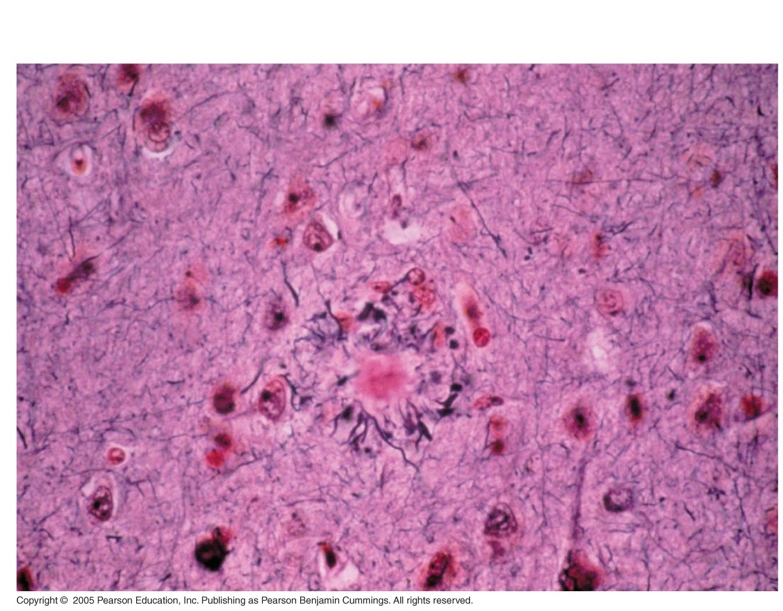
LE 28-20b
Senile plaque
Neurofibrillary tangle

Slide 38
  Parkinson's disease is a motor disorder
    Characterized by difficulty in initiating movements, slowness of movement, and rigidity
    Progressive; increases with age
    Symptoms result from death of neurons in midbrain
    Results from combination of environmental and genetic factors
    At present, no cure available

