Slide 1
THE NERVOUS SYSTEM
INTEGRATION & CONTROL

Slide 2
INTRODUCTION
A. Characteristics of the Nervous System
  1. Requires information
  2. Integrates information
  3. It’s FAST!!!! It can receive info, integrate it, and process in tenths of a second!

Slide 3
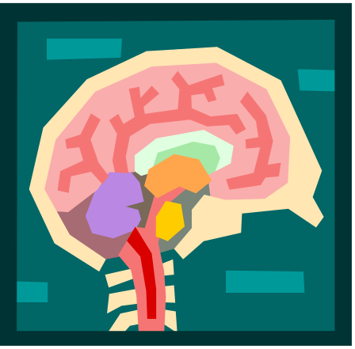
INTRODUCTION
A. Characteristics of the Nervous System
  4. Parts of the Nervous System
  5. Central - CNS
  6. Peripheral - PNS

Slide 4
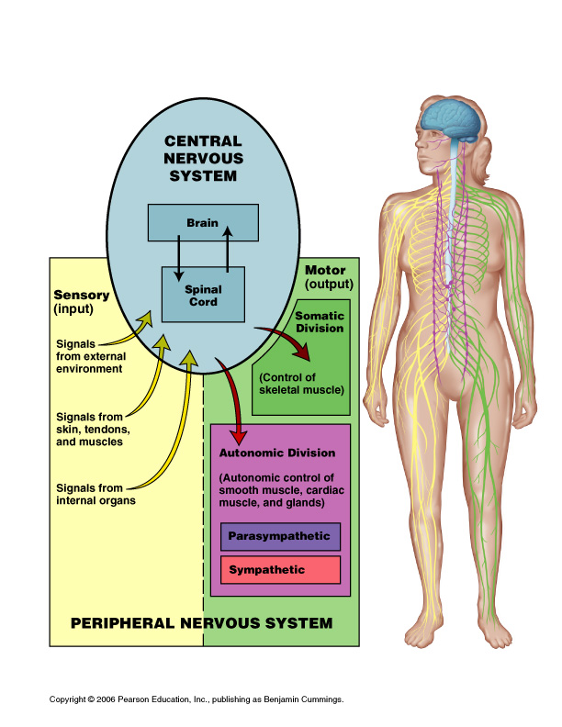

Slide 5


Slide 6
INTRODUCTION
B. Divisions of the Peripheral Nervous System (functional)
1. Sensory - receives info from sensory organs and receptors and sends it to CNS
2. Motor - receives info from the CNS and sends it to effectors (muscles, glands, and organs)

Slide 7
INTRODUCTION
C. Divisions of the Motor Nervous System
1. Somatic - can consciously controlled (ex: muscles)
2. Autonomic - not under conscious control (organs like the stomach or glands)

Slide 8
INTRODUCTION
D. Divisions of the Autonomic Nervous System
1. Sympathetic - speeds up metabolism and raises energy levels
2. Parasympathetic - slows down metabolism and lowers energy levels
** Both are always working together to maintain homeostasis.

Slide 9
When you are taking an exam, the sympathetic nervous system is dominant.
True
False

Slide 10
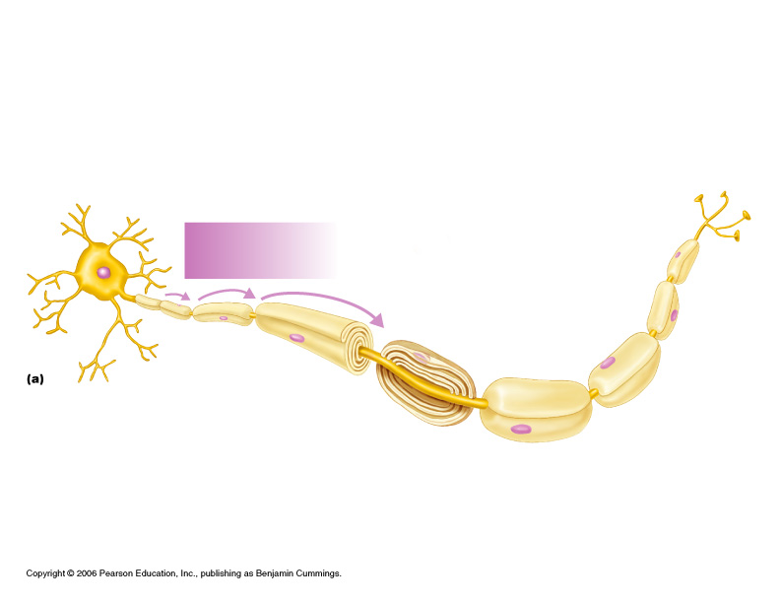
NERVOUS SYSTEM CELLS
A. Neurons are specialized for communication. They carry impulses (action potentials) from one part of the body to another.

Slide 11
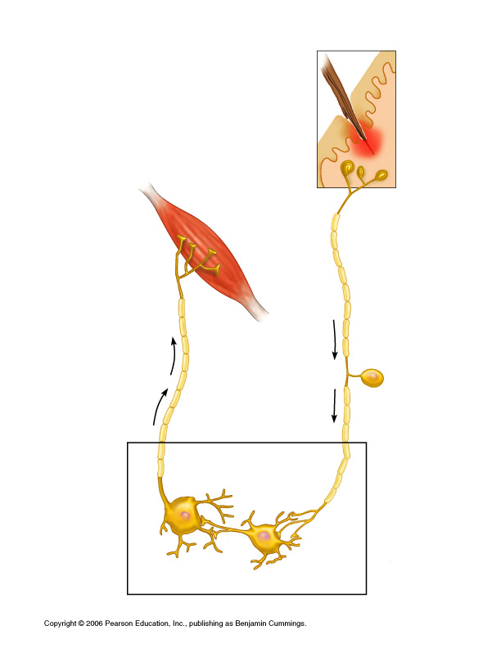
Sensory
Neuron
Motor
Neuron
Interneuron

Slide 12
NERVOUS SYSTEM CELLS
B. Three Types of Neurons
  1. Sensory - receive info from receptors and sends it to CNS (found in both CNS and PNS)
  2. Interneurons (Associative) - integrate and interpret the information (found only in CNS)
  3. Motor - receive info from CNS and sends it to effectors (found in both CNS and PNS)

Slide 13
NERVOUS SYSTEM CELLS
C. Parts of a Neuron
  1. Cell Body (perikaryon) - main part with the nucleus
  2. Dendrites - short extensions that receive impulses from another neuron towards the cell body
  3. Axon - long extension that carries impulses away from the cell body
    a) Axon hillock
    b) Axon terminals (teleodendria)

Slide 14
NERVOUS SYSTEM CELLS
D. Neuroglial cells do not carry impulses, but they are extremely important. They make up 80% of all cells in the nervous system. Functions include:
1. Physical support
2. Protection
3. Maintain healthy concentrations of chemicals in fluid around neurons

Slide 15
NERVOUS SYSTEM CELLS
E. The word “glia” is Greek for glue. Neuroglia is an appropriate name because these cells are the “glue” that hold the nervous system together.

Slide 16
NERVOUS SYSTEM CELLS
1. Types of glial cells include:
a) Astrocytes
b) Microglia
c) Oligodendrocytes
d) Ependymal cells
e) Schwann cells
**a-d are found in the CNS and e is found in the PNS

Slide 17
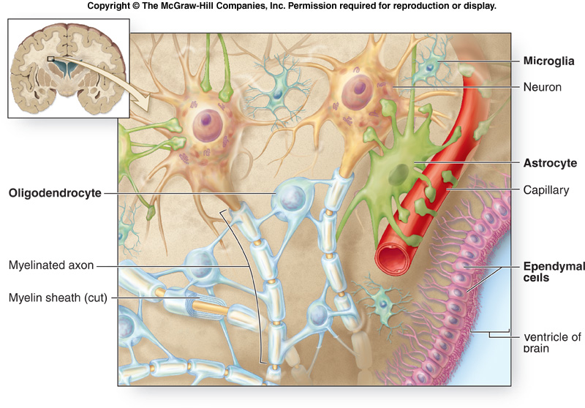
NEUROGLIAL CELLS
http://academic.kellogg.cc.mi.us/herbrandsonc/bio201_McKinley/f14-6_cellular_organiza_c.jpg

Slide 18
NERVOUS SYSTEM CELLS
F. Myelin sheath - a layer that surrounds the axons of CNS and PNS neurons.
1. The myelin sheath is made up of Schwann cells (in PNS) or Oligodendrocytes (in CNS) that wrap themselves around the axons.
2. These cells form a lipid insulating layer called myelin.

Slide 19
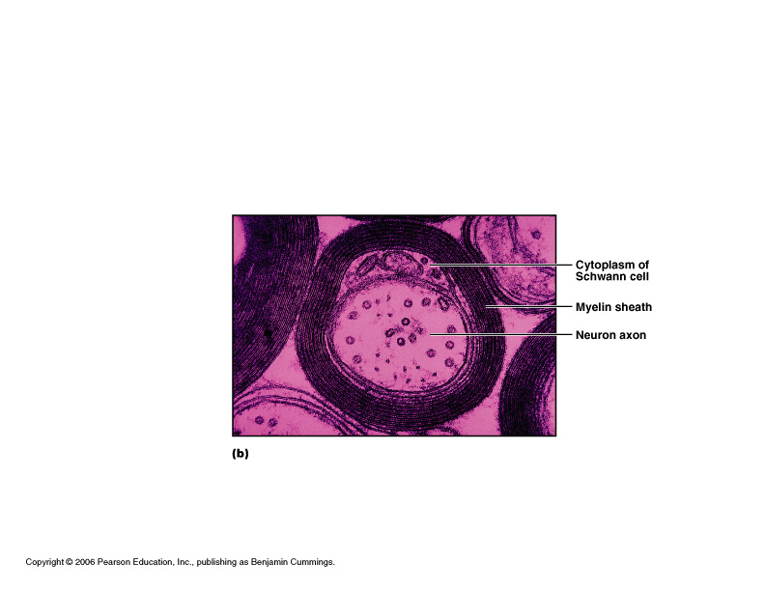

Slide 20
NERVOUS SYSTEM CELLS
G. Nodes of Ranvier are gaps in the myelin sheath caused by the space between the Schwann cells along the axon. There is no insulation here.
Saltatory conduction occurs as the action potential (impulse) jumps across the Nodes of Ranvier. This speeds up the rate at which the impulse travels.

Slide 21
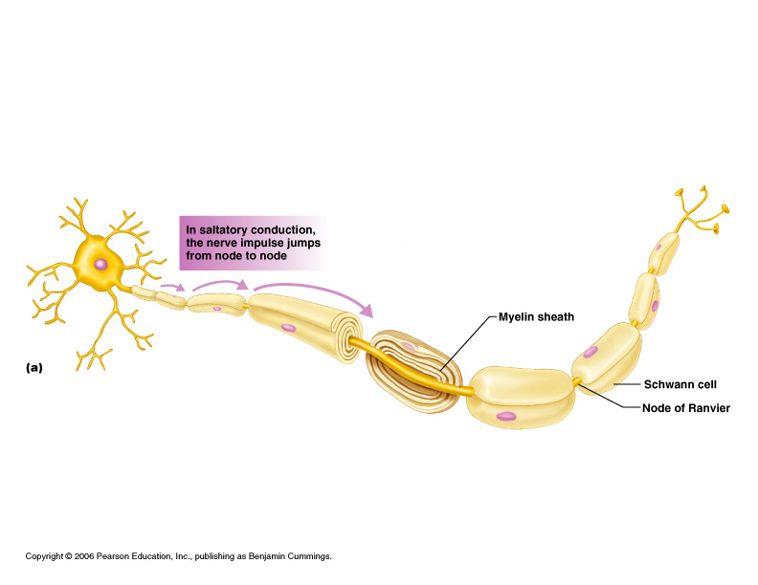

Slide 22
SALTATORY CONDUCTION ANIMATION
http://www.blackwellpublishing.com/matthews/actionp.html

Slide 23
How fast can a nerve impulse travel?
a. Up to 10 mph
b. Up to 80 mph
c. Up to 250 mph
d. Faster than the speed of light

Slide 24
NERVOUS SYSTEM CELLS
H. Three functions of the myelin sheath:
  1. It saves the neuron energy because the sheath prevents the leakage of ions.
  2. It speeds up the transmission of impulses due to saltatory conduction. (250 mph vs. 5 mph for unmyelinated axons)
  3. It helps damaged or severed axons of the peripheral nervous system. (No myelin sheath = no repair.)

Slide 25
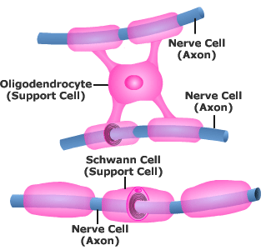
NERVOUS SYSTEM CELLS
I. Cells known as oligodendrocytes form the myelin sheath in the CNS.
http://www.getbodysmart.com/ap/nervoussystem/celltypes/menu/image.gif

Slide 26
NERVOUS SYSTEM CELLS
J. Multiple Sclerosis
An autoimmune disorder where the myelin sheath in the CNS is damaged so badly that sclerotic or scar tissue is formed
Symptoms include muscle weakness and visual impairment. It usually appears between the ages of 20 to 40. There is no cure.

Slide 27
NERVOUS SYSTEM CELLS
K. Amyotrophic Lateral Sclerosis (ALS or Lou Gehrig’s Disease)
Sclerosis of the motor neurons in the spinal cord that leads to weakening and wasting away of skeletal muscle tissue. Death is usually caused by respiratory failure as the diaphragm no longer works.

Slide 28
NERVE IMPULSES
The function of a neuron is to transmit info from one part of the body to another. How does this happen?
A. Resting membrane potential: Nerve cells membranes are polarized, producing a small but measurable voltage difference between the inside and outside of the cell membrane.

Slide 29
NERVE IMPULSES
A. Resting membrane potential:
1. Role of the sodium-potassium pump -
maintains the resting membrane
potential by pumping sodium out and
potassium into the cell. This keeps
the cell membrane polarized. If the
membrane is NOT polarized, no
impulses can occur.

Slide 30
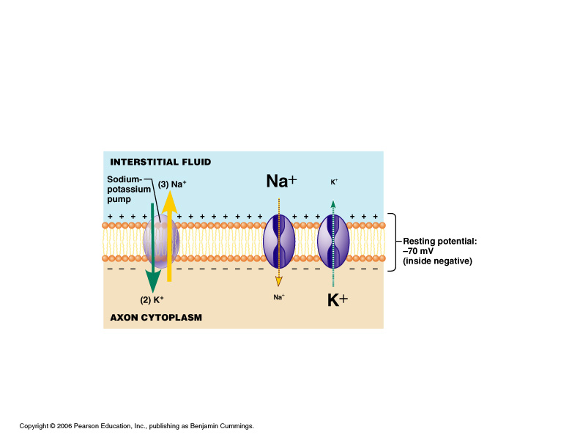

Slide 31
NERVE IMPULSES
A. Resting membrane potential:
2. The outside of the cell membrane
has a positive charge and the inside
has a negative charge compared to
the outside. (polarized)
3. The resting membrane potential is
about -70 millivolts (mV)

Slide 32
NERVE IMPULSES
B. Graded Potentials:
1. Every nerve impulse produces
small changes in the resting
membrane potential.
2. If the voltage gets closer to zero
(0), the membrane becomes
depolarized.

Slide 33
NERVE IMPULSES
B. Graded Potentials:
3. If the voltage becomes even more
negative, the membrane becomes
hyperpolarized.
These changes are called graded
potentials.

Slide 34
NERVE IMPULSES
B. Graded Potentials:
4. Summation occurs when many of
these small changes or graded
potentials add up and produce a
bigger change in membrane
potential than one impulse alone.
1 + 1 + 1 + 1 +1 = 5!

Slide 35
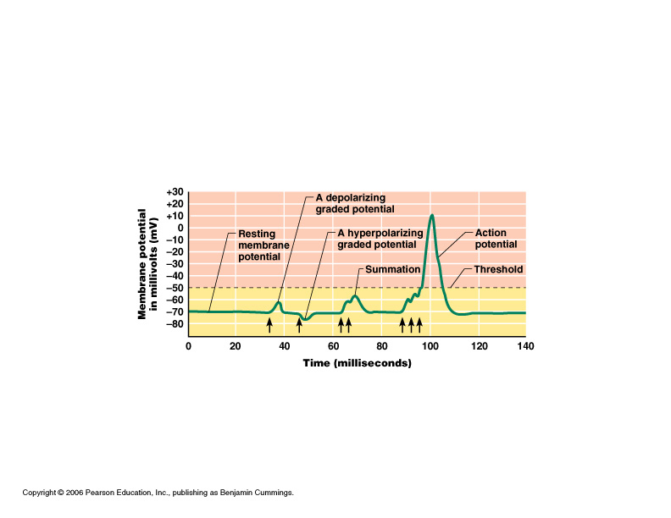
Resting membrane potential, graded potentials, summation, & action potential

Slide 36
NERVE IMPULSES
C. What is meant by “reaching the threshold?

Slide 37
NERVE IMPULSES
D. Propagation of an action potential:
There are 3 stages.
  1.
  2.
  3.

Slide 38
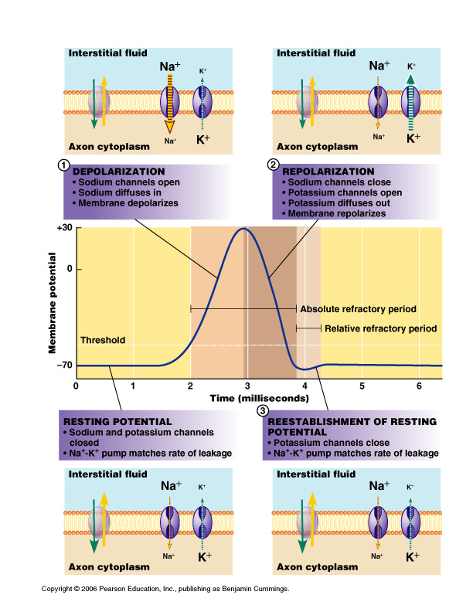

Slide 39
ACTION POTENTIAL ANIMATION
http://outreach.mcb.harvard.edu/animations/actionpotential_short.swf

Slide 40
BRAIN U - Cool Stuff

Slide 41
An action potential
a. reverses the + and – charges of the membrane.
b. allows sodium to leave the cell.
c. expels calcium from the endoplasmic reticulum.
d. is the same as the resting potential.

Slide 42
NERVE IMPULSES
E. The absolute refractory period occurs during an action potential. This means that no new action potential can be generated, regardless of the strength of the stimulus.
F. This is followed by the relative refractory period where a suprathreshold stimulus is needed for a new action potential to occur.

Slide 43
NERVE IMPULSES
G. This ensures that action potentials always travel in one direction because an area of the axon that just went through an action potential cannot start another one right away.
H. Action potentials are all-or-none, which means _________________.

Slide 44
NERVE IMPULSES
I. Action potentials are also self-propagating, which means it continues to create itself in the next region of the axon.
J. The speed of action potentials can vary from 5 mph to 250 mph.
  1. Increasing diameter of axon
  2. Presence of myelin sheath (nodes of Ranvier)

Slide 45
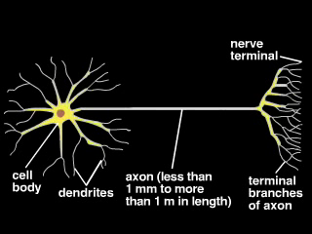

Slide 46
NERVE IMPULSES
K. How does a nerve impulse get from one neuron to another?
  1. Synapse
  2. Neurotransmitter
  3. Synaptic transmission

Slide 47
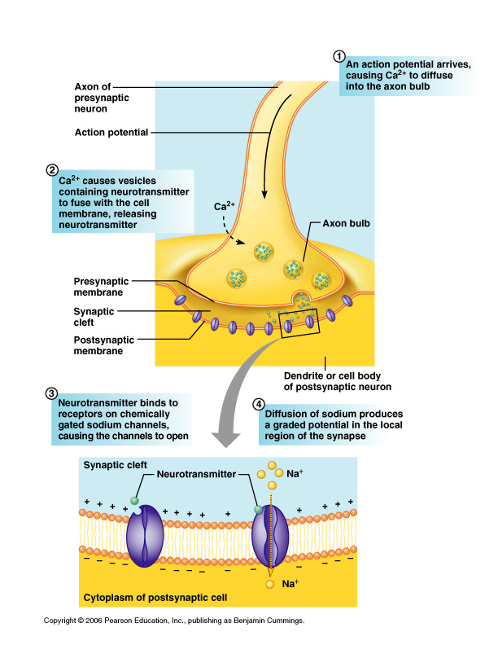

Slide 48
NERVE IMPULSES
L. The neurotransmitter is released by the axon bulb of the neuron sending the info.
M. The neuron that receives the info receives it at the post-synaptic membrane at receptor sites.

Slide 49
NERVE IMPULSES
N. Steps involved in synaptic transmission:
  1. A.P. Arrives at axon bulb, causing calcium channels in the presynaptic membrane to open and calcium diffuses into the axon bulb.
  2. This causes vesicles to fuse with the presynaptic membrane and release their neurotransmitters into the synaptic cleft.

Slide 50
NERVE IMPULSES
  3. The neurotransmitters bind to chemically sensitive ion channels, causing them to open.
  4. This will cause a new action potential on the postsynaptic membrane when the sodium ions diffuse into the cell. (depolarization)

Slide 51
SYNAPTIC TRANSMISSION ANIMATION
http://outreach.mcb.harvard.edu/animations/synaptic.swf

Slide 52
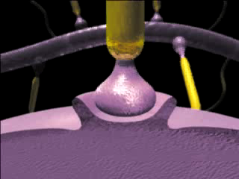

Slide 53
NERVE IMPULSES
O. Neurotransmitters can have inhibitory or excitatory effects.
  1. Excitability
  2. Inhibitory
  3. See Table 9.2 - Know 3 of each
  type

Slide 54
NERVE IMPULSES
P. Neurotransmitters have very short-lived effects because they are in the synaptic cleft for a very short time. Three things can happen:
1.
2.
3.

Slide 55
NERVE IMPULSES
Q. Postsynaptic neurons integrate and process information. Typically one neuron received input from many neurons. This is known as convergence.

Slide 56
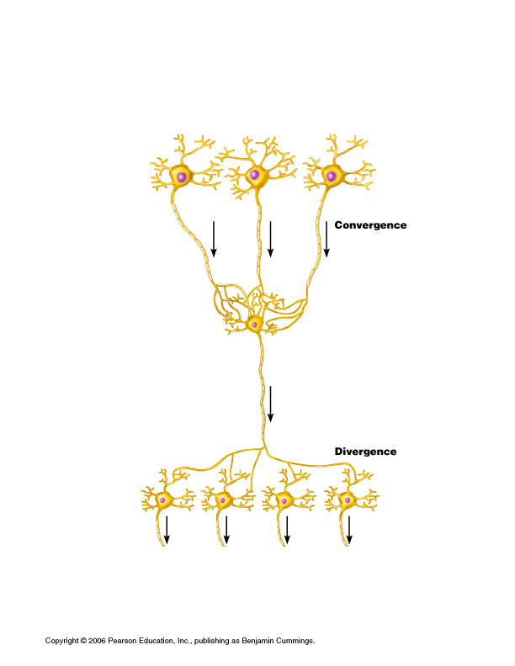

Slide 57
NERVE IMPULSES
R. This neuron’s action potential will then go to many other neurons in a process known as divergence.

