Slide 1
The Human Nervous System
Central Nervous
System
(CNS)
Peripheral Nervous
System
(PNS)
Brain
Spinal Cord
Sensory
(afferent)
Motor
(efferent)
Autonomic Nervous
System (ANS)
(involuntary)
Somatic Nervous
System
(voluntary)
Sympathetic Nervous
System
Parasympathetic Nervous
System

Slide 2
Sympathetic and Parasympathetic Divisions
Sympathetic- “fight-or-flight”- rapid heart rate; deep breathing; dry mouth; cold, sweaty skin; dilated pupils
  During vigorous physical activity- constricts blood vessels, bronchioles dilate, liver releases more glucose to blood, all nonessential activities are slowed
Parasympathetic- “resting & digesting”- keeps body E use as low as possible as it directs vital activities (digestion, elimination of wastes, etc)
  Blood pressure & heart rate regulated at low normal levels while gastrointestinal tract actively digests

Slide 3
Sensory Receptors
Specialized to respond to changes in environment (stimuli)
Mechanoreceptors- touch, pressure, vibration, stretch
Thermoreceptors- temp
Photoreceptors- light E
Chemoreceptors- chemicals in solution
Nociceptors- pain receptors- respond to potentially damaging stimuli

Slide 4
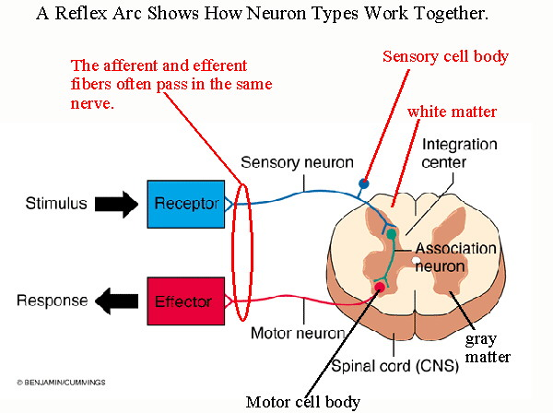
Reflex Arc
Highly specific neural pathways- 5 components
  1) Receptor- site of stimulus action
  2) Sensory neuron- transmits afferent impulses to CNS
  3) Intergration center- always in CNS
    may be 1 synapse
    between sensory
    & motor neuron
    or multiple synapses
    with chains of
    interneurons
  4) Motor neuron-
  transmits efferent
  impulses
  5) Effector- muscle fiber or gland that responds

Slide 5
Reflexes
Intrinsic (inborn) reflexes
  Usually rapid, predictable motor response to stimulus
  Many cases we are aware of reflex, some go without awareness (visceral reflexes are regulated by lower regions of CNS- brain stem & spinal cord)
Acquired (learned) reflexes
  Result from practice & repetition
  Pavlov’s Dog (conditioned reflexes)

Slide 6
Types of Reflexes
Spinal Reflexes (Ch 12)
Superficial reflexes- elicited by gentle cutaneous stimulation
Plantar reflex- elicited by drawing a blunt object downward along lateral aspect of the plantar surface
  Normal response: Downward curling of toes, tests integrity of spinal cord from L4 to S2
  Babinski’s sign- great to dorsiflexes & smaller toes fan laterally
    Seen in infants up to about 1yr, nervous system is not completely mylineated yet
Plantar Reflex
Babinski’s sign- Infant
Babinski’s sign- damage on right side

Slide 7
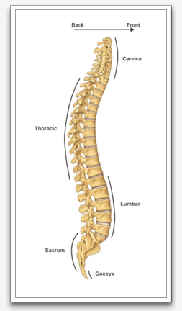

Slide 8
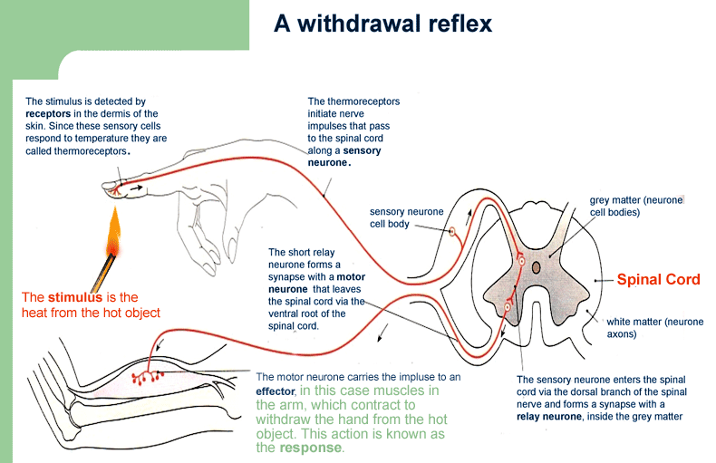
http://www.aqnt.com.au/images/SRA_Graph.gif

Slide 9
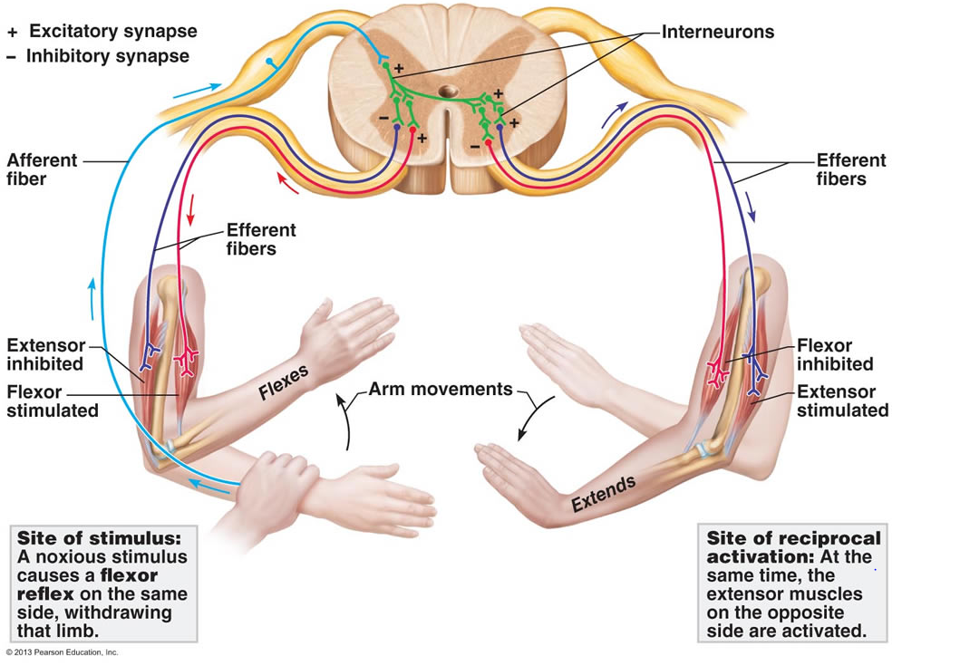
http://classes.midlandstech.edu/carterp/Courses/bio210/chap13/210_figure_13_20_labeled.jpg

Slide 10
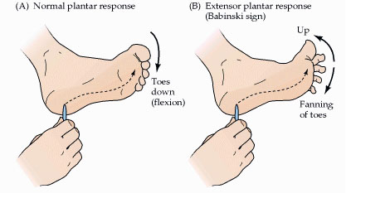
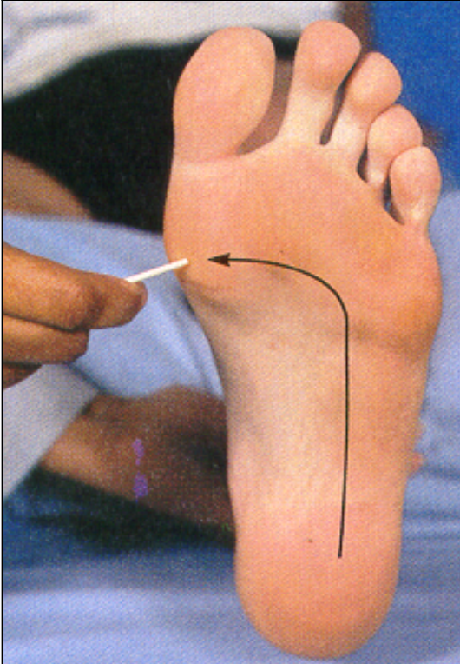
http://2.bp.blogspot.com/-Hdz81mh8s70/VeQGZKHIz-I/AAAAAAAAA6E/yy7XPPMIEw4/s1600/babinski.jpg
https://classconnection.s3.amazonaws.com/467/flashcards/941467/png/picture26-13F5AA29F40344BC330.png

