Slide 1
R
11 / 11 / 11
Paleobiology Lab workshop
by Adam Jost: Stanford University

Slide 2
What’s R?
- Open source language for stats, graphing, and programming
- Evolved from S at Bell Labs
- Maintained by volunteers in Austria
- Works across all major OS
- Can be customized/expanded w/ packages

Slide 3
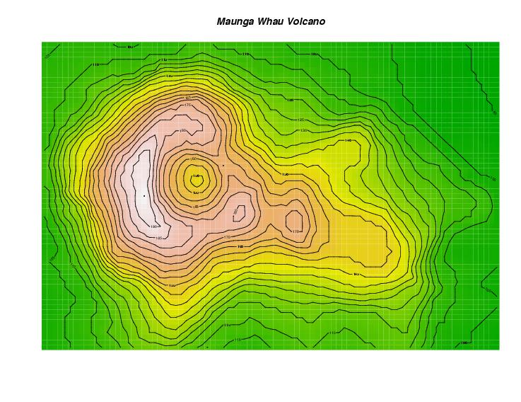
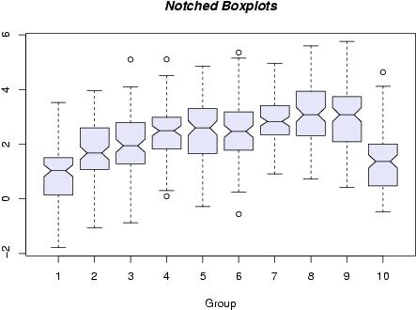
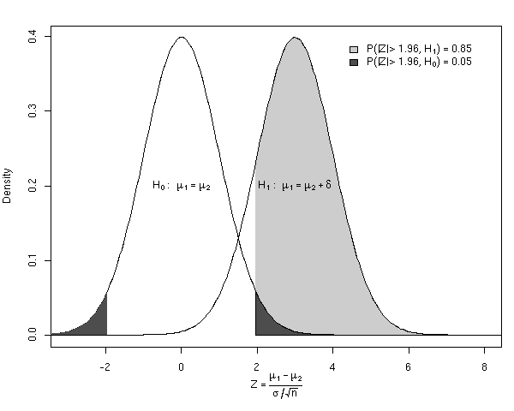
http://www.r-project.org
http://tolstoy.newcastle.edu.au/R/ (R email listserve)

Slide 4
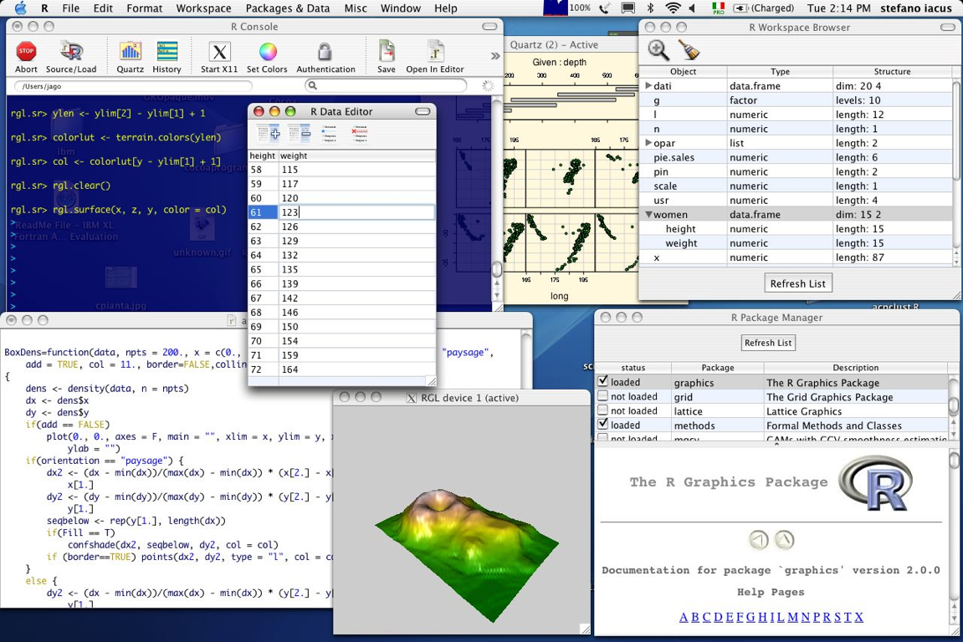
“Whoaaaa cool!!!”

Slide 5
Purpose of this workshop
Learn the basics of R
Familiarize yourselves with the syntax and structure of the R language
Create a foundation of knowledge which will allow you to start coding on your own
There is (almost) always several ways to answer the same question!

Slide 6
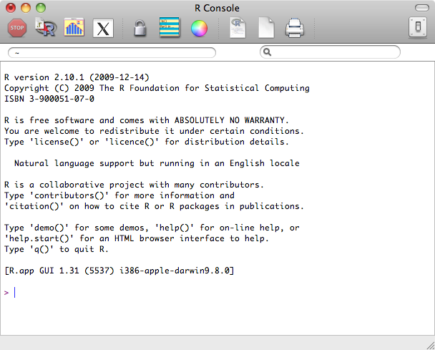
Getting started - the command line
    3 3
3+3 6
assigning variables:
x <- 3
x 3
x+3 6
x <- “hello”
x hello
Variables are case sensitive

Slide 7
Action | Symbol | Example
Arithmetic | + - / * ^ | 4^(2+2)
Grouping | { [ ( ) ] } | [1,2]
Assignment | <- = | foram <- 22
Variable Types | Example
numeric | 4, 0.538, -500
character | “foram, bivalves, Trex”
logical | TRUE, FALSE, T, F
factor | {for categorical data}
complex | 2+4i

Slide 8
Basic functions
> sqrt(9)
> mean(c(5,6,7))
  > seq(1,4)
  > seq(1,9,2)
3
6
1 2 3 4
1 3 5 7 9
Functions take arguments
> seq(1,9,2)
> seq(from=1, to=9, by=2)
> seq(to=9, by=2, from=1)

Slide 9
Making data structures
Making a vector:
> y <- c(1,2,4,4,5,6)
> mean(y)
> length(y)
> x <- mean(y)
> x+3
Subsetting elements
> y[2]
> y[2:4]
> y[c(1,6)]
3.666667
6
6.666667
2
2 4 4
1 6

Slide 10
Data structures cont.
Matrices
[ ]
> z <- matrix(1:6, nrow=3)
> z[,1]
> z[1,]
> z[1,2]
1 4
2 5
3 6
# calls the entire first column
# calls the entire first row
# calls element in 1st row, second column

Slide 11
Using functions on data structures
> 1:4
> x <- 1:4
> x+2
> x!
1 2 3 4
3 4 5 6
1 2 6 24

Slide 12
Exercise
1) Create a matrix called “W” with 4 rows and 3 columns with numbers from 2 to 24 by 2 (so 2, 4, 6, 8, …. 22, 24)
2) Assign row 3 to a new variable called “zz”
3) Calculate zz*zz and zz*3
4) Now calculate zz+250 and store the results as a new variable called “m3”

Slide 13
Useful tools
? and ??
    example: > ?mean
    -------------------------------------------------------
    use # for annotations
    -------------------------------------------------------
    press the up-arrow to pull up previous entered commands

Slide 14
Date frames
Different from vectors - allow you to combine different types of data (ie. character and numeric)
> x <- list(“puppies”, 10000, TRUE)
> x [[2]]
> x [1:2]
10000
[[1]] “puppies”
[[2]] 10000

Slide 15
> data <- list(student=“Thienan”, numforams=10000)
> data$student
> data[[1]]
> data$numforams
> data[[2]]
Data frame are similar, but are more like actual data tables
Easiest to create a data frame from imported data
“Thienan”
“Theinan”
10000
10000

Slide 16
Testing relationships
Greater than, less than | > <
Greater than or equal to, Less than or equal to | >= <=
Equal, not equal | == =/=
AND, OR | & |
> x <- 4
> x==10
FALSE
> if (x==10) “awesome!” else “oh no!”
“oh no!”
> if (x==10) “awesome!” else if (x==4) “oh ok” else “oh no!”
“oh ok”

Slide 17
Selecting values from data structures
> x <- c(4,7,11,17)
> x[c(3,4)]
> x > 10
> x[x>10]
> which(x>10)
> y <- which(x>10)
> x[y]
11 17
FALSE FALSE TRUE TRUE
11 17
3 4
11 17
Also works in data frames:
Ex: > which(x[,3]>10)

Slide 18
Summarizing and reordering data
> x <- c(2, 23, 11, 55, 9, 6)
> rank(x)
> order(x, decreasing=F)
> sort(x, decreasing=F)
1 5 4 6 3 2
1 6 5 3 2 4
2 6 9 11 23 55
vector positions
position in a sequence

Slide 19
Summarizing and reordering data cont.
> DNA <- c(“AGA”, “AGG”, “GTG”, “AGA”, “AGA”,”GTG”)
> unique(DNA)
> table(DNA)
“AGA” “AGG” “GTG”
“AGA” “AGG” “GTG”
3 1 2

Slide 20
Importing data
Easiest to save data as a .txt or a .csv
You can set a working directory multiple ways
A) Go to “Misc”, “Change Working Directory”
B) In the command line: > setwd(“~/Desktop/”)
C) Specify the full file path when importing

Slide 21
Some preliminary steps
Telling R that your new table is a data frame:
> foram <- data.frame(forams)
checking your table
> foram
> head(foram, 5)

Slide 22
making plots
huge variety of plots can be made with R
we will focus on basic histograms, box and whisker plots, and scatter plots
plot(foram$AU_vol,….)
Boxplot (foram$AU_vol,….)
Hist(foram$AU_vol,….)

Slide 23
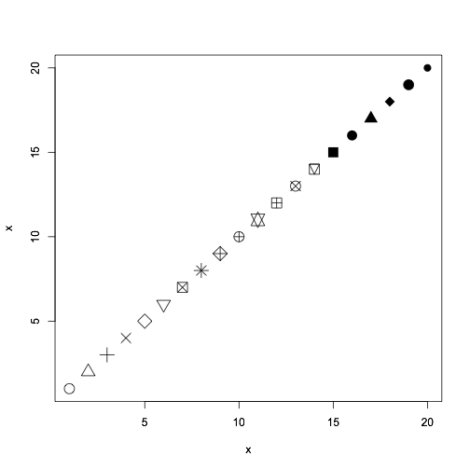
important plot() arguments
xlim=c(…)
ylim=c(…)
xlab= “Period”
ylab= “log size”
pch=20
cex=1.0

Slide 24
linear regression
> lm (y~x)
> regression <- lm (y~x)
> reg_summary <- summary(regression)
> reg_coefficients <- coef(reg_summary)

Slide 25
Another exercise
Switch to R
We are going to discuss:
- importing data using read.table()
- downloading packages
- setting your working directory
- writing functions
- constructing loops
- using sapply()
- making and exporting graphs

