Slide 1
HOW DO MUSCLES CONTRACT?
THE SLIDING FILAMENT THEORY OF MUSCLE CONTRACTION

Slide 2
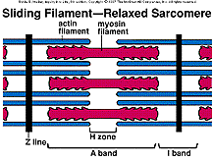
The Huxley Sliding Filament Theory
A review of myofilaments:
  Thick filament - A band, myosin
  Thin filaments - I band, but extends into A band, actin (& troponin and tropomyosin).
http://www.mhhe.com/biosci/ap/dynamichuman2/content/gifs/0205As.gif

Slide 3
Thick filaments
Made of about 200 molecules of myosin
Each myosin molecule has two “heads”
Each head has an actin binding site and an ATP binding site
The ATP site splits ATP and transfers energy to myosin head; which remains charged (“cocked”) until contraction.

Slide 4
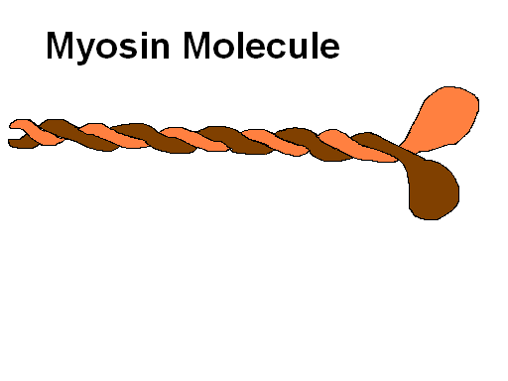
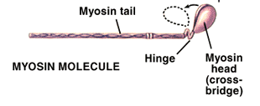

Slide 5
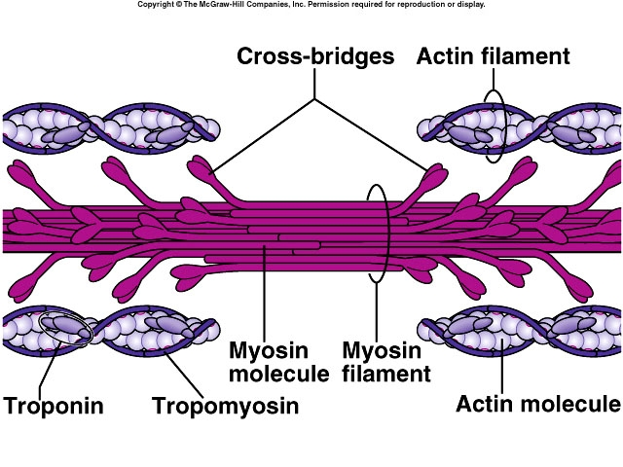

Slide 6
Thin Filaments
Actin molecules form a helix
  Each actin molecule has a myosin binding site
Other proteins:
Tropomyosin – long, filamentous protein, it wraps around the actin and covers the myosin binding sites
Troponin – a smaller molecule bound to tropomyosin, it has calcium binding sites.

Slide 8
The Huxley Sliding Filament Theory
When a muscle contracts, the A band and I band slide past each other. The filaments overlap.
  Myosin molecules in thick filaments have cross bridges, which act as hooks to pull actin filaments at specific receptor sites.
  This creates a ratchet-like motion.

Slide 9
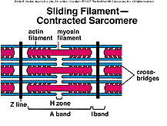
The Huxley Sliding Filament Theory
The I band width gets greatly reduced as the Z lines get pulled closer together.
http://www.mhhe.com/biosci/ap/dynamichuman2/content/muscular/visuals.mhtml

Slide 10
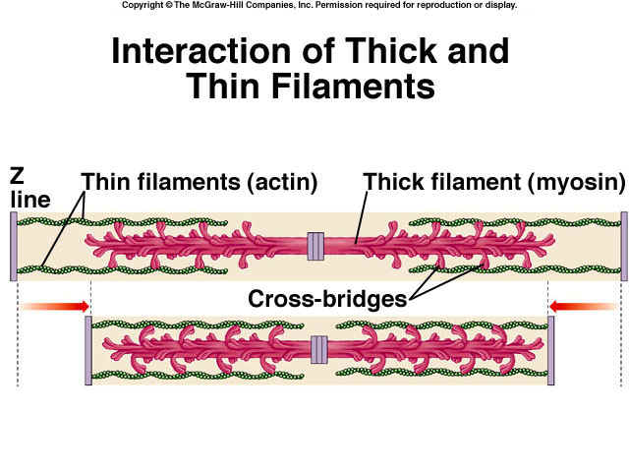
http://faculty.southwest.tn.edu/rburkett/AP1_m24.jpg

Slide 11
SLIDING FILAMENT ANIMATION

Slide 12
The Huxley Sliding Filament Theory
The H zone width gets greatly reduced and may disappear altogether.
The A band width is little changed because the thick filament length stays the same.
Energy is supplied by ATP molecules.

Slide 13
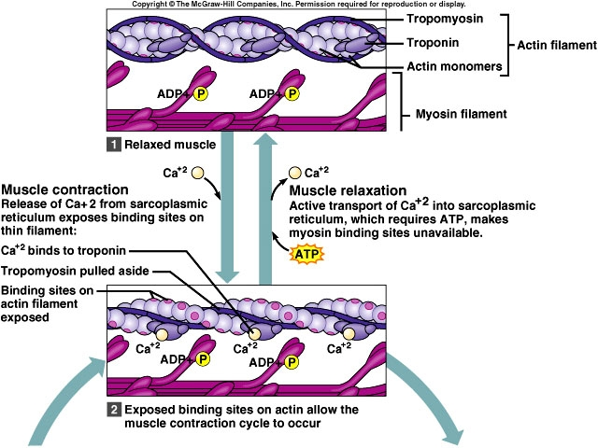

Slide 14
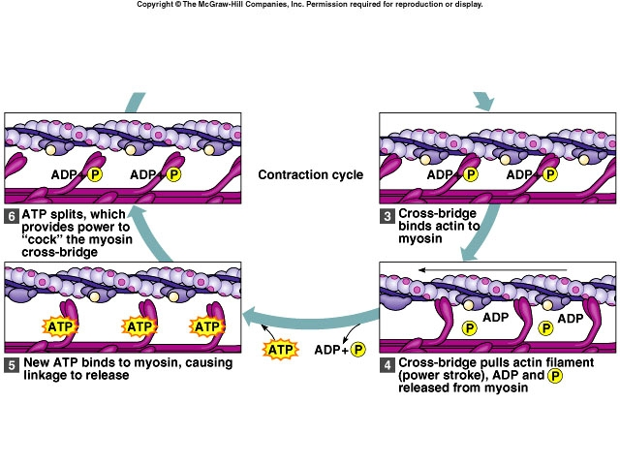

Slide 16
The Sliding Filament Theory
MECHANISM OF FILAMENT SLIDING IN MUSCLES

Slide 17
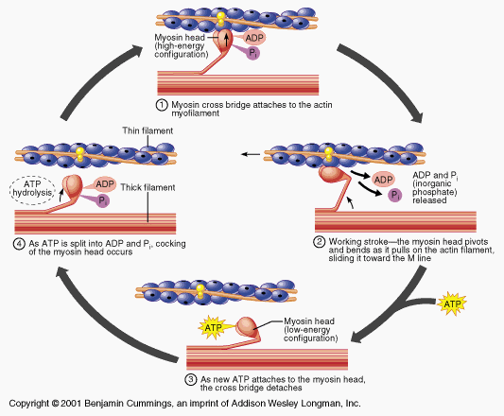
http://www.octc.kctcs.edu/gcaplan/anat/images/Image336.gif

Slide 18
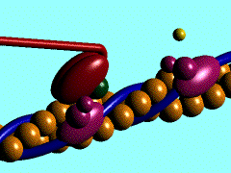
Watch the myosin.
THICK GRABS THIN AND PULLS IT IN.

Slide 19


Slide 20
MUSCLE STRUCTURE AND
FUNCTION TUTORIAL
CLICK ON THIS LINK AND GO THROUGH THIS ENTIRE TUTORIAL. IT WILL BE VERY HELPFUL .

Slide 21

Strength of Muscles

