Slide 1
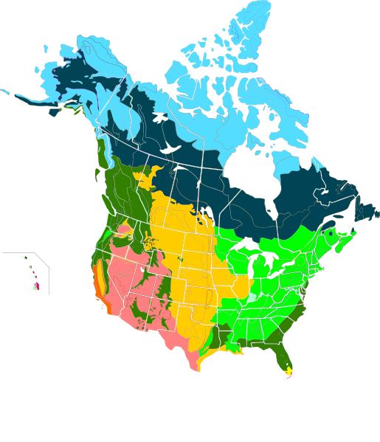
Biome Ecology Unit
(adapted from Faith Wittke, Westside High School Augusta, GA who credited Barbara Howerton with the original idea)
http://commons.wikimedia.org/wiki/File:Major_habitat_type_CAN_USA.svg

Slide 2
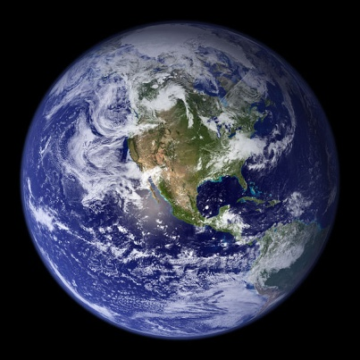
Project Overview
Biome project (project category—counts as one lab grade & one test grade).
This project covers the ecology unit standards.
Your group will be assigned a biome to research. You will be able to draw from a list of biome/ecosystems.
You will be graded based on my assessment of your biome and presentation, and your team members’ assessment of your contribution to the project.
The maximum number of team members is 3 (4 with teacher's permission)
http://en.wikipedia.org/wiki/File:Earth_Western_Hemisphere.jpg

Slide 3
Objective:
The Biome Ecology Project
130 points
The Basics:
Find out some basic information about the ecosystem of the location you are assigned.
Decide what the location is best suited for, ideas below.
Work together as a group to gather lots of information about your location, details below.
Compile information digitally to submit to the teacher.
Design a creative and engaging 3-5 min presentation (using technology) for the class that highlights the most interesting and crucial aspects of your location.

Slide 4
Objectives (continued)
The Details:
Your groups will be three people. Some exceptions will be made, based on class size, with teacher permission. Your group will draw one biome to research from a list of possibilities.*
Your grade will be determined in three components:
  the Biome Digital Presentation you share with the class: 50 points possible, assessed by teacher (Animoto, Prezi, Haiku Deck, or PowerPoint, etc)
  the Digital Research Compilation you turn in to the teacher: 50 points possible, assessed by teacher (PowerPoint, MentorMob, LiveBinder, etc.)
  your team members’ peer assessment of your contribution to the project: 30 points possible
.
Addresses: California standards: Ecology (6)

Slide 5
Items to include in Digital Compilation (not presented to class although some images you design or use should be considered for use in the Digital presentation to the class):
Location Details Inserting Google Maps
Date Range
Yearly Climate Pattern
  climatogram in Excel XP
  How to make a climatogram in Excel 2007 or 2010
  (How to make a climatogram link (simple)
Sources of natural resources
List of indigenous plants, especially edible ones
  http://www.survivaliq.com/index.htm
  Bryophytes, Pteridophytes, Gymnosperms, Angiosperms
List of native animals
  phyla and classes
Other organisms that could be considered food
  Bacteria, Archaea, Protista, Fungi
What is the carrying capacity of the area?
Trends for the area, represented quantitatively,
  climate change, weather patterns, invasive species, human impact, etc.
Construct a food web that includes you and other organisms in your biome.
Challenges of this biome
Which natural disasters is your biome prone to experience?
How can the environment be protected? What measures can be taken to limit impact?

Slide 6
Items that need to be included:
Latitude and Longitude
Exact location (keep in mind what water supply will be used when choosing a location within your assigned biome) a world map and the landmarks or features, type of biome or ecosystem. Inserting Google Maps
http://en.wikipedia.org/wiki/File:Earth_Western_Hemisphere.jpg

Slide 7
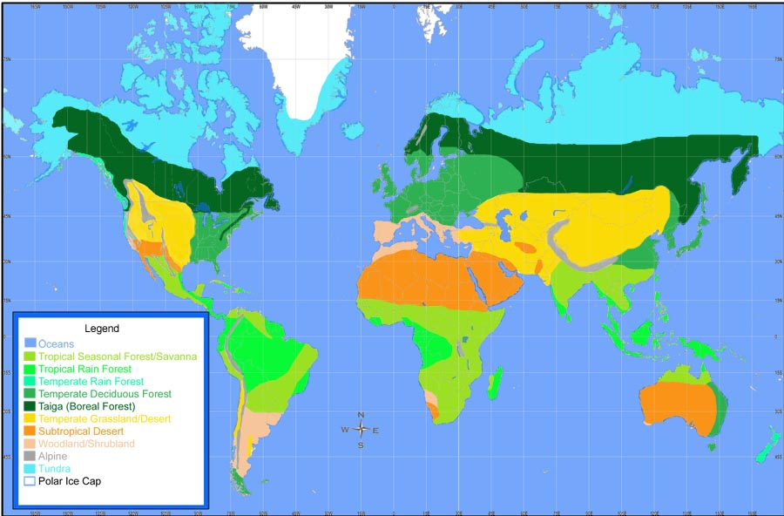
Name and describe your biome:
http://www.marietta.edu/~biol/biomes/biome.jpg

Slide 8

Dates:
Exact dates (your choice)
why is this date better than other dates?
You will use the climatogram to help with your choice (see the next item).
http://en.wikipedia.org/wiki/Calendar

Slide 9
Describe the yearly climate pattern (making a climatogram)
what are your expected weather conditions for the chosen location and time.
Create a climatogram of the yearly precipitation and temperature of your site.
A climatogram is a graphical representation that shows the amount of precipitation and the average temperature per month of a given biome. Both variables are plotted on the same graph to show how they relate to each other. The data on the climatogram must be accurate
See links on the online instructions:
(How to make a climatogram link (simple)
(climatogram in Excel XP)
(How to make a climatogram in Excel 2007 or 2010)

Slide 10
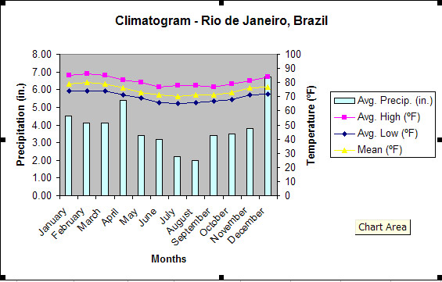
Example Climatogram
NOTE: THIS ISN’T QUITE RIGHT, NEEDS CM FOR PRECIPITATION AND º C for temperature…don’t forget

Slide 11
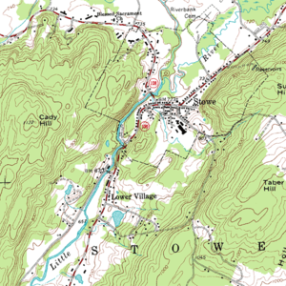
Natural Resources…
Example:
Where is the water located in the area?
How will you make sure it is safe to drink?
How are you making sure you don’t contaminate downstream?
http://upload.wikimedia.org/wikipedia/commons/thumb/7/79/Topographic_map_example.png/300px-Topographic_map_example.png

Slide 12
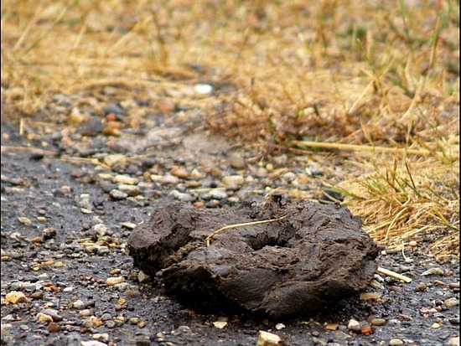
Sources of "natural" renewable energy (how will the contestants stay warm or cook food???)
What is available on the site?
You are not allowed to cut down living trees
What is unique to the site that can be used as a fuel source?
http://images.travelpod.com/users/bbaxterj/1.1283162030.buffalo-chip.jpg

Slide 13

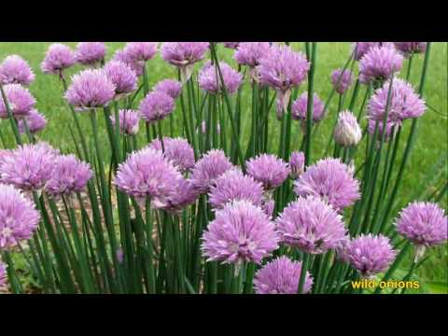
List of indigenous (native) plants
http://foraging.com/images/1602396922.jpg
http://i.ytimg.com/vi/vVaxCyExab8/0.jpg
http://www.survivaliq.com/index.htm

Slide 14
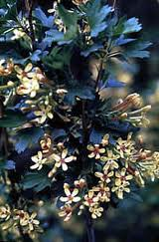
List of plants that might be grown
(… if that is possible in your biome)...
are there any plants you could grow and you can harvest?
Plan for capturing food, harvesting food, or growing food
make sure you mention any other types of plants like:
Bryophytes (mosses)
Pteridophytes (ferns)
Gymnosperms (pines, firs, redwoods…)
Angiosperms (flowering plants)
http://www.loc.gov/rr/scitech/tracer-bullets/images/Golden_Current2.jpg

Slide 15
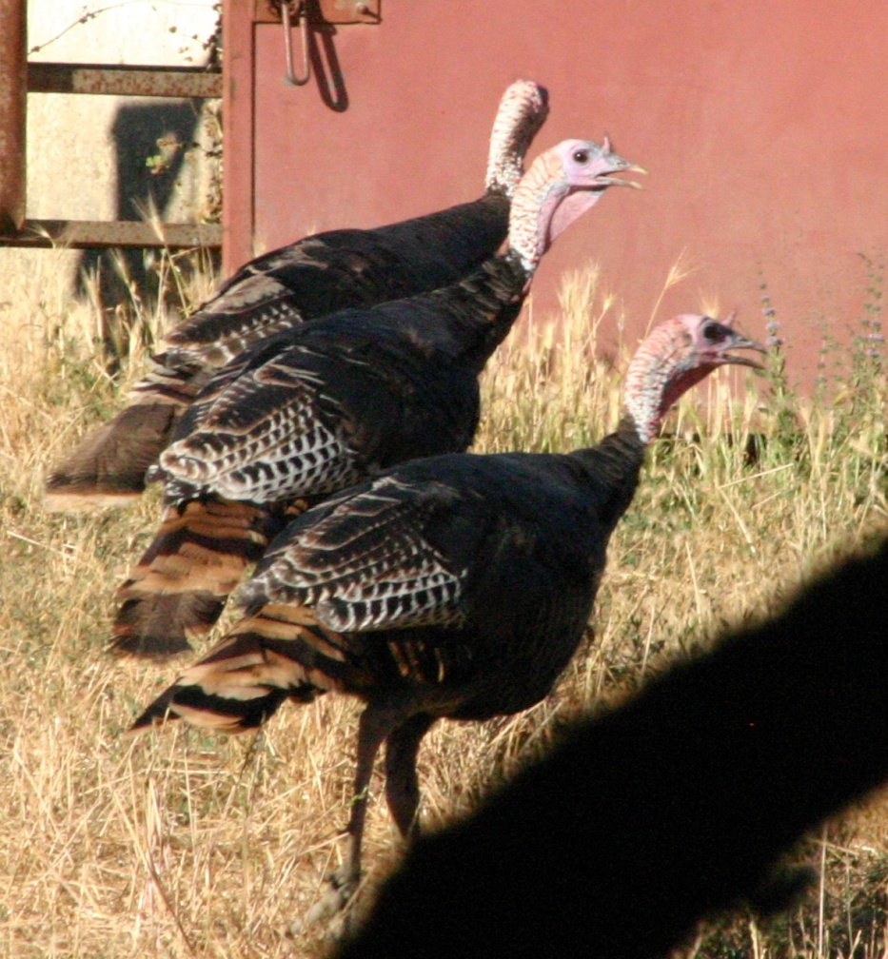
List of native animals (including endangered species)
how much you need to survive.
(Try to find examples from as many phyla and classes as possible...
see the list of phyla and classes
How will you capture your food?
http://backyardzoologist.files.wordpress.com/2010/11/img_5600.jpg

Slide 16
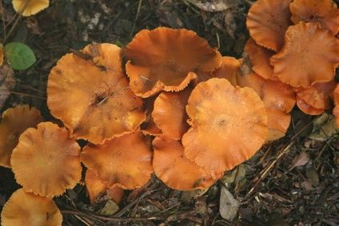
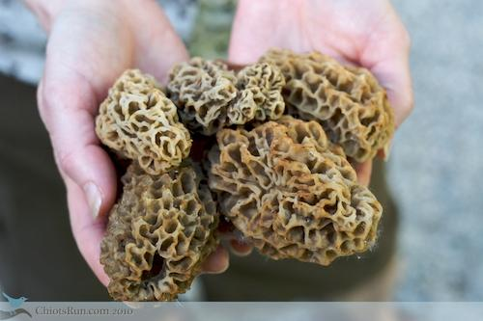
Other organisms (other kingdoms) that could be considered food (Bacteria, Archaea, Protista,Fungi)
http://www.grit.com/uploadedImages/GRT/blogs/Susy/handful-of-morels.jpg
http://img.ehowcdn.com/article-new/ehow/images/a07/65/00/guide-wild-mushrooms-northern-california-800x800.jpg

Slide 17
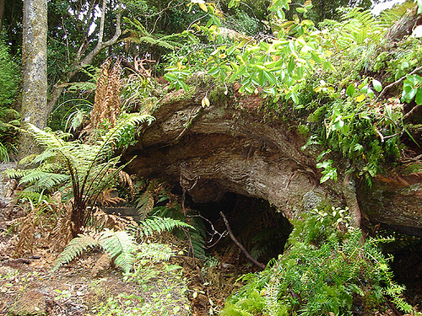
Plan for shelter (if needed)
remember you will only have the naturally occurring resources available
must be appropriate for your biome
http://2.bp.blogspot.com/_nXcjv069Ncs/TTjApXl5SKI/AAAAAAAAAEk/GXNAGSxst7Y/s1600/naturalshelter.jpg

Slide 18
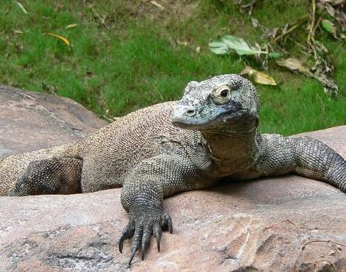
Organisms that can pose a threat
remember not all threats are large mammals
MUST be native (found) in your biome
how will you defend yourselves?
http://a-z-animals.com/media/animals/images/470x370/komodo_dragon.jpg

Slide 19
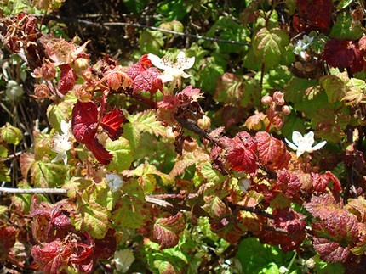
Are there any native medicinal organisms and how they can be utilized
Example: Blackberries…”The most astringent part is the root. Orally, (can be) used to treat sore throats, mouth ulcers and gum inflammations. “
http://www.altnature.com/gallery/Blackberry.htm
Blackberries…
http://cdn2-b.examiner.com/sites/default/files/styles/image_full_width_scaled/hash/ed/4f/ed4fc1f0e1bccd5dab6920415060aa76.JPG http://www.altnature.com/gallery/Blackberry.htm

Slide 20
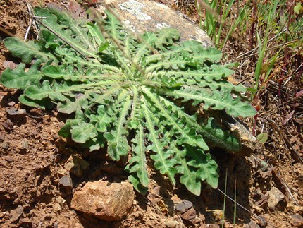
???medical emergencies (broken leg, insect or snake bites, sunburn, rashes, etc.)
Example: soap plant
http://cdn2-b.examiner.com/sites/default/files/styles/image_full_width_scaled/hash/39/0d/390d0ceb511e7c758f15e144075bb11b.JPG

Slide 21
Plan for division of labor among participants
What tasks are you planning on for the participants and you?
What challenges? (make sure apply to that particular biome).

Slide 22
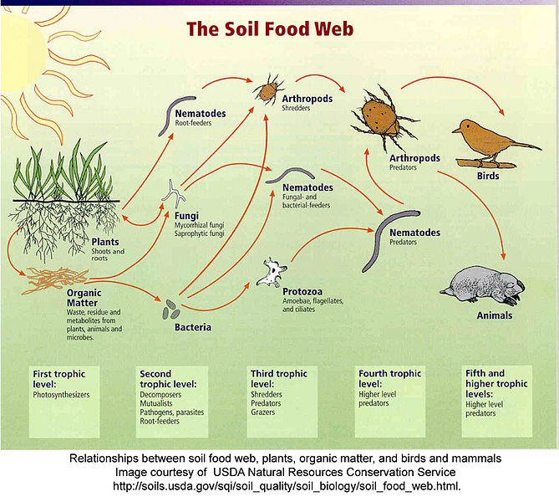
Construct a food web
includes contestants
other organisms in your biome.
Make sure the arrows POINT INTO the mouth of the consumer.
Make sure applies to your biome.
http://upload.wikimedia.org/wikipedia/commons/8/89/Soil_food_webUSDA.jpg

Slide 23
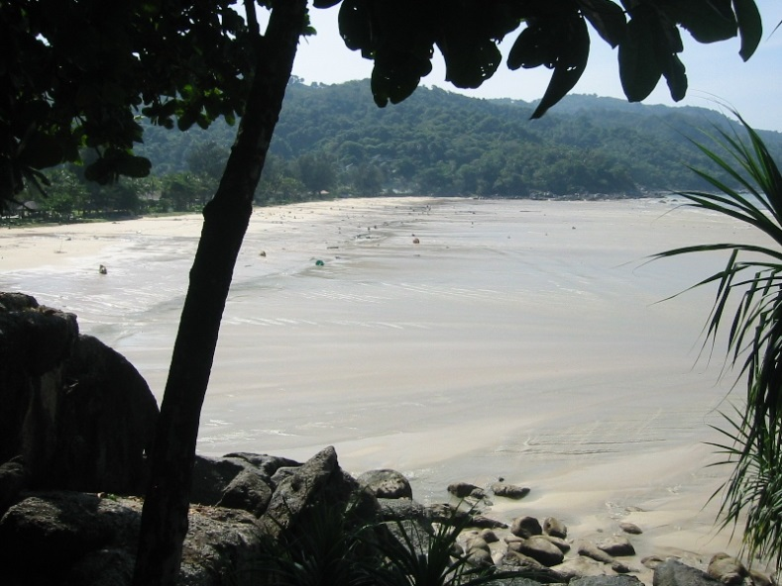
Create one probable problem
For example if you are doing the Survivor show explain how tribes would deal with the problem and actually SURVIVE!
http://upload.wikimedia.org/wikipedia/commons/3/36/KataNoiReceding.jpg

Slide 24
Challenges
What challenges are appropriate for your biome
Incorporate landmarks (natural features)
Make it probable

Slide 25
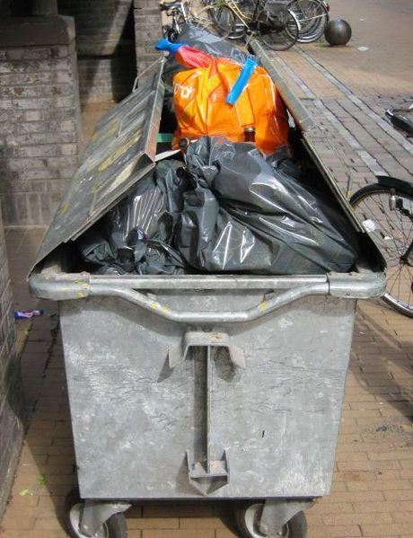
Avoid Impacting the Site
How you are going to prevent the destroying of the environment while you arethere?
Are you leaving it a better place? How?
http://upload.wikimedia.org/wikipedia/commons/7/78/Vuilnis.JPG

Slide 26
Make your project interesting
think about using appropriate props/costumes (remember you can't break the school dress code... ).
Don’t forget this is a SALES pitch for your project (market yourself appropriately

Slide 27
REFERENCES
Make sure you put references for images (you can put a number right under each picture and make a slide with Image References)
a separate slide of all web sites and books used in preparation of the project.
(use APA format for your references (www.bibme.org)

Slide 28
Biome Digital Presentation Reminders
you share with the class: 50 points possible, assessed by teacher (Animoto, Prezi, Haiku Deck, or PowerPoint, etc)
Building an Engaging Digital Presentation:
Identify all participants
Use credible websites to investigate the following: Google Map location, climate, weather, seasons, plants and animals, food webs.
Maximum presentation time 3-5 minutes (does not include question time after presentation)
Use a digital app (examples: Animoto, Prezi, Haiku Deck, PowerPoint, etc.) iPads will be available certain class periods, to be announced. Plan accordingly if you do not have access to your own personal device.
Be artistic and creative! Use color, sound clips, clear and legible text, video clips, etc.
Your presentation must be dynamic and engaging.
Don’t forget your references

Slide 29
More Reminders for
Digital Research Compilation :
All slides must be readable (avoid too many flying effects, transitions, overlays, difficult to read backgrounds).
No more than 5 words per bullet, no more than 25 words per slide.
Maximum 20 slides not including references.

Slide 30
Important Reminders for both sections of the project:
Cite references in APA format (www.bibme.org)
Be specific and thorough
See posted resources for more details
This project must be shared and received, and compatible to open by the teacher by the posted due date, otherwise it will be considered late.
There are further resources to support your work on this project, such as rubrics, standards, expanded details, etc, posted on the class website and School Loop! Please be thorough and responsible researchers and group members, and plan how you will be sure to accomplish all aspects of the project within the allotted time. Take into consideration computer lab days, iPad access, group members’ schedules, and organizational strengths and weaknesses of everyone involved. Good luck, and have fun!
Don’t forget to turn in your presentation group evaluation: http://www.grochbiology.org/BiomeProjectSelf-TeamAssessment.docx

Slide 31
Even More Reminders:
All participants must PARTICIPATE, divide up the presentation... limited to 5 minutes (grade drops 1% per minute over).
Presentation should look like a "sales pitch" (look it up) not a traditional report.
Practice, pre-prepare, it is ok to use notes to refer to during the question and answer period.

