Slide 1
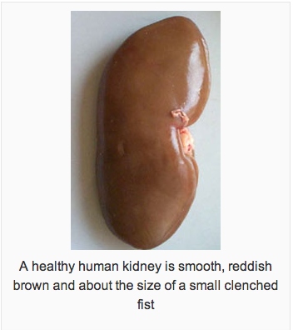
Kidneys
Maintain homeostasis/chemical equilibrium
Filter blood as it passes through
About 2000 liters of blood/day get filtered and 1.5-2 liters exit in urine
Urine is a combination of excess water and urea: a waste product that contains excess amino acids from proteins broken down by liver.
http://www.abpischools.org.uk/page/modules/homeostasis_kidneys/index.cfm?coSiteNavigation_allTopic=1

Slide 2
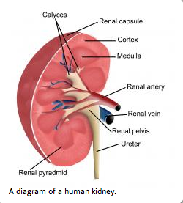
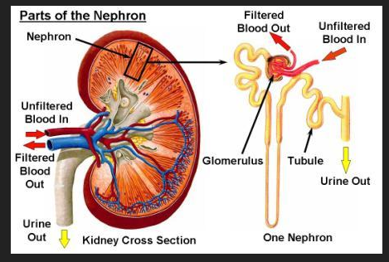
http://www.wisegeek.com/what-are-the-symptoms-of-kidney-stones.htm

Slide 3
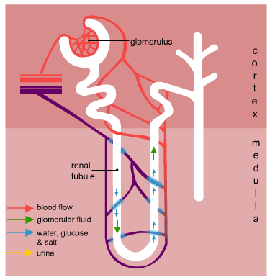
The Nephron

Slide 4
1
When blood leaves the capsule, the concentration of some substances has changed. Give four substances whose concentration has changed and say what has happened to the concentration.
A
More water
E
More urea
F
B
Less urea
Less water
G
C
More glucose
More salt
H
D
Less glucose
Less salt

Slide 5
2
Where does the nitrogenous waste that ends up in urea come from?
A
Amino acids from the muscular system
B
Neurons from the nervous system
C
Toxins from the spleen
D
Amino acids from the liver
E
Glucose from the intestines

Slide 6
3
Looking at the picture below, choose which letter points to a spot where you would expect to find the greatest concentration of glucose in the renal tubule.
A
B
D
C
E

Slide 7
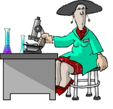
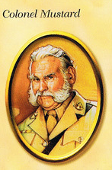


Scenario:
You are a clinical (lab) technician. Several urine samples have arrived at the laboratory and the labels have become separated from the samples. Oops!
Patient A
Colonel Mustard: Jaundice-Liver Damage or Kidney Stone
You have the names of the patients and possible diagnoses for each one:
Patient B
Miss Peacock: Bladder Infection or Kidney Damage
Patient C
Professor Plum: Diabetes or Kidney Damage

Slide 8

Your job is to design an experiment to match the unlabeled samples with their owners.
You have a list of tests; research and learn what each will tell you.
Write out your experiment including your:
Hypothesis, SV, IV, DV and control
Your procedures
Design a data table
3. With your lab group discuss and match the patients to the urine samples. Provide your rationale for matching each urine to each patient using a table format.
4. Write up using an outside source (internet, medical dictionary). Copying and pasting earns a big 0.
You should: describe major symptoms of the diagnosed disease; explain why the lab tests are appropriate and can indicate the presence of the disease; and explain recommended treatments.

Slide 9
Patient A
Colonel Mustard: Jaundice-Liver Damage or Kidney Stone
Patient B
Miss Peacock: Bladder Infection or Kidney Damage
Patient C
Professor Plum: Diabetes or Kidney Damage

Slide 11
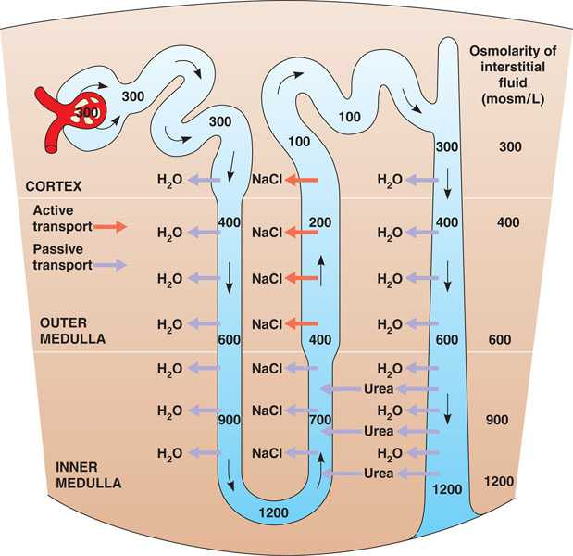

Slide 12
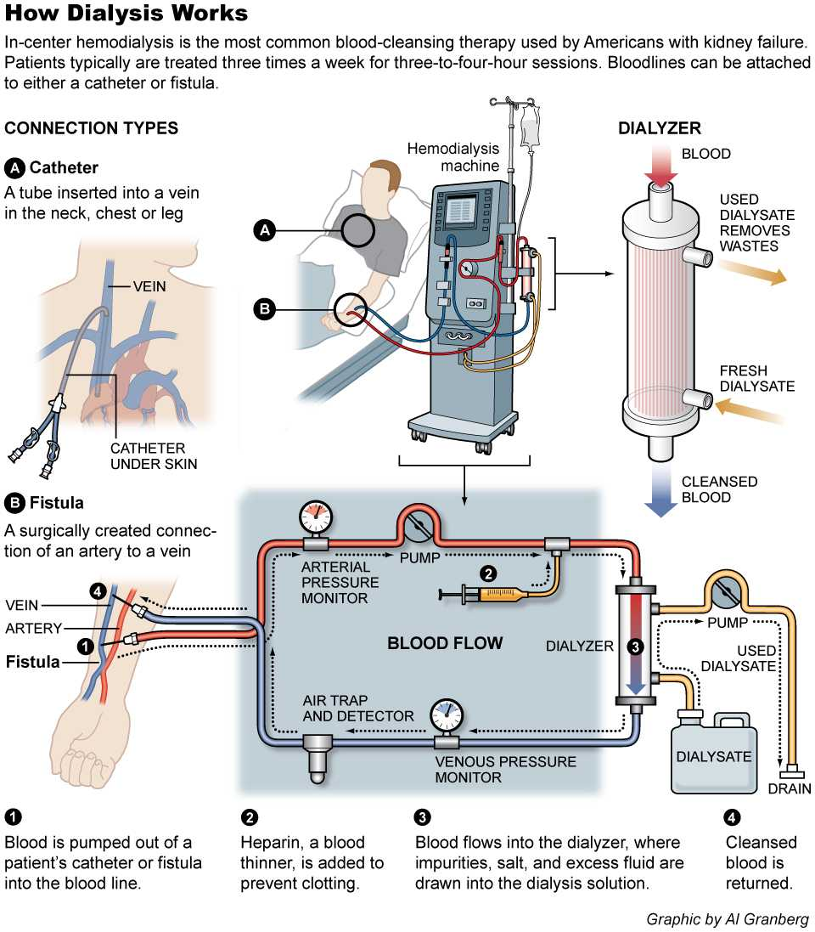

Slide 13
Credits
UR in Trouble Lab taken from Robin Groch San Ramon Valley High School; retrieved from grochbiology.org
Animations, graphics and question content taken from:ABPI Resources for schools website: http://www.abpischools.org.uk/page/modules/homeostasis_kidneys/kidneys6.cfm?coSiteNavigation_allTopic=1
Adapted by Pam Sheppel 2/3/2013

