Slide 1
Excretory/Urinary System and Kidneys
Function: Remove nitrogenous & other wastes from blood, help maintain blood P, pH & chemical composition
  Ammonia (NH₃)- Toxic H₂O-soluble N-waste
    Urea- H₂O-based
        Majority of N waste in humans
    Uric acid- more solid
    Creatinine
Kidneys= main excretory organs
  Filter 200L of fluid from bloodstream a day & make urine
  Location: dorsal body wall between, near bottom of rib cage
  3 processes of blood purification:
    Filtration- using P & a filter to separate substances, creating filtrate
    Reabsorption- absorbing useful material back from filtrate
    Secretion- transporting substances into forming filtrate

Slide 2
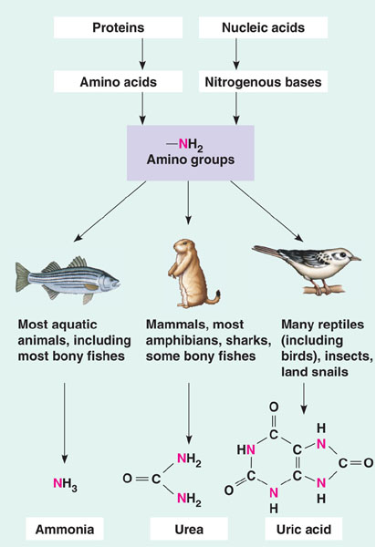

Slide 3
… From the Kidneys….
Ureters- tube from each kidney to bladder
  Continuous with “renal pelvis”
  Muscular layer of walls, active roll in transporting urine
Urinary bladder- smooth, collapsible, muscular bag that stores urine
  On pelvic floor, just behind pubic symphysis
  Transitional epithelium
Urethra- thin-walled muscular tube from bladder to external opening
  Internal urethral sphincter- at bladder urethra junction, involuntary, closed when urine not passing through
  External urethral sphincter- surrounds urethra as passes through urogenital diaphragm, voluntary skeletal muscle

Slide 4
Micturition (Voiding)
Stretch receptors in bladder wall activate, send signals to spinal cord, 2 Reflexes:
  Low stretch- sympathetic nervous system inhibits bladder muscle to keep internal sphincter closed
  More stretch- stimulate contraction of external sphincter
When ~200mL of urine has accumulated, afferent motor fibers make contraction of bladder more frequent & urgent
  If allowed, voiding reflex initiated
If not voided, contractions subside after about 1 min, once ~200mL more urine accumulates, process repeats
  When V exceeds 500-600mL, urge to urinate becomes irresistible

Slide 5
Structure of the Kidney
Bean-shaped, hilum of medial surface for entrance/exit ureter, blood & lymph vessels, & nerves
Internal Anatomy:
  Renal Cortex- superficial
  Renal Medulla- darker, with multiple cone shaped renal pyramids
    Each with many “collecting ducts” leading to a papillae
  Renal Pelvis- Collects urine from papillae of renal pyramids, funnels into ureter
    Common area for formation of kidney stones
Blood and Nerve Supply:
  Large Renal Artery & Vein to each kidney
    1/4 total cardic output directly to kidneys each minute
    Artery branches many times, until over 1mil vessels going to each “nephron” in each kidney
  Renal Plexus- autonomic nerves supplying kidneys & ureters, regulating vasomotor fibers & blood flow to & urine forming role of kidney

Slide 6
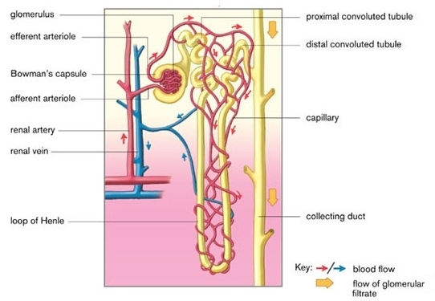
Nephrons
Structural & functional unit of kidney
  Each kidney has >1mil, each with own arteriole, each connected to 1 of 1000s of collecting ducts, leading from medulla to pelvis
Anatomy:
  Glomerulus: Clump of capillaries
    Delivers blood for filtration, artery feeding glomerulus also wraps around tubule to facilitate processing of urine
  Renal tubule: Collects & processes (reabsorption & secretion) filtrate
    Bowman’s Capsule- cup-like end, surrounds glomerulus
    Proximal Convoluted Tubule- PCT- (coils as leaves Bowman’s)
    Loop of Henle (descending and ascending limbs)
    Distal Convoluted Tubule- DCT- (coils after loop, continues to connect to a collecting duct)

Slide 7
Filtration
Hydrostatic P drives fluids & some solutes out of blood in glomerulus, into Bowman’s capsule
  Passive
  Filtrate includes H₂O, NaCl, NH₃, urea, uric acid, glucose, amino acids, etc
  Kidneys make approx 180L filtrate a day, less than 1% actually leaves body
Membrane of capillaries in glomerulus 1000x more permeable than others
  Walls of Bowman’s capsule also very permeable
Blood P in glomerulus much higher than in other capillaries

Slide 8
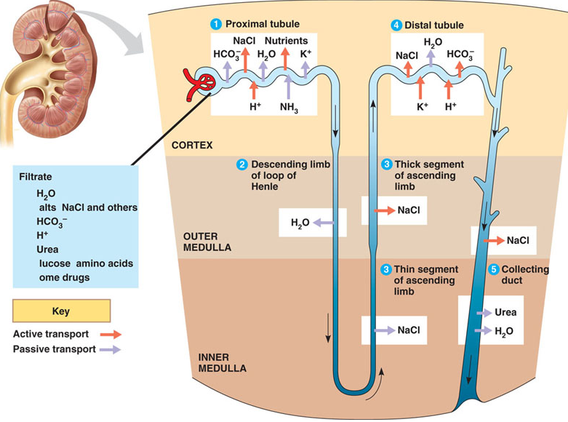

Slide 9
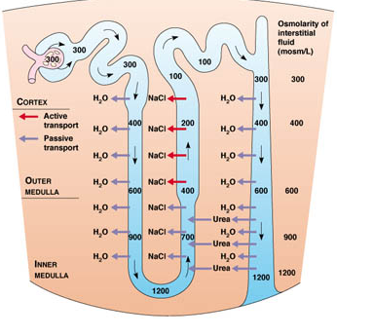

Slide 10
Regulation of Filtration
Intrinsic- smooth muscles of arterioles contract/relax, controlling flow into glomeruli, give tubules enough time to make adjustments in filtrate
Extrinsic- Sympathetic nervous system adjusts blood vessel diameter in response to blood P or “fight-or-flight” response. Hormones adjust blood P by stimulating reabsorption of Na⁺, increasing thirst, & causing glomerulus to constrict (less SA)

Slide 11
Tubular Reabsorption
Primary Active Transport: Na⁺ most abundant cation in filtrate, 80% of active transport for reabsorption
  By Na/K pumps, K⁺ almost immediately diffuses back, Na⁺ continues to be pumped into blood stream
  Occurs in PCT, DCT, & collecting ducts
Passive Tubular Reabsorption: Diffusion, Facilitated Diffusion & Osmosis-
  Na ⁺ moving establishes electrical gradient, anions (Cl⁻, HCO3⁻, etc) follow
    Occurs in PCT & Ascending Loop of Henle
  Aquaporins allow water to follow solutes (osmosis)
    Occurs in PCT, Descending Loop of Henle, & collecting ducts
  As H₂O leaves, concentration of some solutes becomes high again, so they diffuse
    Occurs in PCT & collecting ducts

Slide 12
Tubular Reabsorption Cont’d and Tubular Secretion
Secondary Active Transport: Glucose, amino acids, etc (most organic molecules) & cations move from filtrate to blood as Na ⁺ moves downs it concentration gradient through a symport pump
  Occurs in PCT (mostly) & Ascending Loop of Henle
Secretion of H⁺ & NH₃ (get rid of more waste or substances body doesn’t need, balance pH)
  Active transport, much depends on hormones
  Occurs in PCT, DCT, & collecting ducts
Symport

Slide 13
One More Look at the Nephron
Filtration- all substances small enough, occurs in glomerulus (into Bowman’s capsule)
Reabsorption- ~99% of H₂O, virtually all nutrients (amino acids, glucose, etc) & majority of ions- Mostly by passive transport
  Mostly in PCT- 65% H₂O & Na ⁺, 90% HCO₃, 60% Cl ⁻ & 55% K ⁺, & ALL organic solutes
  Descending Loop of Henle- H₂O only
  Ascending Loop of Henle- Ions only
  DCT- Na+ mostly
  Collecting Ducts- H₂0, urea and ions
Secretion- mostly H⁺, K⁺ and NH₄⁺
  PCT, DCT & Collecting Ducts
Simplified Nephron
Interactive Nephron
Kidneys and the Nephron

Slide 14
Kidney Function is Regulated By…
Composition of blood (osmosis/diffusion)
  If your blood has a high concentration of a substance, it will be retained in the urine (not reasbsorbed in the blood)
  EXP: When you drink H₂O - amount of H₂O in blood ↑, amount of H₂O resabsorbed in kidneys ↓- leaving more H₂O in urine
  EXP: When you eat salt- amount of salt in blood ↑, amount of salt reabsorbed by kidneys ↓- leaving more salt in urine
  Countercurrents- tubules & blood vessels running in opposite directions can adjust osmolality to promote H₂O conservation
& hormones (released by endocrine system in response to composition of blood)

Slide 15
