Slide 1
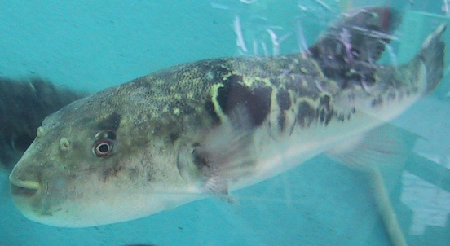
Bad Fish, Bad Bird
Kristi Hannam, SUNY-Geneseo
Adapted from a case by James A. Hewlett

Slide 2
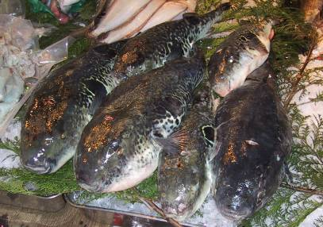
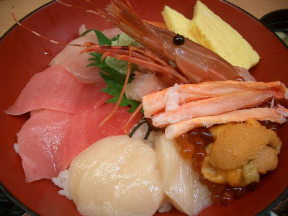
Local Cuisine
One evening during a trip to Indonesia to study the recent sightings of a coelacanth, Dr. Marshall Westwood from the Montana Technical Institute ate a meal of pufferfish.

Slide 3
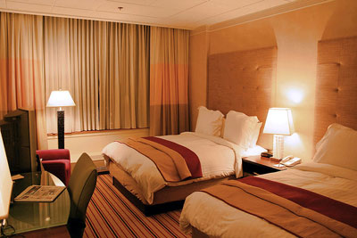
Within an hour of returning to his hotel room, he:
felt numbness in his lips and tongue
  which quickly spread to his face and neck.
began to feel pains in his stomach and throat
  which produced feelings of nausea and eventually severe vomiting.

Slide 4

Dr. Westwood called a local hospital. Numbness in his lips and face made it almost impossible for him to communicate, but the hospital staff sent an ambulance.

Slide 5
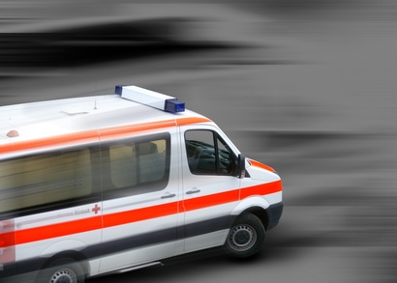
As Dr. Westwood was rushed to the hospital, he had:
  trouble breathing;
  signs of paralysis in his upper body and arms.

Slide 6
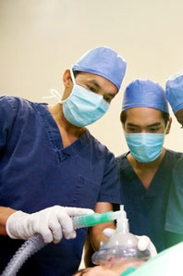
The Physicians…
kept his airway open.
administered drugs to bring his heart back to a normal rhythm.
put a mixture of charcoal into his stomach to help absorb any chemicals that might still be there.

Slide 7
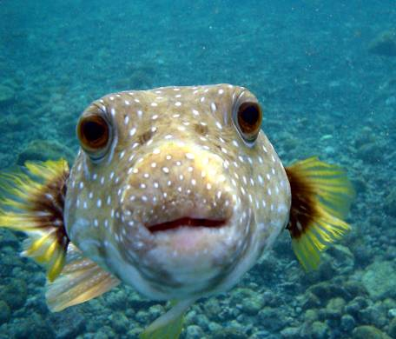

Within a few hours, Dr. Westwood's condition improved and he was on his way to a full recovery.
After discussing his case with his physician, he learned that he had probably been the victim of a pufferfish poisoning. (in your group research pufferfish… what could have caused his problems?)

Slide 8
What did you find out?

Slide 9
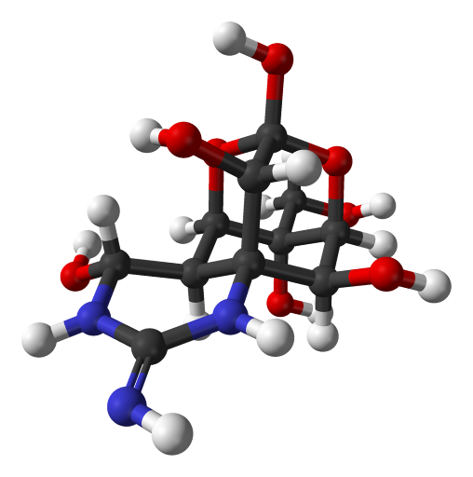
POISONED!
The active toxin in the tissues of this fish is a chemical called tetrodotoxin.
Tetrodotoxin is a neurotoxin - it affects nerve cells (neurons).
Specifically, tetrodotoxin blocks voltage-gated sodium ion channels.

Slide 10
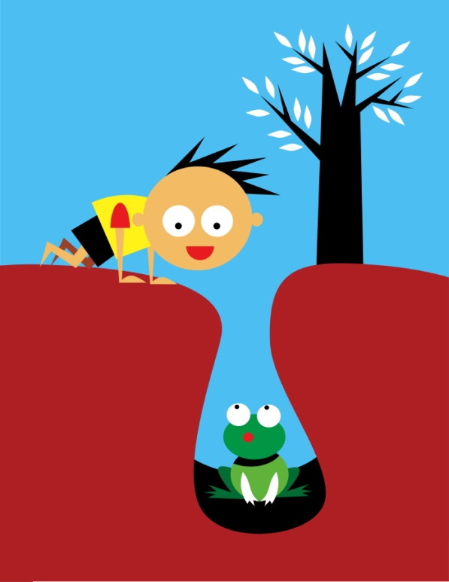
What are voltage gated sodium ion channels?
Voltage gated sodium channels
Crash course the nervous system
(show first)
Khan Academy (anatomy of a neuron)
Action Potential

Slide 11
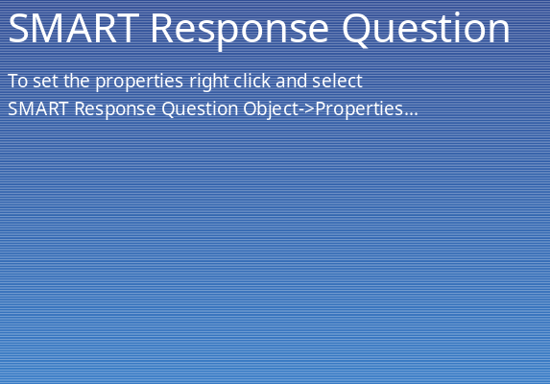
CQ#1: The symptoms Dr. Westwood suffered included all of the following EXCEPT:
A. Fever and chills
B. Numbness
C. Paralysis
D. Difficulty breathing
E. Nausea and vomiting

Slide 12
CQ#2: According to what you know so far, voltage-gated sodium ion channels are found in:
A. Cells of pufferfish
B. All living cells
C. Epithelial cells
D. Nerve cells
E. None of the above

Slide 13
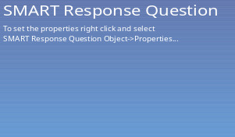
CQ#3: If tetrodotoxin (TXX) blocks voltage-gated sodium ion channels, which part of the action potential graph would be impacted? (Copy this action potential graph into your lab journals)
A. Part A
B. Part B
C. Part C
D. Part D
E. Part E
30
Membrane Voltage (mV)
C
D
0
B
E
-55
-70
A
TIME

Slide 14
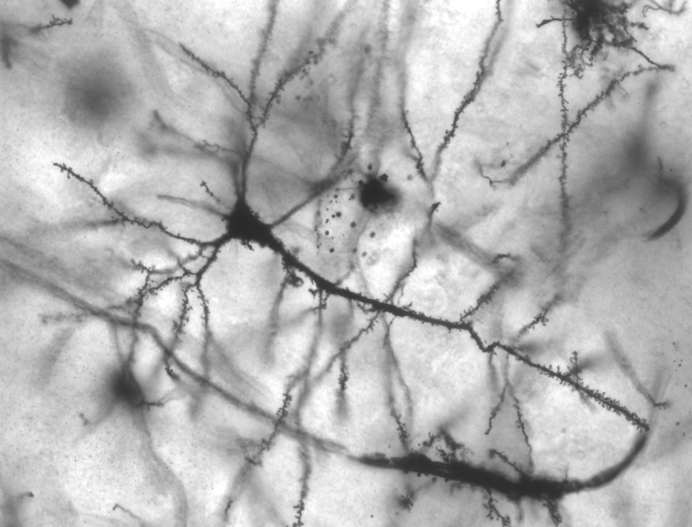
Resting Potential in Neurons
Diffusion of K⁺ (and less Na⁺⁾ leads to a separation of charges across the membrane, and the resting potential.
  Remember: There are MANY K+ and very few Na+ channels, thus membrane permeability is 100x for K+ than Na+.
  Movement of K+ increases the positive charge outside the membrane relative to the inside.
Thus an ELECTRICAL gradient is formed that
can also influence ion flow.

Slide 15
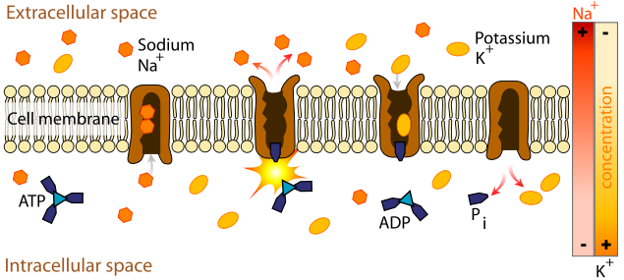
Maintaining the Resting Potential: the Sodium-Potassium Pump
The pump moves three sodium (Na+) ions out of the cell for every two potassium (K+) ions that it brings in.
This helps the cell maintain a separation of charges.

Slide 16
Action Potentials: How Nerves Communicate
Neurons are specialized to use changes in membrane potential for fast communication- called an ACTION POTENTIAL.
Neurons have special gated ion channels, that open or close in response to stimuli.
Membrane potential may change in response to stimuli that open or close those channels.

Slide 17
Action Potential: Part 1
For an action potential (nerve firing) to occur, the cell membrane potential must reach a threshold value of …
~ -55mV
When this threshold is reached, the voltage-gated Na+ channels open, allowing more Na+ to diffuse rapidly into the cell.
  DEPOLARIZATION
30
Membrane Voltage (mV)
0
-55
-70
TIME

Slide 18
CQ#7: Dr. Westwood ate a meal of pufferfish and rice. As a result, he was a victim of pufferfish poisoning that caused his life-threatening symptoms of numbness, paralysis, irregular heartbeat, and difficulty breathing. Tetrodotoxin (TXX), found in pufferfish flesh, is a molecule that:
Causes the flesh of pufferfish to go bad.
Causes an incurable illness in humans.
Blocks voltage-gated sodium ion channels.
Blocks neurotoxins.
Affects the immune system.

Slide 19
CQ#8: If tetrodotoxin (TXX) blocks voltage-gated sodium ion channels, which part of the action potential would be impacted?
Part A
Part B
Part C
Part D
Part E
30
Membrane Voltage (mV)
C
D
0
B
E
-55
-70
A
TIME

Slide 20

CQ#9: Dr. Westwood experienced numbness after eating the pufferfish meal because TXX causes: (time for some research on sensory and motor neurons:what are they and what do they do?)
Motor neurons to fire continuously, overloading the brain with signals, resulting in numbness.
Motor neurons to stop firing, preventing communication with the brain, resulting in numbness.
Sensory neurons to stop firing preventing communication with the brain, resulting in numbness.
Sensory neurons to fire continuously, overloading the brain with signals, resulting in numbness.
None of the above explain why Dr. Westwood experienced numbness after his pufferfish meal.

Slide 21
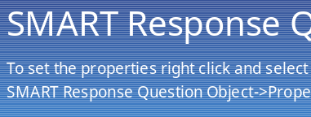
CQ#10: Why did Dr. Westwood experience paralysis after eating the pufferfish meal?
TXX causes motor neurons to fire continuously, overloading the brain with signals, resulting in paralysis.
TXX causes motor neurons to stop firing, preventing communication with the muscles, resulting in paralysis.
TXX causes sensory neurons to stop firing preventing communication with the brain, resulting in paralysis.
TXX causes sensory neurons to fire continuously, overloading the brain with signals, resulting in paralysis.
None of the above explain why Dr. Westwood experienced numbness after his pufferfish meal.

Slide 22
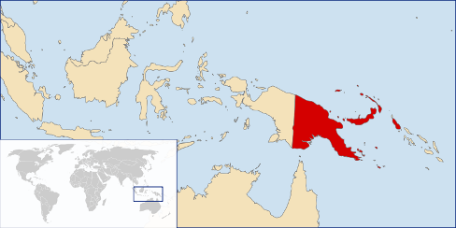
After recovering from his TTX poisoning, Dr. Marshall Westwood took a vacation. An avid birder, he went to Papua New Guinea with Bill Whitlatch, an ornithologist and friend.

Slide 23
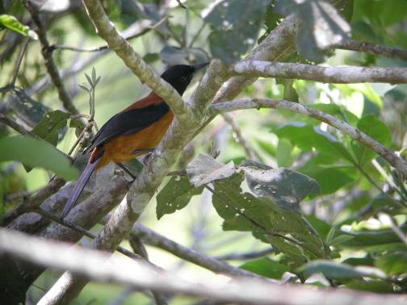
Three days into their trip, Bill netted a bird with an orange body and black wings and head.
Dr. Westwood was very curious and looked closely at the bird.

Slide 24
After handling the bird and later touching his mouth with his hand, Dr. Westwood noticed that his fingers and lips were going numb. His mind immediately flashed back to the disastrous trip to Indonesia and he began to panic. Luckily, the symptoms faded.

Slide 25
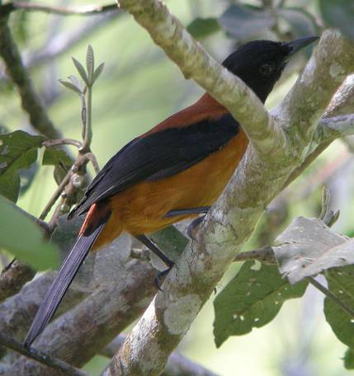
His friend Bill used a key to identify the animal as a pitohui. The pitohui are small, social songbirds that live in Papua New Guinea.
Their encounter was the first time any scientist had realized the birds were toxic.

Slide 26
Dr. Westwood collected feather and tissue samples to bring back to the lab. After returning to Montana, he isolated the toxic compound that he was active in the feathers of the pitohui. It appeared that the active ingredient was a homobatrachotoxin.
What’s that?

Slide 27
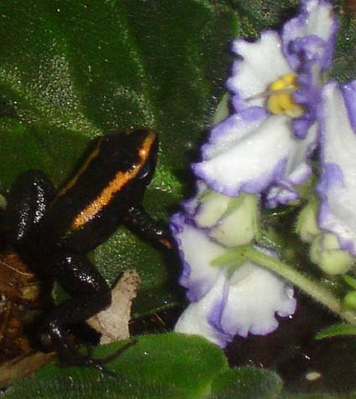
Homobatrachotoxin is a steroidal alkaloid that is similar to batrachotoxin, the toxic principle of the Central American poison arrow frog Phyllobates aurotaenia.
Batrachotoxin and homobatrachotoxin are both known to act on voltage-sensitive sodium channels in excitable tissues.

Slide 28
CQ#11: What symptoms did Dr. Westwood experience after both his pufferfish meal and after handling the new bird species?
Nausea
Numbness
Paralysis
Difficulty breathing
More than one of the above

Slide 29
CQ#12: The toxin found in the bird feathers:
Is used by the birds to deter predators.
Is found in birds that have eaten poison arrow frogs.
Is the same toxin found in pufferfish flesh.
Affects voltage sensitive ion channels.
Affects voltage sensitive potassium channels.

Slide 30
Dr. Westwood has asked you to help figure out the mechanism of action of this new toxic compound.
In your first experiment, you generate action potentials in axons of large neurons obtained from squid in the presence of this new toxin. You find after depolarizing, the membrane potential remained positive for an extended length of time and the repolarization was often extremely delayed.
Draw a graph showing membrane potential vs. time to illustrate this effect.

Slide 31
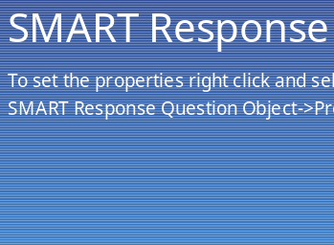
CQ#13: Choose the graph below that most closely matches the graph you just created:
A
30
B
30
0
0
Membrane potential (mV)
Membrane potential (mV)
-55
-55
-70
-70
Time
Time
C
D
30
30
0
0
Membrane potential (mV)
Membrane potential (mV)
-55
-55
-70
-70
Time
Time

Slide 32
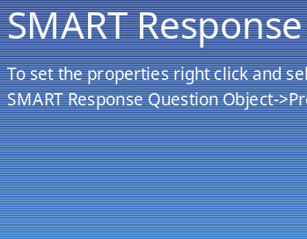
CQ#14: You experiment with higher concentrations of toxin and find cases when the cell could not repolarize at all or, if it began to repolarize, it immediately depolarized again. This tells you that the toxin:
Prevents voltage-gated K+ channels from opening.
Increases the speed that Na+ ion channels open.
Prevents Na+ ion channels from closing.
Makes Na+ ion channels close too soon.
Doesn’t affect the Na+ ion channels at all, it affects the sodium-potassium pump instead.

Slide 33
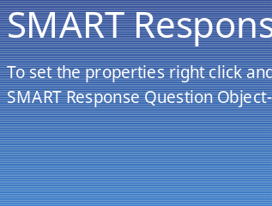
CQ#15: In this case study you have learned:
Poisons that affect nerves interfere with ion channels.
Never eat pufferfish.
Science depends on accidental discoveries.
Electrical potentials across membranes can be manipulated with ion channels.
None of the above.

Slide 34
Slide Credits
Slide 1
  Description: Pufferfish (Takifugu rubripes) swimming in tank.
  Author: Chris 73, http://en.wikipedia.org/wiki/User:Chris_73
  Source: Wikimedia Commons, http://commons.wikimedia.org/wiki/Image:Fugu_in_Tank.jpg
  Clearance: Licensed according to terms of Creative Commons Attribution-Share Alike 3.0 Unported.
Slide 2 —Top right
  Description: Tray with six pufferfish (Takifugu rubripes).
  Author: Chris 73, http://en.wikipedia.org/wiki/User:Chris_73
  Source: Wikimedia Commons, http://commons.wikimedia.org/wiki/Image:Fugu.Tsukiji.CR.jpg
  Clearance: Licensed according to terms of Creative Commons Attribution-Share Alike 3.0 Unported.
Slide 2 —Bottom right
  Description: Sushi plate.
  Author: Evil Julia, http://www.flickr.com/photos/evil_julia
  Source: Flickr, http://www.flickr.com/photos/evil_julia/124972796/
  Clearance: Licensed according to terms of Creative Commons Attribution-Share Alike 2.0 Generic.
Slide 3
  Description: Hotel room.
  Author: Derek Jensen
  Source: Wikimedia Commons, http://commons.wikimedia.org/wiki/File:Hotel-room-renaissance-columbus-ohio.jpg
  Clearance: Released into the public domain by the image author.
Slide 4
  Description: Phone.
  Author: ©Benjamin Mercer
  Source: Fotolia.com
  Clearance: Licensed, royalty free image.

Slide 35
Slide 5
  Description: Ambulance.
  Author: ©Thaut Images
  Source: Fotolia.com
  Clearance: Licensed, royalty free image.
Slide 6
  Description: Surgeons.
  Author: ©Andres Rodriguez
  Source: Fotolia.com
  Clearance: Licensed, royalty free image.
Slide 7
  Description: Puffer fish.
  Author: Mila Zinkova
  Source: Wikimedia, http://commons.wikimedia.org/wiki/File:Puffer_Fish_DSC01257.JPG
  Clearance: Licensed according to terms of Creative Commons Attribution-Share Alike 3.0 Unported.
Slide 8
  Description: Tetrodotoxin molecular structure.
  Author: Ben Mills
  Source: Wikimedia, http://commons.wikimedia.org/wiki/Image:Tetrodotoxin-3D-balls.png
  Clearance: Released into the public domain by the image author.
Slide 11 , Slide 18 , Slide 20 , Slide 21 , Slide 22 , Slide 24 , and Slide 36
  Description: Various graphs.
  Author: Kristina M. Hannam, Department of Biology, SUNY Geneseo
  Clearance: Used with permission of author.
Slide 12 , Slide 13 , Slide 14 , and Slide 15
  Description: Images depicting membrane potential in nerve cell with ion concentrations.
  Author: Kristina M. Hannam, Department of Biology, SUNY Geneseo
  Clearance: Used with permission of author.

Slide 36
  Slide 16 and Slide 19
  Description: Golgi stained pyramidal neuron in the hippocampus of an epileptic patient. 40 times magnification.
  Author: MethoxyRoxy
  Source: Wikimedia, http://commons.wikimedia.org/wiki/Image:Pyramidal_hippocampal_neuron_40x.jpg
  Clearance: Licensed according to terms of Creative Commons Attribution-Share Alike 2.5 Generic.
Slide 17
  Description: Sodium-potassium pump.
  Author: LadyofHats, Mariana Ruiz Villarreal
  Source: Wikimedia Commons, http://commons.wikimedia.org/wiki/Image:Scheme_sodium-potassium_pump-en.svg
  Clearance: Released into the public domain by the image author.
Slide 27
  Description: Map of Papua New Guinea.
  Author: User:Vardion
  Source: Wikimedia Commons, http://commons.wikimedia.org/wiki/File:LocationPapuaNewGuinea.svg
  Clearance: Licensed according to terms of Creative Commons Attribution-Share Alike 3.0 Unported.
Slide 28 and Slide 30
  Description: Hooded Pitohui, Pitohui dichrous.
  Author: markaharper1
  Source: Flickr, http://www.flickr.com/photos/16420772@N07/2884896043/
  Clearance: Licensed according to terms of Creative Commons Attribution-Share Alike 2.0 Generic.
Slide 32
  Description: A kokoe dart frog (Phyllobates aurotaenia) staring at an African violet.
  Author: Onagro
  Source: Wikimedia Commons, http://commons.wikimedia.org/wiki/File:Phyllobates_Aurotaenia_Red_%26_Violets.jpg
  Clearance: Licensed according to terms of Creative Commons Attribution-Share Alike 3.0 Unported.

