Slide 1
FOXP2 and Speech: A Gene Expression Case
Part I – Transcription and Translation
Jianli Zhou and Peggy Brickman
Department of Plant Biology
University of Georgia

Slide 2
Learning Objectives
Know how the three types of RNA function.
Be able to explain the following terms: promoter, RNA polymerase, triplet code.
Describe the process of transcription and predict what would happen if one factor involved in the process were missing.
Explain how all cells have the same DNA, but don’t make the same proteins.
Describe the process of translation and predict what would happen if one factor involved in the process were missing.
Be able to predict the protein sequence if the corresponding DNA sequence is provided.

Slide 3
Typical Language Development
6 months Make sounds with intonation
1 year Vocabulary: One or a few words
2 years Vocabulary: 150~300 words
4 years Extensive Vocabulary; can name
common objects
6 years Socially useful speech; can tell a
connected story
(adapted from Child Development Institute, LLC)

Slide 4
Identification of the “speech gene” – FOXP2
The story: In 1990, scientists became interested in the KE family in London, half of whose family members have speech disorders.

Slide 5
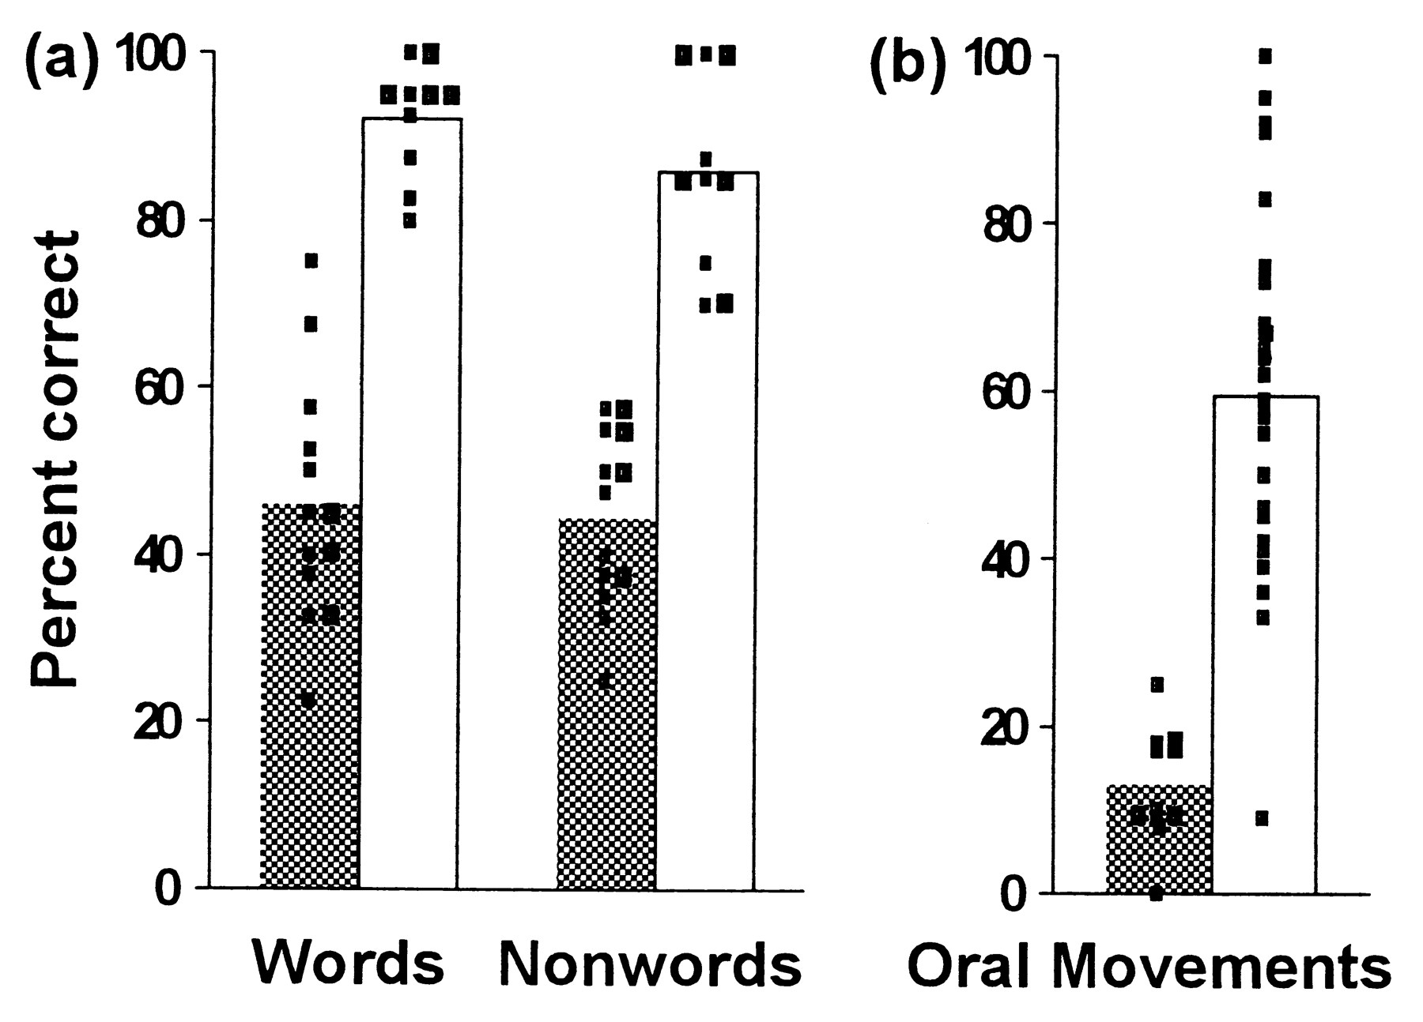
CQ#1: According to the KE family speech test results below, on which test(s) did the unaffected group do better than the affected group?
Words
Nonwords
Oral Movement
I
I, II
I, II, III
I, II
None of the above
Affected group
Unaffected group
Vargha-Khadem F et al. PNAS 1998; 95:12695-12700
©1998 by The National Academy of Sciences

Slide 6
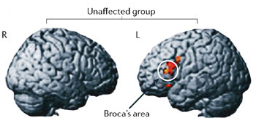
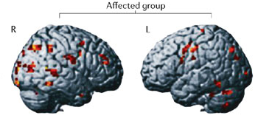
Neuroimaging of the KE Family Members
Image used by permission from Macmillan Publishers Ltd: Nature Neuroscience 6, 1230–1237 (2003) copyright (2003), http://www.nature.com/neuro/index.html.

Slide 7

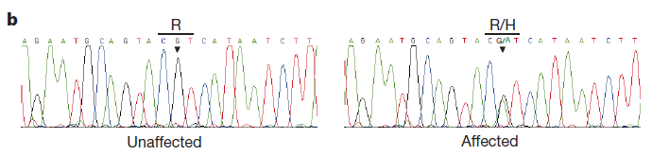
Identification of the FOXP2 Gene
By analyzing the KE family DNA sequences, scientists found that the speech problem was caused by a mutation in the FOXP2 gene located on chromosome 7 region 7q31.
7q31
Lower panel used by permission from Macmillan Publishers Ltd: Nature (Lai, et al, 2001, 413, 519-523 ) copyright (2001), http://www.nature.com/.

Slide 8

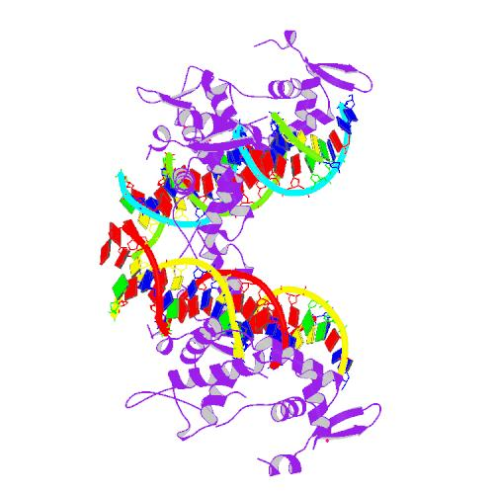
FOXP2 DNA, RNA, and Protein
DNA
Promoter
(Adapted from Fisher and Marcus, 2006)
mRNA
Protein

Slide 9
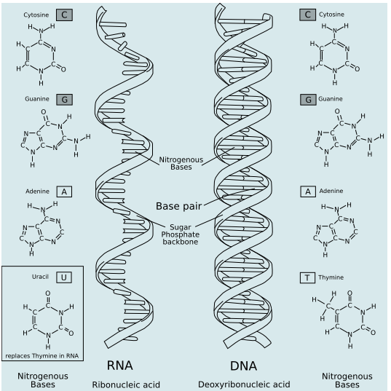
RNA Brief Review - I

Slide 10
How RNA is Produced - Transcription
Step 1: RNA polymerase binds to promoter.
RNA
polymerase
Promoter
Step 2: RNA polymerase unwinds the double-stranded DNA and begins assembling RNA nucleotides.
G C A T
Base pairing
DNA
DNA
C G T A
RNA
G C A U
Step 3: Release the RNA transcript.

Slide 11
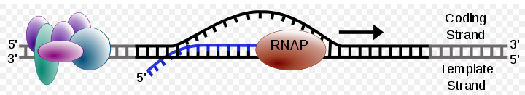
How RNA is Produced - Transcription
transcription start site
Transcription start site: where transcription of a gene into RNA begins
Direction of transcription: 5′ to 3′

Slide 12
Group Activity 1: The KE family moms are very concerned about their kids. As soon as the babies were born, their moms took them to a DNA sequencing center to do a test.
The next slide shows the FOXP2 DNA sequences of four newborn KE family babies. The bottom strand is the template strand. Mutated nucleotides are noted with red.
Get a piece of paper and write down what the FOXP2 transcription product is in each one of the four babies (the bottom strand is to be transcribed).

Slide 13
Promoter
coding strand template strand: will be transcribed
Neighbor gene
Transcription start site
unaffected
5’CG…TATA
3’GC…ATAT
TATG…ATTA3’
ATAC…TAAT5’
5’GG…CAT3’
3’CC…GTA5’
5’CG…TATA
3’GC…ATAT
TATG…ATTA3’
ATAC…TAAT5’
5’GG…AAT3’
3’CC…TTA5’
John
5’TATG…ATTA3’
3’ATAC…TAAT5’
5’GG…CAT3’
3’CC…GTA5’
Athena
5’CG…TATA
3’GC…ATAT
TATT…CCTA3’
ATAA…GGAT5’
5’GG…CAT3’
3’CC…GTA5’
Phil
5’CG…TTTA
3’GC…AAAT
TATG…ATTA3’
ATAC…TAAT5’
5’GG…CAT3’
3’CC…GTA5’
Cathy

Slide 14
CQ#2:Which baby is less likely to have severe speech disorder problems? (“X” indicates a mutation.)
Promoter
Coding Strand
A neighbor gene
Template Strand
A. John
B. Athena
C. Phil
D. Cathy
E. I don’t know.

Slide 15


RNA Brief Review - II
On average, a growing mammalian cell consists of:
5% mRNA (messenger RNA, codes for protein)
15% tRNA (transfer RNA, transfer amino acids during protein synthesis)
80% rRNA (ribosomal RNA, part of the ribosome)

Slide 16
How Protein is Produced - Translation
DNA
T G A A C C A G T G C A
Transcription
Nucleus
mRNA
A C U U G G U C A C G U
Translation
Cytoplasm
Protein
– Thr – Trp – Ser – Arg-

Slide 17
Triplet Code
U
C
A
G
U
UUU
UUC
UUA
UUG
UCU
UCC
UCA
UCG
UAU
UAC
UAA
UAG
UGU
UGC
UGA
UGG
Phe
Tyr
Cys
Ser
Leu
Stop
Stop
Trp
C
CUU
CUC
CUA
CUG
CCU
CCC
CCA
CCG
CAU
CAC
CAA
CAG
CGU
CGC
CGA
CGG
His
Leu
Pro
Arg
Gln
A
AUU
AUC
AUA
AUG
ACU
ACC
ACA
ACG
AAU
AAC
AAA
AAG
AGU
AGC
AGA
AGG
Asn
Ser
Ile
Thr
Lys
Arg
Met
G
GUU
GUC
GUA
GUG
GCU
GCG
GCA
GCG
GAU
GAC
GAA
GAG
GGU
GGC
GGA
GGG
Asp
Val
Ala
Gly
Glu

Slide 18
Translation Video
http://highered.mcgraw-hill.com/olc/dl/120077/micro06.swf

Slide 19
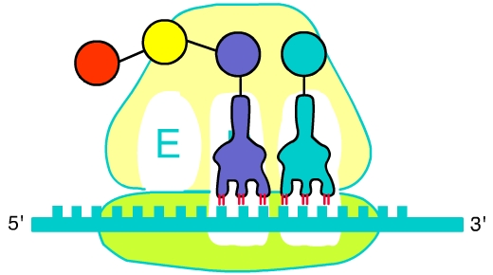
Identify the players at work
3
1
4
2

Slide 20
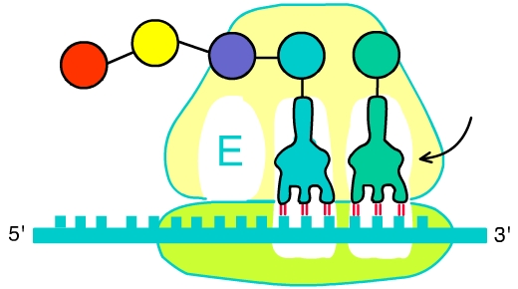
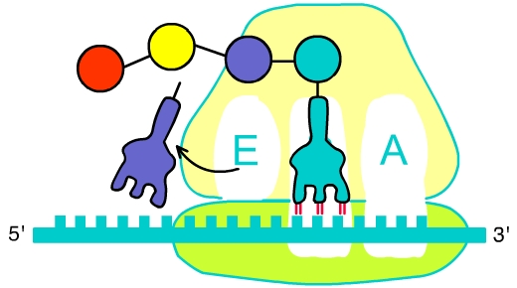
CQ#3: Steps in Translation: The pictures below show the production of a growing peptide chain. Place the steps in order.
A
B
C
A, B, C
B, A, C
C, B, A
B, C, A
C, A, B

Slide 21
CQ#4: 13-deoxytedanolide is an antibiotic that binds to the E site of the ribosome. If 13-deoxytedanolide is added right before translation starts, which one of the statements is TRUE?
Translation would not happen.
Translation would not be affected.
The end product carries a 13-deoxytedanolide before the first amino acid Met.
The end product only has 2 amino acids.
The end product only has 1 amino acid.

Slide 22
FOXP2 Protein

Slide 23
CQ#5: FOXP2 protein is found in certain but not all brain cells in the same individual; how is this possible?
Some brain cells don’t have Chromosome 7.
FOXP2 DNA is only present in some brain cells.
Some brain cells don’t have ribosomes.
FOXP2 mRNA is only produced in some brain cells.
Some brain cells contain more DNA.

Slide 24

Transcriptional Regulation
Cell Differentiation
Stress Response
Single Cell
No Stress
Stress
mitosis
Daughter Cells
Expression of skin cell specific genes
Expression of muscle cell specific genes
No expression of stress response genes
Expression of stress response genes
Skin Cell
Muscle Cell

Slide 25
FOXP2 and Speech: A Gene Expression Case
Part II –Transgenic Organisms and Recombinant DNA
Jianli Zhou and Peggy Brickman
Department of Plant Biology
University of Georgia

Slide 26
Learning Objectives
Describe the steps for making a transgenic mouse and what techniques/substances are involved in the steps. Understand the purpose of each step.
Explain what a restriction enzyme/DNA ligase/plasmid is and how it works.
Describe the steps for making recombinant DNA and what techniques/substances are involved in the steps. Understand the purpose of each step.
Know applications of transgenic organisms.
2

Slide 27
Identification of the “speech gene” – FOXP2
The story goes like this: In 1990, scientists became interested in the KE family in London, half of whose family members have speech disorders.

Slide 28
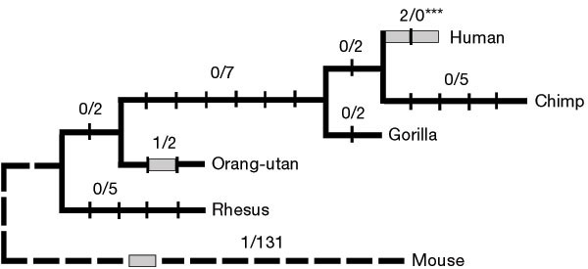
The mouse FOXP2 protein differs in just 3 amino acids from human beings!
Grey Bars indicate amino-acid changes
Image used by permission from Macmillan Publishers Ltd: Nature (Enard, et al, 2002, 418, 869-872) copyright (2002), http://www.nature.com.

Slide 29
CQ#6: Based on available information about FOXP2 protein, which one of the following statements makes the most sense?
If its FoxP2 gene is removed, the mouse might “talk.”
Feeding mice the three amino acids that differ between human and mouse might enable the mice to “talk.”
Replacing the mutated human FOXP2 gene with a mouse FoxP2 gene is a way to cure speech disorders.
Putting the human version of FOXP2 gene into a mouse might enable it to “talk.”

Slide 30
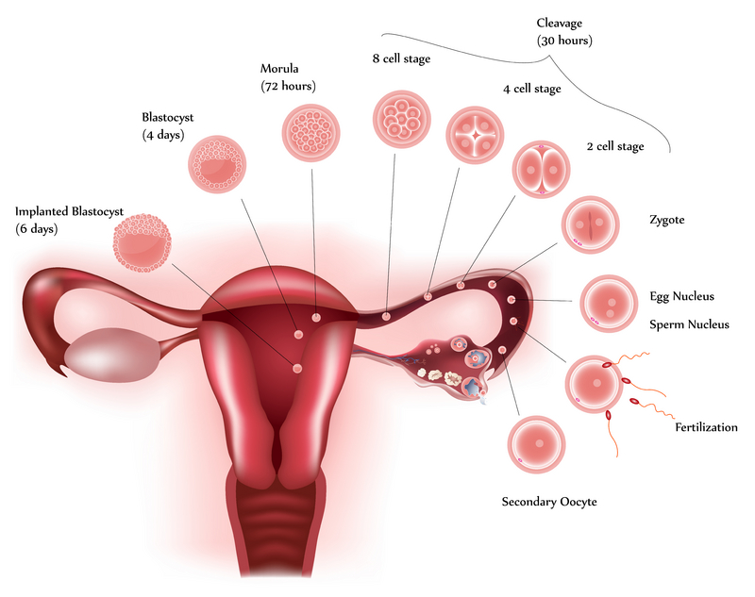
Mouse Development

Slide 31
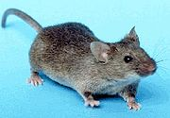
Transgene solution
Microinjection
Transfer to pseudopregnant female
Microinjection Video http://www.youtube.com/watch?v=h-Bfc1GPWpE

Slide 32
Group Activity 2: Draw a flowchart using some of the following items (1-7) to illustrate how you could make a “humanized” FOXP2 transgenic mouse and label where FOXP2 is going to be at different developmental stages (from the zygote stage to the baby mouse stage.)
Pseudopregnant female mouse
Mouse blastocyst
Mouse zygote cell
Human FOXP2 DNA
Human FOXP2 RNA
Human FOXP2 protein
Mouse FoxP2 DNA

Slide 33
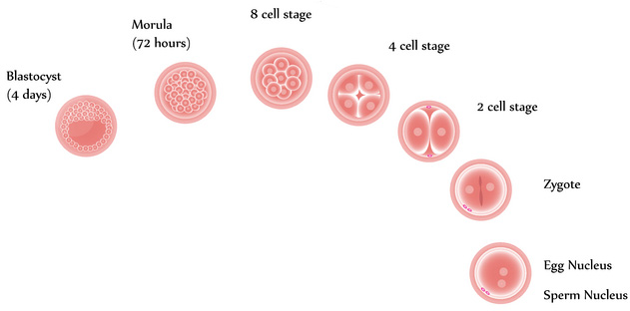
CQ#7:
Below are some
alternative methods for making a “humanized” FOXP2 mouse that has the transgene in every single cell. Which one would work best?
Inject the human FOXP2 PROTEIN into both cells at the 2-cell stage.
Inject the human FOXP2 RNA into the zygote.
Inject the human FOXP2 DNA into a fertilized egg.
Inject the human FOXP2 RNA into the blastocyst cavity.

Slide 34

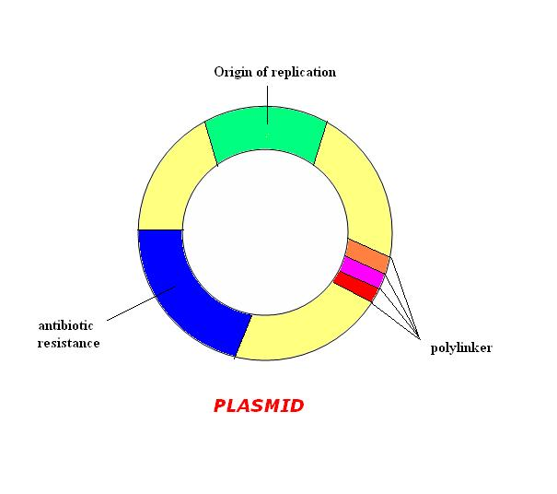
Recombinant DNA Technology
DNA transport vehicle - Plasmid
Replicate independently of the chromosomal DNA.
Carry antibiotic resistance genes.
Polylinkers allow insertion of DNA fragments.

Slide 35
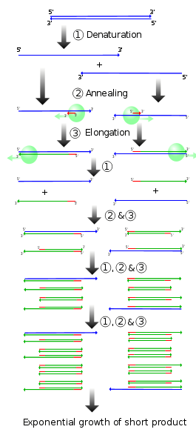
Recombinant DNA Technology
Step 1: Amplify your DNA of interest using PCR (Polymerase Chain Reaction)

Slide 36
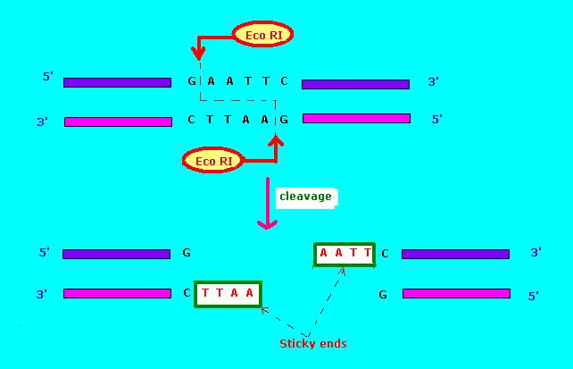
Step 2: Digest your DNA of interest by restriction enzymes
Cut double stranded DNA at specific nucleotide sequence.
Produce sticky ends.

Slide 37
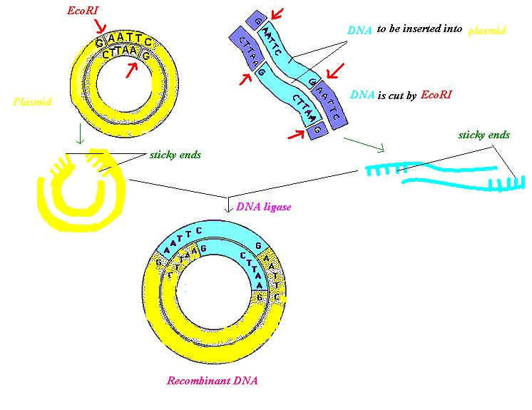
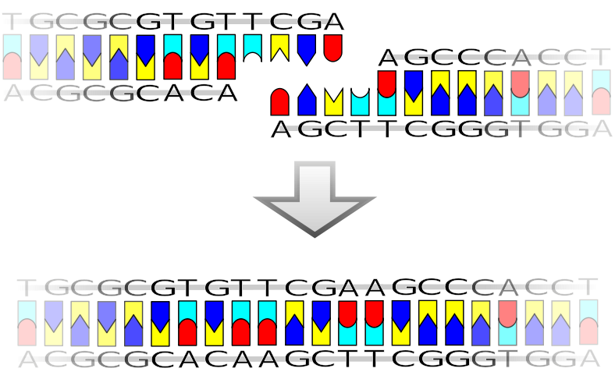
Step 3: Ligation of DNA
DNA molecules with compatible ends can be joined together by DNA ligase.

Slide 38
Step 4: Transformation and Selection
Propagation of recombinant DNA.
Only bacteria containing recombinant DNA grow on medium + antibiotic.
Transformation
Bacterial cell
Bacterial cell
alive
Plate out on medium + antibiotic
dead
Extract and purify
Ready to inject!

Slide 39
CQ #8 Some of the bacterial cells fail to grow on medium + antibiotics. Why?
The gene for antibiotic resistance is not cut by restriction enzymes in dead bacterial cells.
Your DNA of interest only replicates a few times in dead bacterial cells.
Those cells die because the DNA of interest (with the antibiotic resistance gene) never got in there.
The antibiotic gene is not in dead bacterial cells but the plasmid is there.

Slide 40
Video of Recombinant DNA
http://www.youtube.com/watch?v=x2jUMG2E-ic&feature=related

Slide 41
CQ#9: Below is a list of techniques and substances involved in the steps to make recombinant DNA. Choose the answer that best describes the correct order of using these techniques/substances in cloning:
PCR (Polymerase Chain Reaction)
Introduce DNA into bacterial cells
Medium + Antibiotics
Restriction Enzymes
DNA Ligase
I, II, III, IV, V D. V, IV, II, III, I
II, III, IV, V, I E. I, II, IV, V, III
I, IV, V, II, III

Slide 42
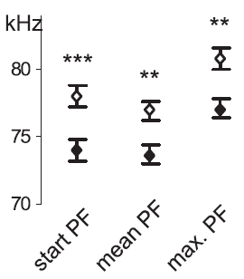
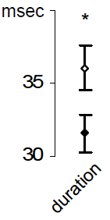

CQ#10: Researchers did sound tests on normal and FOXP2 transgenic mice. Which is the most reasonable conclusion drawn from the figures?
The sound duration time of transgenic mice is less than the mean PF of normal mice.
Transgenic mice have lower mean PF than normal mice.
The max PF of transgenic mice is similar to the mean PF of normal mice.
All of the above.
Normal Mice
FOXP2 Transgenic Mice
PF: Peak Frequency
Credit: Panel B of Figure 6, from Cell 137(5), Wolfgang Enard et al., “A Humanized Version of Foxp2 Affects Cortico-Basal Ganglia Circuits in Mice,” 961-971, copyright 2009, used with permission from Elsevier.

Slide 43
Applications of Transgenic Organisms
Alzheimer’s Pig: A transgenic pig with Alzheimer’s Disease (AD) for medical research.
Bt cotton: Produce toxins that kill pests.

Slide 44
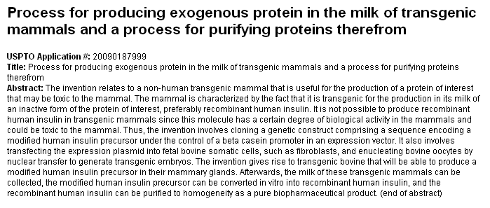
The Patent below is from USPTO Patent Application 20090187999. You are interested in investing in it, but your partners are concerned about food safety issues regarding the milk of transgenic mammals.

Slide 45
Group Activity 3: Simply put, human insulin (a growth hormone) DNA is introduced into mammals such as cows. The insulin DNA results in the production of insulin protein, which is secreted in the milk of transgenic cows. The milk can be collected and purified as a biopharmaceutical product.
Suppose that the transgenic milk does not contain cow cells. Now work in groups, write down where I-V would eventually be and use arrows to connect the movement of I-V among A-F.
Human
Plasmid
Bacterial cells
Cow zygote
Cow
Milk
Human insulin DNA
Human insulin proteins
Plasmid DNA
Cow DNA
Bacterial chromosomal DNA

Slide 46
CQ#11: Which of the following would be in Mike’s body after he drinks the milk of transgenic cows? (Suppose that the transgenic milk does not contain cow cells.)
Human insulin DNA
Human insulin proteins
Plasmid DNA
Cow DNA
Bacterial chromosomal DNA
I, II
II
I, II, III
I, II, III, V
II, III, IV, V

Slide 47
Discuss in groups: decide whether or not your group wants to invest in the patent. Think about the potential impact on cows, milk, and human beings. List the Pros and Cons.

Slide 48
Survey Question
Would you consider investing in the patent?
Yes
No
I don’t know

Slide 49
Credits
Except as indicated below, images appearing in this presentation were created by the authors of the case.
Slide #5
Description: Figure of the KE family speech test.
Source: Figure 2 from "Neural basis of an inherited speech and language disorder" by Faraneh Vargha-Khadem et al., PNAS 1998; 95(21):12695-12700. doi: 10.1073/pnas.95.21.12695 PNAS October 13, 1998 vol. 95 no. 21 12695-12700.
Link: http://www.pnas.org/content/95/21/12695.full
Clearance: http://www.pnas.org/site/misc/rightperm.shtml#reprint, "Anyone may, without requesting permission, use original figures or tables published in PNAS for noncommercial and educational use (i.e., in a review article, in a book that is not for sale) provided that the original source and the applicable copyright notice are cited.“
Slide #6
Description: Neuroimaging of the KE family members.
Source: Liégeois, F. et al. Language fMRI abnormalities associated with FOXP2 gene mutation. Nature Neurosci. 6, 1230–1237 (2003).
Link: http://www.nature.com/neuro/journal/v6/n11/abs/nn1138.html
Clearance: Reprinted by permission from Macmillan Publishers Ltd: Nature Neuroscience, copyright (2003).
Slide #7 (upper left hand corner)
Description: Graphic of chromosome
Source: Wikimedia, by user Mrmariokartguy
Link: http://commons.wikimedia.org/wiki/File:Chromosome_pair_drawing.svg
Clearance: Creative Commons Attribution-Share Alike 3.0 Unported
Slide #7 (bottom)
Description: Figure of Foxp2 mutation in the KE family members.
Source: Cecilia S. L Lai et al., A forkhead-domain gene is mutated in a severe speech and language disorder, Nature 413, 519-523 (4 October 2001) | doi:10.1038/35097076.
Link: http://www.nature.com/nature/journal/v413/n6855/full/413519a0.html
Clearance: Reprinted by permission from Macmillan Publishers Ltd: Nature, copyright (2001).
Slide #8 (upper)
Description: Graphic of Foxp2 DNA structure
Source: Adapted from panel A of Figure 1 of “The eloquent ape: genes, brains and the evolution of language” by Simon E. Fisher and Gary F. Marcus at University of Oxford.
Link: http://www.psych.nyu.edu/gary/marcusArticles/Fisher Marcus 2006.pdf
Slide #8 (bottom) and #22 (center)
Description: Graphic of FOXP2 protein structure
Source: Wikipedia
Link: http://en.wikipedia.org/wiki/File:PBB_Protein_FOXP2_image.jpg
Clearance: Public domain.

Slide 50
Credits cont.
Slide #9
Description: Graphic of RNA and DNA molecules
Source: Wikimedia, by users Antilived, Fabiolib, Turnstep, Westcairo on en.wikipedia.
Link: http://commons.wikimedia.org/wiki/File:RNA-comparedto-DNA_thymineAndUracilCorrected.png
Clearance: Creative Commons Attribution-Share Alike 3.0 Unported
Slide #11
Description: Graphic of transcription elongation.
Source: Wikimedia
Link: http://commons.wikimedia.org/wiki/File:Simple_transcription_elongation1.svg
Clearance: Public domain.
Slide #28
Description: Figure of FOXP2 phylogenetic Tree
Source: Wolfgang Enard, Molly Przeworski, Simon E. Fisher, Cecilia S. L. Lai, Victor Wiebe, Takashi Kitano, Anthony P. Monaco and Svante Pääbo. Molecular evolution of FOXP2, a gene involved in speech and language, Nature 418, 869-872 (22 August 2002) | doi:10.1038/nature01025
Link: http://www.nature.com/nature/journal/v418/n6900/fig_tab/nature01025_F2.html#figure-title
Clearance: Reprinted by permission from Macmillan Publishers Ltd: Nature, copyright (2002).
Slide # 30
Description: Illustration of embryonic development.
Source: © Guniita | Dreamstime.com.
Link: http://www.dreamstime.com/royalty-free-stock-photos-cell-development-image19080278
Clearance: Licensed.
Slide #31 (bottom)
Description: Photo of a mouse
Source: Wikipedia
Link: http://en.wikipedia.org/wiki/File:House_mouse.jpg
Clearance: public domain
Slide #34 (left hand side)
Description: Graphic of plasmid
Source: Wikimedia
Link: http://commons.wikimedia.org/wiki/File:PLASMID.JPG
Clearance: Public domain

Slide 51
Credits cont.
Slide #34 (upper right hand corner)
Description: Graphic of plasmid in bacterial cell
Source: Wikimedia, user Spaully
Link: http://commons.wikimedia.org/wiki/File:Plasmid_(english).svg
Clearance: Licensed according to Creative Commons Attribution-Share Alike 2.5 Generic
Slide #35
Description: Graphic of PCR steps
Source: Wikimedia, user Madprime
Link: http://commons.wikimedia.org/wiki/File:PCR.svg
Clearance: This file is licensed under the Creative Commons Attribution-Share Alike 3.0 Unported license.
Slide #36
Description: Graphic of restriction enzyme digestion
Source: Wikimedia
Link: http://commons.wikimedia.org/wiki/File:Restriction_enzyme_Eco_RI.JPG
Clearance: Public domain
Slide #37 (left hand side)
Description: Graphic of ligation
Source: Wikimedia, user Madprime
Link: http://commons.wikimedia.org/wiki/File:Ligation.svg
Clearance: This file is licensed under the Creative Commons Attribution-Share Alike 3.0 Unported license.
Slide #37 (right hand side)
Description: Graphic of ligation
Source: Wikimedia
Link: http://commons.wikimedia.org/wiki/File:Recombinant_DNA.JPG
Clearance: Public domain
Slide #42 (left hand side)
Description: Figure of Foxp2 mouse sound test
Source: Cell 137(5), Wolfgang Enard et al., “A Humanized Version of Foxp2 Affects Cortico-Basal Ganglia Circuits in Mice,” 961-971, Copyright 2009.
Link: http://www.eva.mpg.de/genetics/pdf/Enard_Humanized_Cell_2009.pdf
Clearance: Reprinted with permission from Elsevier.

