Slide 1
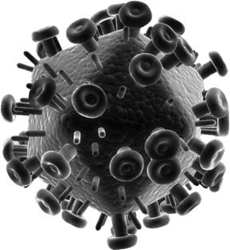
Resistance Is Futile ... or Is It?
The Immune System and HIV Infection
Modified for clickers by
Steven Telleen
San Joaquin Delta College
From a case study by
Annie Prud’homme-Généreux
Life Sciences
Quest University, Canada

Slide 2
The vast majority of people are susceptible to HIV infection.
  However, in the 1990s, several individuals noticed that despite repeated exposure to the HIV virus they remained HIV negative.
  Were these individuals extremely lucky?
  Was something different about them that made HIV infection less likely?
William Paxton and his colleagues became interested in this phenomenon of HIV protection.
  We will retrace the steps and experiments that these researchers performed to understand the mechanism underlying the protection against HIV (Paxton et al., 1996)
  First, let us review a few facts about the HIV virus, the immune system, and HIV infection

Slide 3
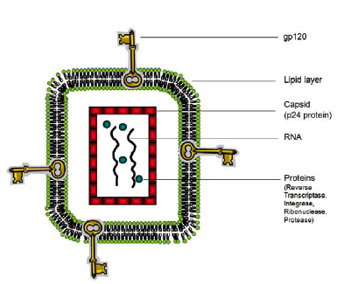
The HIV Virus
  Is spherical in shape
  HIV encodes its 9 genes using the nucleic acid molecule RNA
  The virus particle also contains proteins important for replication
    Reverse transcriptase
    Integrase
    Protease
    Ribonuclease
  The HIV virus is enclosed by multiple layers
  Capsid the outer protein coat made of the protein p24
    The level of p24 protein is an indicator of the amount of HIV virus in the blood
  The capsid is wrapped in a double layer of phospholipids
  Proteins stick out of the lipid layer, perhaps most important gp120 (Env)
The gp120 protein gives HIV its specificity:
  gp120 interacts with specific proteins allowing the virus to infect specific human cell types

Slide 4
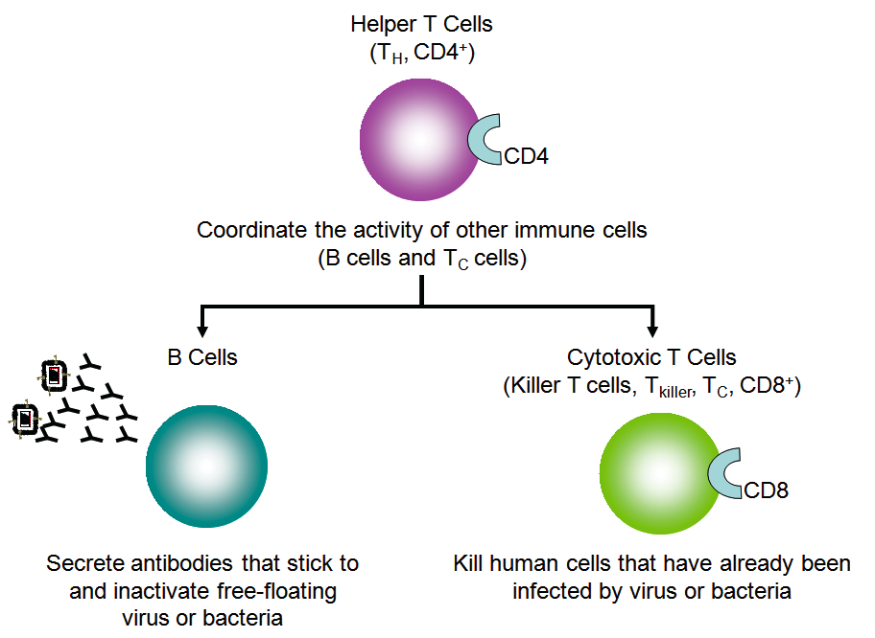
Immune System Review
  Lymphocytes are immune cells that attack foreign particles (antigens) in the body
  B cells
    Secrete antibody into the circulatory system
    Antibody binds to a specific antigen
    Antibodies neutralize their target
  Cytotoxic T cells (T_{C,} T_{killer} or CD8+)
    Kill cells that have already been infected
    Have the CD8 protein on their cell surface
  T Helper cells (T_{H} or CD4+)
    Coordinate the action of T_{C} cells and B cells
    Have the CD4 protein on their cell surface

Slide 5
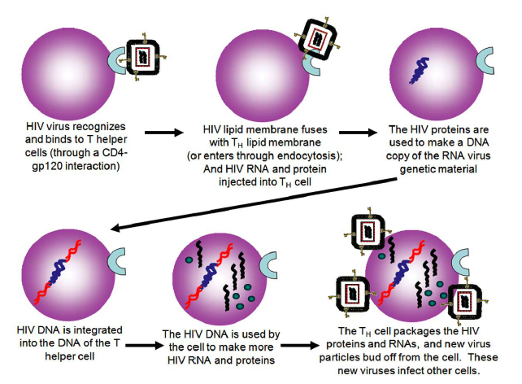
HIV Infection
  HIV targets and infects T_{H} cells
  The HIV gp120 protein recognizes and binds to the T_{H} CD4+ protein
  HIV is a retrovirus
    It has to convert its RNA genome to DNA
    Reverse transcriptase makes DNA copies of the RNA virus
    Integrase integrates the converted DNA into the cell’s DNA
  The 9 HIV genes hijack the cell’s machinery
    Produce all the proteins and RNA needed to make more virus particles
    Newly-made virus particles bud off of the T helper cell
    It now is a virus-producing factory

Slide 6
Clicker Question 1
Which of the following is true of lymphocytes?
  B cells directly destroy invaders in the blood and body fluids
  Individual B-cells can produce antibodies for multiple antigens
  T_{H} cells activate both T_{C} cells and B cells
  T_{C} cells destroy invading microbes

Slide 7
Clicker Question 2
How is a retrovirus different from other viruses?
  It must convert its RNA to DNA and integrate its genome with the host DNA
  It avoids recognition by reverting to an earlier version of its genome
  It undergoes mutations in the host to avoid detection
  It only targets CD4 receptors on the host cell

Slide 8
Clicker Question 3
Why are most body cells other than T_{H} cells not targeted by the HIV virus?
  Other cells are not as critical to overall immunity
  Most other cells do not have CD4 receptors on their surface
  HIV can only attach to cells with CD8 receptors
  Other cells do not contain reverse transcriptase

Slide 9
In groups of two or three, come up with as many hypotheses as you can to explain why some individuals might be protected against HIV infection.
To get there:
      Discuss how the immune system fights viral infection.
      Discuss how HIV infects cells and reproduces.

Slide 10
Two hypotheses proposed by Paxton and colleagues:
  “Super Cytotoxic T Cells” Hypothesis (CD8+ lymphocyte inhibition)
    T_{C} cells of the protected individuals were better and faster at recognizing infected T_{H} cells
    Infected T_{H} cells are destroyed before the virus can replicate
    Therefore they are not transformed into HIV factories
  “Super T Helper Cells” Hypothesis (CD4+ infectibility and replication efficiency)
    T_{H} cells of the protected individuals were different, preventing the infection and replication of the virus
    There are many steps necessary for viral infection and replication
    Any of them could be impeded.

Slide 11
Back to your group
  Classify each of your proposed hypotheses into the two categories proposed by Paxton and his colleagues:
    Super Cytotoxic T Cells” Hypothesis
    Super T Helper Cells” Hypothesis
  Note: some hypotheses may fit into neither category
How might you test your hypotheses?
  Propose an experiment for one of your hypotheses.
  How will you set up the experiment?
  What will you measure (specific data you will collect)?
  What are your controls?

Slide 12
Paxton and his colleagues recruited 25 volunteers
  who claimed to have had repeated exposure to the HIV virus and yet were not infected with HIV
They also recruited 9 individuals
  Not exposed to the HIV virus (and who tested negative for the virus)
  This latter group is the control, whose response to HIV should be the same as the response of the majority of people

Slide 13
They isolated T_{H} cells and T_{C} cells from individuals in each group. They then performed the following experiments:
  In one tube, they mixed HIV virus and T helper cells
  In another tube, they mixed HIV virus, T helper cells, and cytotoxic T cells
  They monitored the accumulation of virus in the test tube over time by measuring the amount of p24 proteins produced
Why does the p24 indicate the accumulation of HIV virus?
Why was one of the tubes not just HIV virus & cytotoxic T cells?

Slide 14
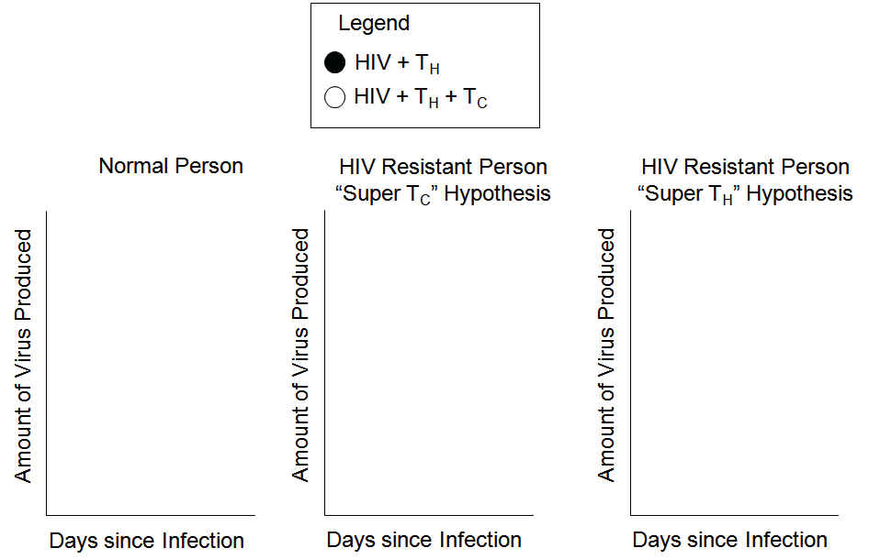
What would the possible outcomes for this experiment look like?
Draw three X Y graphs as shown below. What would expected results look like for a:
  Protected individual, assuming that the “Super Cytotoxic T Cells” Hypothesis is correct.
  Protected individual, assuming that the “Super T Helper Cells” Hypothesis is correct.
  Note that each graph requires two lines (the two test tubes).

Slide 15
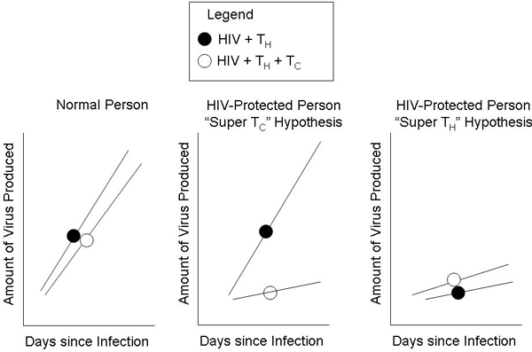
Clicker Question 4
If your results for the resistant group look like those on the right, which hypothesis is supported?
NOTE: You should be able to quickly match this to one of your possible outcomes from the previous exercise!
  The Super Cytotoxic T Cells Hypothesis
  The Super T Helper Cells Hypothesis
  Neither hypothesis is supported

Slide 16
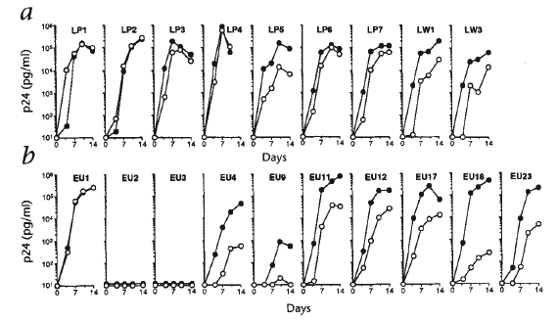
Paxton’s Results
  The top graph data (a) come from control individuals
  The bottom graph data (b) come from 10 people claiming to be protected against HIV infection
LP = Leukopac Preparation (random blood donors)
EU = Exposed Unaffected
Notes:
Figure 1 from Paxton, W.A., Martin, S.R., Tse, D., O’Brien, T.R., Skurnick, J., VanDevanter, N.L., Padian, N., Braun, J.F., Kotler, D.P., Wolinsky, S.M., Koup, R.A. (1996). Relative resistance to HIV-1 infection of CD4 lymphocytes from persons who remain uninfected despite multiple high-risk sexual exposures. Nature Medicine 2(4): 412–417. Reused with permission of Macmillan Publishers Ltd: Nature Medicine, copyright 1996.

Slide 17
Clicker Question 5
Do cytotoxic T cells provide protection from HIV in control individuals?
  Yes
  No
  Sometimes

Slide 18
Clicker Question 6
Do any individuals in the “protected” group appear to be protected from HIV?
  Yes
  No

Slide 19
Back to your group
Try to identify patterns in the results of the protected individuals?
  Can you group the individual experimental results into categories?
  If so, how many?
  Classify each subject into the different categories

Slide 20
Clicker Question 7
Which of Paxton’s hypotheses seem to be validated by the results of the protected individuals?
  The Super Cytotoxic T Cells Hypothesis
  The Super T Helper Cells Hypothesis
  Neither hypothesis is supported
  Both, the results are mixed

Slide 21
Paxton’s team was particularly interested in protected subjects EU2 and EU3 and in investigating the mechanism of action of their protection against HIV
HIV-1, the most common form of the virus and the one responsible for the pandemic, can be classified into two different types:
  M-tropic (also called non-syncitia-inducing (NSI) or R5 HIV-1) strains
    Must bind to two cell surface proteins to enter and infect a cell:
      CD4 protein
      Beta-chemokine receptor CCR5
  T-tropic (also called syncitia-inducing (SI) or X4 HIV-1) strains
    Must bind to slightly different proteins to enter and infect a cell:
      CD4 protein
      Alpha-chemokine receptor CXCR4 (at the time called fusin)

Slide 22
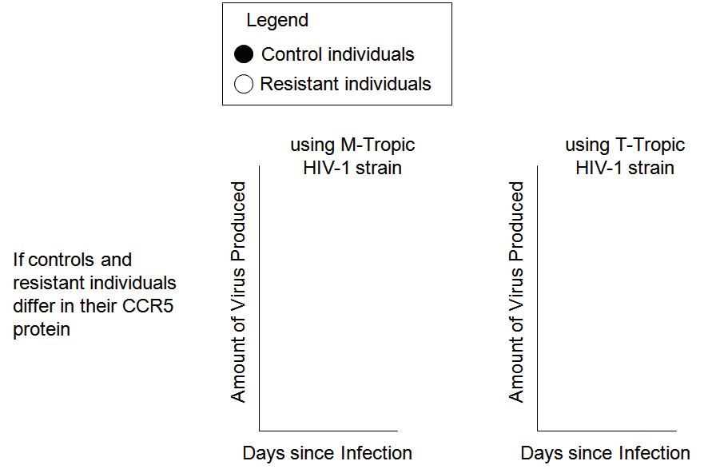

Let’s assume that compared to controls, protected individuals have one of the following mutations
  CCR5 protein (M-tropic gene mutation)
  CXCR4 protein (T-tropic gene mutation)
What would the possible outcomes for this experiment look like?
Draw graphs like those below and show what results for each would look like
Remember that each graph should have two lines, and review which proteins are required for infection by the two strains

Slide 23
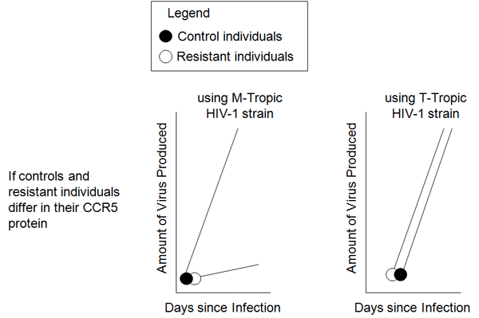
Clicker Question 8
The results on the right indicate a mutation in which protein of protected individuals?
  CCR5 protein
  CXCR4 protein

Slide 24
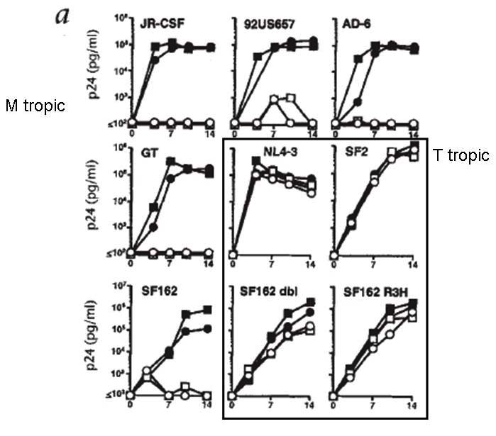
Clicker Question 9
Which strain(s) of HIV-1 can infect and replicate in the T_{H} cells of protected individuals?
  T-tropic
  M-tropic
  Filled circles (•) represent T_{H} cells from controls,
  Empty circles (º) represent T_{H} cells from protected individuals.
  Letters and numbers above each graph show the name of the HIV-1 strain used in the experiment.
Notes:
Figure 4 from Paxton, W.A., Martin, S.R., Tse, D., O’Brien, T.R., Skurnick, J., VanDevanter, N.L., Padian, N., Braun, J.F., Kotler, D.P., Wolinsky, S.M., Koup, R.A. (1996). Relative resistance to HIV-1 infection of CD4 lymphocytes from persons who remain uninfected despite multiple high-risk sexual exposures. Nature Medicine 2(4): 412–417. Reused with permission of Macmillan Publishers Ltd: Nature Medicine, copyright 1996.

Slide 25
The M-strain HIV-1 is the infectious agent 90% of the time in sexually transmitted HIV (Ahmad, 2002)
  CD4 and CCR5 proteins are used by HIV to gain entry into the T_{H} cell
  Most of the individuals resistant through a “Super T_{H} Cell” mechanism harbor the same mutation making their CCR5 gene non-functional
  Recent studies have shown that individuals homozygous for the CCR5 mutation are more prone to West Nile Virus infection and possibly hepatitis
The mutation is found predominantly in populations of European descent
  1–3% homozygous, 14% heterozygous, 83% homozygous non-mutated
  It is first thought to have appeared in the population around 700 years ago
  Suggested hypotheses for the mutation frequency include:
    Conferring resistance to Yersinia pestis, the infectious agent of the bubonic plague
    Conferring resistance to smallpox
    Neutral evolution

Slide 26
Back to your group
  It is a relatively simple procedure to test the genotype of a person at the CCR5 gene to determine whether they have the CCR5Δ32 mutation.
  What are the arguments for and against genotype testing of the CCR5 gene?
  Discuss it in your group

Slide 27
Clicker Question 10
Should a person wishing to have their genotype tested to determine whether they have the CCR5Δ32 mutation be allowed to do so?
  Yes
  No

Slide 28
Image Credits
Except as noted below, images appearing in this presentation are the creation of Annie Prud’homme-Généreux from the original version of this case and are reused with the permission of NCCSTS.
Slide 1: Image of HIV virus in title block ©Sebastian Kaulitzki | Dreamstime.com.
Slides 16, 17, 18, 19, 20, and 24: Figures take from: Paxton, W.A., Martin, S.R., Tse, D., O’Brien, T.R., Skurnick, J., VanDevanter, N.L., Padian, N., Braun, J.F., Kotler, D.P., Wolinsky, S.M., Koup, R.A. (1996). Relative resistance to HIV-1 infection of CD4 lymphocytes from persons who remain uninfected despite multiple high-risk sexual exposures. Nature Medicine 2(4): 412–417. Reused with permission of Macmillan Publishers Ltd: Nature Medicine, copyright 1996.

