Slide 1
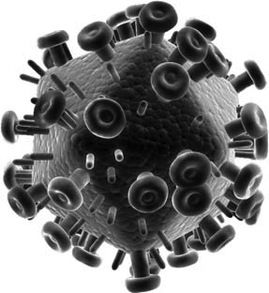
Resistance Is Futile ... or Is It?
The Immune System and HIV Infection
Modified for clickers by
Steven Telleen
San Joaquin Delta College
From a case study by
Annie Prud’homme-Généreux
Life Sciences
Quest University, Canada

Slide 2
The vast majority of people are susceptible to HIV infection.
However, in the 1990s, several individuals noticed that despite repeated exposure to the HIV virus they remained HIV negative.
Were these individuals extremely lucky?
Was something different about them that made HIV infection less likely?
What are the new ideas for treating HIV
What do you already know about the HIV virus, the immune system, and HIV infection and what did you find out?
http://www.youtube.com/watch?v=hdgNnXLY8LU

Slide 3
Introduction Clicker Question #1:
I can be infected by being around HIV positive people?
Yes
No
Unsure

Slide 4
Introduction Question #2
HIV can be cured.
Yes
No
Unsure

Slide 5
What did you learn:

Slide 6
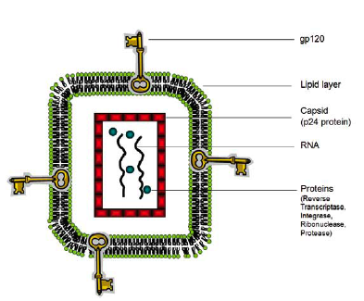
The HIV Virus
Is spherical in shape
HIV encodes its 9 genes using the nucleic acid molecule RNA
The virus particle also contains proteins important for replication
Reverse transcriptase
Integrase
Protease
Ribonuclease
The HIV virus is enclosed by multiple layers
Capsid the outer protein coat made of the protein p24
The level of p24 protein is an indicator of the amount of HIV virus in the blood
The capsid is wrapped in a double layer of phospholipids
Proteins stick out of the lipid layer, perhaps most important gp120 (Env)
The gp120 protein gives HIV its specificity:
gp120 interacts with specific proteins allowing the virus to infect specific human cell types

Slide 7
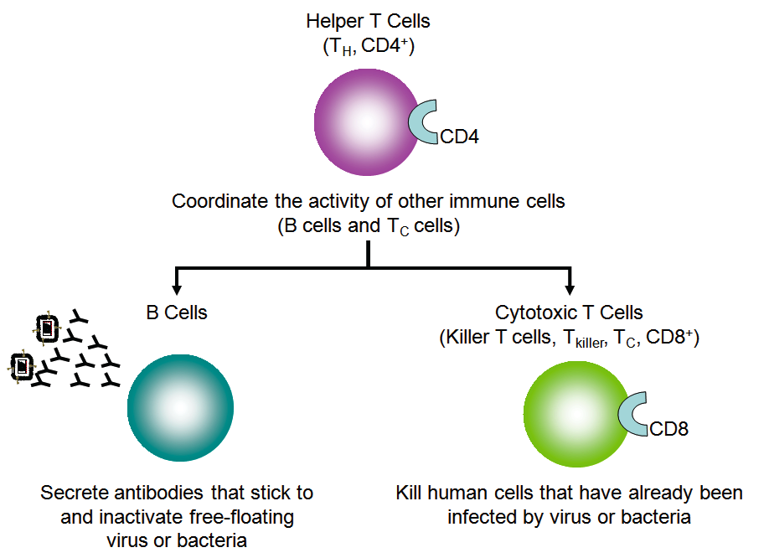
Immune System Review
Innate (nonspecific immune system)
Immunity
interferon
antigens
B cell lymphocyte
antibodies
Cytotoxic T cell/ lymphocyte (T_{C,} T_{killer} or CD8+)
T Helper cells (T_{H} or CD4+)
http://www.youtube.com/watch?v=CeVtPDjJBPU

Slide 8
Innate (nonspecific immune system)
Immunity
interferon
Antigens
B cell lymphocyte
Antibodies
Cytotoxic T cell/ lymphocyte (T_{C,} T_{killer} or CD8+)
T Helper cells (T_{H} or CD4+)

Slide 9
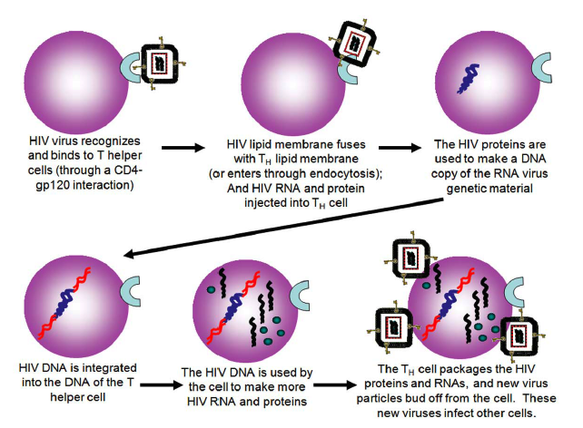
HIV Infection
HIV targets and infects T_{H} cells
The HIV gp120 protein recognizes and binds to the T_{H} CD4+ protein
HIV is a retrovirus
It has to convert its RNA genome to DNA
Reverse transcriptase makes DNA copies of the RNA virus
Integrase integrates the converted DNA into the cell’s DNA
The 9 HIV genes hijack the cell’s machinery
Produce all the proteins and RNA needed to make more virus particles
Newly-made virus particles bud off of the T helper cell
It now is a virus-producing factory

Slide 10
In your informal groups, come up with as many hypotheses as you can to explain why some individuals might be protected against HIV infection.
To get there:
Discuss how the immune system fights viral infection.
Discuss how HIV infects cells and reproduces.

Slide 11
What did you come up with?

Slide 12
Go out on the internet and find out who (which human groups) might be somewhat immune to HIV infection.
What reasons do scientists give for the people’s apparent immunity to HIV infection?
Is there a “downside” (disadvantage) to having this immunity?
What’s the latest news on combatting HIV infection for those people who are not naturally immune to infection?

Slide 13
Image Credits
Except as noted below, images appearing in this presentation are the creation of Annie Prud’homme-Généreux from the original version of this case and are reused with the permission of NCCSTS.
Slide 1: Image of HIV virus in title block ©Sebastian Kaulitzki | Dreamstime.com.
Slides 16, 17, 18, 19, 20, and 24: Figures take from: Paxton, W.A., Martin, S.R., Tse, D., O’Brien, T.R., Skurnick, J., VanDevanter, N.L., Padian, N., Braun, J.F., Kotler, D.P., Wolinsky, S.M., Koup, R.A. (1996). Relative resistance to HIV-1 infection of CD4 lymphocytes from persons who remain uninfected despite multiple high-risk sexual exposures. Nature Medicine 2(4): 412–417. Reused with permission of Macmillan Publishers Ltd: Nature Medicine, copyright 1996.

