Slide 1
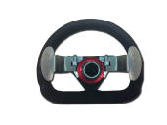
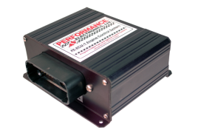
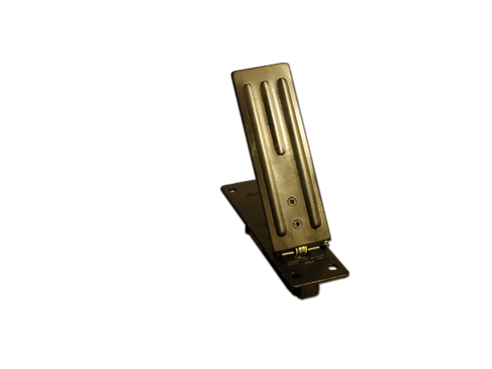
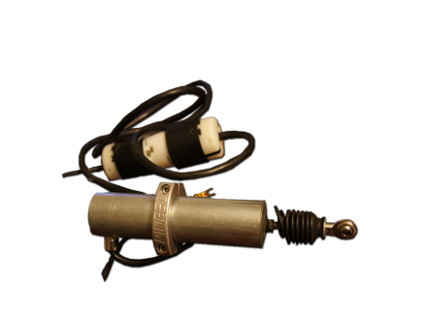
Functional Block Diagram
Shifter System
Buttons
Shift || Chmod
ECU
Tach data ready
Update rpms
Get sig
Main
Tach
ECU sig ready
Kill ignition
User Calibration
Get rpms
Update rpms
Manual||Semi / shift
Input data
Shifter
Gears
Gear info
position
Pedal
Actuate (direction)
Simulator
Solenoid

Slide 2
Hierarchy of Control
Main
Shifter
Gears
Tach
Objects
Simulator
Drivers
Pedal
ECU
Solenoid
User Input
User Calibration
Buttons

