Slide 1
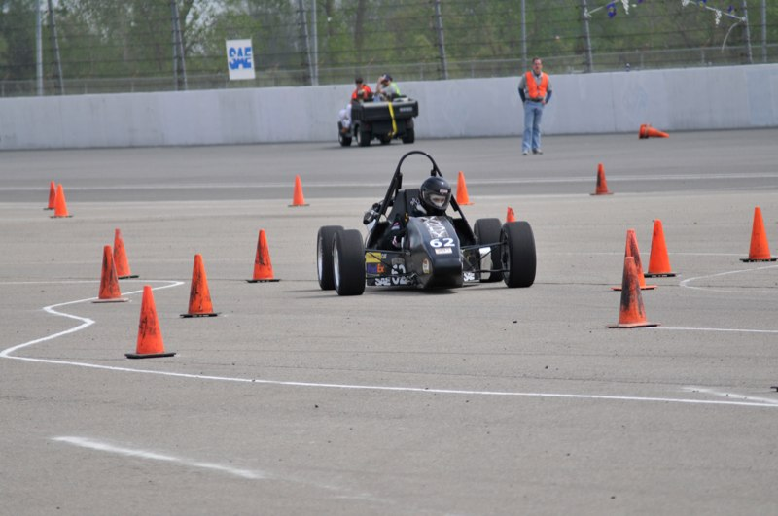


FSAE Automated Shifter
By:
Nor Aimi Ghazali
Rocky Gray
DeAndre Jones
Spencer Price

Slide 2
Vanderbilt Motorsports Team
Compete in the Formula SAE series
Competition is in Michigan, May 11th
Uses a 1 cylinder engine with sequential gearbox taken from a Yamaha YFZ450 ATV

Slide 3
Design Objective
Build a working shifting system that allows the driver to shift quicker and makes the car more accessible to student drivers

Slide 4
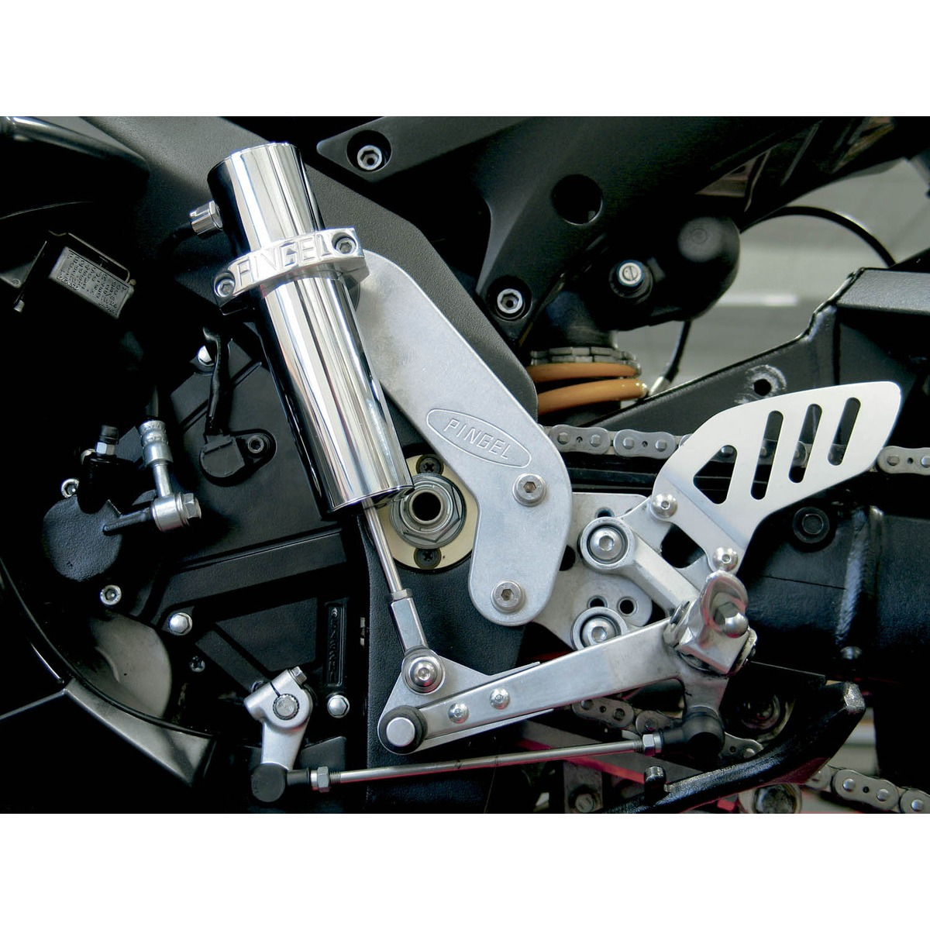
Similar Designs
PINGEL Electric Shifter
Similar design used for motorcycles and ATVS

Slide 5
Design Stages
Stage 1: Manual Paddle Shifters
Paddles nearly complete, need wiring and installation
Circuitry: nearly complete, full simulation available but need a few parts
Stage 2: Semi-Automatic Shifting
Defined initial shifting parameters but needs tuning
Stage 3: Fully Automatic Shifting
Defined initial parameters but needs tuning

Slide 6
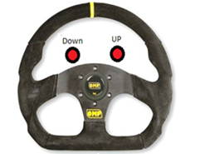
Paddle Shifters
Initial design: buttons on the wheel
Lack of haptic response with driving gloves
Redesign: paddle shifters offer larger contact patch and more physical action
Keeps thumbs and palm on the wheel for more stability
But adds more weight
Buttons: 60 grams
Paddles: currently 110 grams (more mass will be taken out of paddles)

Slide 7
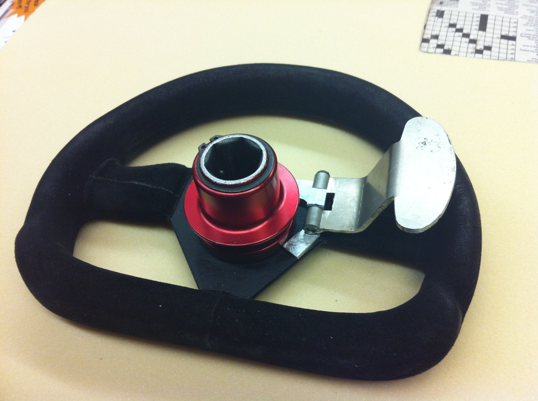
Paddle Shifter

Slide 8
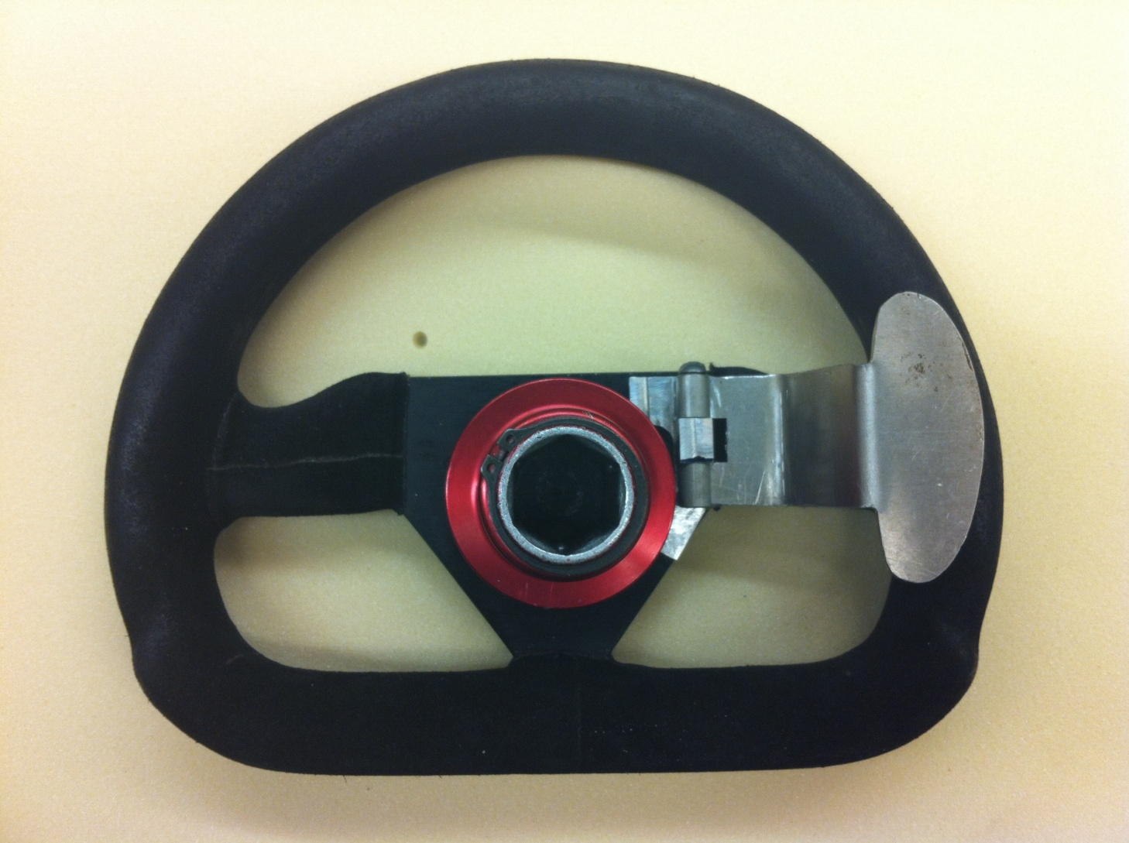
Paddle Shifter

Slide 9
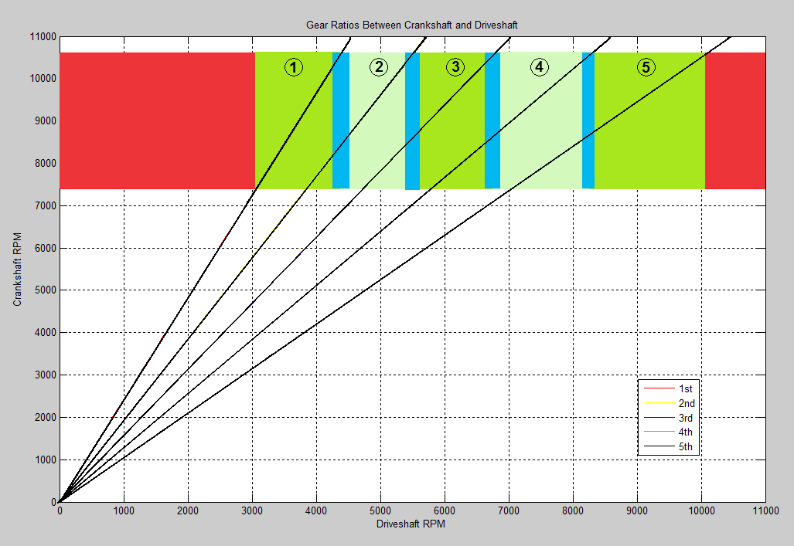
Automatic Shift Regulation

Slide 10
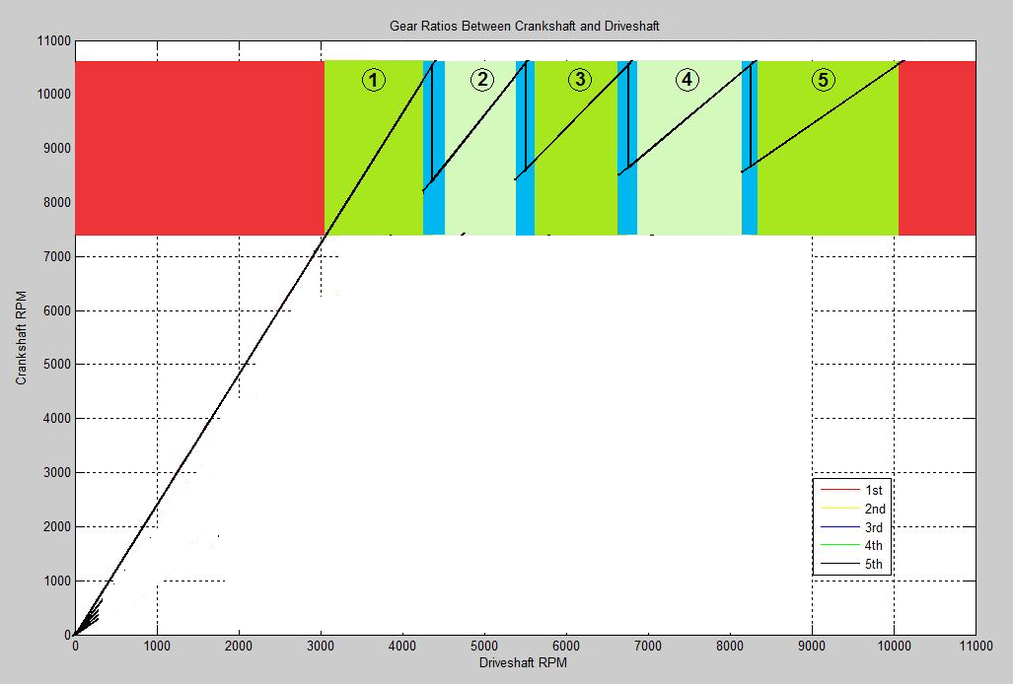
Automatic Shift Regulation

Slide 11
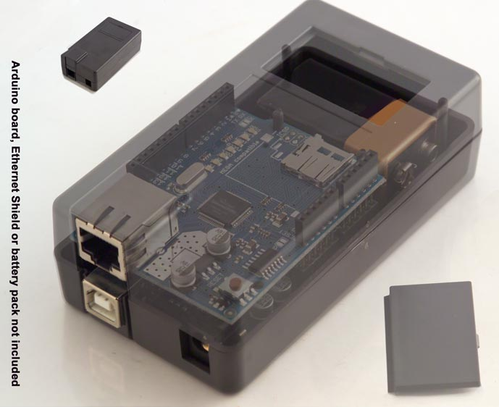
Hard Casing
Placed at the bottom left of cockpit (right by ECU)
Protects Breadboard & Arduino from dirt & debris
No need to worry about heat from Engine
Notes:
Arduino Prototyping shield

Slide 12
Software Structure
Tach
INT0
(rising edge)
Main Task
pulse_count
rpms
index
rpm_hist[]
Timer1
(16-bit)
Gear
Usr_Btn
max_rpm
min_rpm
Timer0
(8-bit)
state
count

Slide 13
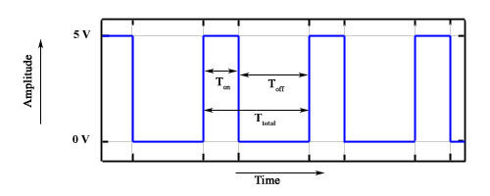

Calculating RPMs
Tach Signal
Square wave
30% duty cycle
2 pulses per rotation
Sample at 1Hz
$RPMs=\frac{count}{2}∗$60

Slide 14
Microcontroller
Voltage
Divider
ECU
µC
ATMega328P
Tach O/P
Tach (PD2)
Digital Input
Ignition (PD3)
USHIFT (PD0)
DSHIFT (PD1)
MODE (PD4)
Solenoid Circuit
SOLEN_UP (PB1)
Pull
SOLEN_DN(PB2)
Push

Slide 15
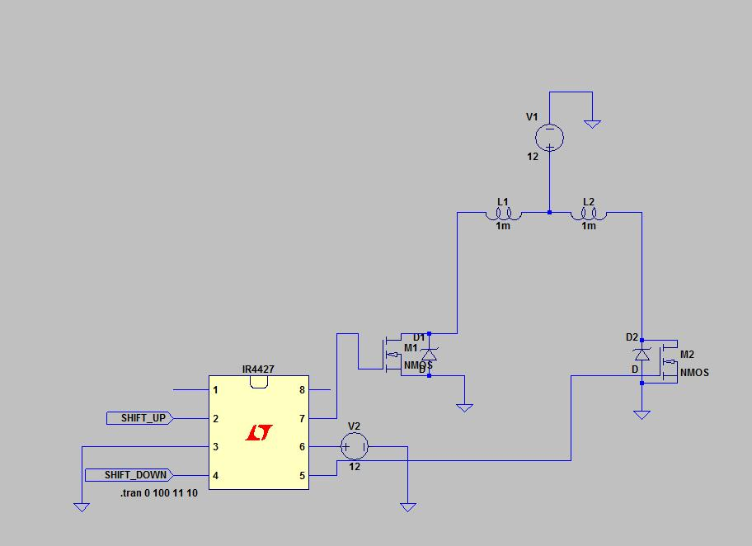
Circuit that drive SAE shifter

Slide 16
Process
Use preliminary tests to design the circuit
MOSFET motor driver stop rotate much faster than using only mechanical switch, by using a fly-back diode

Slide 17
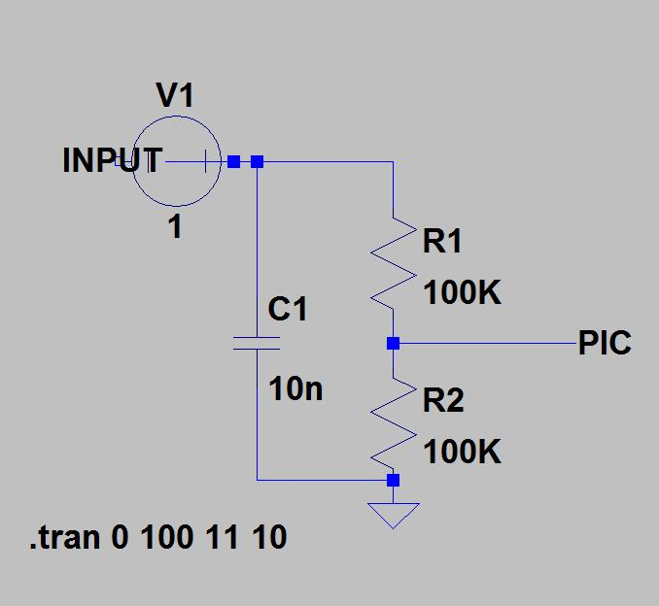
Circuit Design
A buffer circuit is constructed so that there is no delay for the signal
Analog to digital
conversion is done on
the PIC

Slide 18
Cost Analysis
Electronics:
Resistors: $19.99
Power adaptor: $6.45
Prototyping shield: $15.95
Capacitor kit: $15.12
Wiring: $11.75
Soldering Iron: already owned, $7.19 new
Solder: already owned, $2.99 new
Multimeter: already owned, $5.95 new
Hardware:
Arduino: already owned, $22.85
Arduino case: $18.94
Pingel Electric Shifter: free from team, $200 new
Raw Materials:
6061 Aluminum Rod 7/16” by 6 ft: $12.49
6061 Aluminum Block 1” by 2” by 12”: free scrap, $19.05 new
6061 Aluminum Sheet 0.090” by 12” by 12”: free scrap, $20.64 new
Software: free
VIM
Win AVR
AVR Studio
Pspice (free with school license)

Slide 19
Cost Analysis
PINGEL Electric Shift Kits New: $608-849 Online
Our Cost (without traditional fixed costs): $378.76
 | Our Cost | Real Cost
Electronics | $ 69.26 | $ 85.39
Hardware | $ 41.79 | $ 241.79
Raw Materials | $ 12.49 | $ 51.58
Software | $ - | $ -
Total | $ 123.54 | $ 378.76

Slide 20

Issues
SAE Team
Able to design up to initial parameters but final tuning is still needed
Coding Arduino to shift properly
Ordering parts

Slide 21
Next Steps
Tuning
Shift points
Button election time
Solenoid action
Overall action time should be less than .6 sec (average time to manually shift car)
Driver Training
Make the paddle attachments easy to use and easily detachable with steering wheel
Build instinct for using the paddles
Building UI for redefining shift points for race changes

Slide 22
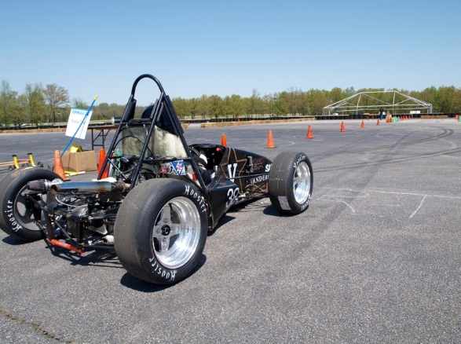
Any Questions?

