Slide 1

Cyclistic Insights Case Study
Dawson Gronemus

Slide 2
Project Overview
Data Source: 12 months of Cyclistic data on bike share rides throughout downtown Chicago
Total Rides Analyzed: 5,585,0044
Key Question: How do annual members and casual riders use Cyclistic bikes differently?
Notes:
Understanding how each group rides helps us design marketing that converts casual riders into annual members.

Slide 3
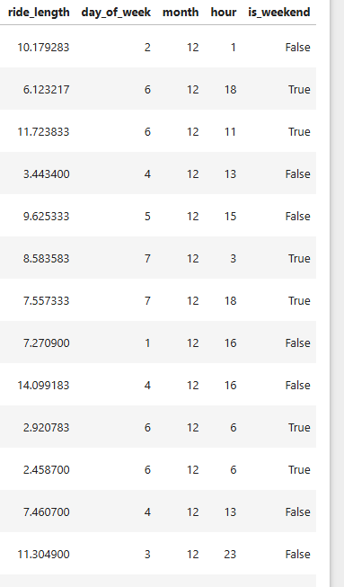
Data Cleaning and Preparation
Removed invalid/negative ride lengths
Filtered out trips > 24 hours
Removed null values
Added 4 new Fields: ride_length, day_of_week, hour, and is_weekend

Slide 4
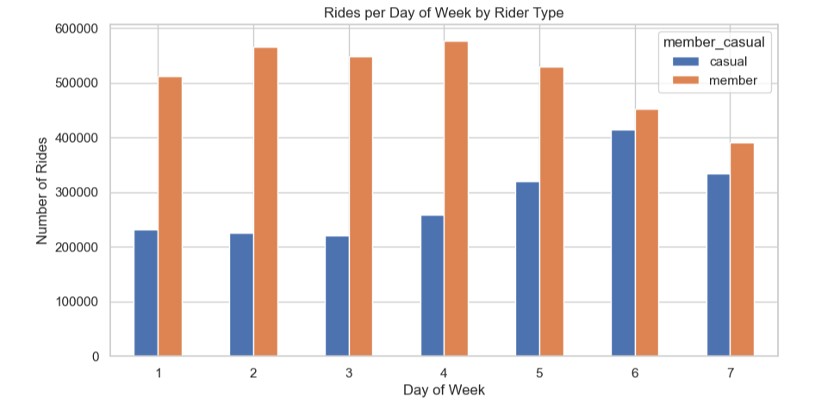
Rides by Rider Type
Finding: Members take significantly more total rides annually, reflecting consistent usage patterns

Slide 5
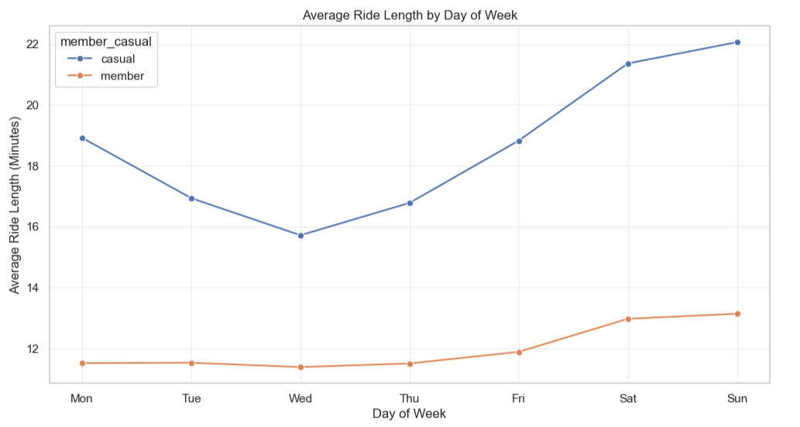
Average Ride Length (by day of week)
Casual riders ride much longer on average
Members ride short, consistent trips typical of commuting

Slide 6
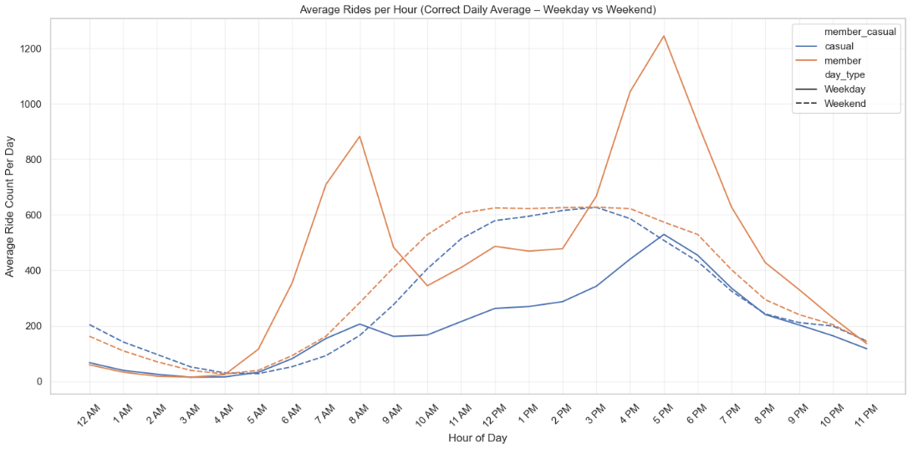
Hourly Usage Patterns (Weekday vs Weekend)
Members show clear commute peaks at 8 AM and 5 PM on weekdays.
Casual riders peak midday on weekends, but still include a rush during commuting hours

Slide 7
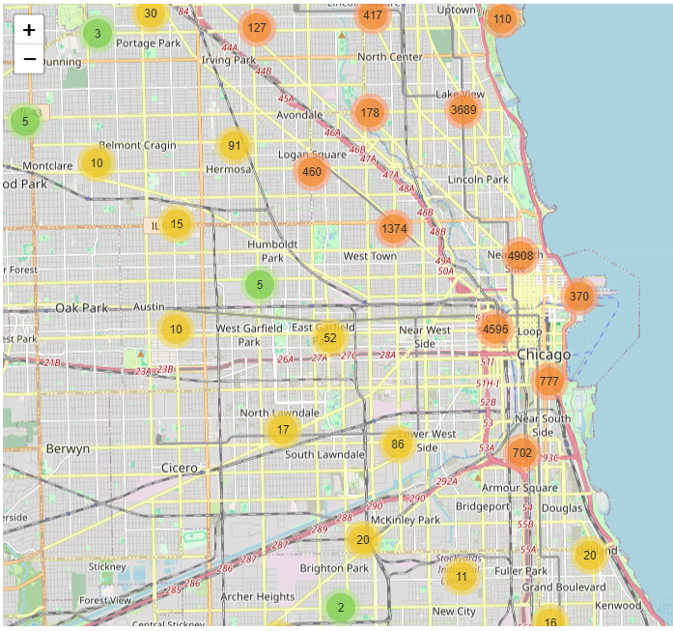
Location
Both Casual and Member Riders used the bikes heavily downtown

Slide 8
Key Behavioral Differences Summary
Behavior Metric | Annual Members | Casual Riders
Ride Length | Shorter | Longer
Usage Pattern | Weekday-heavy | Weekend-heavy
Peak Hours | 8 AM & 5 PM | Mid-afternoon
Trip Purpose | Commute | Leisure/Tourism
Location Hotspots | Business & commuting corridors | Lakefront, parks, attractions

Slide 9
Marketing Recommendations
1. Target casual riders on weekends with membership messaging.
1
Ads at Lakeshore kiosks
In-app popups during long leisure rides
2. Promote the value for commuting.
2
“Skip the traffic, the annual membership pays for itself in 5 weeks.”
3. Create seasonal or trial memberships.
3
Encourage casual riders to try weekday riding
4. Offer conversion discounts at high-casual stations
4

Slide 10

Thanks / Q/A

