Slide 1
Genome Analysis of Clostridium tetani
Grace Rodrigues

Slide 2
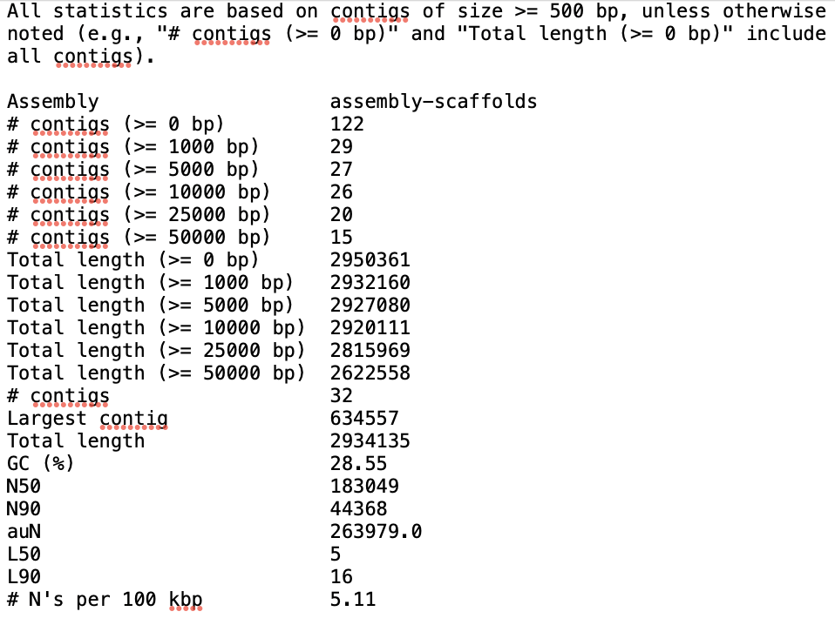
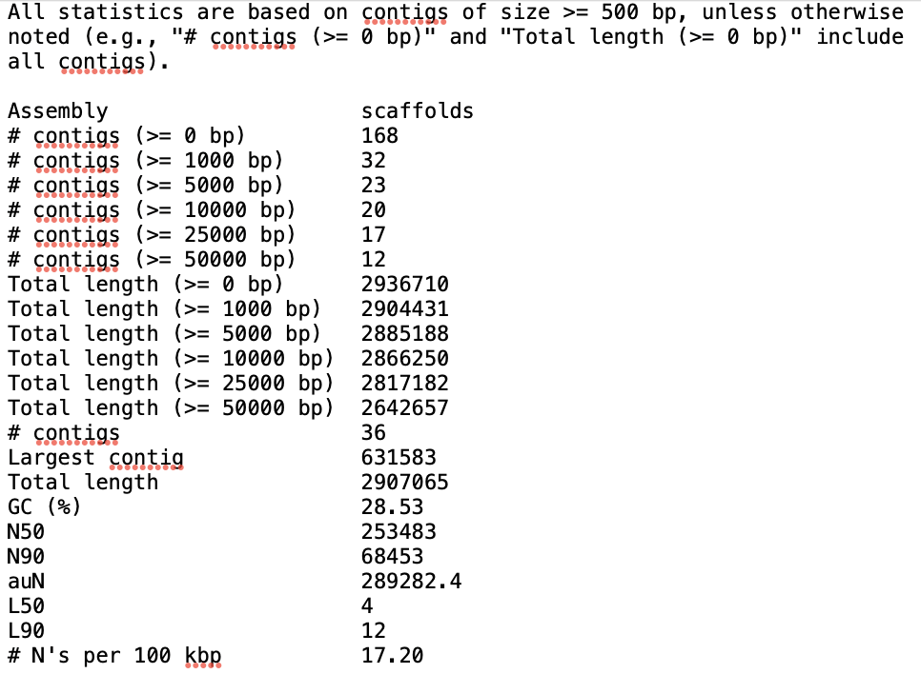
QUAST
ABySS:
SPAdes:
I chose SPAdes assembly to annotate

Slide 3
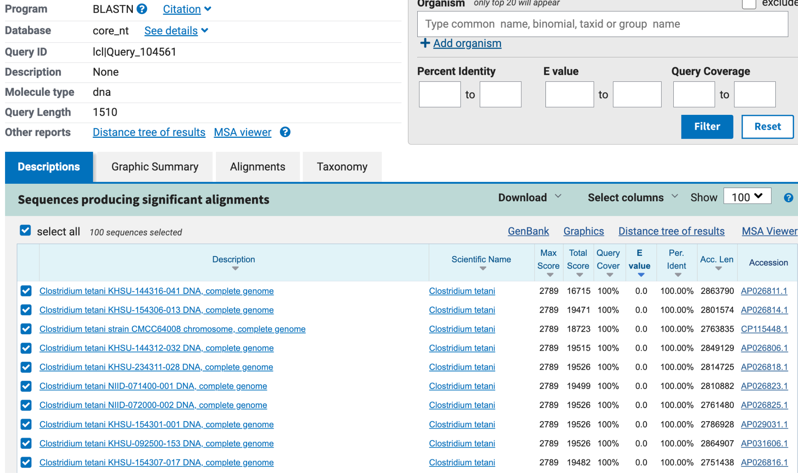
NCBI
blastn

Slide 4
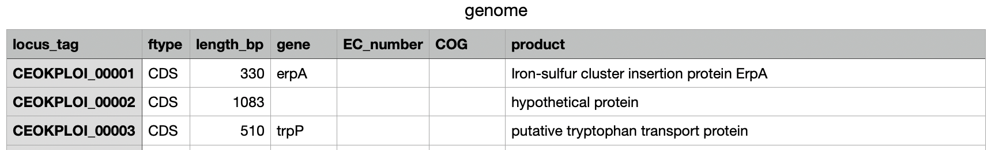
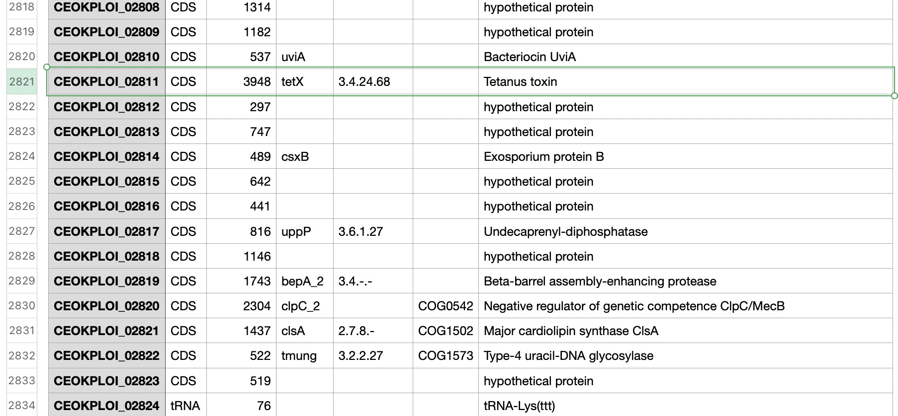
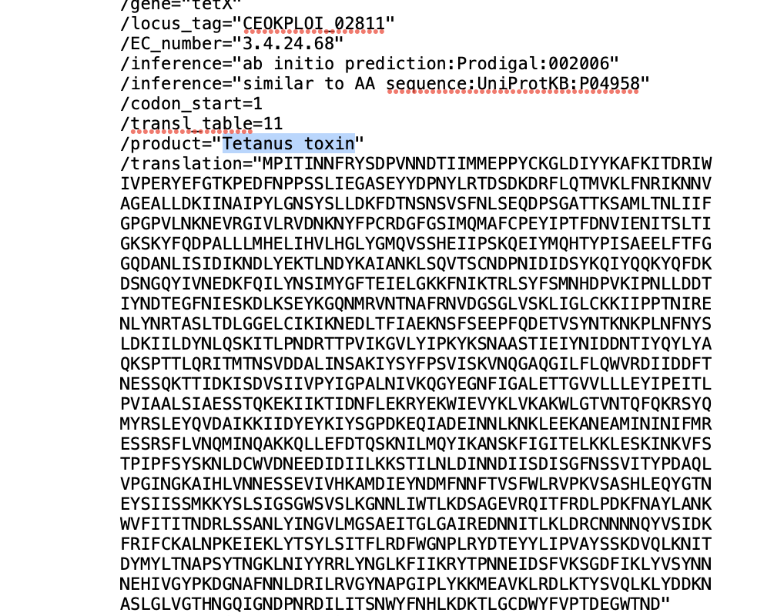
Prokka
genome.tsv
genome.gbk

Slide 5
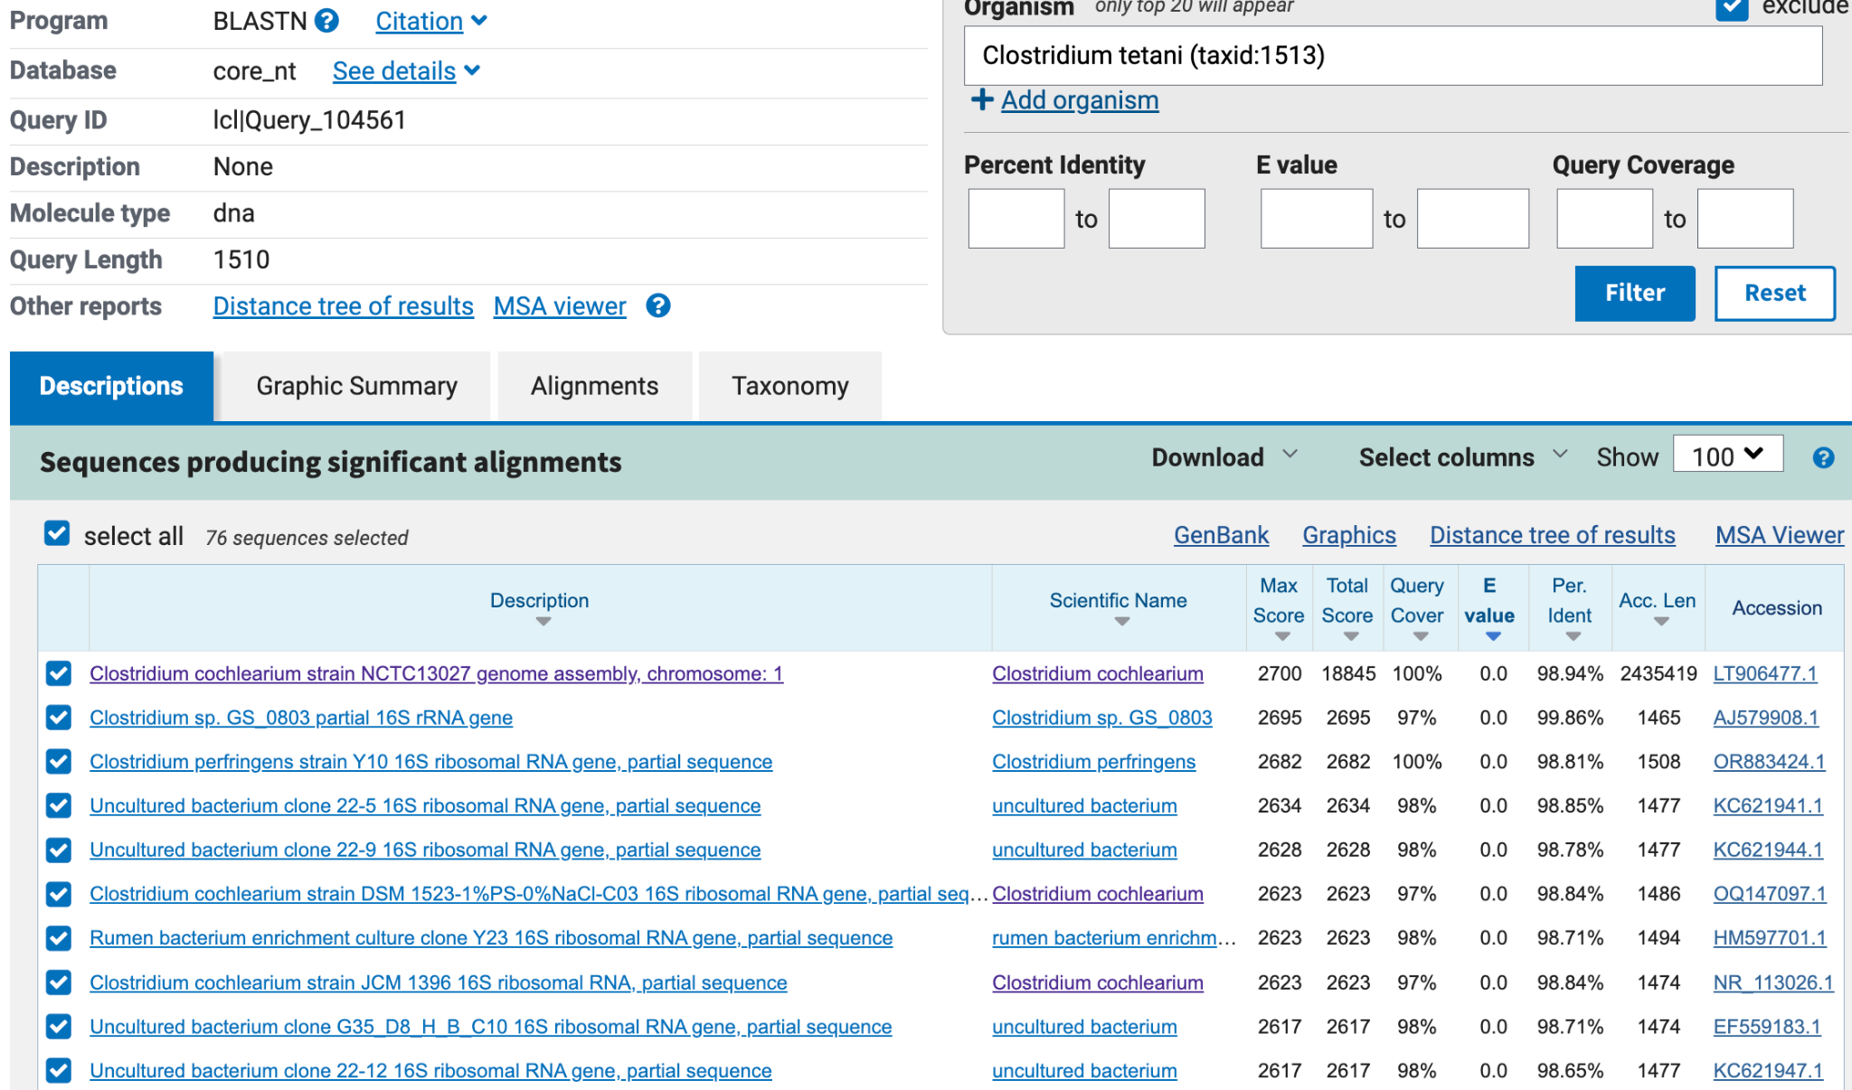
NCBI
blastn
Excluding
C. tetani

Slide 6
Final Relationships compared to C. tetani
 | Percent identity | Identical fragments | Total fragments
Clostridium cochlearium | 87.4194 % | 643 | 949
Clostridium perfringens | < 70 %
Notes:
fastANI wont output a result if less than 70

Slide 7
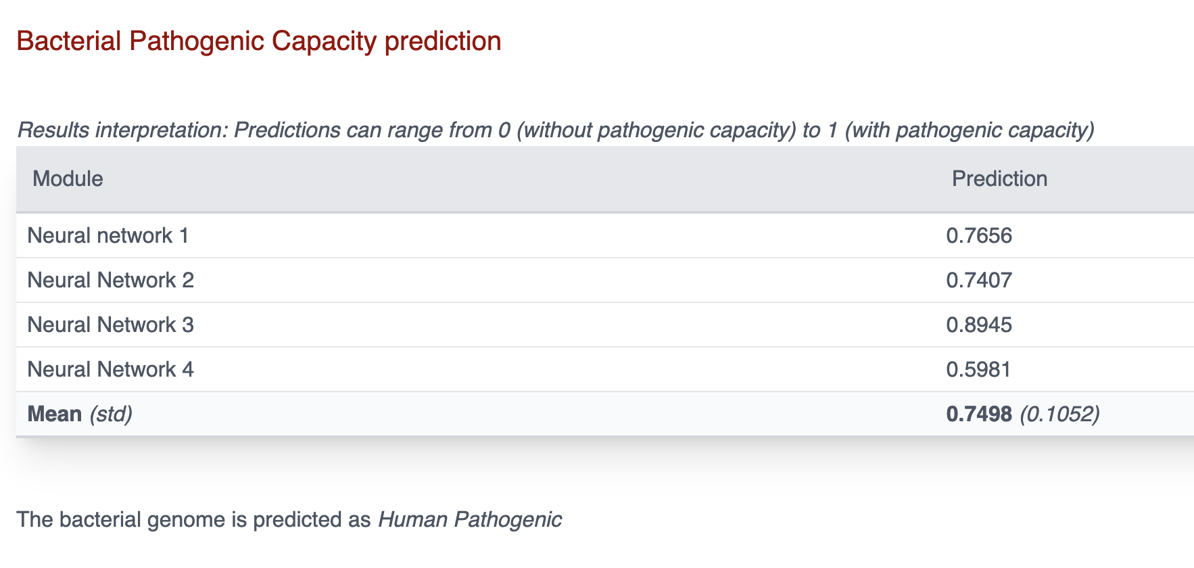
C. tetani pathogenic prediction
Notes:
This is a pathogen with 0.7498 prediction and a 0.1052 standard deviation

