Slide 1

ACCIDENT AVOIDANCE SYSTEM IN AUTOMOBILES
BY
BATCH NO: A11
G. PALLAVI (15H51A0419)
K .SAI TEJA (15H51A0425)
G .ROHIT RAJ (15H51A0421)
PROJECT COORDINATOR PROJECT GUIDE
Mr. C. VEERANJANEYULU MRS. VANDANA KHARE
ASSISTANT PROFESSOR ASSISTANT PROFESSOR
DEPARTMENT OF ELECTRONICS AND COMMUNICATION ENGINEERING
CMR COLLEGE OF ENGINEERING & TECHNOLOGY
(AUTONOMOUS)
KANDLAKOYA,MEDCHAL ROAD,HYDERABAD-501401

Slide 2
LIST OF CONTENTS
INTRODUCTION
OBJECTIVE
BLOCK DIAGRAM
REQUIREMENTS
FLOW CHART
DESCRIPTION OF MODULE
SCHEMATIC DIAGRAM
RESULTS
ADVANTAGES
APPLICATIONS
CONCLUSION

Slide 3
INTRODUCTION
Accidents are caused yearlong due to various factors such as drunk driving, texting while driving, speeding, distractions etc.
A collision avoidance system is an automobile safety system designed to prevent or reduce the severity of a collision.It uses RADAR (all-weather) and sometimes LASER and camera to detect an imminent crash.

Slide 4
OBJECTIVE
The aim of the project is to develop automatic speed control of automobiles and preventing from accidents using IR sensors.

Slide 5
BLOCK DIAGRAM
A
T
8
9
S
5
2
16X2
LCD
POWER
SUPPLY
BUZZER
IR
TRANSMITTER
IR RECEIVER
RELAY
MOTOR
POWER
SUPPLY

Slide 6
REQUIREMENTS
HARDWARE COMPONENTS
SOFTWARE COMPONENTS
MICRO CONTROLLER (AT89S52)
POWER SUPPLY-12V
LCD DISPLAY (16x2)
BUZZER
RELAY
DC MOTOR
IR SENSORS
KEIL uVISION 4
PROTEUS
EMBEDDED C

Slide 7
FLOW CHART
Start
Initialize AT89S51, LCD, Buzzer, Sensors
If IR receiver detects any obstacle
YES
NO
Alarm sounds
Motor speed reduced

Slide 8
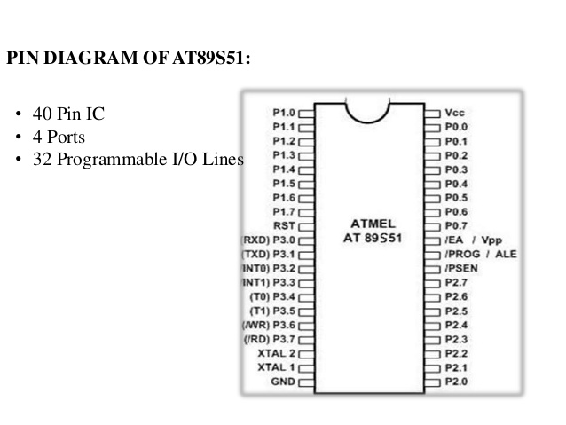
MICRO CONTROLLER
AT89S51 is a low power, high performance CMOS 8-bit micro controller with 8K bytes of in-system programmable Flash memory.
40 pins
4 ports
32 programmable I/O pins

Slide 9
SPECIFICATIONS OF AT89S52
Compatible with MCS®-51 Products.
8K Bytes of In-System Programmable (ISP) Flash Memory.
Endurance: 10,000 Write/Erase Cycles.
4.0V to 5.5V Operating Range.
Fully Static Operation: 0 Hz to 33 MHz.
Three-level Program Memory Lock.
256 x 8-bit Internal RAM.

Slide 10
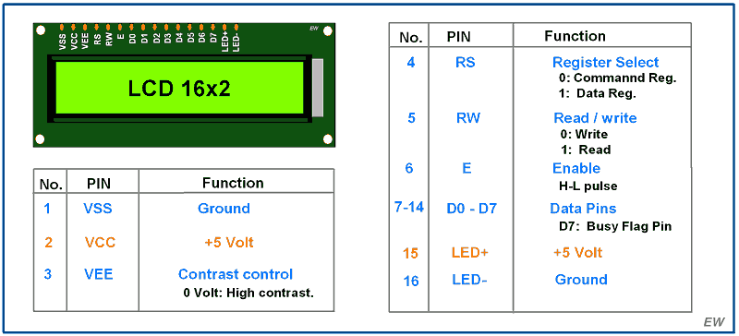
LIQUID CRYSTAL DISPLAY
A Liquid Crystal Display(LCD) is a thin ,flat panel used for elecronically displaying information such as text.
This is the most widely used display device for embedded systems.

Slide 11
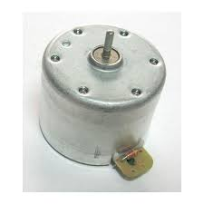
DC MOTOR
A DC motor is any of a class of rotary electrical machines converts direct current electrical energy into mechanical energy.

Slide 12
SPECIFICATIONS OF DC MOTOR
RPM
No load speed
Stall torque
Maximum current

Slide 13
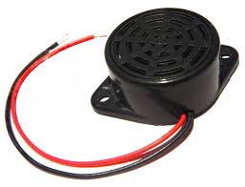
BUZZER
A buzzer or beeper is an audio signalling device.

Slide 14
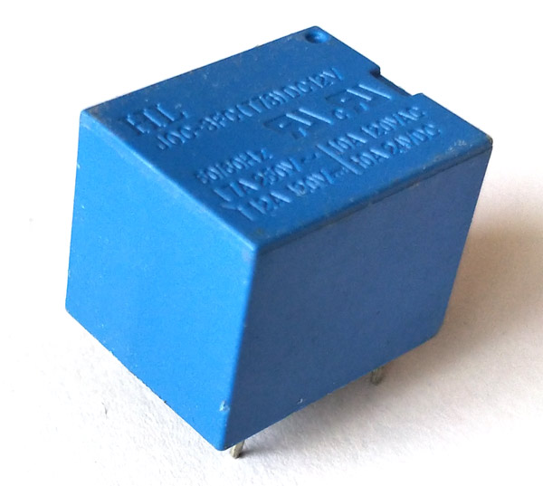
RELAY
A Relay is an electrically operated switch.
Relays control one electrical circuit by opening and closing contacts in another circuit.

Slide 15
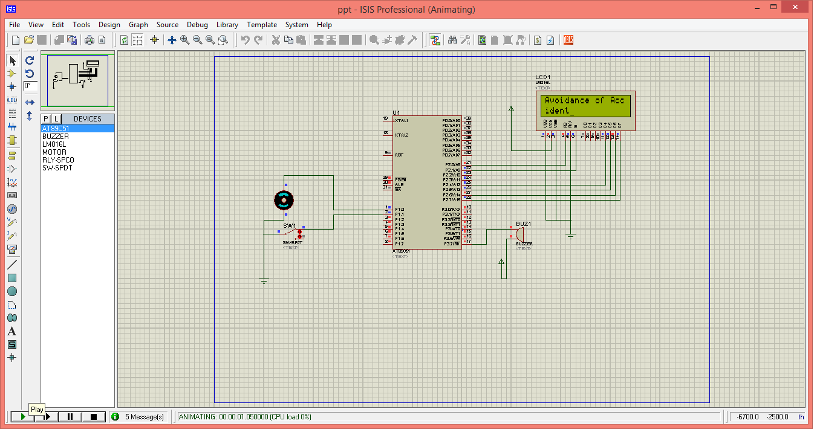
SCHEMATIC

Slide 16
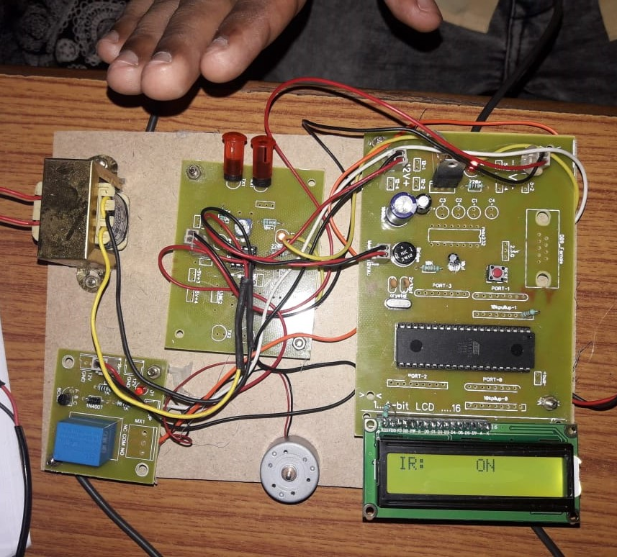
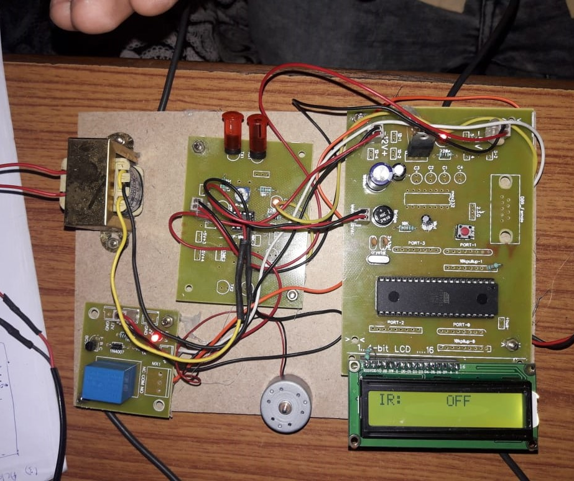
RESULTS
Case 1: WHEN MOTOR IS OFF
Case 2: WHEN MOTOR IS ON

Slide 17
ADVANTAGES
Highly Sensitive, Low cost and Reliable circuit.
This is applicable for only large farms riding to the soil condition.
Complete elimination of manpower.
Can handle heavy loads up to 7A.
System can be switched into manual mode when even required.

Slide 18
APPLICATIONS
Night vision detectors
Infrared tracking
Hyperspectral imaging
Infrared astronomy

Slide 19
CONCLUSION
We have implemented a project that comes from the field of embedded system “ACCIDENT AVOIDANCE SYSTEM IN AUTOMOBILES”.
The project helps in reducing the number of accidents.
It is also used for security alerts where 24 hours surveillance is required.

Slide 20
FUTURE SCOPE
Future car collision avoidance system may be smart phone based.
In future, this project may be used in railways, military etc.

Slide 21
ANY QUERIES?

Slide 22

. .

