Slide 1

A ROBOTIC CRACK INSPECTION AND MAPPING SYSTEM FOR BRIDGE DECK MAINTENANCE
BY
BATCH NO: A5
ANUSHA DUGGIRALA 15H51A0403
G. ROHIT RAJ 15H51A0421
K. PREETHAM CHANDRA 15H51A0429
PROJECT COORDINATOR PROJECT GUIDE
MR.V. PANDURANGA MRS VANDANA SHARMA
ASSISTANT PROFESSOR ASSISTANT PROFESSOR
DEPARTMENT OF ELECTRONICS AND COMMUNICATION ENGINEERING
CMR COLLEGE OF ENGINEERING & TECHNOLOGY
(AUTONOMOUS)
KANDLAKOYA,MEDCHAL ROAD,501401

Slide 2
CONTENTS
INTRODUCTION
OBJECTIVE
EXISTING SYSTEM AND PROPOSED SYSTEM
REQUIREMENTS
BLOCK DIAGRAM
WORKING PRINCIPLE
SCHEMATIC
RESULTS
ADVANTAGES
CONCLUSION
FUTURE SCOPE
REFERENCES

Slide 3
INTRODUCTION
Crack inspection and mapping system for bridge decks plays a vital role in maintaining the structural health and reliability of concrete bridges.
Many bridges exhibit defects in early stages immediately after construction.

Slide 4
OBJECTIVE
The objective of the project is to develop a robotic crack inspection and mapping system which can conduct accurate assessment of cracking on bridge decks.

Slide 5
EXISTING SYSTEM AND PROPOSED SYSTEM
EXISTING SYSTEM:
The current method of site inspection using human visual inspection is a time-consuming process for long-span bridges.
Typically, square grid coordinates are marked on the bridge deck. Skilled inspectors go to the site and assess the deck condition, grid by grid, marking the corrosions and cracks on a chart, all under strict traffic control this is very risk and time taken process.

Slide 6
PROPOSED SYSTEM:
The proposed system is based on the robotic Technology. We present a novel automated crack detection algorithm and demonstrate results using data from a state-of-the-art robotic bridge scanning system illustrated in block diagram.
The automated crack detection algorithm can analyze any cracks on bridges and that cracks to intimated to the authorized person through sms and also update data to website(thing speak) .

Slide 7
REQUIREMENTS
HARDWARE
Microcontroller(AT89S52)
Power Supply
LCD (16x2)
IR Sensor
GSM Module
GPS
L293D Driver
DC Motor
SOFTWARE
Keil Micro Vision
Proteus
UC Flash
Embedded C

Slide 8
BLOCK DIAGRAM
A
T
8
9
S
5
2
LCD
DISPLAY
Power Supply
L293D
IR SENSOR
DC MOTOR
DC MOTOR
GSM
Max-232
SERIAL
SHIFTER
GPS
THING SPEAK
WEB PAGE

Slide 9
Working principle
Initially, all the commands are loaded and the robot is in the moving state and the IR sensor is in the inactivated state.
When the crack is detected, the IR sensor is activated and the robot stops moving and “crack occurred” is displayed in the LCD and at the same it is sent to the registered mobile number along with the latitude and longitude values of the crack and the crack is also updated in the server.

Slide 10
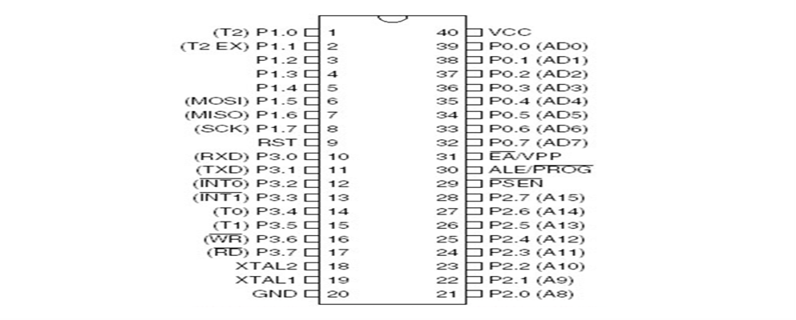
MICROCONTROLLER(AT89S52)
AT89S52 is a low power, high performance CMOS 8 bit microcontroller with 4k bytes of in-system programmable.
4.0V to 5.5V Operating Range
Fully Static Operation: 0 Hz to 33 MHz
Fast Programming Time

Slide 11
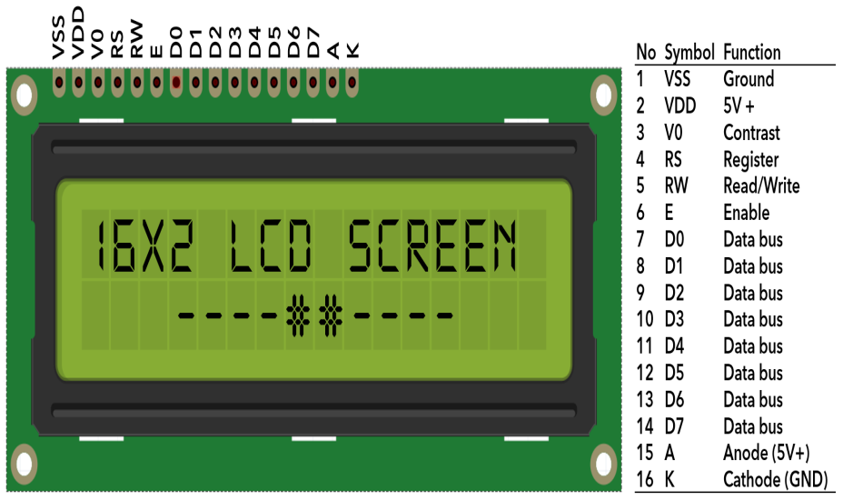
LCD
LCD (Liquid Crystal Display) screen is an electronic display module and find a wide range of applications.
A 16x2 LCD display is very basic module and is very commonly used in various devices and circuits.
A 16x2 LCD means it can display 16 characters per line and there are 2 such lines.

Slide 12
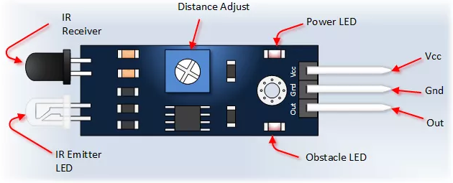
IR SENSOR
The IR Sensor has a built-in IR transmitter that sends out IR energy and an IR receiver looks for reflected IR energy to detect presence of any obstacle.
The module has on board potentiometer that facilitates the adjustment detection range.

Slide 13
GSM
GSM, which stands for Global System for Mobile communications, reigns (important) as the world’s most widely used cell phone technology.
Cell phones use a cell phone service carrier’s GSM network by searching for cell phone towers in the nearby area. Global system for mobile communication (GSM) is a globally accepted standard for digital cellular communication.

Slide 14
GPS
The GPS provides continuous three-dimensional positioning 24 hrs a day throughout the world.
The technology seems to be beneficiary to the GPS user community in terms of obtaining accurate data up to about100 meters for navigation, meter-level for mapping, and down to millimeter level for geodetic positioning.

Slide 15
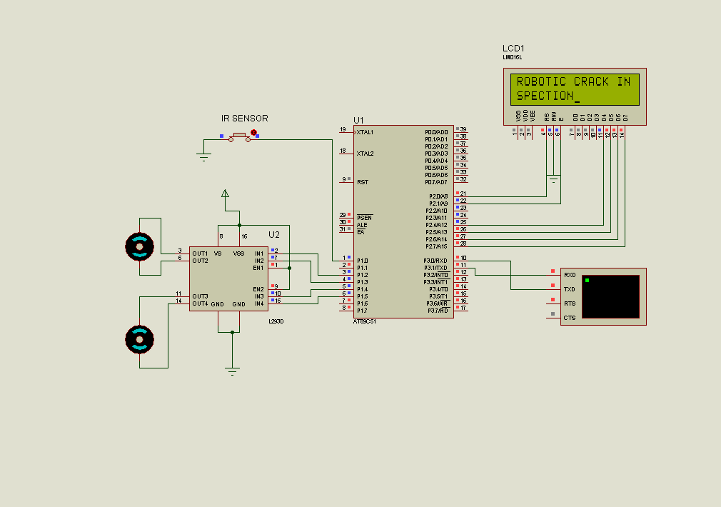
SCHEMATIC
WHEN THE SYSTEM IS INITIALISED

Slide 16
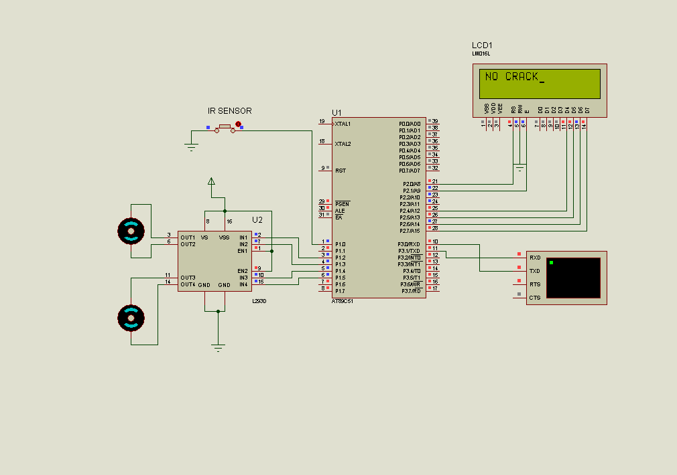
SCHEMATIC
WHEN “NO” CRACK IS DETECTED

Slide 17

SCHEMATIC
WHEN CRACK IS DETECTED

Slide 18
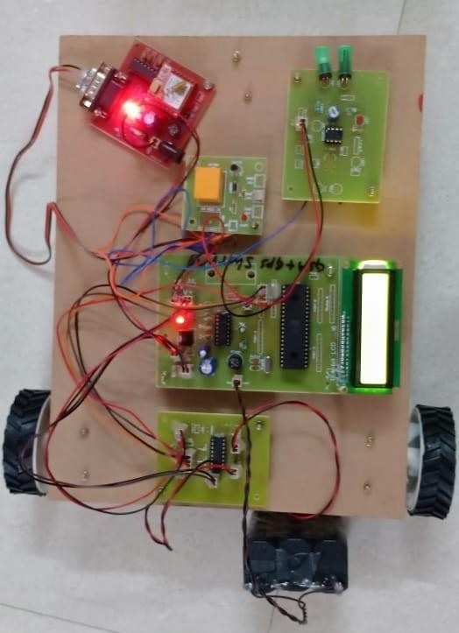
RESULTS
CASE: WHEN NO CRACK IS DETECTED

Slide 19
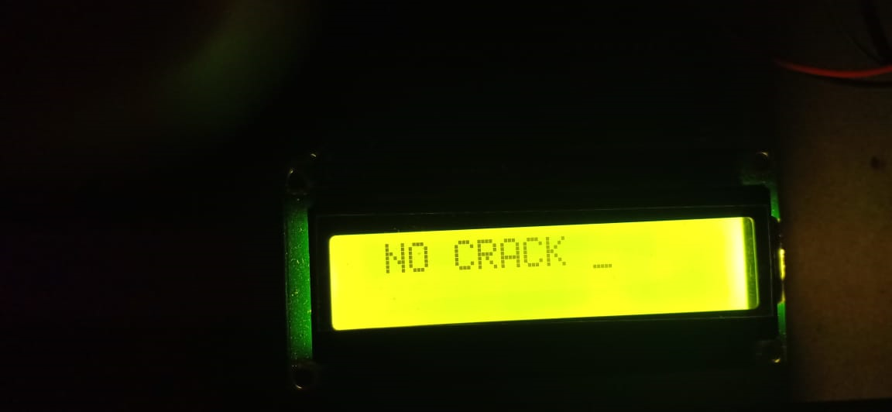

RESULTS
CASE: WHEN NO CRACK IS DETECTED

Slide 20
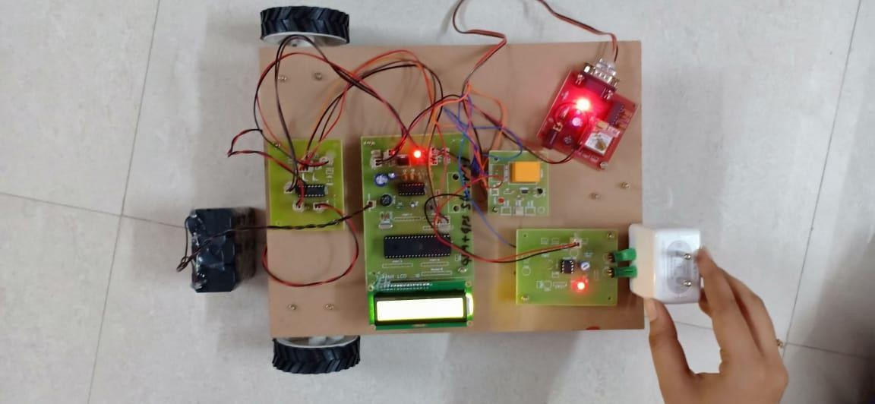
RESULTS
CASE : WHEN THE CRACK IS OCCURED

Slide 21

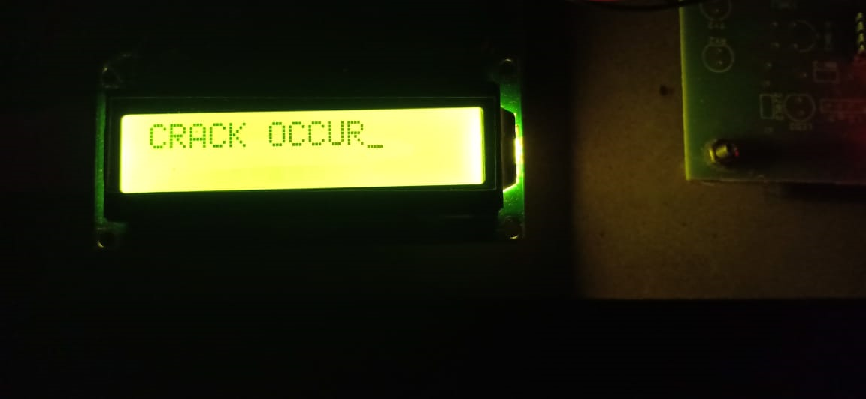
RESULTS
CASE : WHEN THE CRACK IS OCCURED

Slide 22
ADVANTAGES
Highly Sensitive, Low cost and Reliable circuit.
Works according to the bridge crack condition.
Complete elimination of manpower.
Can handle heavy loads up to 7A.
System can be switched into manual mode when even required.

Slide 23
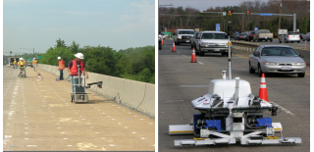
CONCLUSION
The crack detection on bridge decks provides a method of inspection for use in on-site robotic scanning. Since automated scanning generates data, automated analysis has clear utility in rapidly assessing bridge condition. Moreover, the results can be quantified, archived and compared over time.

Slide 24
FUTURE SCOPE
We will utilize Non-Destructive Evaluation (NDE) sensors such as Impact Echo and Ultrasonic Surface Wave to detect vertical cracks (crack depth) and elimination of the bridge deck.

Slide 25

THANK YOU….
FOR LISTENING TO MY IDEAS

