Slide 1
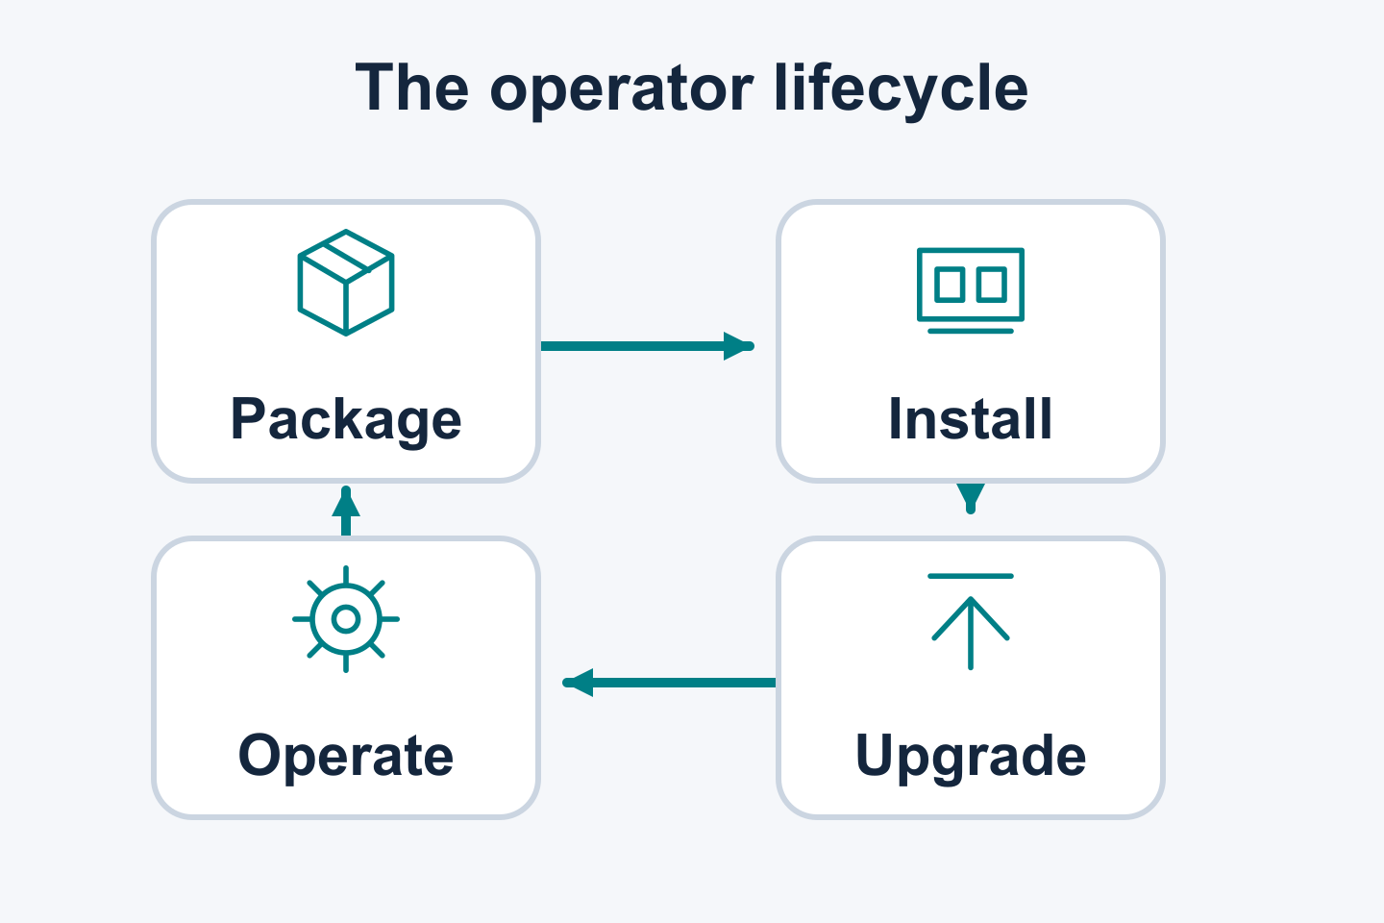
The Next Era of Kubernetes Operator Lifecycle Management
KubeCon + CloudNativeCon North America 2026
1 / 27 | KUBECON NA 2026 | DRY RUN
Notes:
SLIDE 1: The Next Era of Kubernetes Operator Lifecycle Management
SPEAKER: OLM A — context and installation; name to confirm
START: 00:00
DURATION: 00:45
STATUS:
TAKEAWAY:
TALK TRACK / SOURCES / CAVEATS / REVIEW:
Welcome the audience and introduce the talk, The Next Era of Kubernetes Operator Lifecycle Management, at KubeCon + CloudNativeCon North America 2026. Retain the operator-lifecycle illustration. Source: ../kubecon-2026-outline.md.
SOURCE CONTEXT ROOT: /Users/jordan/Documents/devel/breadcrumbs/2026-kubecon-wip

Slide 2
Presentation team
Rashmi
Joe
Jordan
2 / 27 | KUBECON NA 2026 | DRY RUN
Notes:
SLIDE 2: Presentation team
SPEAKER: OLM A — context and installation; name to confirm
START: 00:45
DURATION: 00:30
STATUS:
TAKEAWAY:
TALK TRACK / SOURCES / CAVEATS / REVIEW:
Introduce Rashmi, Joe and Jordan as the OLM presentation team. Introduce Attila as the fourth speaker, covering Java Operator SDK. The mapping from A/B/C to individual OLM presenters remains to be confirmed. Photos are deferred. The session uses prepared examples without live demos.
SOURCE CONTEXT ROOT: /Users/jordan/Documents/devel/breadcrumbs/2026-kubecon-wip

Slide 3
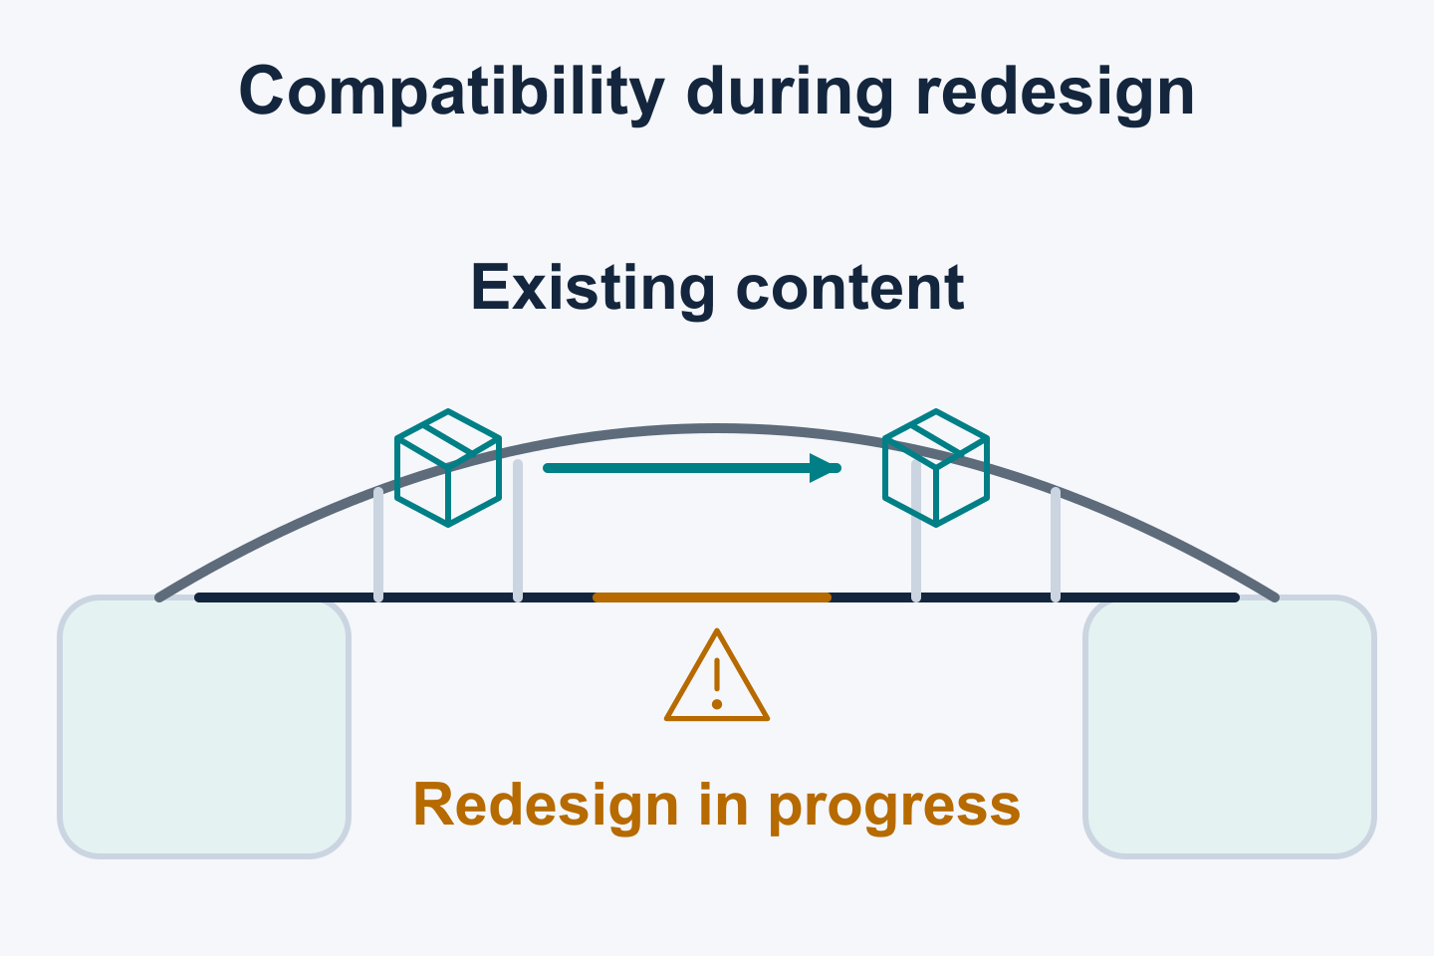
01 / OLM CONTEXT
Compatibility and lifecycle foundations
FOUNDATIONAL WORK
OLM evolution builds on existing packages and operational experience.
OLMv0 established lifecycle management
Existing registry+v1 content shapes compatibility
Operational experience informs OLMv1
Existing content and users shape lifecycle implementation.
3 / 27 | KUBECON NA 2026 | DRY RUN
Notes:
SLIDE 3: Compatibility and lifecycle foundations
SPEAKER: OLM A — context and installation; name to confirm
START: 01:15
DURATION: 01:30
STATUS: FOUNDATIONAL WORK
TAKEAWAY: OLM evolution builds on existing packages and operational experience.
TALK TRACK / SOURCES / CAVEATS / REVIEW:
Use OLMv0 evolution and compatibility with existing registry+v1 content as the historical basis. Explain how existing package formats, resource ownership and operational behavior shaped lifecycle implementation. Configuration and migration preparation build on that foundation. The bridge illustration is conceptual. This slide makes no measured availability, performance, adoption or elapsed-time claims. Sources: ../kubecon-2025-slide-context.md; ../kubecon-2026-resource-assessment.md; supplied evolution background.
SOURCE CONTEXT ROOT: /Users/jordan/Documents/devel/breadcrumbs/2026-kubecon-wip

Slide 4
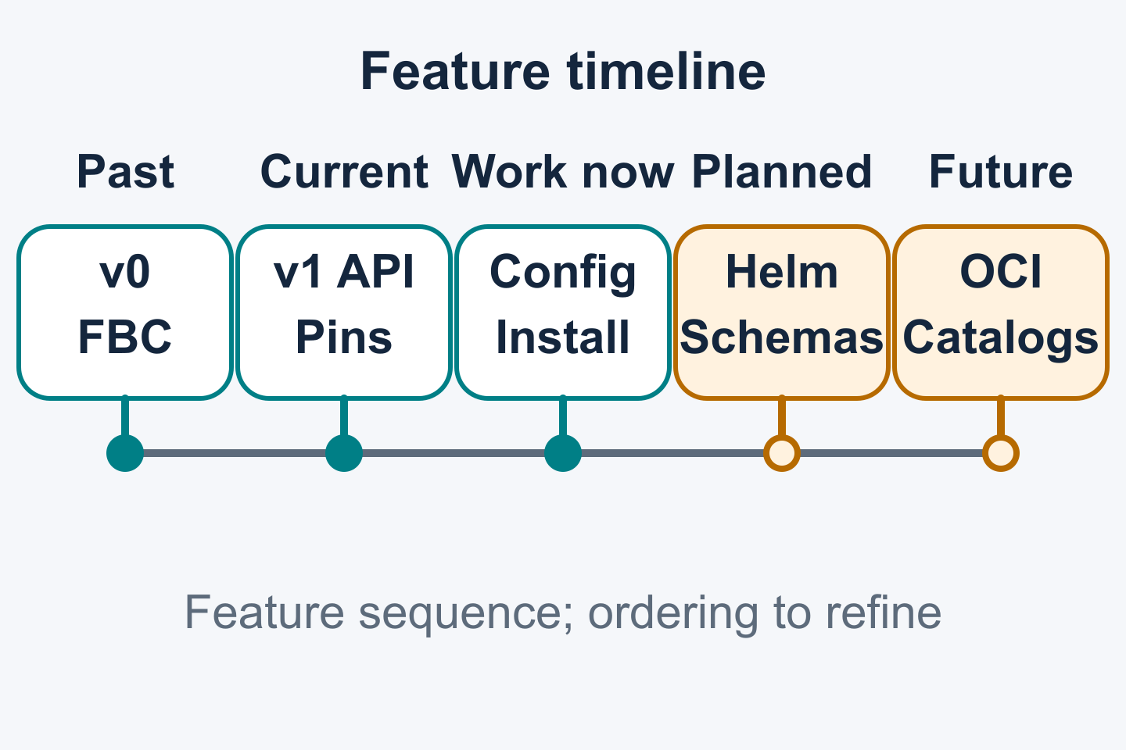
01 / OLM CONTEXT
OLM: past, current and future
EVOLUTION / PLANNED / FUTURE WORK
OLM feature evolution
Past: OLMv0, flawed namespace-local CRD visibility assumptions, SQLite, FBC
Current: OLMv1, ClusterExtension, pins, webhooks
Ongoing: rollouts, config, install, migration
Planned: helm+v2 and v2 schemas. Future: OCI catalog storage.
4 / 27 | KUBECON NA 2026 | DRY RUN
Notes:
SLIDE 4: OLM: past, current and future
SPEAKER: OLM A — context and installation; name to confirm
START: 02:45
DURATION: 01:15
STATUS: EVOLUTION / PLANNED / FUTURE WORK
TAKEAWAY: OLM feature evolution
TALK TRACK / SOURCES / CAVEATS / REVIEW:
Enumerate the timeline: past work includes OLMv0, SQLite catalogs and established file-based catalogs (FBC). Summarize OLMv0's flawed assumptions about namespace-local CRD visibility, independently managed APIs and watch-aware dependencies. CRD definitions are cluster-scoped shared APIs; custom resource instances may be namespaced, and controller watch scope is configured separately. Shared CRDs can couple operator upgrades. The flawed assumptions belonged to OLMv0's lifecycle model; Kubernetes' cluster-scoped CRD design is the underlying API boundary. Keep the OperatorGroup recap brief and explain how these lessons informed OLMv1. Current OLMv1 capabilities include ClusterExtension, version pins and webhooks. Ongoing development includes resource rollouts, user configuration, direct bundle installation and migration. Direct installation remains an open proposal in PR #2907 at the supplied 2026-10-09 check. Planned work includes Helm content using helm+v2 and v2 catalog schemas. OCI-native catalog storage and transport remain future work. Release-specific availability and feature gates require the source-version qualifications on the detailed slides. The 2025 deck already listed delivered features. A continues with installation changes. Sources: ../kubecon-2025-slide-context.md slide 9; ../kubecon-2026-resource-assessment.md K-1/K-2/V0-2/V0-3; supplied feature-planning context.
SOURCE CONTEXT ROOT: /Users/jordan/Documents/devel/breadcrumbs/2026-kubecon-wip

Slide 5
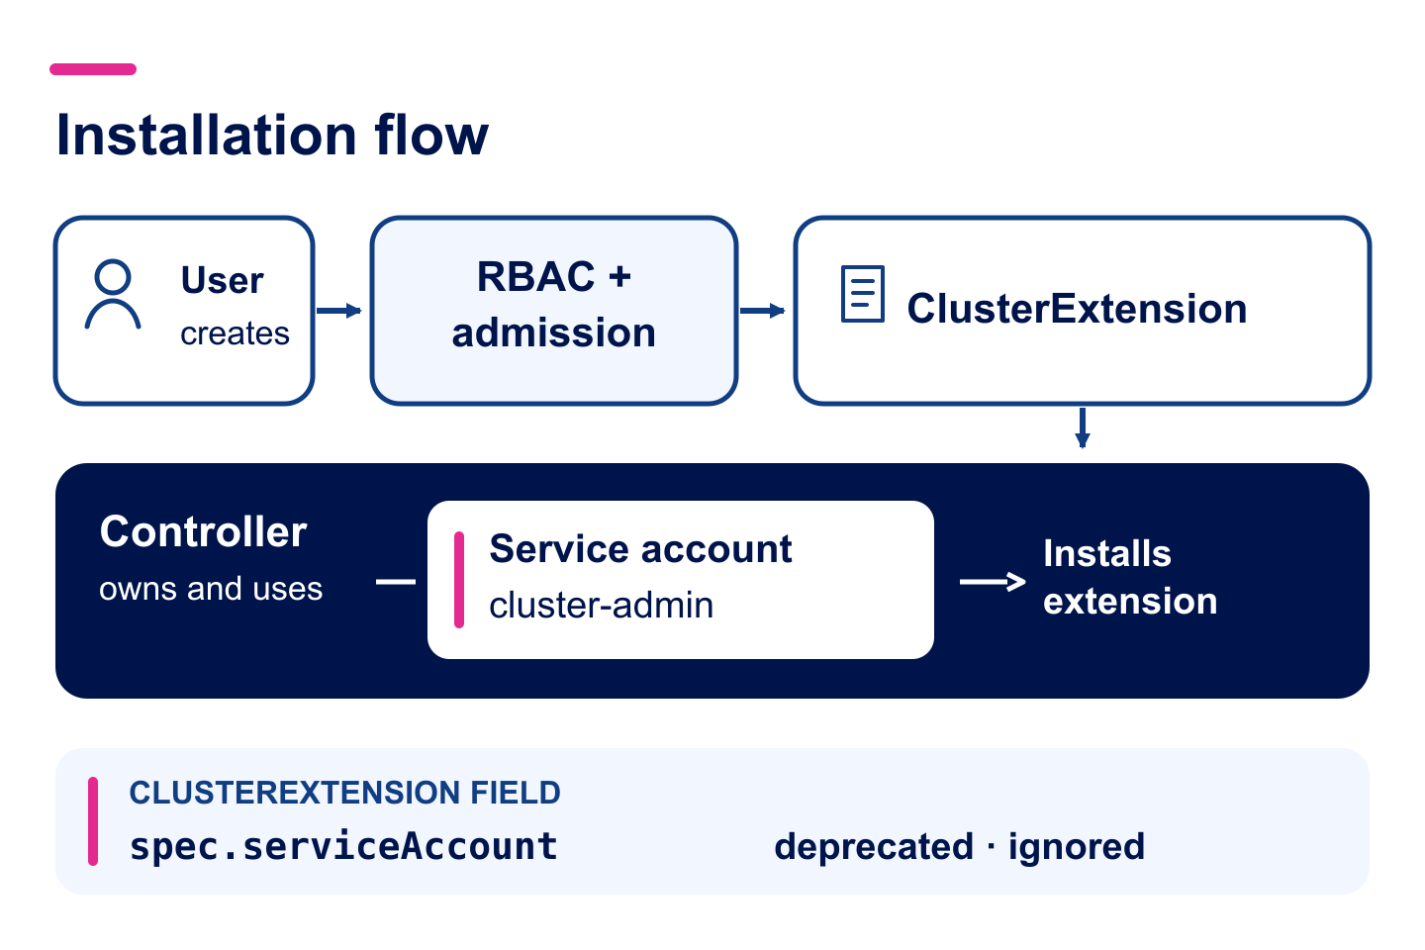
02 / INSTALLATION
Streamlined Installation
Standard channel since v1.11.0
spec.serviceAccount is optional and ignored.
The controller uses its own service account.
Restrict ClusterExtension access with RBAC and admission policy.
5 / 27 | KUBECON NA 2026 | DRY RUN
Notes:
SLIDE 5: Streamlined Installation
SPEAKER: OLM A — context and installation; name to confirm
START: 04:00
DURATION: 01:00
STATUS:
TAKEAWAY: Standard channel since v1.11.0
TALK TRACK / SOURCES / CAVEATS / REVIEW:
As of operator-controller v1.11.0, the standard installation channel no longer requires spec.serviceAccount. The controller uses its own service account; the deprecated field is ignored. ClusterExtension write access is a high-privilege operation because the controller uses cluster-admin permissions. When delegating access, combine Kubernetes RBAC with appropriate admission policy, such as ValidatingAdmissionPolicy, to constrain allowed extensions. Source: https://github.com/operator-framework/operator-controller/pull/2770 and the v1.11.0 release notes.
SOURCE CONTEXT ROOT: /Users/jordan/Documents/devel/breadcrumbs/2026-kubecon-wip

Slide 6
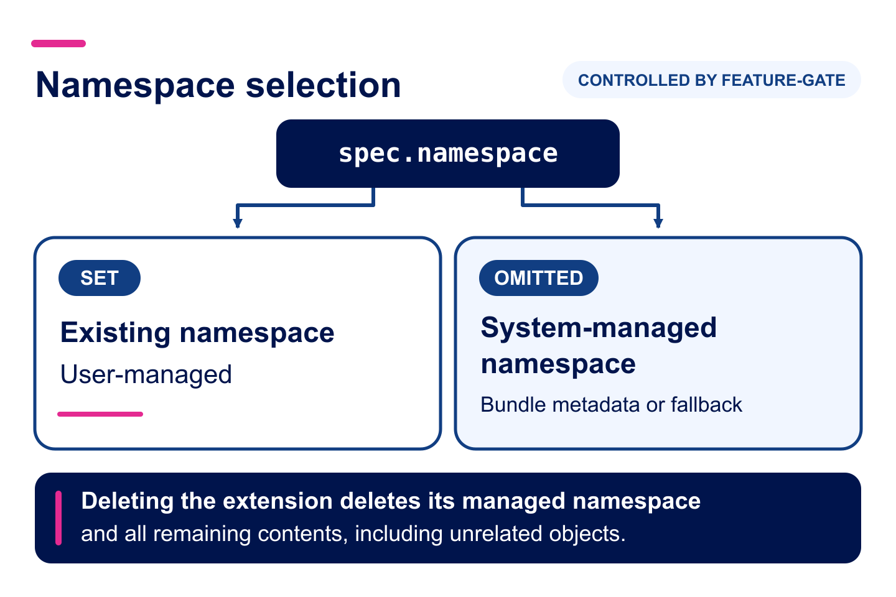
02 / INSTALLATION
Namespace Management
Experimental channel since v1.12.0
Controlled by feature gate
Set spec.namespace: use an existing user-managed namespace.
Omit it: OLM manages a derived namespace.
Deletion removes that namespace and its contents.
6 / 27 | KUBECON NA 2026 | DRY RUN
Notes:
SLIDE 6: Namespace Management
SPEAKER: OLM A — context and installation; name to confirm
START: 05:00
DURATION: 01:00
STATUS:
TAKEAWAY: Experimental channel since v1.12.0
Controlled by feature gate
TALK TRACK / SOURCES / CAVEATS / REVIEW:
Operator-controller v1.12.0 introduced optional spec.namespace in the experimental installation channel. With the feature-gated runtime, an explicitly supplied namespace remains user-managed. When the field is omitted, OLM derives and manages an install namespace using bundle metadata and defaults. Deleting the extension also deletes its managed namespace and all remaining objects in that namespace, including objects OLM did not install. Explain namespace-transition validation and verify the selected bundle and controller version before demonstrating. Sources: https://github.com/operator-framework/operator-controller/pull/2925, https://github.com/operator-framework/operator-controller/pull/2926, https://github.com/operator-framework/operator-controller/pull/2929.
SOURCE CONTEXT ROOT: /Users/jordan/Documents/devel/breadcrumbs/2026-kubecon-wip

Slide 7
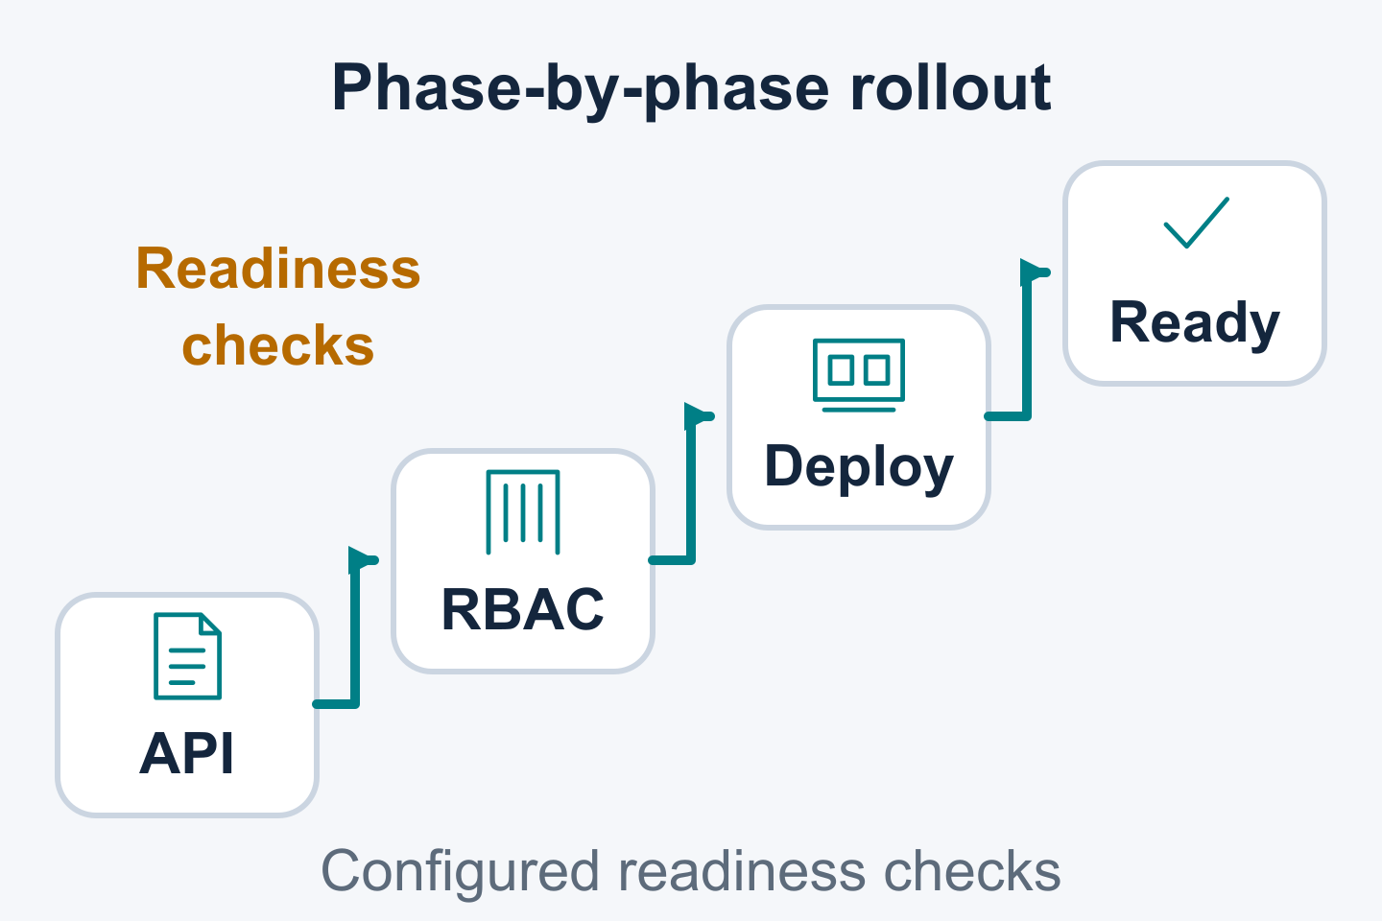
02 / LIFECYCLE PRIMITIVES
Inspect phased resource rollouts
IN ACTIVE DEVELOPMENT / CONTROLLED BY FEATURE-GATE
Ordered phases expose resource application and readiness progress.
Apply resource groups in phase order
Wait for applicable readiness checks
Inspect ClusterObjectDeployment and revision status
Readiness checks show which phase is waiting.
7 / 27 | KUBECON NA 2026 | DRY RUN
Notes:
SLIDE 7: Inspect phased resource rollouts
SPEAKER: OLM B — lifecycle primitives and migration; name to confirm
START: 06:00
DURATION: 02:00
STATUS: IN ACTIVE DEVELOPMENT / CONTROLLED BY FEATURE-GATE
TAKEAWAY: Ordered phases expose resource application and readiness progress.
TALK TRACK / SOURCES / CAVEATS / REVIEW:
Explain the ClusterExtension → ClusterObjectDeployment → ClusterObjectSet ownership model. ClusterObjectDeployment manages rollout and revision history; ClusterObjectSets hold immutable revisions with ordered phases. observedPhases and other status details help identify stalled objects. Objects within a phase have no defined ordering. The API and rollout behavior are in active development and controlled by feature-gate. Standalone ClusterObjectDeployment use is in active development. A namespace-scoped ObjectDeployment is under consideration, with no committed availability. Sources: https://github.com/operator-framework/operator-controller/pull/3058 and https://github.com/operator-framework/operator-controller/pull/3072.
SOURCE CONTEXT ROOT: /Users/jordan/Documents/devel/breadcrumbs/2026-kubecon-wip

Slide 8
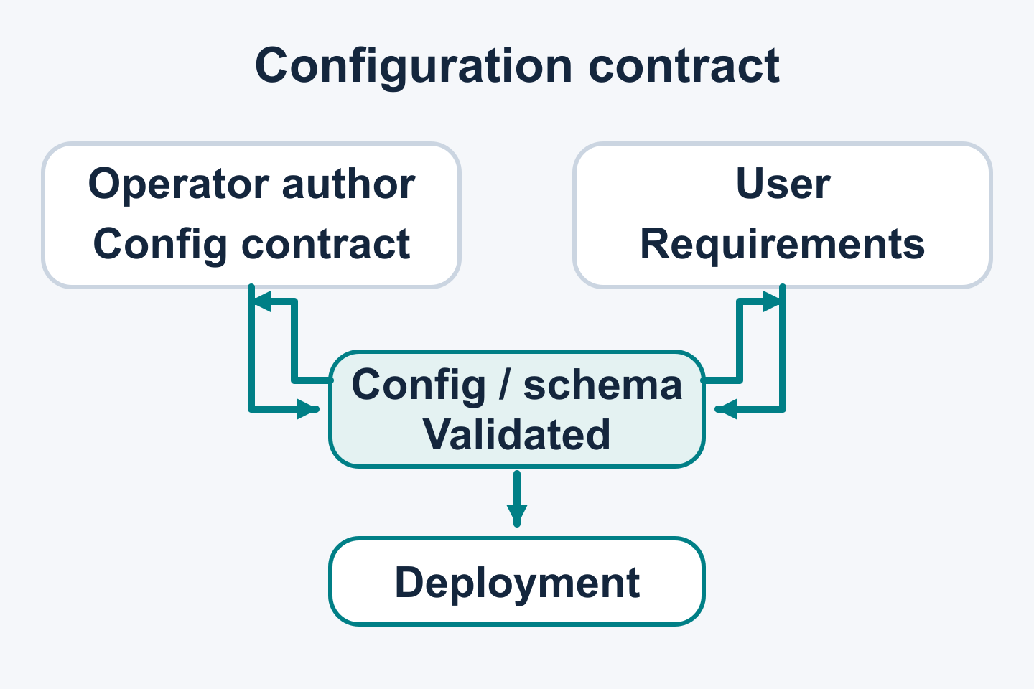
02 / LIFECYCLE PRIMITIVES
User control of extension deployments
IN ACTIVE DEVELOPMENT / CONTROLLED BY FEATURE-GATE
Flexible user-defined deployment configuration.
Environment variables and resource settings
Placement, volumes and deployment metadata
Operator-provided configuration and schemas
OLM applies user choices through operator configuration.
8 / 27 | KUBECON NA 2026 | DRY RUN
Notes:
SLIDE 8: User control of extension deployments
SPEAKER: OLM B — lifecycle primitives and migration; name to confirm
START: 08:00
DURATION: 01:30
STATUS: IN ACTIVE DEVELOPMENT / CONTROLLED BY FEATURE-GATE
TAKEAWAY: Flexible user-defined deployment configuration.
TALK TRACK / SOURCES / CAVEATS / REVIEW:
Describe the deployment as a configuration exchange between users and the operator team. Users express environment, resource, placement, volume and metadata requirements through the package's configuration interface. Operator authors define schema and validation behavior. OLM carries the selected configuration into the deployment. DeploymentConfig is in active development and controlled by feature-gate; values are expressed through ClusterExtension configuration. Explain field-specific merge, replace and append behavior and annotation precedence. Validate example input and inspect the resulting deployment against the pinned source version. Watch-namespace pass-through leaves CRDs shared and supplies no watch-aware dependency management. Sources: supplied customization draft; ../kubecon-2026-resource-assessment.md; ../kubecon-2025-slide-context.md slide 14.
SOURCE CONTEXT ROOT: /Users/jordan/Documents/devel/breadcrumbs/2026-kubecon-wip

Slide 9
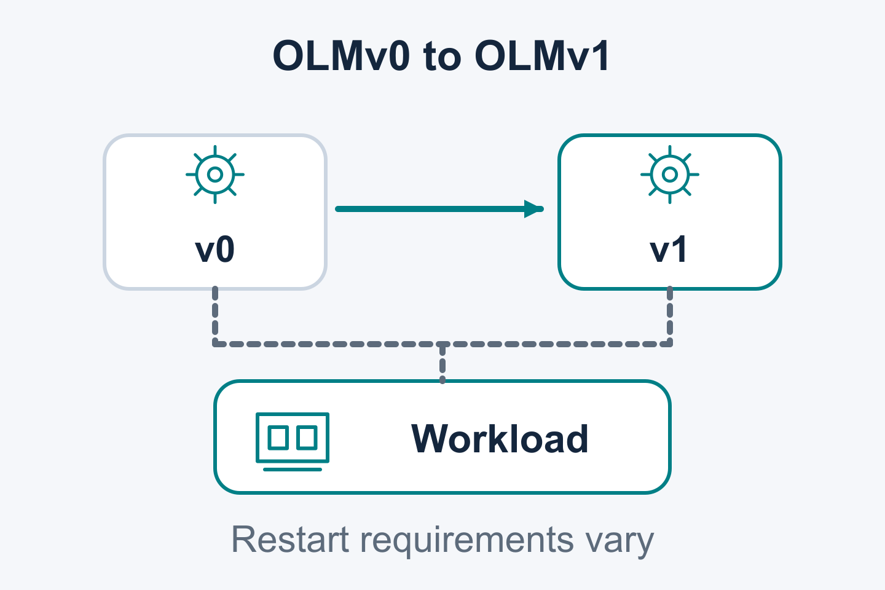
02 / LIFECYCLE PRIMITIVES
OLMv0 → OLMv1 migration
IN ACTIVE DEVELOPMENT
Move operator management from OLMv0 to OLMv1.
Prepare v1 catalogs from v0 CatalogSources
Check and preview operator migrations
Migration library with example binaries
Structured output supports automation and models.
9 / 27 | KUBECON NA 2026 | DRY RUN
Notes:
SLIDE 9: OLMv0 → OLMv1 migration
SPEAKER: OLM B — lifecycle primitives and migration; name to confirm
START: 09:30
DURATION: 02:00
STATUS: IN ACTIVE DEVELOPMENT
TAKEAWAY: Move operator management from OLMv0 to OLMv1.
TALK TRACK / SOURCES / CAVEATS / REVIEW:
Prepare OLMv1 ClusterCatalogs from the existing OLMv0 CatalogSources first. Then evaluate each operator installation for eligibility and preview its migration before transferring management. The check and preview actions evaluate operators; catalog preparation is the earlier prerequisite. The migration specification describes check, convert, rollback and cleanup with ClusterObjectSets. Functionality is supplied as library-olm. The example binaries illustrate library use. The example binaries produce structured output for automation and model consumers. The companion migration scenario exercises JSON Lines output. Eligibility checks have defined coverage. Retaining the namespace can reduce disruption; namespace changes may restart workloads or cause downtime. Validate recovery boundaries and source/gate versions for the selected case. This area is in active development. Sources: library-olm README/spec; ../kubecon-2026-resource-assessment.md; user migration guidance.
Note: Ask Todd to make a separate repo for the binaries (naming is hard :))
SOURCE CONTEXT ROOT: /Users/jordan/Documents/devel/breadcrumbs/2026-kubecon-wip

Slide 10
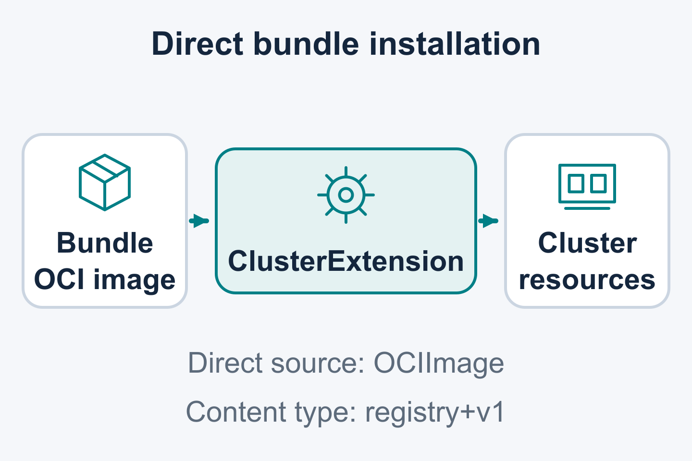
02 / LIFECYCLE PRIMITIVES
Install a bundle directly
IN ACTIVE DEVELOPMENT / CONTROLLED BY FEATURE-GATE
Select a registry+v1 bundle by its OCI image reference.
Use sourceType: OCIImage
Set source.ociImage.ref
Bypass catalog resolution
Proposed in open PR #2907; controlled by BoxcutterRuntime.
10 / 27 | KUBECON NA 2026 | DRY RUN
Notes:
SLIDE 10: Install a bundle directly
SPEAKER: OLM B — lifecycle primitives and migration; name to confirm
START: 11:30
DURATION: 01:30
STATUS: IN ACTIVE DEVELOPMENT / CONTROLLED BY FEATURE-GATE
TAKEAWAY: Select a registry+v1 bundle by its OCI image reference.
TALK TRACK / SOURCES / CAVEATS / REVIEW:
PR #2907 is OPEN and unmerged as of the 2026-10-28 check. Present direct bundle installation as proposed behavior in active development. It supports registry+v1 bundles only and is controlled by the BoxcutterRuntime feature gate. The requested source uses sourceType: OCIImage and source.ociImage.ref. It bypasses catalog resolution. Describe CRD checks and other lifecycle safeguards according to the proposal's supported path; catalog bypass alone establishes no blanket removal of CRD safety. Pin the source revision and gate configuration before preparing an example. The session uses prepared examples without a live demo.
SOURCE CONTEXT ROOT: /Users/jordan/Documents/devel/breadcrumbs/2026-kubecon-wip

Slide 11
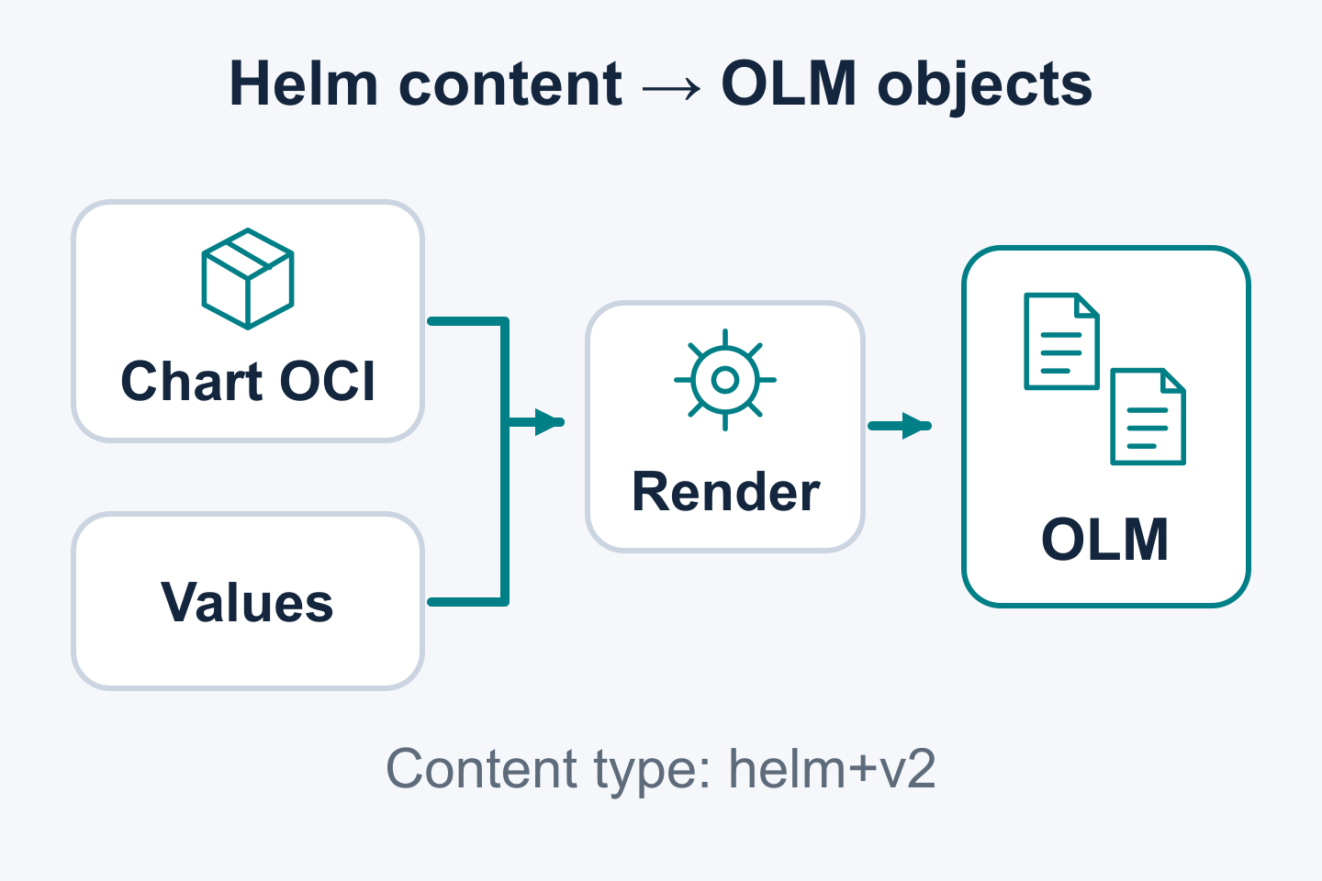
03 / CONTENT & CATALOGS
Planned Helm content support
PLANNED / helm+v2
The rendering contract targets deterministic chart behavior.
Chart and values produce managed manifests
Allow-listed features support reproducible rendering
helm+v2 identifies the content representation
Standard chart artifacts use a defined rendering contract.
11 / 27 | KUBECON NA 2026 | DRY RUN
Notes:
SLIDE 11: Planned Helm content support
SPEAKER: OLM C — content, catalogs and contributions; name to confirm
START: 13:00
DURATION: 02:00
STATUS: PLANNED / helm+v2
TAKEAWAY: The rendering contract targets deterministic chart behavior.
TALK TRACK / SOURCES / CAVEATS / REVIEW:
helm+v2 is the user-confirmed canonical discriminator for versioned OLM Helm packaging/catalog content. Standard chart OCI identity is used, with rendered manifests managed through OLM lifecycle behavior. User values are parsed and validated during rendering. Deterministic rendering is the design goal: features are allow-listed to exclude non-deterministic functionality, with compatibility fixtures required to validate the supported subset. Dependencies are vendored. Hooks and keep behavior are unsupported in the proposal. CRDs use templates/; crds/ is unsupported. Chart release-object mappings and restricted template functions require compatibility testing. Moving CRDs affects upgrade, deletion and data handling. Implementation of proposed gates remains independently unconfirmed. Native chart OCI identity and future OCI catalog storage are separate scopes. Sources: supplied Helm planning brief and feature-planning context.
Transition: the direct-image source motivates future chart content support. The companion Helm experiment uses an OCI image config; standard Helm OCI config handling remains unverified.
SOURCE CONTEXT ROOT: /Users/jordan/Documents/devel/breadcrumbs/2026-kubecon-wip

Slide 12
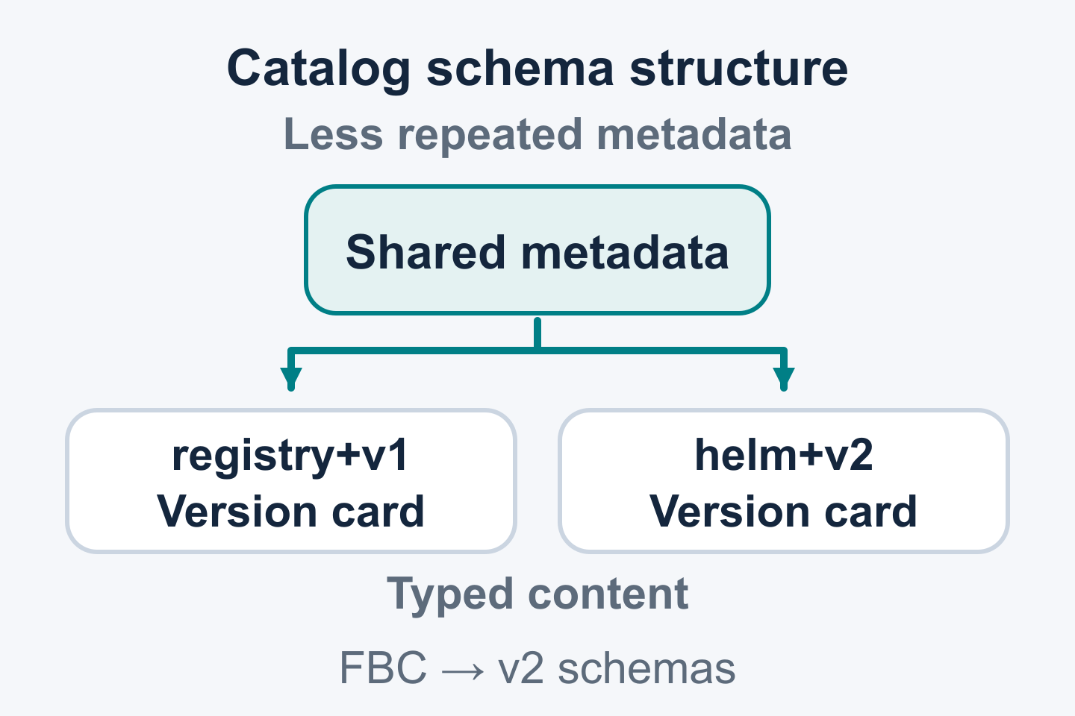
03 / CONTENT & CATALOGS
Catalog performance and content types
PLANNED / FUTURE WORK
Design for lower catalog-processing cost and additional content types.
Lower duplicated CSV metadata
Direct version fields reduce property traversal
Typed registry+v1 and helm+v2 content
File-based catalogs remain the established foundation.
12 / 27 | KUBECON NA 2026 | DRY RUN
Notes:
SLIDE 12: Catalog performance and content types
SPEAKER: OLM C — content, catalogs and contributions; name to confirm
START: 15:00
DURATION: 01:30
STATUS: PLANNED / FUTURE WORK
TAKEAWAY: Design for lower catalog-processing cost and additional content types.
TALK TRACK / SOURCES / CAVEATS / REVIEW:
Credit established FBC capabilities: plaintext editing, composition, extensibility, package-level metadata and version/release properties already exist. The v2 work refines the representation and consumers: less duplicated CSV metadata, version/release fields available directly rather than via property traversal, and explicit mediaType dispatch for installable formats including Helm. Arbitrary FBC schema extensibility alone does not supply end-to-end installation support for a new content type. Catalog processing efficiency is a design benefit to validate, with no measured speedup claimed. Show the practical resolution/metadata work the new representation is intended to reduce. The user-confirmed near-term focus is flexible OLMv1 schemas; OCI-native catalog storage, transport and selective fetching are future work. Channels and legacy graphs are excluded from v2; lifecycle/constraint metadata remains open. Sources: https://olm.operatorframework.io/docs/reference/file-based-catalogs/ ; supplied v2 catalog brief; feature-planning context.
SOURCE CONTEXT ROOT: /Users/jordan/Documents/devel/breadcrumbs/2026-kubecon-wip

Slide 13
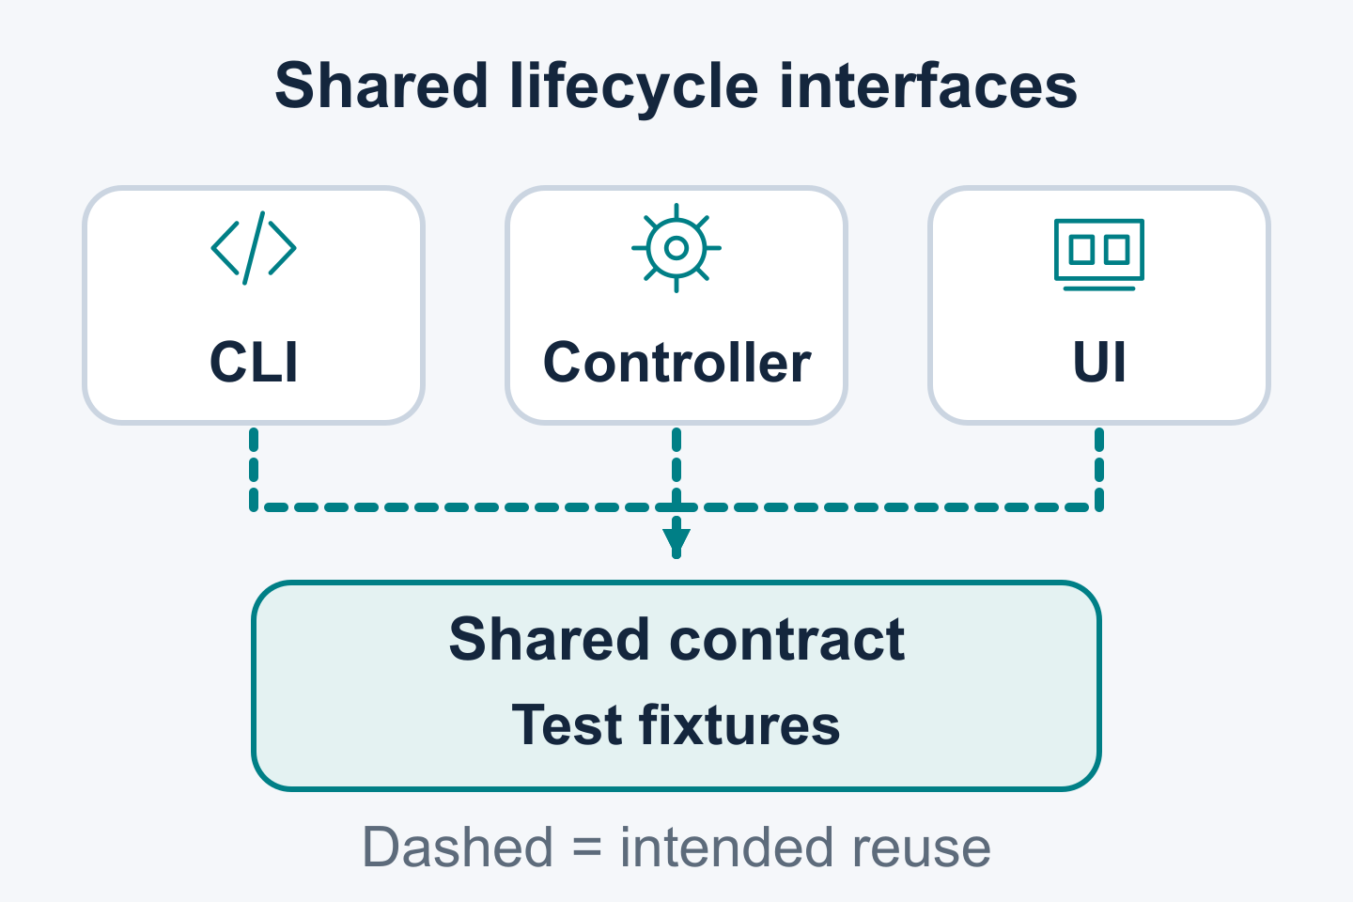
02 / LIFECYCLE PRIMITIVES
Shared lifecycle logic in library-olm
IN ACTIVE DEVELOPMENT
Reuse lifecycle logic through a library with explicit contracts.
Share migration checks and workflow logic
Exercise current development examples
Record expected results in reusable fixtures
Examples and fixtures make supported behavior concrete.
13 / 27 | KUBECON NA 2026 | DRY RUN
Notes:
SLIDE 13: Shared lifecycle logic in library-olm
SPEAKER: OLM C — content, catalogs and contributions; name to confirm
START: 16:30
DURATION: 01:00
STATUS: IN ACTIVE DEVELOPMENT
TAKEAWAY: Reuse lifecycle logic through a library with explicit contracts.
TALK TRACK / SOURCES / CAVEATS / REVIEW:
Describe library reuse, the current migration development examples and fixtures that record inputs and expected results. The example binaries exercise library behavior and provide contribution starting points. Broader controller, CLI and UI consumption remains a design intent requiring implementation evidence and explicit contracts. Successor semantics need a defined contract. Fixtures can cover legacy input or version/release selection while respecting the proposed v2 schema direction. Pin source versions when documenting examples. C connects catalog work with shared lifecycle logic. Sources: library-olm README/spec; supplied feature-planning context; ../kubecon-2025-slide-context.md slide 13.
SOURCE CONTEXT ROOT: /Users/jordan/Documents/devel/breadcrumbs/2026-kubecon-wip

Slide 14

03 / CONTENT & CATALOGS
Contribute to Operator Framework
PROJECT DEVELOPMENT
Contribute to Operator Framework development.
Read the repository contribution guide
Discuss an issue and propose a change
Submit code, documentation or test fixtures
operator-controller: CONTRIBUTING.md
14 / 27 | KUBECON NA 2026 | DRY RUN
Notes:
SLIDE 14: Contribute to Operator Framework
SPEAKER: OLM C — content, catalogs and contributions; name to confirm
START: 17:30
DURATION: 01:00
STATUS: PROJECT DEVELOPMENT
TAKEAWAY: Contribute to Operator Framework development.
TALK TRACK / SOURCES / CAVEATS / REVIEW:
Invite contributions to the Operator Framework project: documentation, focused tests, code, and reproducible migration, chart, or schema fixtures. Start with the repository contribution guide: https://github.com/operator-framework/operator-controller/blob/main/CONTRIBUTING.md. Identify an issue or discussion, provide a reproducible case, and describe the expected result.
SOURCE CONTEXT ROOT: /Users/jordan/Documents/devel/breadcrumbs/2026-kubecon-wip

Slide 15
Operator Framework: Java Operator SDK
15 / 27 | KUBECON NA 2026 | DRY RUN
Notes:
SLIDE 15: Operator Framework: Java Operator SDK
SPEAKER: OLM C — content, catalogs and contributions; name to confirm
START: 18:30
DURATION: 00:30
STATUS:
TAKEAWAY:
TALK TRACK / SOURCES / CAVEATS / REVIEW:
C hands off to Attila for the Java Operator SDK section. OLM packaging supports operators written in any language; SDKs support controller implementation. Attila presents the ten authored SDK slides, unchanged, in approximately ten minutes.
SOURCE CONTEXT ROOT: /Users/jordan/Documents/devel/breadcrumbs/2026-kubecon-wip

Slide 16
Read-Cache-After-Write Consistency
since v5.3
API:
  UpdateControl.patchStatus(resource)
  context.resourceOperations().serverSideApply(resource);
Additional cache brings complexity:
  Indexers
  Items store
Comparable Resource Versions KEP
Read-cache-after-write consistency blog
Notes:
[SDK import: speaker=Attila; section=SDK; sourceSlide3; duration=60 seconds; start=19:00; end=20:00]

Slide 17
Read-Cache-After-Write Consistency
Notes:
[SDK import: speaker=Attila; section=SDK; sourceSlide4; duration=60 seconds; start=20:00; end=21:00]

Slide 18
Event Filtering - API & Challenges
Filter out events for our own updates
Challenges
  Informer lost event problem
  Our update did not change the resource but other actor did concurrently
context.resourceOperations().serverSideApply(resource);
Notes:
[SDK import: speaker=Attila; section=SDK; sourceSlide5; duration=60 seconds; start=21:00; end=22:00]

Slide 19
Event Filtering
for Read-Cache-After-Write-Consistency
Notes:
[SDK import: speaker=Attila; section=SDK; sourceSlide6; duration=60 seconds; start=22:00; end=23:00]

Slide 20
Informer Pools
Sharing underlying informers between controller
Matches the informer configuration
  Except list limit
  Details in InformerClassifier
Supports dynamic Informer registration and de-registration
Notes:
[SDK import: speaker=Attila; section=SDK; sourceSlide7; duration=60 seconds; start=23:00; end=24:00]

Slide 21
Informer Pools
Notes:
[SDK import: speaker=Attila; section=SDK; sourceSlide8; duration=60 seconds; start=24:00; end=25:00]

Slide 22
Observability stack enhancements
Facelift over Observability stack
Improved logging and Mapped Diagnostic Context (MDC)
  Putting event and primary resource to MDC if available
Metrics API refined
  MicrometerMetricsV2
  Generic Grafana Dashboard
  Sample with OTel + Prometheus + Grafana
Notes:
[SDK import: speaker=Attila; section=SDK; sourceSlide9; duration=60 seconds; start=25:00; end=26:00]

Slide 23
Java Virtual Threads (WIP)
Planned for v5.7.0
We will officially support this for Java 25+ (but will work with Java 21+)
  Replacing ThreadPools with virtual threads across framework
Virtually unlimited number of concurrent reconciliation
  The explicit limit applies though
Notes:
[SDK import: speaker=Attila; section=SDK; sourceSlide10; duration=60 seconds; start=26:00; end=27:00]

Slide 24
Java Virtual Threads (WIP)
Notes:
[SDK import: speaker=Attila; section=SDK; sourceSlide11; duration=60 seconds; start=27:00; end=28:00]

Slide 25
Some honorable mentions…
EventRecorder API
ShardSelector support
Documentation improvements - operations section
Notes:
[SDK import: speaker=Attila; section=SDK; sourceSlide12; duration=60 seconds; start=28:00; end=29:00]

Slide 26
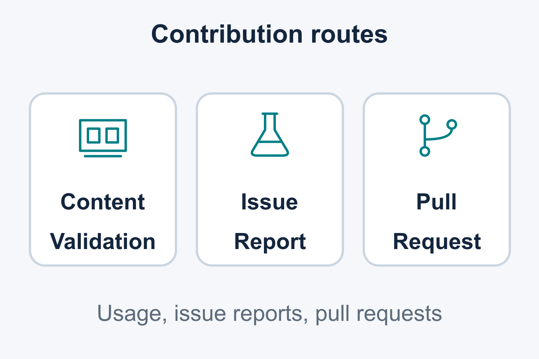
05 / RESOURCES
Resources and contribution steps
RESOURCE PACKAGE TO PREPARE
Use documented contracts and reproducible cases to guide contributions.
Check content against a documented contract
Share a reproducible case or fixture
Select a maintainer-scoped contribution
Companion examples and task links are being prepared.
26 / 27 | KUBECON NA 2026 | DRY RUN
Notes:
SLIDE 26: Resources and contribution steps
SPEAKER: OLM A — session host; name to confirm
START: 29:00
DURATION: 01:00
STATUS: RESOURCE PACKAGE TO PREPARE
TAKEAWAY: Use documented contracts and reproducible cases to guide contributions.
TALK TRACK / SOURCES / CAVEATS / REVIEW:
Close with the Operator Framework contribution guide, the OLM documentation, and the Java Operator SDK project. Companion demos are intended for online use; no live demo is planned. Confirm resource links before publication.
SOURCE CONTEXT ROOT: /Users/jordan/Documents/devel/breadcrumbs/2026-kubecon-wip

Slide 27
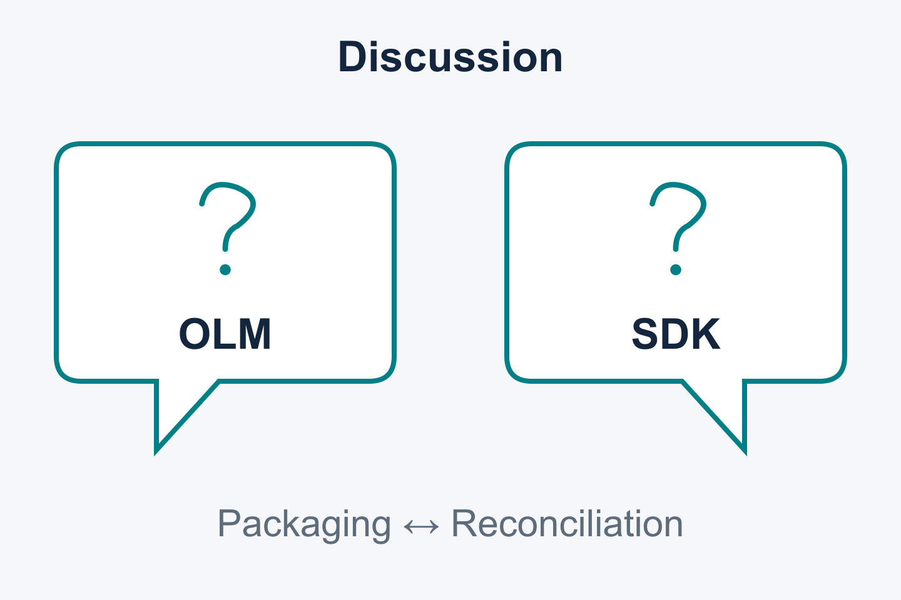
06 / QUESTIONS
Questions?
Questions about lifecycle APIs, packaging or controller behavior?
OLM configuration and migration
Helm content and catalog schemas
Java Operator SDK reconciliation
Discussion of capabilities and proposed work.
27 / 27 | KUBECON NA 2026 | DRY RUN
Notes:
SLIDE 27: Questions?
SPEAKER: OLM A/B/C and Attila — questions
START: 30:00
DURATION: 02:00
STATUS:
TAKEAWAY: Questions about lifecycle APIs, packaging or controller behavior?
TALK TRACK / SOURCES / CAVEATS / REVIEW:
Reserve two minutes for questions and transition overruns. A/B/C answer OLM questions; Attila answers Java Operator SDK questions. The proposed total duration is 32 minutes.
SOURCE CONTEXT ROOT: /Users/jordan/Documents/devel/breadcrumbs/2026-kubecon-wip

