Slide 1
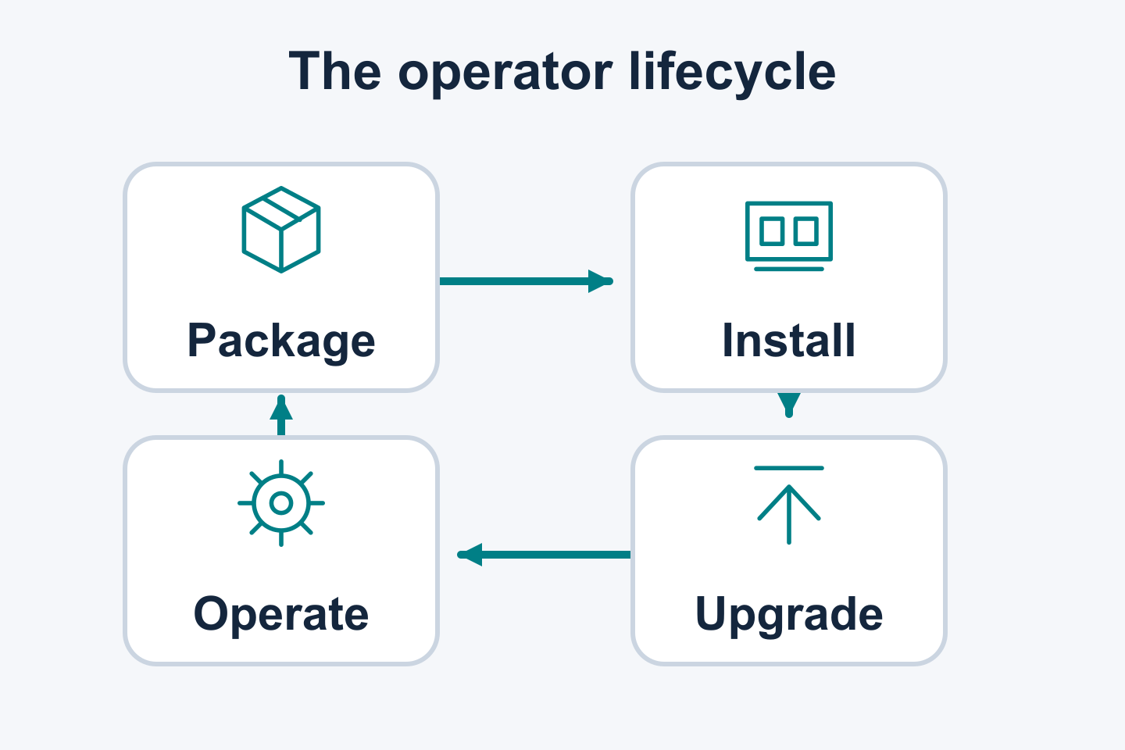
OPERATOR LIFECYCLE / KUBECON NA 2026
The Next Era of Kubernetes Operator Lifecycle Management
OLM progress since 2025
Operator installation and ongoing management
Current capabilities and planned work
KubeCon + CloudNativeCon North America 2026
01 / 25 | KUBECON NA 2026 | DRY RUN
Notes:
SLIDE 1: The Next Era of Kubernetes Operator Lifecycle Management
SPEAKER: OLM A — context / host; name to confirm
START: 00:00
DURATION: 00:45
STATUS:
TAKEAWAY: OLM progress since 2025
TALK TRACK / SOURCES / CAVEATS / REVIEW:
Introduce the confirmed talk title and progress since 2025. Four speakers participate: A covers base slides 1–4, B covers 5–9, C covers 10–13, and Attila covers Java Operator SDK exclusively. Speaker names for A/B/C remain to be confirmed. The primary builder imports original SDK source slides 3–12 unchanged after the divider, allocating 60 seconds to each. These become final slides 14–23; the host closes on final slide 24 and topic owners answer questions on final slide 25. The 15 base records total 1,200 seconds; the original SDK segment adds 600 seconds for a 30-minute session. Keep the no-live-demo plan. Sources: ../kubecon-2026-outline.md; ../kubecon-2025-slide-context.md.
SOURCE CONTEXT ROOT: /Users/jordan/Documents/devel/breadcrumbs/2026-kubecon-wip

Slide 2
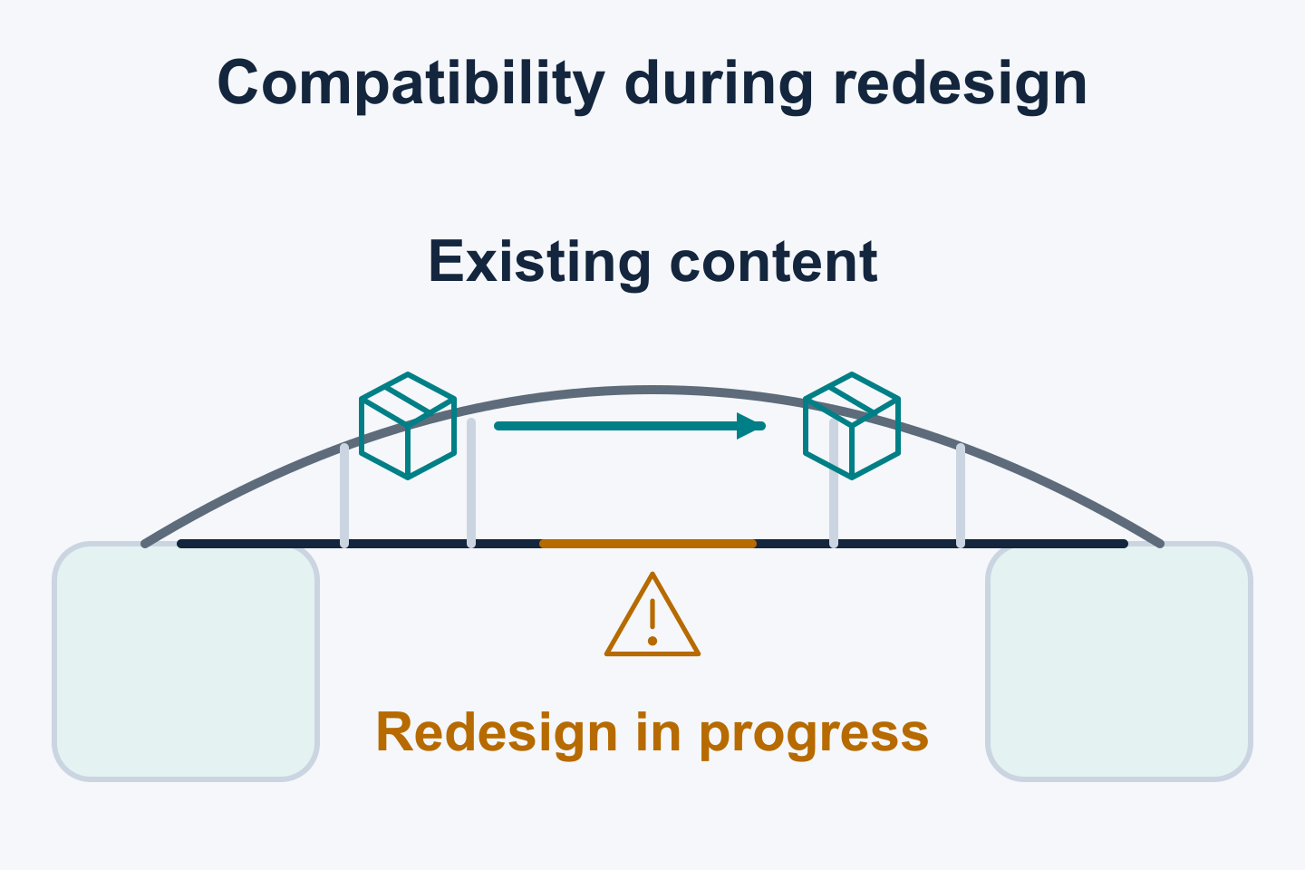
01 / OLM CONTEXT
Compatibility and lifecycle foundations
FOUNDATIONAL WORK
OLM evolution builds on existing packages and operational experience.
OLMv0 established lifecycle management
Existing registry+v1 content shapes compatibility
Operational experience informs OLMv1
Existing content and users shape lifecycle implementation.
02 / 25 | KUBECON NA 2026 | DRY RUN
Notes:
SLIDE 2: Compatibility and lifecycle foundations
SPEAKER: OLM A — context / host; name to confirm
START: 00:45
DURATION: 01:15
STATUS: FOUNDATIONAL WORK
TAKEAWAY: OLM evolution builds on existing packages and operational experience.
TALK TRACK / SOURCES / CAVEATS / REVIEW:
Use OLMv0 evolution and compatibility with existing registry+v1 content as the historical basis. Explain how existing package formats, resource ownership and operational behavior shaped lifecycle implementation. Configuration and migration preparation build on that foundation. The bridge illustration is conceptual. This slide makes no measured availability, performance, adoption or elapsed-time claims. Sources: ../kubecon-2025-slide-context.md; ../kubecon-2026-resource-assessment.md; supplied evolution background.
SOURCE CONTEXT ROOT: /Users/jordan/Documents/devel/breadcrumbs/2026-kubecon-wip

Slide 3
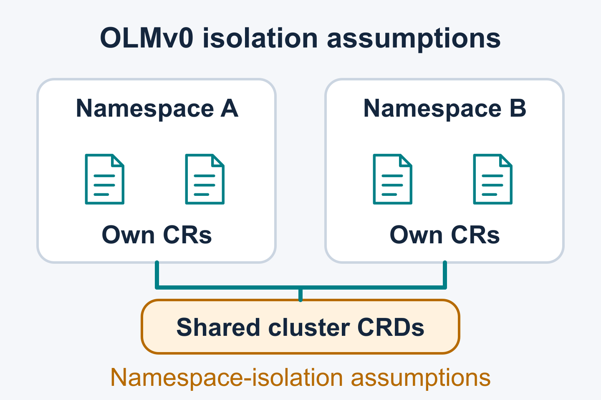
01 / OLM CONTEXT
OLMv0 assumptions left behind in OLMv1
DESIGN LESSONS
Shared APIs exposed flaws in OLMv0's lifecycle assumptions.
CRD definitions are shared cluster APIs
Controller watch scope is configured separately
Dependency assumptions coupled upgrades
These lessons shaped the OLMv1 design.
03 / 25 | KUBECON NA 2026 | DRY RUN
Notes:
SLIDE 3: OLMv0 assumptions left behind in OLMv1
SPEAKER: OLM A — context / host; name to confirm
START: 02:00
DURATION: 01:15
STATUS: DESIGN LESSONS
TAKEAWAY: Shared APIs exposed flaws in OLMv0's lifecycle assumptions.
TALK TRACK / SOURCES / CAVEATS / REVIEW:
Present the flawed OLMv0 assumptions about independent APIs, namespace watch scope and dependency management as historical lessons left behind in the OLMv1 design. CRD definitions have cluster scope; custom resource instances may have namespace scope; controller watch scope is configured separately. A shared-CRD example illustrates coupling between upgrades. Keep the OperatorGroup recap brief. Shared CRDs remain a Kubernetes boundary. Describe these as design lessons rather than newly delivered OLMv1 features. Sources: ../kubecon-2026-resource-assessment.md K-1/K-2/V0-2/V0-3; ../kubecon-2025-slide-context.md slide 9.
SOURCE CONTEXT ROOT: /Users/jordan/Documents/devel/breadcrumbs/2026-kubecon-wip

Slide 4
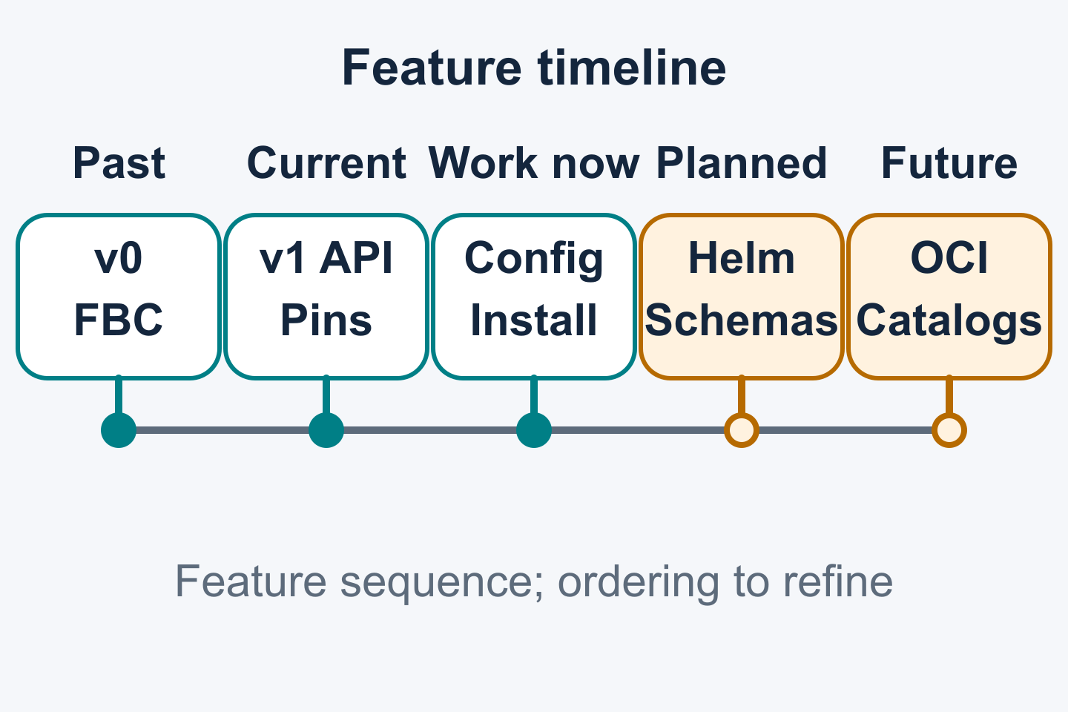
01 / OLM CONTEXT
OLM: past, current and future
EVOLUTION / PLANNED / FUTURE WORK
OLMv0 foundations, OLMv1 capabilities and the road ahead.
Past: OLMv0, SQLite and FBC
Current: OLMv1, ClusterExtension, pins, webhooks
Ongoing: rollouts, config, install, migration
Planned: helm+v2 and v2 schemas. Future: OCI catalog storage.
04 / 25 | KUBECON NA 2026 | DRY RUN
Notes:
SLIDE 4: OLM: past, current and future
SPEAKER: OLM A — context / host; name to confirm
START: 03:15
DURATION: 00:45
STATUS: EVOLUTION / PLANNED / FUTURE WORK
TAKEAWAY: OLMv0 foundations, OLMv1 capabilities and the road ahead.
TALK TRACK / SOURCES / CAVEATS / REVIEW:
Enumerate the timeline: past work includes OLMv0, SQLite catalogs and established file-based catalogs (FBC); current OLMv1 capabilities include ClusterExtension, version pins and webhooks. Ongoing development includes resource rollouts, user configuration, direct bundle installation and migration. Direct installation remains an open proposal in PR #2907 at the supplied 2026-10-09 check. Planned work includes Helm content using helm+v2 and v2 catalog schemas. OCI-native catalog storage and transport remain future work. Release-specific availability and feature gates require the source-version qualifications on the detailed slides. The 2025 deck already listed delivered features. A hands off to B after this overview at 04:00. Sources: ../kubecon-2025-slide-context.md; ../kubecon-2026-resource-assessment.md; supplied feature-planning context.
SOURCE CONTEXT ROOT: /Users/jordan/Documents/devel/breadcrumbs/2026-kubecon-wip

Slide 5
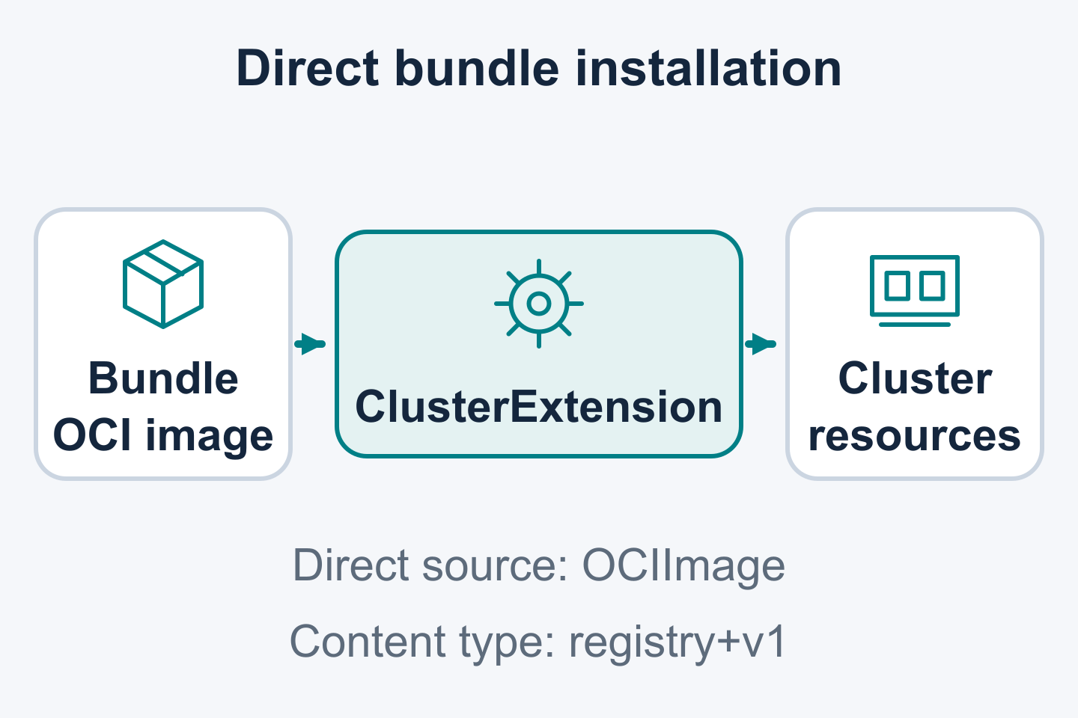
02 / LIFECYCLE PRIMITIVES
Install a bundle directly
IN ACTIVE DEVELOPMENT / CONTROLLED BY FEATURE-GATE
Select a registry+v1 bundle by its OCI image reference.
Use sourceType: OCIImage
Set source.ociImage.ref
Bypass catalog resolution
Proposed in open PR #2907; controlled by BoxcutterRuntime.
05 / 25 | KUBECON NA 2026 | DRY RUN
Notes:
SLIDE 5: Install a bundle directly
SPEAKER: OLM B — lifecycle primitives; name to confirm
START: 04:00
DURATION: 01:30
STATUS: IN ACTIVE DEVELOPMENT / CONTROLLED BY FEATURE-GATE
TAKEAWAY: Select a registry+v1 bundle by its OCI image reference.
TALK TRACK / SOURCES / CAVEATS / REVIEW:
PR #2907 is OPEN and unmerged as of the supplied check dated 2026-10-09. Present direct bundle installation as proposed behavior in active development. It supports registry+v1 bundles only and is controlled by the BoxcutterRuntime feature gate. The requested source uses sourceType: OCIImage and source.ociImage.ref. It bypasses catalog resolution. Describe CRD checks and other lifecycle safeguards according to the proposal's supported path; catalog bypass alone establishes no blanket removal of CRD safety. Pin the source revision and gate configuration before preparing an example. The session uses prepared examples without a live demo.
SOURCE CONTEXT ROOT: /Users/jordan/Documents/devel/breadcrumbs/2026-kubecon-wip

Slide 6
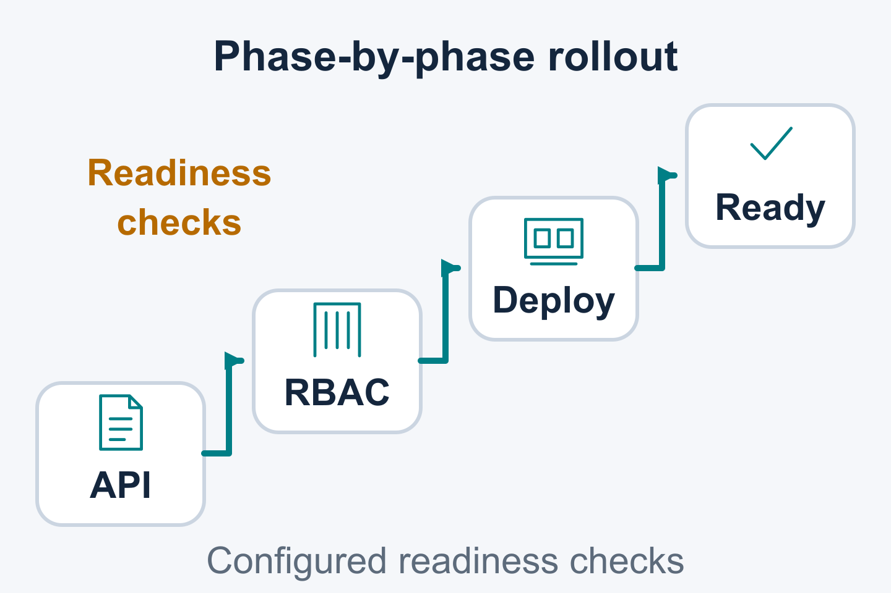
02 / LIFECYCLE PRIMITIVES
Inspect phased resource rollouts
IN ACTIVE DEVELOPMENT / CONTROLLED BY FEATURE-GATE
Ordered phases expose resource application and readiness progress.
Apply resource groups in phase order
Wait for applicable readiness checks
Inspect revision content and ownership changes
Readiness checks show which phase is waiting.
06 / 25 | KUBECON NA 2026 | DRY RUN
Notes:
SLIDE 6: Inspect phased resource rollouts
SPEAKER: OLM B — lifecycle primitives; name to confirm
START: 05:30
DURATION: 02:00
STATUS: IN ACTIVE DEVELOPMENT / CONTROLLED BY FEATURE-GATE
TAKEAWAY: Ordered phases expose resource application and readiness progress.
TALK TRACK / SOURCES / CAVEATS / REVIEW:
Explain the evolution from ClusterExtensionRevision to ClusterObjectSets. The ascending stair-step illustration shows resource readiness progressing toward the installation goal. Objects within a phase have unspecified ordering. Readiness checks cover defined conditions; application correctness and transactional availability require additional validation. The rollout runtime is in active development and controlled by feature-gate. Pin the source version and gate settings for examples. Reconcile draft Succeeded wording with the inspected Ready/completedAt type before using status examples. Sources: supplied ClusterObjectSets draft and feature-planning context; ../kubecon-2026-resource-assessment.md; ../kubecon-2025-slide-context.md slides 7, 10 and 12.
SOURCE CONTEXT ROOT: /Users/jordan/Documents/devel/breadcrumbs/2026-kubecon-wip

Slide 7
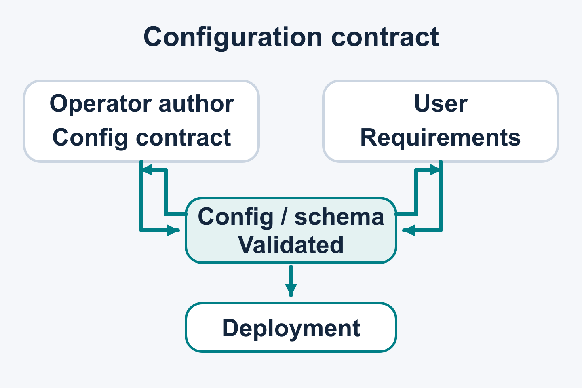
02 / LIFECYCLE PRIMITIVES
User control of extension deployments
IN ACTIVE DEVELOPMENT / CONTROLLED BY FEATURE-GATE
Flexible user-defined deployment configuration.
Environment variables and resource settings
Placement, volumes and deployment metadata
Operator-provided configuration and schemas
OLM applies user choices through operator configuration.
07 / 25 | KUBECON NA 2026 | DRY RUN
Notes:
SLIDE 7: User control of extension deployments
SPEAKER: OLM B — lifecycle primitives; name to confirm
START: 07:30
DURATION: 01:30
STATUS: IN ACTIVE DEVELOPMENT / CONTROLLED BY FEATURE-GATE
TAKEAWAY: Flexible user-defined deployment configuration.
TALK TRACK / SOURCES / CAVEATS / REVIEW:
Describe the deployment as a configuration exchange between users and the operator team. Users express environment, resource, placement, volume and metadata requirements through the package's configuration interface. Operator authors define schema and validation behavior. OLM carries the selected configuration into the deployment. DeploymentConfig is in active development and controlled by feature-gate; values are expressed through ClusterExtension configuration. Explain field-specific merge, replace and append behavior and annotation precedence. Validate example input and inspect the resulting deployment against the pinned source version. Watch-namespace pass-through leaves CRDs shared and supplies no watch-aware dependency management. Sources: supplied customization draft; ../kubecon-2026-resource-assessment.md; ../kubecon-2025-slide-context.md slide 14.
SOURCE CONTEXT ROOT: /Users/jordan/Documents/devel/breadcrumbs/2026-kubecon-wip

Slide 8
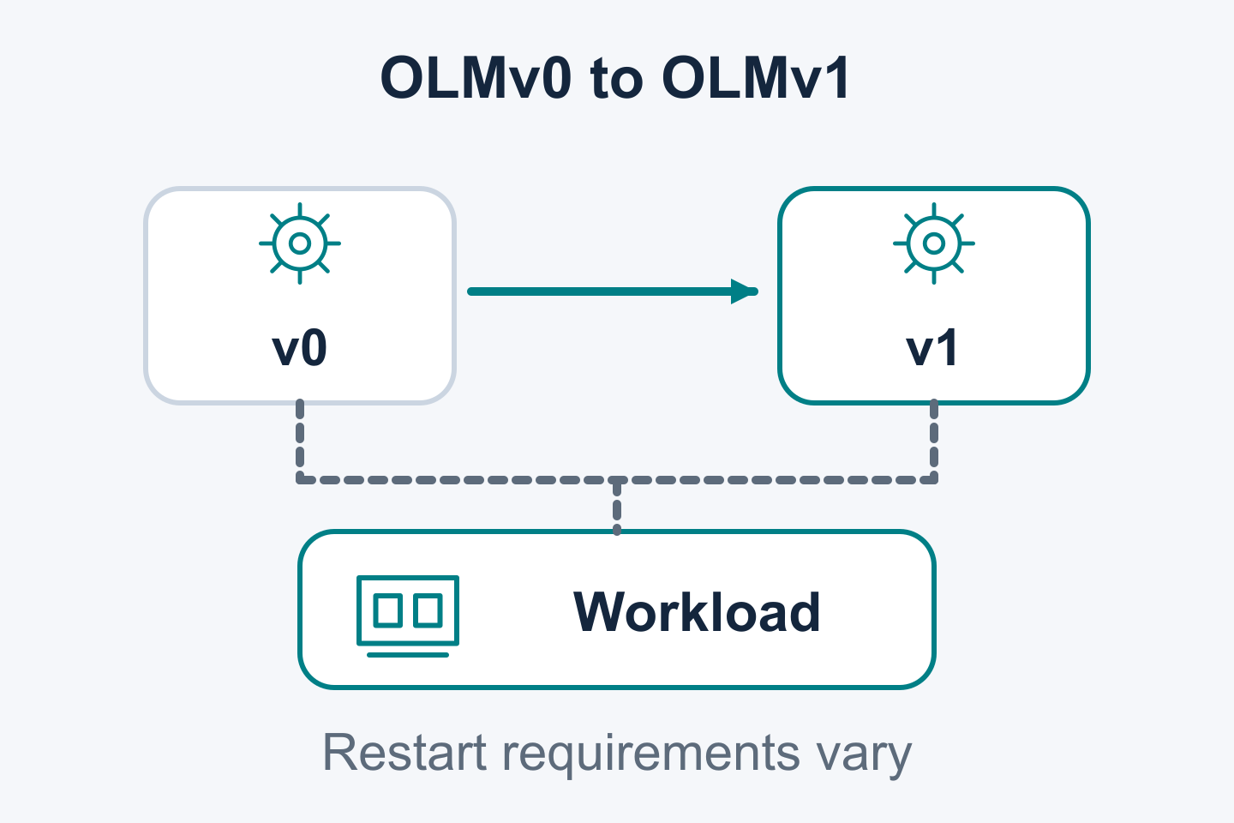
02 / LIFECYCLE PRIMITIVES
OLMv0 → OLMv1 migration
IN ACTIVE DEVELOPMENT
Move operator management from OLMv0 to OLMv1.
Prepare v1 catalogs from v0 CatalogSources
Check and preview operator migrations
Migration library with example binaries
Structured output supports automation and models.
08 / 25 | KUBECON NA 2026 | DRY RUN
Notes:
SLIDE 8: OLMv0 → OLMv1 migration
SPEAKER: OLM B — lifecycle primitives; name to confirm
START: 09:00
DURATION: 02:00
STATUS: IN ACTIVE DEVELOPMENT
TAKEAWAY: Move operator management from OLMv0 to OLMv1.
TALK TRACK / SOURCES / CAVEATS / REVIEW:
Prepare OLMv1 ClusterCatalogs from the existing OLMv0 CatalogSources first. Then evaluate each operator installation for eligibility and preview its migration before transferring management. The check and preview actions evaluate operators; catalog preparation is the earlier prerequisite. The migration specification describes check, convert, rollback and cleanup with ClusterObjectSets. Functionality is supplied as library-olm. The example binaries illustrate library use. The user confirms structured output that supports automated processing, including models; it has not been independently exercised in this editing task. Eligibility checks have defined coverage. Retaining the namespace can reduce disruption; namespace changes may restart workloads or cause downtime. Validate recovery boundaries and source/gate versions for the selected case. This area is in active development. Sources: library-olm README/spec; ../kubecon-2026-resource-assessment.md; user migration guidance.
SOURCE CONTEXT ROOT: /Users/jordan/Documents/devel/breadcrumbs/2026-kubecon-wip

Slide 9
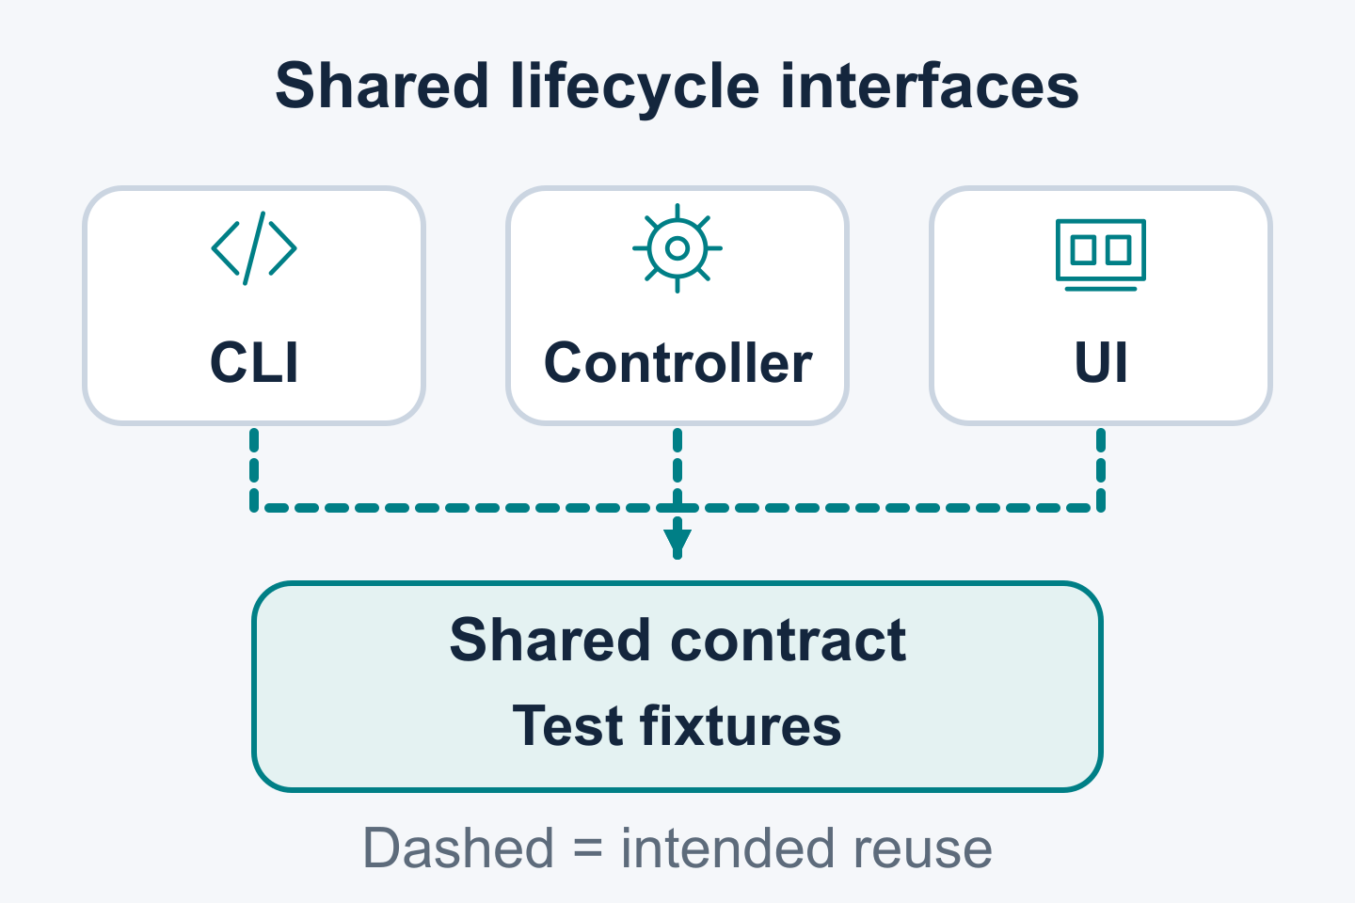
02 / LIFECYCLE PRIMITIVES
Shared lifecycle logic in library-olm
IN ACTIVE DEVELOPMENT
Reuse lifecycle logic through a library with explicit contracts.
Share migration checks and workflow logic
Exercise current development examples
Record expected results in reusable fixtures
Examples and fixtures make supported behavior concrete.
09 / 25 | KUBECON NA 2026 | DRY RUN
Notes:
SLIDE 9: Shared lifecycle logic in library-olm
SPEAKER: OLM B — lifecycle primitives; name to confirm
START: 11:00
DURATION: 01:00
STATUS: IN ACTIVE DEVELOPMENT
TAKEAWAY: Reuse lifecycle logic through a library with explicit contracts.
TALK TRACK / SOURCES / CAVEATS / REVIEW:
Describe library reuse, the current migration development examples and fixtures that record inputs and expected results. The example binaries exercise library behavior and provide contribution starting points. Broader controller, CLI and UI consumption remains a design intent requiring implementation evidence and explicit contracts. Successor semantics need a defined contract. Fixtures can cover legacy input or version/release selection while respecting the proposed v2 schema direction. Pin source versions when documenting examples. B hands off to C after this slide at 12:00. Sources: library-olm README/spec; supplied feature-planning context; ../kubecon-2025-slide-context.md slide 13.
SOURCE CONTEXT ROOT: /Users/jordan/Documents/devel/breadcrumbs/2026-kubecon-wip

Slide 10
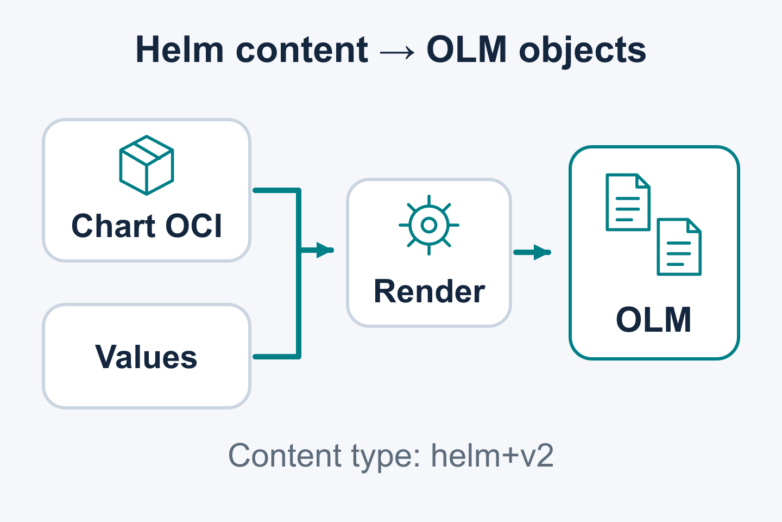
03 / CONTENT & CATALOGS
Planned Helm content support
PLANNED / helm+v2
The rendering contract targets deterministic chart behavior.
Chart and values produce managed manifests
Allow-listed features support reproducible rendering
helm+v2 identifies the content representation
Standard chart artifacts use a defined rendering contract.
10 / 25 | KUBECON NA 2026 | DRY RUN
Notes:
SLIDE 10: Planned Helm content support
SPEAKER: OLM C — content/catalogs/contributions; name to confirm
START: 12:00
DURATION: 02:00
STATUS: PLANNED / helm+v2
TAKEAWAY: The rendering contract targets deterministic chart behavior.
TALK TRACK / SOURCES / CAVEATS / REVIEW:
helm+v2 is the user-confirmed canonical discriminator for versioned OLM Helm packaging/catalog content. Standard chart OCI identity is used, with rendered manifests managed through OLM lifecycle behavior. User values are parsed and validated during rendering. Deterministic rendering is the design goal: features are allow-listed to exclude non-deterministic functionality, with compatibility fixtures required to validate the supported subset. Dependencies are vendored. Hooks and keep behavior are unsupported in the proposal. CRDs use templates/; crds/ is unsupported. Chart release-object mappings and restricted template functions require compatibility testing. Moving CRDs affects upgrade, deletion and data handling. Implementation of proposed gates remains independently unconfirmed. Native chart OCI identity and future OCI catalog storage are separate scopes. Sources: supplied Helm planning brief and feature-planning context.
SOURCE CONTEXT ROOT: /Users/jordan/Documents/devel/breadcrumbs/2026-kubecon-wip

Slide 11
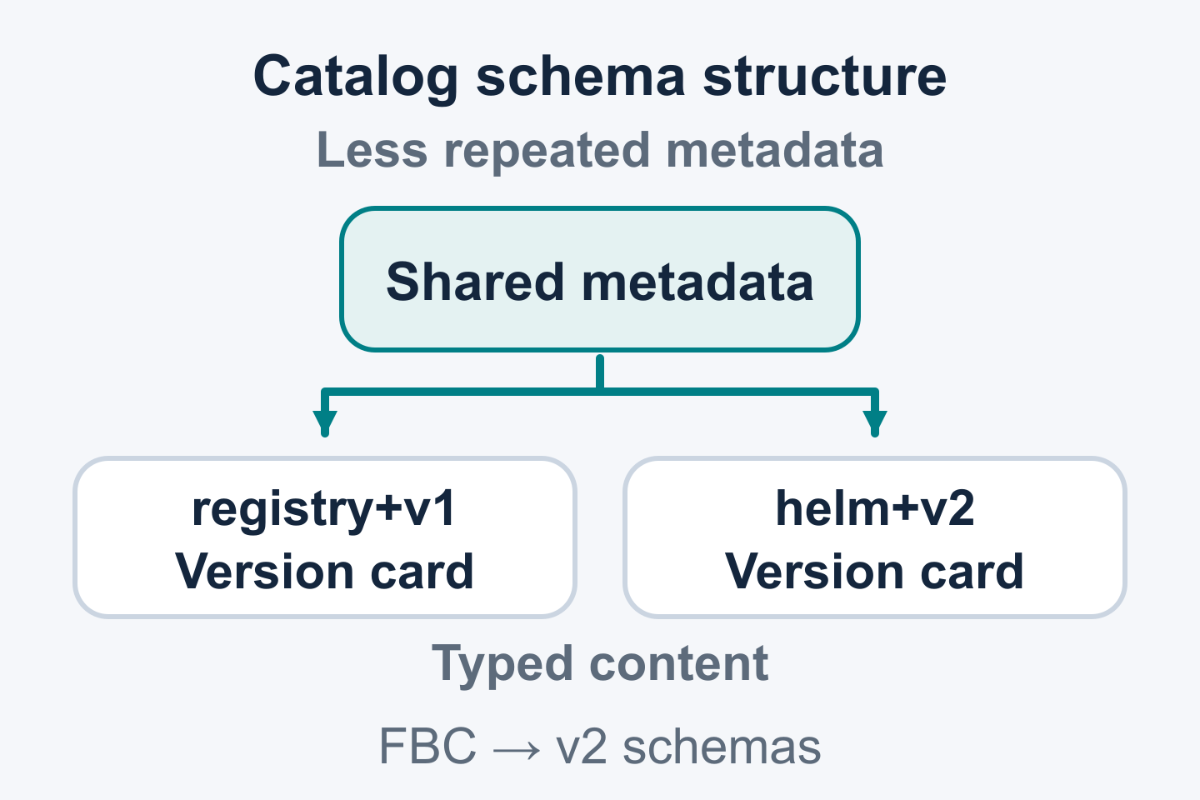
03 / CONTENT & CATALOGS
Catalog performance and content types
PLANNED / FUTURE WORK
Design for lower catalog-processing cost and additional content types.
Lower duplicated CSV metadata
Direct version fields reduce property traversal
Typed registry+v1 and helm+v2 content
File-based catalogs remain the established foundation.
11 / 25 | KUBECON NA 2026 | DRY RUN
Notes:
SLIDE 11: Catalog performance and content types
SPEAKER: OLM C — content/catalogs/contributions; name to confirm
START: 14:00
DURATION: 01:30
STATUS: PLANNED / FUTURE WORK
TAKEAWAY: Design for lower catalog-processing cost and additional content types.
TALK TRACK / SOURCES / CAVEATS / REVIEW:
Credit established FBC capabilities: plaintext editing, composition, extensibility, package-level metadata and version/release properties already exist. The v2 work refines the representation and consumers: less duplicated CSV metadata, version/release fields available directly rather than via property traversal, and explicit mediaType dispatch for installable formats including Helm. Arbitrary FBC schema extensibility alone does not supply end-to-end installation support for a new content type. Catalog processing efficiency is a design benefit to validate, with no measured speedup claimed. Show the practical resolution/metadata work the new representation is intended to reduce. The user-confirmed near-term focus is flexible OLMv1 schemas; OCI-native catalog storage, transport and selective fetching are future work. Channels and legacy graphs are excluded from v2; lifecycle/constraint metadata remains open. Sources: https://olm.operatorframework.io/docs/reference/file-based-catalogs/ ; supplied v2 catalog brief; feature-planning context.
SOURCE CONTEXT ROOT: /Users/jordan/Documents/devel/breadcrumbs/2026-kubecon-wip

Slide 12
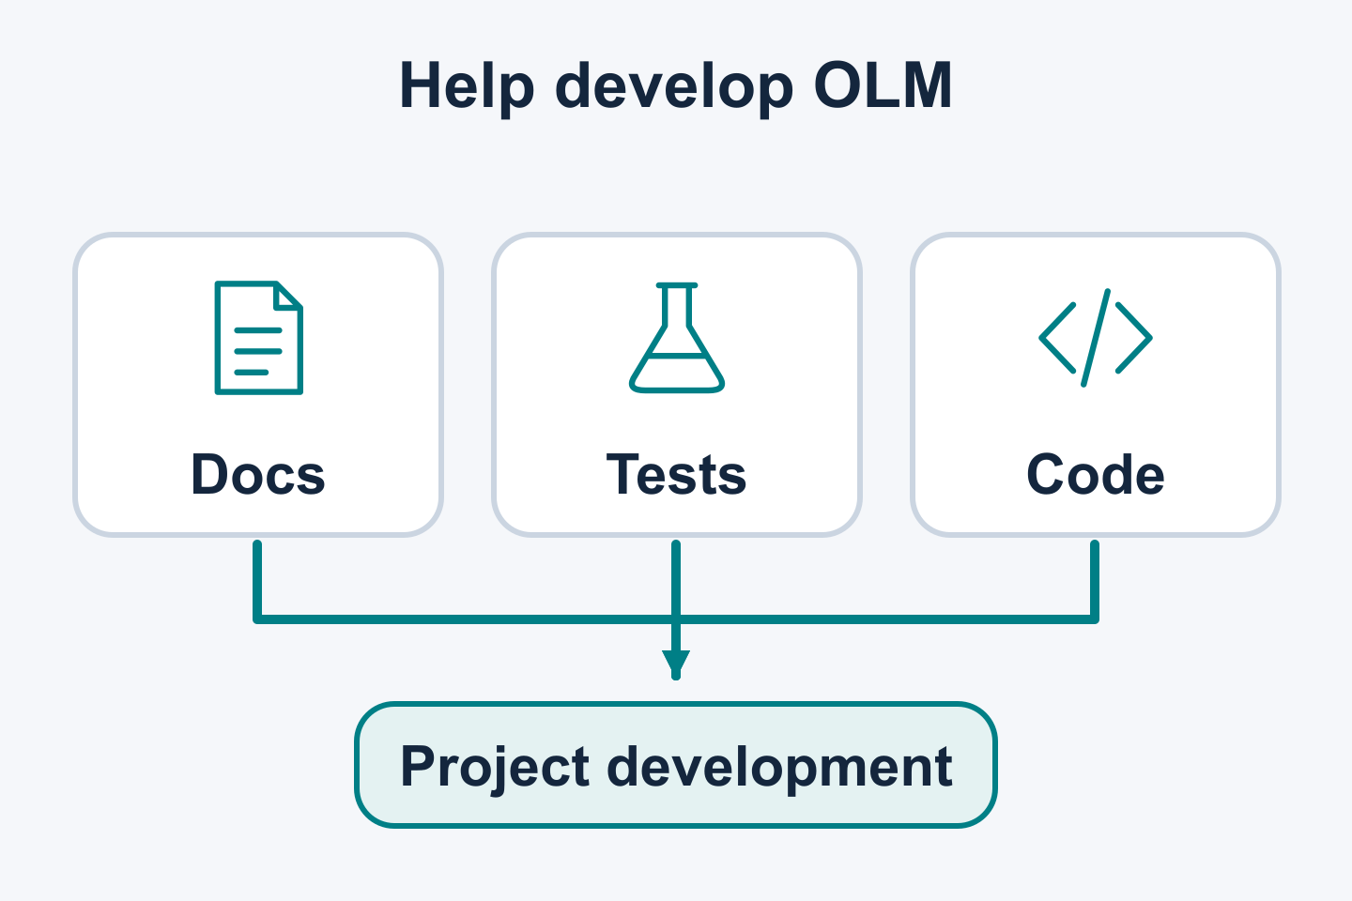
03 / CONTENT & CATALOGS
Contribute to Operator Framework
PROJECT DEVELOPMENT
Help develop the project through documentation, code and test cases.
Improve documentation and examples
Contribute code and focused tests
Add migration, chart and schema fixtures
Start with a reproducible case and a clear expected result.
12 / 25 | KUBECON NA 2026 | DRY RUN
Notes:
SLIDE 12: Contribute to Operator Framework
SPEAKER: OLM C — content/catalogs/contributions; name to confirm
START: 15:30
DURATION: 01:00
STATUS: PROJECT DEVELOPMENT
TAKEAWAY: Help develop the project through documentation, code and test cases.
TALK TRACK / SOURCES / CAVEATS / REVIEW:
Make an explicit project-development ask: contribute documentation, code, tests and fixtures to Operator Framework. Explain the distinction from submitting operator versions or upgrade graphs to a catalog; those submissions serve a separate publishing workflow. Useful development cases include rollout/configuration edge cases, migration eligibility, chart/values compatibility and schema behavior. Each contribution should identify the repository, issue or discussion, reproducible input and expected result. Maintainers still need to vet concrete task links and destinations. Companion examples are intended for online use; this session has no live demos. Sources: supplied feature-planning context; ../kubecon-2025-slide-context.md slide 15.
SOURCE CONTEXT ROOT: /Users/jordan/Documents/devel/breadcrumbs/2026-kubecon-wip

Slide 13
Operator Framework: Java Operator SDK
13 / 25 | KUBECON NA 2026 | DRY RUN
Notes:
SLIDE 13: Operator Framework: Java Operator SDK
SPEAKER: OLM C — content/catalogs/contributions; name to confirm
START: 16:30
DURATION: 00:30
STATUS:
TAKEAWAY:
TALK TRACK / SOURCES / CAVEATS / REVIEW:
C hands off to Attila for Java Operator SDK. OLM packaging is language-neutral, and SDKs support controller implementation and reconciliation. Keep bundle metadata and the runnable controller image distinct in the spoken transition. The primary builder imports original SDK source slides 3–12 unchanged immediately after this divider. Each original SDK slide receives 60 seconds, for ten minutes total on final slides 14–23. Attila covers this segment exclusively.
SOURCE CONTEXT ROOT: /Users/jordan/Documents/devel/breadcrumbs/2026-kubecon-wip

Slide 14
Read-Cache-After-Write Consistency
since v5.3
API:
  UpdateControl.patchStatus(resource)
  context.resourceOperations().serverSideApply(resource);
Additional cache brings complexity:
  Indexers
  Items store
Comparable Resource Versions KEP
Read-cache-after-write consistency blog
Notes:
[SDK import: speaker=Attila; section=SDK; sourceSlide3; duration=60 seconds; start=17:00; end=18:00]

Slide 15
Read-Cache-After-Write Consistency
Notes:
[SDK import: speaker=Attila; section=SDK; sourceSlide4; duration=60 seconds; start=18:00; end=19:00]

Slide 16
Event Filtering - API & Challenges
Filter out events for our own updates
Challenges
  Informer lost event problem
  Our update did not change the resource but other actor did concurrently
context.resourceOperations().serverSideApply(resource);
Notes:
[SDK import: speaker=Attila; section=SDK; sourceSlide5; duration=60 seconds; start=19:00; end=20:00]

Slide 17
Event Filtering
for Read-Cache-After-Write-Consistency
Notes:
[SDK import: speaker=Attila; section=SDK; sourceSlide6; duration=60 seconds; start=20:00; end=21:00]

Slide 18
Informer Pools
Sharing underlying informers between controller
Matches the informer configuration
  Except list limit
  Details in InformerClassifier
Supports dynamic Informer registration and de-registration
Notes:
[SDK import: speaker=Attila; section=SDK; sourceSlide7; duration=60 seconds; start=21:00; end=22:00]

Slide 19
Informer Pools
Notes:
[SDK import: speaker=Attila; section=SDK; sourceSlide8; duration=60 seconds; start=22:00; end=23:00]

Slide 20
Observability stack enhancements
Facelift over Observability stack
Improved logging and Mapped Diagnostic Context (MDC)
  Putting event and primary resource to MDC if available
Metrics API refined
  MicrometerMetricsV2
  Generic Grafana Dashboard
  Sample with OTel + Prometheus + Grafana
Notes:
[SDK import: speaker=Attila; section=SDK; sourceSlide9; duration=60 seconds; start=23:00; end=24:00]

Slide 21
Java Virtual Threads (WIP)
Planned for v5.7.0
We will officially support this for Java 25+ (but will work with Java 21+)
  Replacing ThreadPools with virtual threads across framework
Virtually unlimited number of concurrent reconciliation
  The explicit limit applies though
Notes:
[SDK import: speaker=Attila; section=SDK; sourceSlide10; duration=60 seconds; start=24:00; end=25:00]

Slide 22
Java Virtual Threads (WIP)
Notes:
[SDK import: speaker=Attila; section=SDK; sourceSlide11; duration=60 seconds; start=25:00; end=26:00]

Slide 23
Some honorable mentions…
EventRecorder API
ShardSelector support
Documentation improvements - operations section
Notes:
[SDK import: speaker=Attila; section=SDK; sourceSlide12; duration=60 seconds; start=26:00; end=27:00]

Slide 24
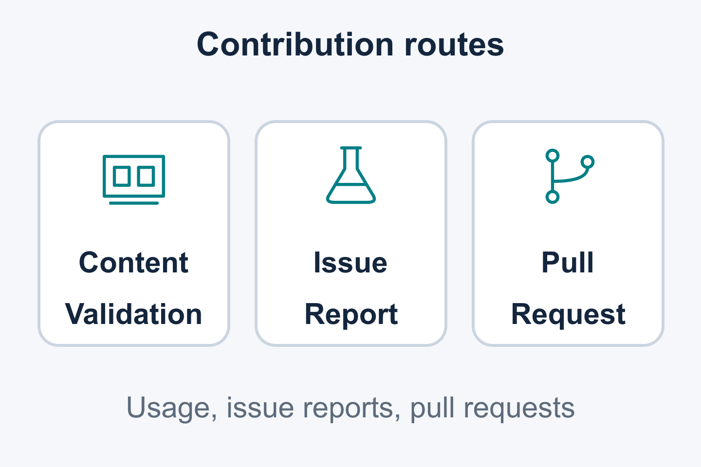
05 / RESOURCES
Resources and contribution steps
RESOURCE PACKAGE TO PREPARE
Use documented contracts and reproducible cases to guide contributions.
Check content against a documented contract
Share a reproducible case or fixture
Select a maintainer-scoped contribution
Companion examples and task links are being prepared.
24 / 25 | KUBECON NA 2026 | DRY RUN
Notes:
SLIDE 24: Resources and contribution steps
SPEAKER: OLM A — session host; name to confirm
START: 27:00
DURATION: 01:00
STATUS: RESOURCE PACKAGE TO PREPARE
TAKEAWAY: Use documented contracts and reproducible cases to guide contributions.
TALK TRACK / SOURCES / CAVEATS / REVIEW:
The host closes on final slide 24, represented here by base record 14. Include verified resource routes for Operator Framework and Java Operator SDK in the final resource hub. Public URLs and QR codes need published destinations. Companion examples and vetted first-task links remain to be prepared. Give the audience a practical next-day contribution supported by the resource package. Speaker ownership stays in these notes. Sources: ../kubecon-2026-outline.md companion package; supplied feature-planning contribution candidates.
SOURCE CONTEXT ROOT: /Users/jordan/Documents/devel/breadcrumbs/2026-kubecon-wip

Slide 25
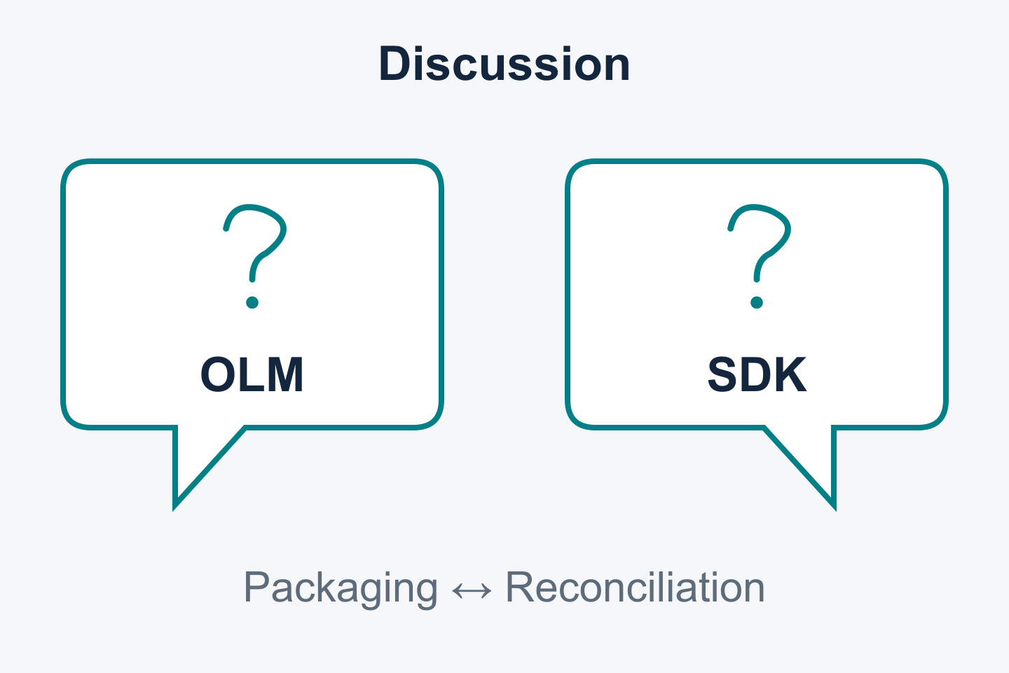
06 / QUESTIONS
Questions?
Questions about lifecycle APIs, packaging or controller behavior?
OLM configuration and migration
Helm content and catalog schemas
Java Operator SDK reconciliation
Discussion of capabilities and proposed work.
25 / 25 | KUBECON NA 2026 | DRY RUN
Notes:
SLIDE 25: Questions?
SPEAKER: OLM A/B/C on OLM; Attila on Java SDK only
START: 28:00
DURATION: 02:00
STATUS:
TAKEAWAY: Questions about lifecycle APIs, packaging or controller behavior?
TALK TRACK / SOURCES / CAVEATS / REVIEW:
Final slide 25 is titled exactly Questions?. Base record 15 reserves two minutes for questions and transition overruns. A/B/C answer their OLM topics; Attila answers Java Operator SDK questions exclusively. The base segment totals 20 minutes, including this question allocation. Original SDK source slides 3–12 add ten minutes for a 30-minute session. Main slides occupy 28 minutes including the one-minute host close. Keep the no-live-demo plan. Source: ../kubecon-2026-outline.md run of show.
SOURCE CONTEXT ROOT: /Users/jordan/Documents/devel/breadcrumbs/2026-kubecon-wip

