Slide 1

Compétences en données de la recherche Qu’est-ce que ça signifie au juste?
René Schneider
Haute école de Gestion de Genève
Licence CC BY 4.0
All cartoons courtesy of Jørgen Stamp,
Digitalbevaring.dk. CC BY 2.5.

Slide 2
Aperçu
Compétences-clés
Aptitudes spécifiques
Durée de cours et public-cible
Littératie en tant que plan de métro

Slide 3
Compétences-clés
Big 6 of Information Literacy as Essential Skills (Eisenberg)
Seven Pillars of Information Literacy as a Core Model for Higher Education (SCONUL)
DPOE curriculum: «Train the trainer program in Digital Curation» (established by the Library of Congress)

Slide 4
Big 6 Information Literacy
Big 6
Clarify
Locate
Select /Analyze
Organize / Synthesize
Evaluate
Create / Present

Slide 5
Seven Pillars for HigHer Education
Big 6 | Seven Pillars
1. Clarify
2. Locate | 1. Identify
3. Select /Analyze | 2. Scope
4. Organize / Synthesize | 3. Plan
 | 4. Gather
5. Evaluate | 5. Evaluate
 | 6. Manage
6. Create / Present | 7. Present

Slide 6
Compétences-clés Train the Trainer en curation digitale
Big 6 | Seven Pillars | DPOE curriculum
1. Clarify
2. Locate | 1. Identify | 1. Identify
3. Select /Analyze | 2. Scope | 2. Select
4. Organize / Synthesize | 3. Plan
 | 4. Gather | 3. Store
 |  | 4. Protect
5. Evaluate | 5. Evaluate
 | 6. Manage | 5. Manage
6. Create / Present | 7. Present | 6. Provide

Slide 7
Fusion
Research Data Literacy
Provide
Identify
Scope
Plan
Store
Protect
Evaluate
Manage

Slide 8
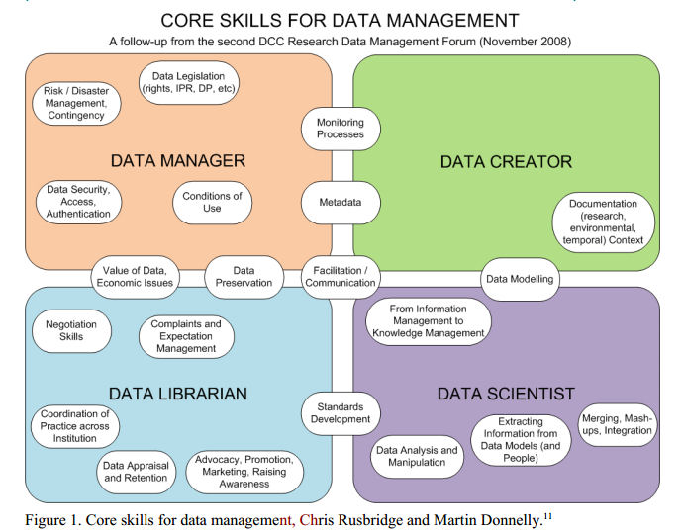
Aptitudes (skills)

Slide 9
Compétences et aptitudes
Competences | Skills
Identify | Documentation (research environmental, temporal) / Context / From Information Management to Knowledge Management
Scope | Monitoring Process / Extracting Information from Data Models (and People)
Plan | Data Modeling / Meta Data / Standards Development
Store | Data Analysis and Manipulation / Merging, Mashing, Integration
Protect | Data Preservation / Data Security / Access Authentication / Conditions of Use / Data Legislation
Evaluate | Data Appraisal and Retention / Value of Data / Economic Issues
Manage | Complaints and Expectation Management / Coordination of Practice across Institution / Negotiation Skills / Risk & Disaster Management / Contingency / Advocacy, Promotion, Marketing
Provide | Facilitation, Communication / Raising Awareness

Slide 10
Compétences et durée de cours
 | Provide | Identify | Scope | Plan | Store | Protect | Evaluate | Manage
2 heures | * | * | *
1 cours de 30 h | * | * | * | * | *
1 module (2-3 cours) | * | * | * | * | * | * | *
1 spécialisation | * | * | * | * | * | * | * | *
1 cursus d’études | * | * | * | * | * | * | * | *

Slide 11
Durée et public
 | 2 heures | 1 cours | 1 module | 1 speciali-sation | 1 cursus d’études | certificat
Any Bachelor student | * | - | - | - | - | -
Any Master student | + | * | - | - | - | -
LIS Bachelor Students | - | + | * | * | - | -
LIS Master Students | - | - | + | * | * | -
Data Creators | + | * | - | - | - | -
Data Scientists | + | * | - | - | - | *
Data Librarians | - | + | - | - | - | +
Data Managers | - | + | - | - | - | +
+ : obligatoire
* : facultatif

Slide 12
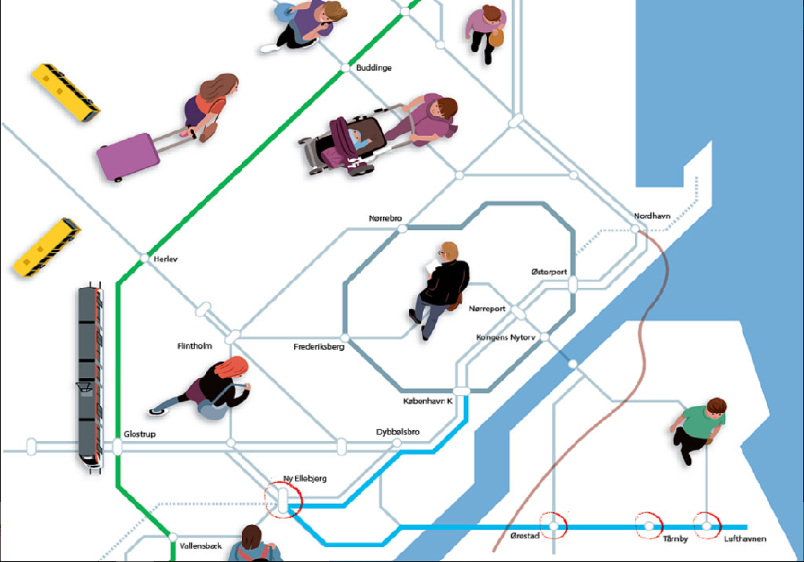
iV. Littératie en tant que plan de métro
© Jørgen Stamp, All rights reserved

Slide 13
Partons du principe que…
- les lignes de métro sont des compétences-clés
- et les arrêts sont les aptitudes spécifiques!

Slide 14
Provision Line

Slide 15
Promotion
Advocation
Raising
Awareness
Provide
Facilitation
Marketing
Communication

Slide 16
Identification Line

Slide 17
Identify
From IM to KM
Promotion
Advocation
Raising
Awareness
Provide
Documentation
Facilitation
Marketing
Context
Communication

Slide 18
Scope Line

Slide 19
Identify
From IM to KM
Promotion
Advocation
Raising
Awareness
Provide
Documentation
Facilitation
Marketing
Context
Communication
Extracting Information
Monitoring
Process
Scope
Access Authentication

Slide 20
Planning Line

Slide 21
Identify
From IM to KM
Promotion
Advocation
Standards
Development
Data
Modelling
Plan
Raising
Awareness
Provide
Documentation
Meta Data
Facilitation
Marketing
Context
Communication
Extracting Information
Monitoring
Process
Scope
Access Authentication

Slide 22
Storage Line

Slide 23
Identify
From IM to KM
Promotion
Integration
Mashing
Advocation
Standards
Development
Merging
Data
Modelling
Manipulation
Plan
Raising
Awareness
Provide
Documentation
Meta Data
Facilitation
Marketing
Context
Communication
Extracting Information
Monitoring
Process
Data Analysis
Scope
Access Authentication
Store
Risk and Disaster
Management

Slide 24
Protection Line

Slide 25
Identify
From IM to KM
Promotion
Integration
Mashing
Advocation
Standards
Development
Merging
Data
Modelling
Manipulation
Plan
Raising
Awareness
Provide
Documentation
Meta Data
Facilitation
Marketing
Data Preservation
Data
Legislation
Context
Communication
Extracting Information
Monitoring
Process
Data Analysis
Scope
Access Authentication
Store
Risk and Disaster
Management
Conditions of Use
Protect
Data Security

Slide 26
Evaluation Line

Slide 27
Identify
From IM to KM
Value of Data
Evaluate
Promotion
Integration
Mashing
Economic Issues
Advocation
Standards
Development
Merging
Data
Modelling
Manipulation
Plan
Raising
Awareness
Retention
Provide
Documentation
Meta Data
Facilitation
Marketing
Data Preservation
Context
Appraisal
Data
Legislation
Extracting Information
Communication
Monitoring
Process
Data Analysis
Scope
Access Authentication
Store
Risk and Disaster
Management
Conditions of Use
Protect
Data Security

Slide 28
Management Line

Slide 29
Identify
From IM to KM
Value of Data
Evaluate
Manage
Promotion
Integration
Negotiation Skills
Contingency
Mashing
Economic Issues
Advocation
Standards
Development
Merging
Data
Modelling
Manipulation
Plan
Raising
Awareness
Retention
Provide
Coordination
of Practice
Documentation
Meta Data
Facilitation
Marketing
Data Preservation
Context
Appraisal
Data
Legislation
Extracting Information
Communication
Complaints &
Expectation
Management
Monitoring
Process
Data Analysis
Scope
Access Authentication
Store
Risk and Disaster
Management
Conditions of Use
Protect
Data Security

Slide 30
Et maintenant, admettons que…
les lignes de métro sont des compétences-clés
les arrêts sont les aptitudes spécifiques,
les zones sont des unités d’enseignement
la durée de validité de l’abonnement correspond à la durée du programme d’études

Slide 31
Valable 2 heures

Slide 32
Identify
From IM to KM
Value of Data
Evaluate
Manage
Promotion
Integration
Negotiation Skills
Contingency
Mashing
Economic Issues
Advocation
Standards
Development
Merging
Data
Modelling
Manipulation
Plan
Raising
Awareness
Retention
Provide
Coordination
of Practice
Documentation
Meta Data
Facilitation
Marketing
Data Preservation
Context
Appraisal
Data
Legislation
Extracting Information
Communication
Complaints &
Expectation
Management
Monitoring
Process
Data Analysis
Scope
Access Authentication
Store
Risk and Disaster
Management
Conditions of Use
Protect
Data Security

Slide 33
Un cours entier / Workshop Ticket

Slide 34
Identify
From IM to KM
Value of Data
Evaluate
Manage
Promotion
Integration
Negotiation Skills
Contingency
Mashing
Economic Issues
Advocation
Standards
Development
Merging
Data
Modelling
Manipulation
Plan
Raising
Awareness
Retention
Provide
Coordination
of Practice
Documentation
Meta Data
Facilitation
Marketing
Data Preservation
Context
Appraisal
Data
Legislation
Extracting Information
Communication
Complaints &
Expectation
Management
Monitoring
Process
Data Analysis
Scope
Access Authentication
Store
Risk and Disaster
Management
Conditions of Use
Protect
Data Security

Slide 35
Ticket pour un module

Slide 36
Identify
From IM to KM
Value of Data
Evaluate
Manage
Promotion
Integration
Negotiation Skills
Contingency
Mashing
Economic Issues
Advocation
Standards
Development
Merging
Data
Modelling
Manipulation
Plan
Raising
Awareness
Retention
Provide
Coordination
of Practice
Documentation
Meta Data
Facilitation
Marketing
Data Preservation
Context
Appraisal
Data
Legislation
Extracting Information
Communication
Complaints &
Expectation
Management
Monitoring
Process
Data Analysis
Scope
Access Authentication
Store
Risk and Disaster
Management
Conditions of Use
Protect
Data Security

Slide 37
Ticket de spécialisation

Slide 38
Identify
From IM to KM
Value of Data
Evaluate
Manage
Promotion
Integration
Negotiation Skills
Contingency
Mashing
Economic Issues
Advocation
Standards
Development
Merging
Data
Modelling
Manipulation
Plan
Raising
Awareness
Retention
Provide
Coordination
of Practice
Documentation
Meta Data
Facilitation
Marketing
Data Preservation
Context
Appraisal
Data
Legislation
Extracting Information
Communication
Complaints &
Expectation
Management
Monitoring
Process
Data Analysis
Scope
Access Authentication
Store
Risk and Disaster
Management
Conditions of Use
Protect
Data Security

Slide 39
Abonnement général
(valable deux ans)

Slide 40
Identify
From IM to KM
Value of Data
Evaluate
Manage
Promotion
Integration
Negotiation Skills
Contingency
Mashing
Economic Issues
Advocation
Standards
Development
Merging
Data
Modelling
Manipulation
Plan
Raising
Awareness
Retention
Provide
Coordination
of Practice
Documentation
Meta Data
Facilitation
Marketing
Data Preservation
Context
Appraisal
Data
Legislation
Extracting Information
Communication
Complaints &
Expectation
Management
Monitoring
Process
Data Analysis
Scope
Access Authentication
Store
Risk and Disaster
Management
Conditions of Use
Protect
Data Security

Slide 41
Questions?
Rene.schneider@hesge.ch
SCHNEIDER, René, 2013. Research Data Literacy. In: Worldwide commonalities and challenges in information literacy research and practice: European Conference, ECIL 2013, Istanbul, Turkey, October 22-25, 2013: revised selected papers. Berlin: Springer, 2013, S. 134-140. Communications in Computer and Information Science, Vol. 397.

