Slide 1
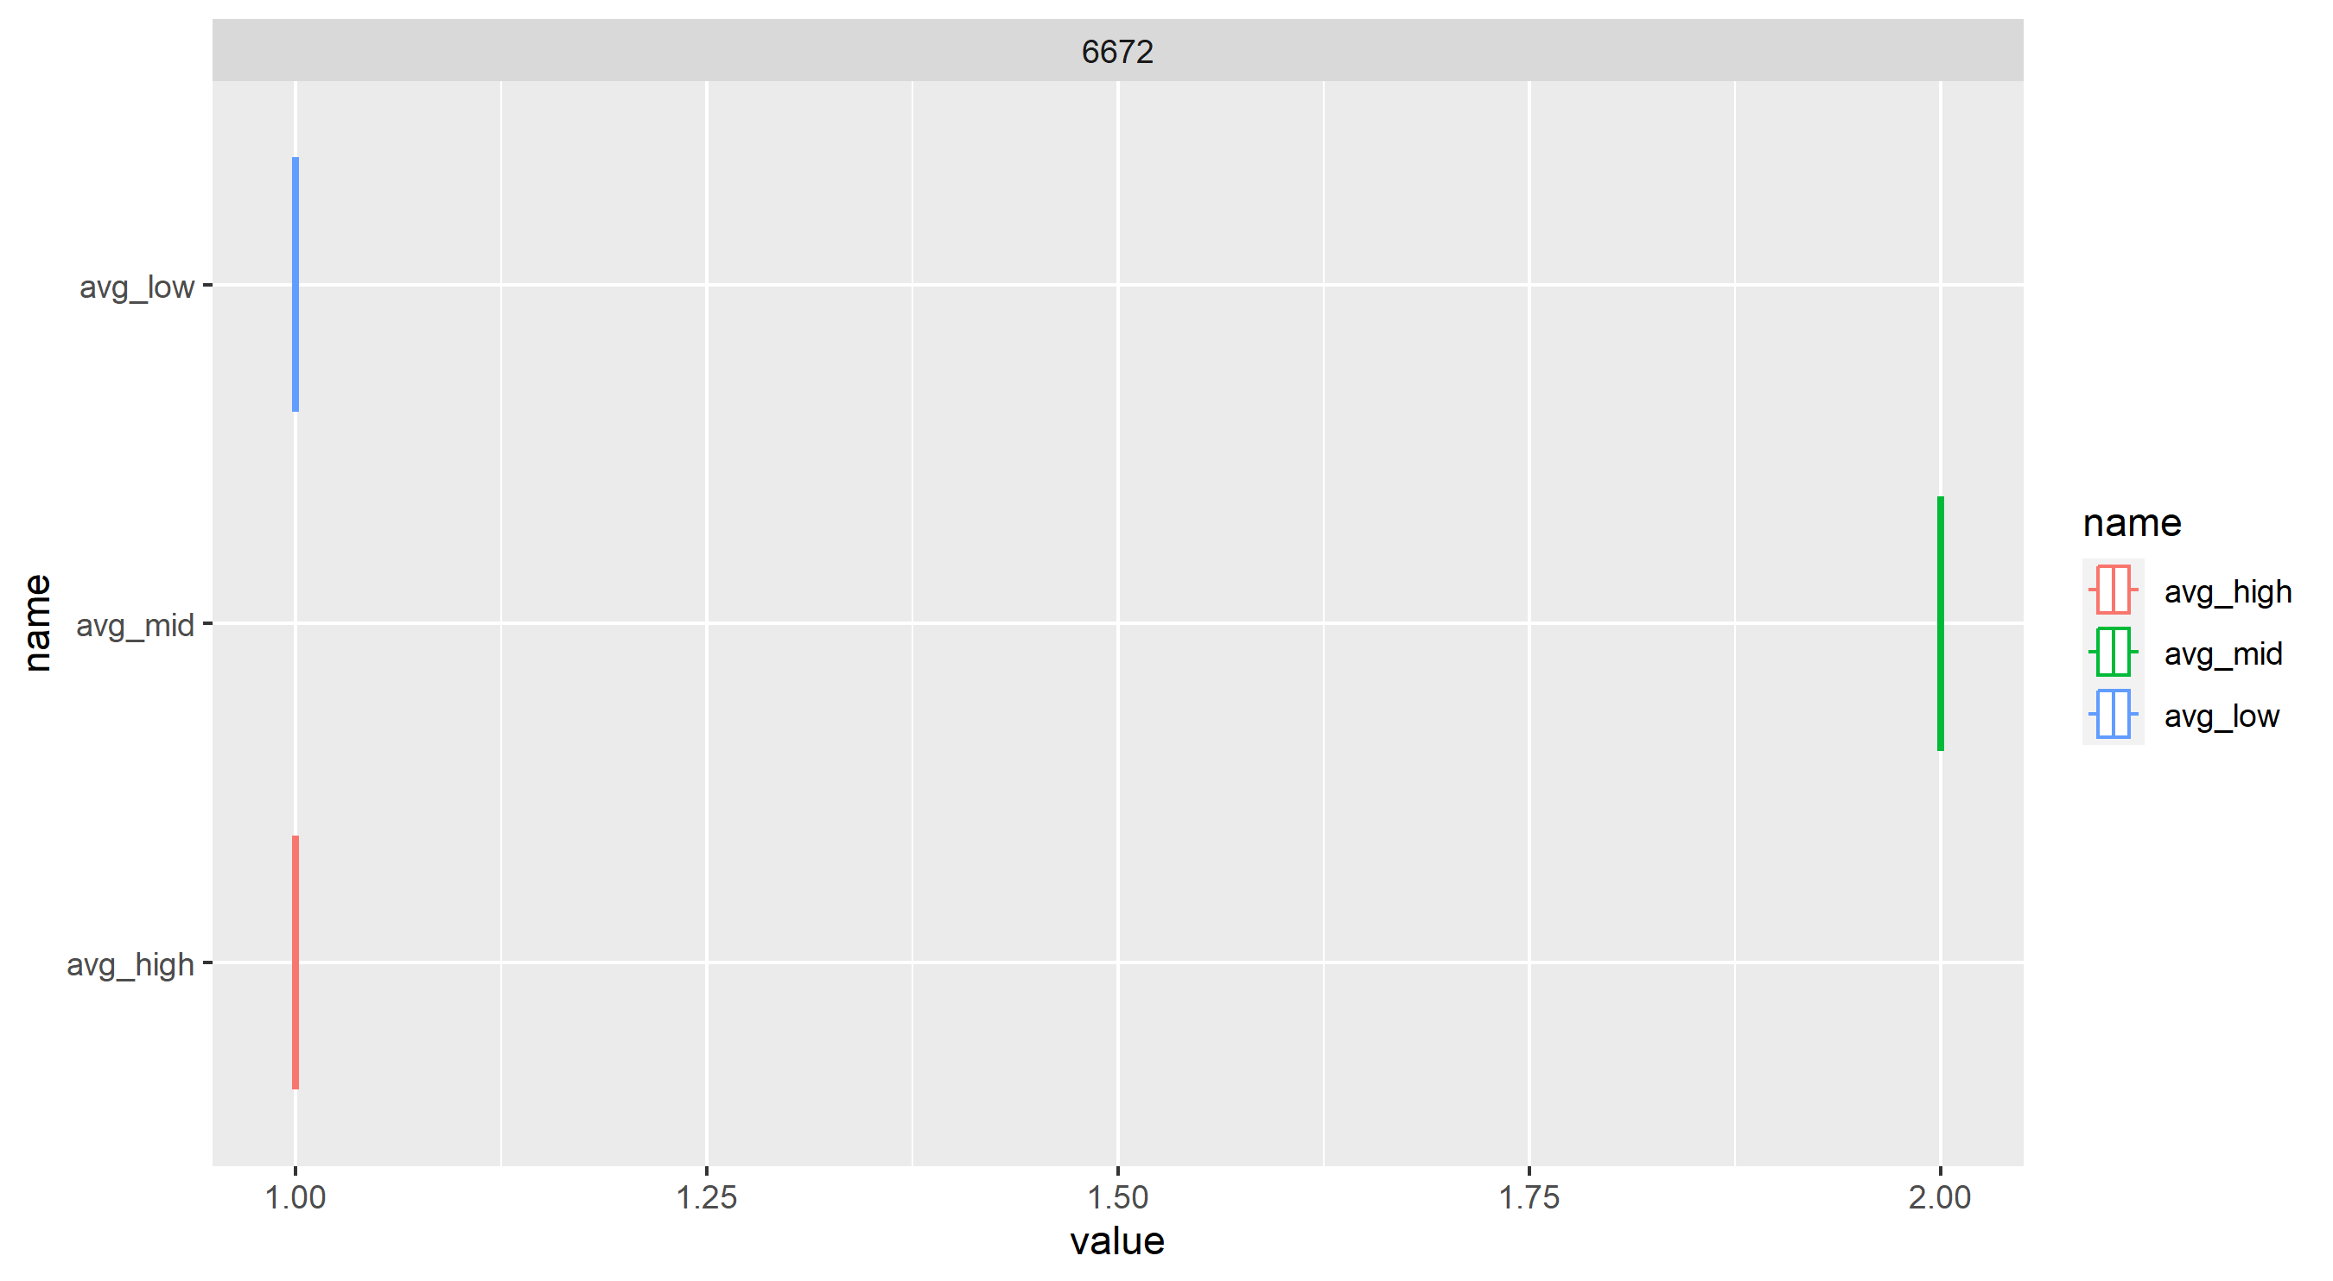
Placement distribution

Slide 2
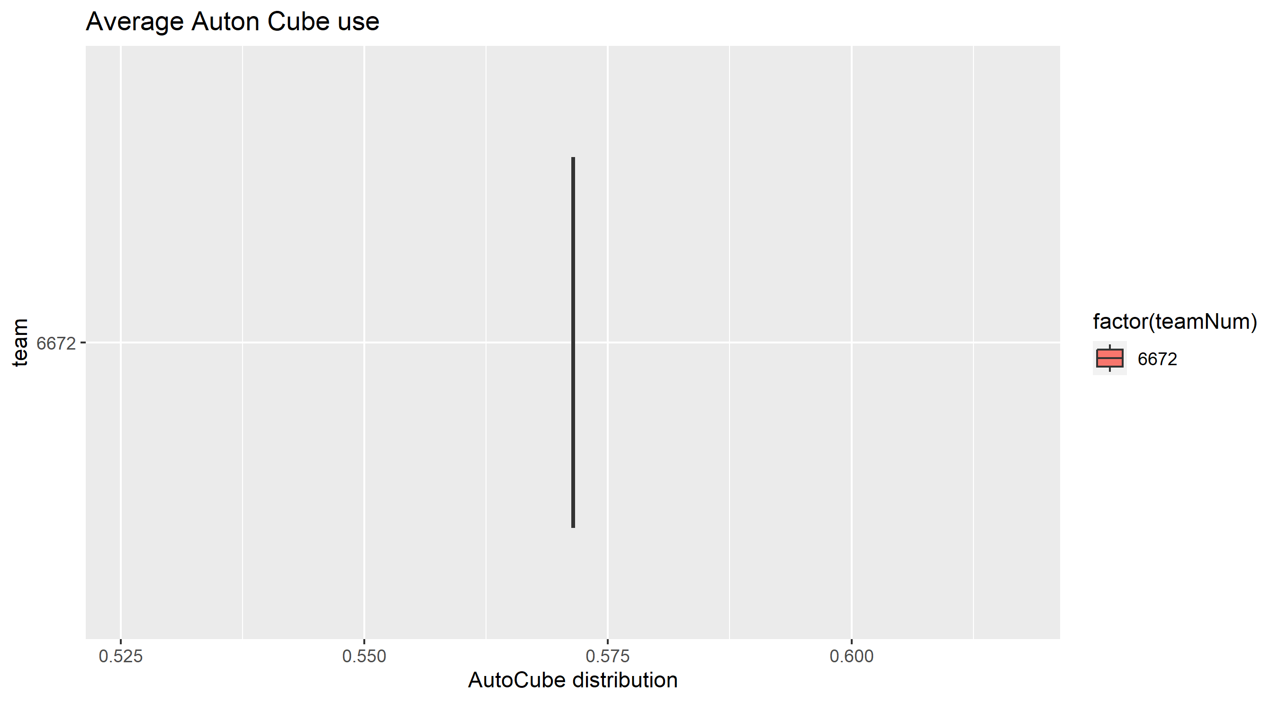
Average Auton. Cube Use

