Slide 1


April 2025
www.nubinix.com

Slide 2







Executive Summary
New Tickets in Last Month
No. Of Databases: 1
Pending Tickets
Number of ec2 instances: 3
Resolved Tickets in Last month
Total Bill Amount- __$

Slide 3
EC2 Instances
Server Name | Specification | Status | Monthly CPU Usage (%) | Monthly Memory Usage (%) | Monthly Disk Usage (%)
server-1 | t2.micro | running | 3.55% | 18.35% | 6.74%
i-0e30701d38f36e2fe | c6g.large | running | 1.67% | N/A | N/A
i-0fe30c240e5efe4f1 | c6g.large | running | 1.63% | N/A | N/A

Slide 4
RESOURCE UTILIZATION OVERVIEW

Slide 5
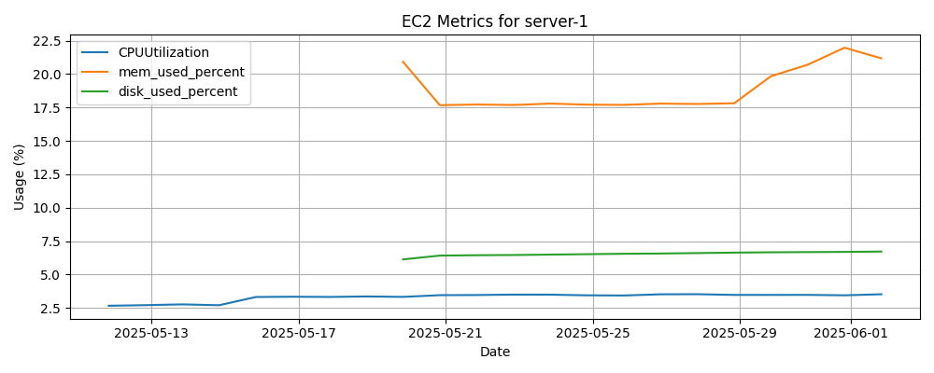
server name: server-1

Slide 6
Relational Databases
DB Identifier | Database Name | Engine | Status | Storage Used / Allocated | Monthly CPU Usage (%) | Freeable Memory
database-1 | N/A | mysql 8.0.41 | available | 2.83 GB / 20 GB | 3.2%

Slide 7
RESOURCE UTILIZATION OVERVIEW

Slide 8
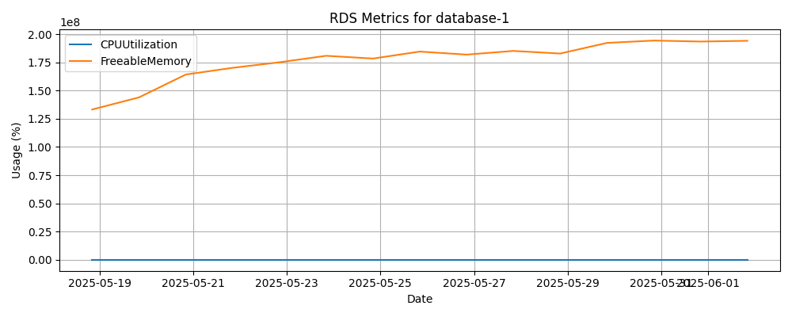
RDS Name: database-1

Slide 9
Resource distribution by optimization status
Resource distribution
No recommendation
Optimized
Under Optimized
Over optimized

Slide 10
EKS Clusters
Cluster Name | Kubernetes Version | Support Period | Node Groups

Slide 11
IAM Users
Username | Groups | MFA Status | Active Key Age (days)

Slide 12
EC2 Backups
Instance Name | AMI ID | Backup Date | Status | Retention (Days) | Next Backup
server-1 | ami-062f0cc54dbfd8ef1 | 2025-06-02 00:30:00 | COMPLETED | N/A | Per backup plan schedule
i-0e30701d38f36e2fe | ami-03bc1a17c3861a52f | 2025-06-02 00:30:00 | FAILED | N/A | Per backup plan schedule
i-0fe30c240e5efe4f1 | ami-03bc1a17c3861a52f | 2025-06-02 00:30:00 | FAILED | N/A | Per backup plan schedule

Slide 13
RDS Backup
DB Name | Snapshot ID | Date | Status | Retention (Days) | Size
database-1 | rds:database-1-2025-06-02-17-36 | 2025-06-02 17:36 | available | 7 days | 20 GB

Slide 14
AWS Health Dashboard
Event | Status | Start Time | Region/Zone | End Time | Affected Resources

Slide 15
Incident Name
Created by | Nubinix Support
Date of Incident | Wednesday, 16 Apr 2025 at 5:13 PM
Platform | Nimbus Logistics
Description | High CPU Usage Alert
Environment | Production
Host | nlcerp.nlclogistic.com
Duration | 4 Seconds
Impact | No impact
Platform | Nimbus Logistics
Status | RESOLVED
RCA Summary | A CPU spike due to a Java application running inside a server.
Action Items | A support ticket has been raised to address the problem.

Slide 16
Support Tickets Overview
Total Tickets
Avg Resolution Time
Tickets by Priority
[Number]
Pie chart showing ticket distribution by priority
[Time]
Ticket Volume Timeline
Support Time Allocation
Timeline showing ticket volume by day
Chart showing the breakdown of ticket support time, ad-hoc support time, and proactive maintenance time

Slide 17
Support Ticket Details
Ticket ID | Description | Root Cause | Resolution | Resolution Time

Slide 18
Support Time Analysis
Breakdown of time spent on ticket support, ad-hoc support, and proactive maintenance
24 hrs
15 hrs
Ticket Support Time
Proactive Maintenance

Slide 19
Billing Summary
RDS
EC2
ECS
VPC
S3

Slide 20
Recent Updates
2023-04-01
2023-02-28
2022-12-10
Upgraded EC2 instances to latest generation
(t3.medium t4g.medium)
Enabled AWS Config monitoring for all resources
(None Comprehensive)
Rolled out new backup policies for EC2 and RDS
(Daily Weekly+Monthly)
2023-03-15
2023-01-20
Migrated RDS databases to new storage configuration
(GP2 GP3)
Implemented AWS CloudTrail for all AWS service activity
(Basic Management Events)

Slide 21

Patch Recommendations
Migrate EC2 instances to latest generation
Upgrading to the latest EC2 instance types can provide significant performance improvements and cost savings.
Centralize backup and recovery processes
Streamline backup and recovery workflows across EC2 and RDS resources to ensure data protection and compliance.
Optimize RDS database configurations
Review and right-size RDS database configurations to improve performance and reduce costs.
Enable AWS CloudTrail logging
Activate CloudTrail logging to gain visibility into all API activities and improve security monitoring.
Implement automated cost optimization policies
Set up AWS Cost Explorer and Budgets to automatically identify and act on cost optimization opportunities.
Implement multi-factor authentication
Enhance security by requiring multi-factor authentication for all IAM user accounts.

Slide 22

END OF REPORT
For questions, feedback, or support, get in touch at support@nubinix.com
www.nubinix.com

