Slide 1
FOOD SHARING APP
Babacar Toure
Clara Gros
1

Slide 2
01
02
03
04
Problem vs. Solution
Solution architecture
Technical implementation
Sneak Peek
05
What for Future?
An innovative concept tackling a real need
Review of the database and the API design
Focus on the Android implementation
Demonstration of the Minimal Viable Product
Scope for improvement and considering the deployment phase
2
Notes:
kyhbgfvdeet

Slide 3
01
Identification of needs
Survey results
Already existing solutions
CShare’s value
3

Slide 4
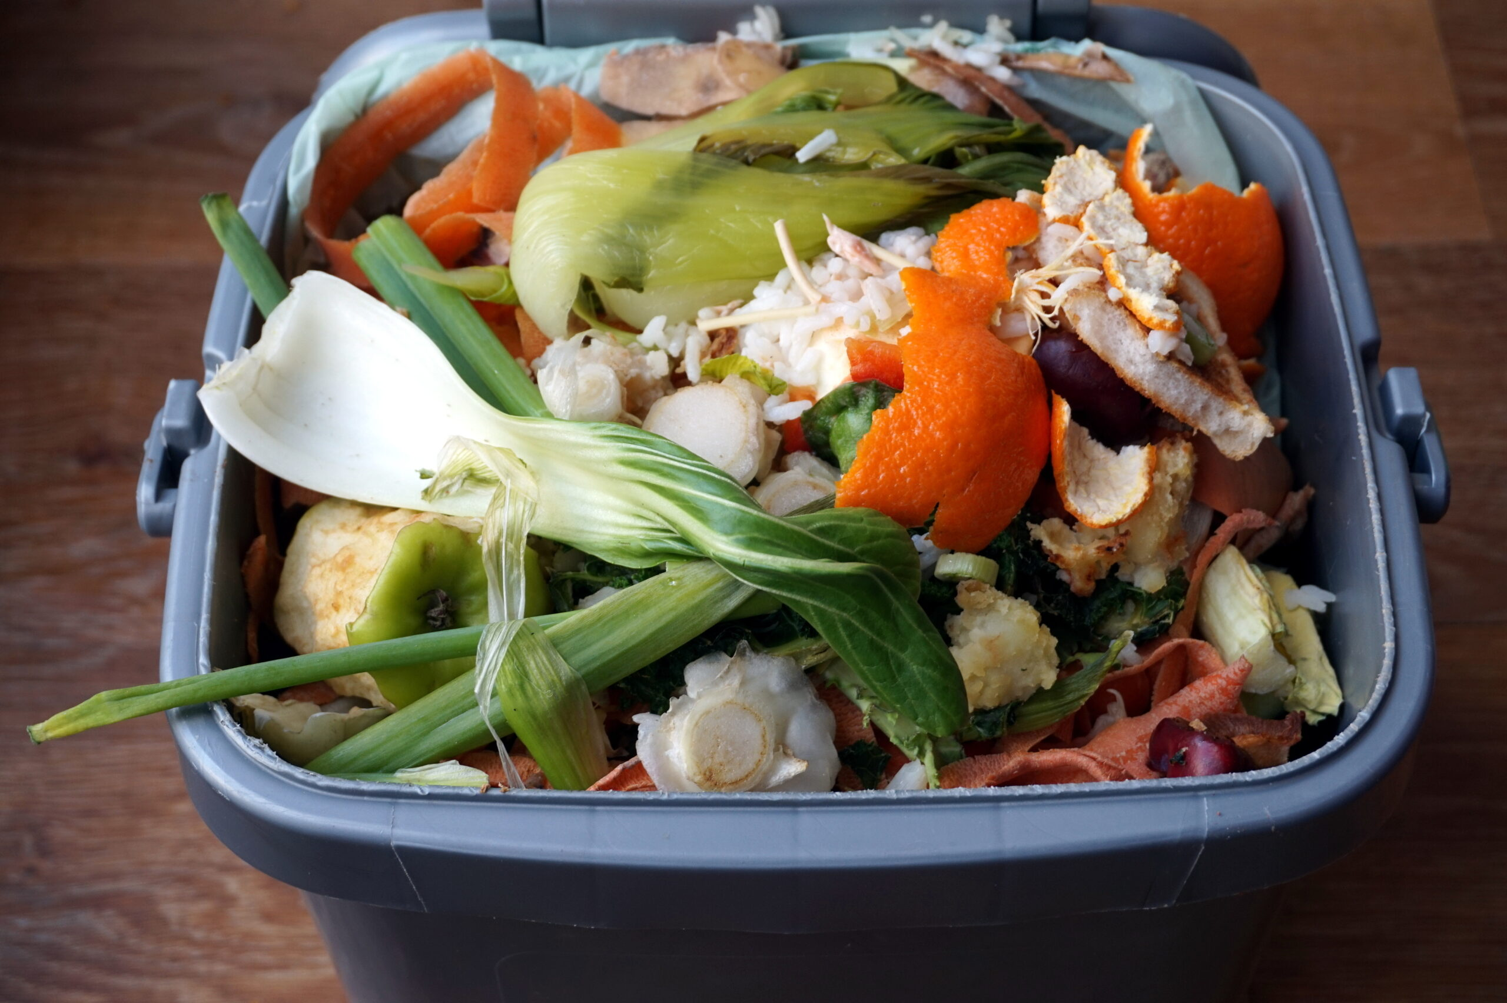
Problem
1,3 billion
1/3 of the food produced for human consumption is lost or wasted in the world, or 1.3 billion tons per year
4

Slide 5
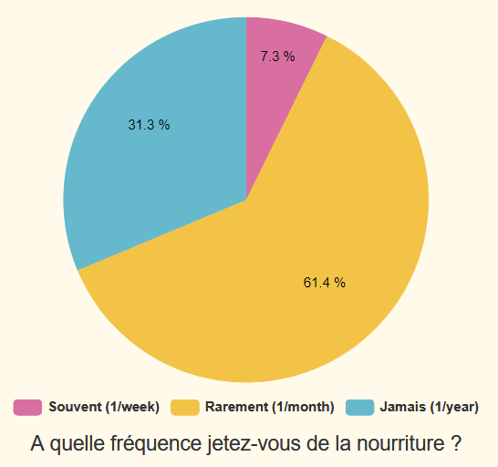
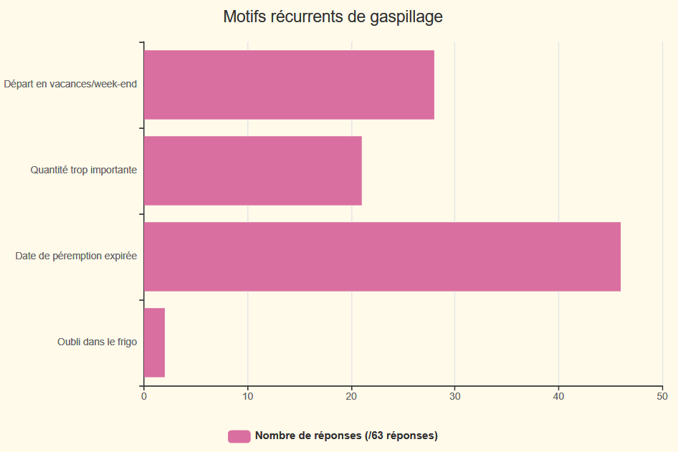
Food waste on the Gif campus
Study carried out with the Google Forms tool on 96 people
5

Slide 6

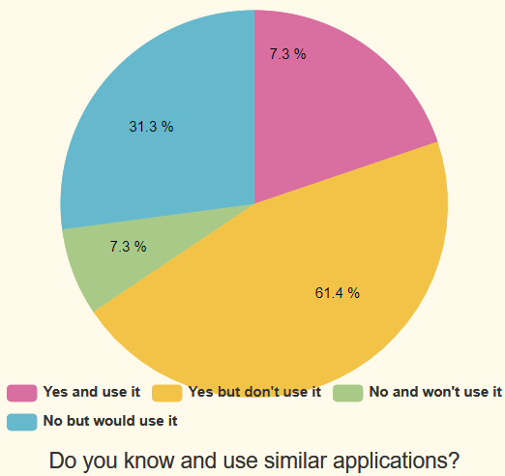

Already existing solutions
Need to travel to pick up products
Paid product baskets and unknown content
Remoteness of available products
Study carried out with the Google Forms tool on 96 people
6
Notes:
BT

Slide 7
Solution
Develop a food sharing application within a campus
to encourage and facilitate exchange between students
and reduce food waste
7

Slide 8

CShare : Product Overview
Authentication
Chat Application
Interaction
Moderation
Auth system for each user to log in and retrieve his data and products
Connect users so they can easily find each other on campus to deliver products
Possibility to add products on the platform but also to order them
Create administrators to moderate and banish malicious users if necessary.
8

Slide 9
02
Architecture of the solution
Database and API designs
9

Slide 10

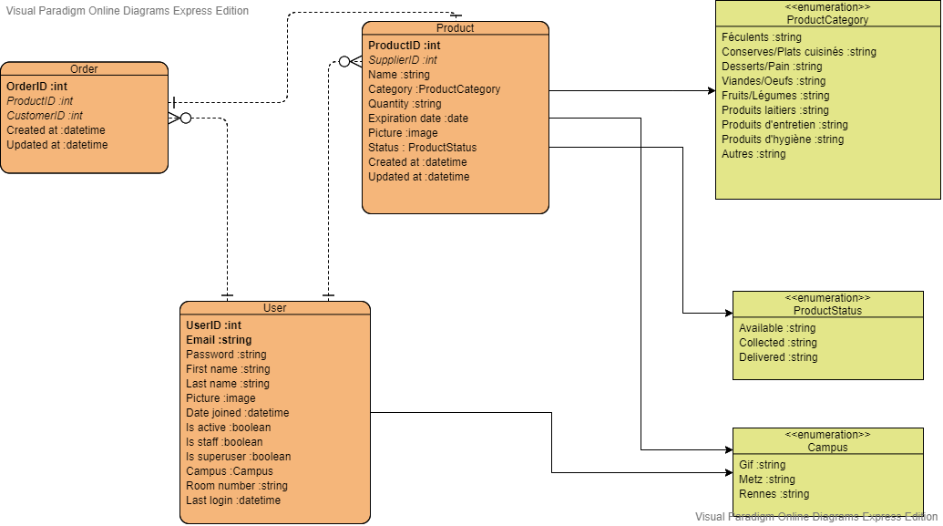
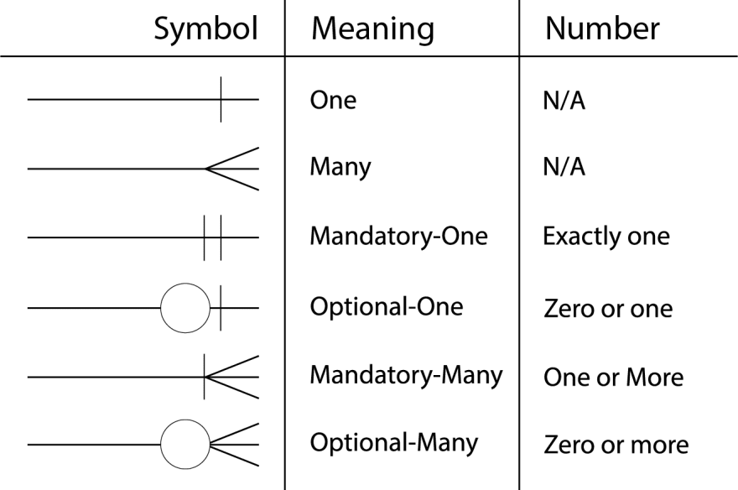
Database design
Normalization degree 3NF
No partial dependency
No transitive dependency
userID ↔ email
Crow’s Foot notation memo
10
6

Slide 11
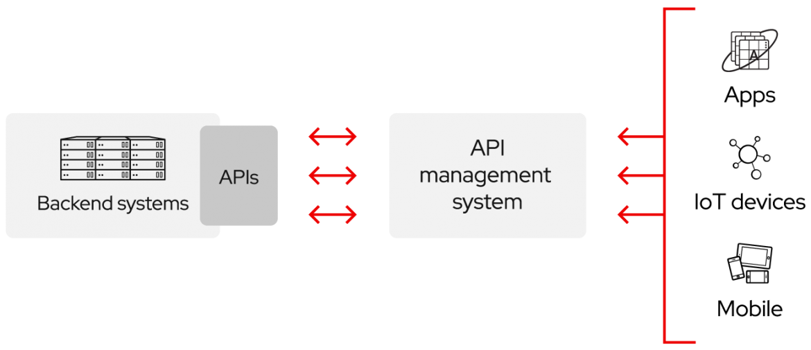

A RESTful API
Client-server architecture
A stateless server
Caching
Resources identification
Manipulation of resources through representations
Self-describing messages
https://identity.getpostman.com/login
11
Notes:
La contrainte d'interface uniforme est fondamentale dans la conception de n'importe quel système REST. Elle simplifie et découple l'architecture, ce qui permet à chaque composant d'évoluer indépendamment. Les quatre contraintes de l'interface uniforme sont les suivantes.
Identification des ressources dans les requêtesChaque ressource est identifiée dans les requêtes, par exemple par un URI dans le cas des systèmes REST basés sur le Web. Les ressources elles-mêmes sont conceptuellement distinctes des représentations qui sont retournées au client. Par exemple, le serveur peut envoyer des données de sa base de données en HTML, XML ou JSON, qui sont des représentations différentes de la représentation interne de la ressource.Manipulation des ressources par des représentationsChaque représentation d'une ressource fournit suffisamment d'informations au client pour modifier ou supprimer la ressource.Messages auto-descriptifsChaque message contient assez d'information pour savoir comment l'interpréter. Par exemple, l'interpréteur à invoquer peut être décrit par un type de médias.

Slide 12
03
Technical implementation
Server and client side
12

Slide 13
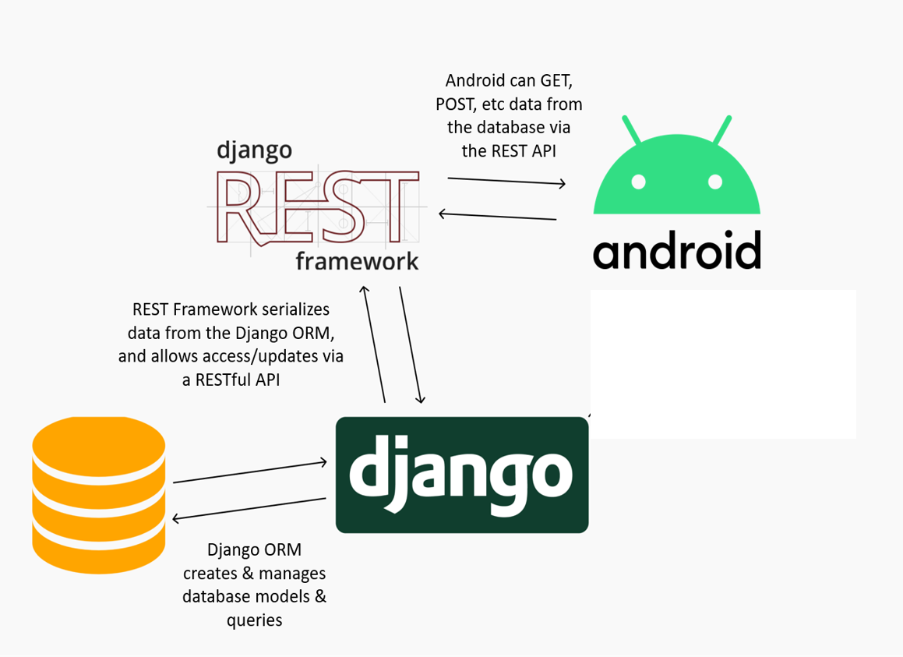
Django REST Framework
Generation of an administration interface
django-rest-auth : Generate REST endpoints related to authentication
13
Notes:
Show the admin plateforme

Slide 14

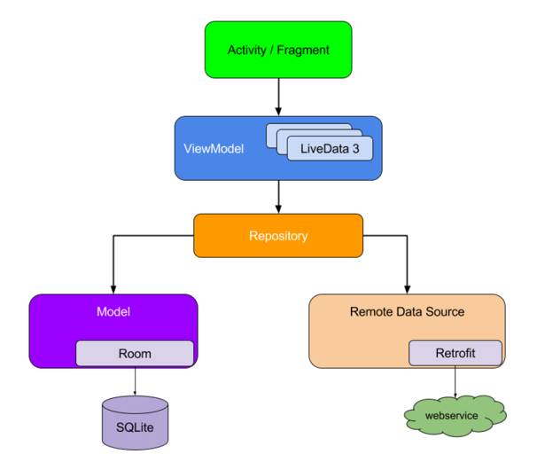
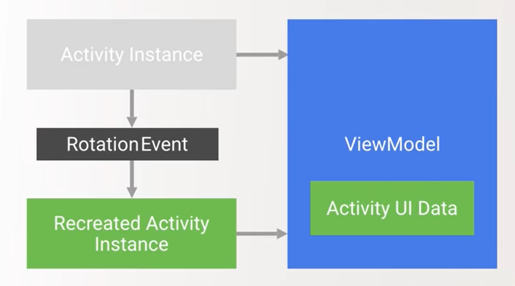
Android MVVM architecture
14

Slide 15
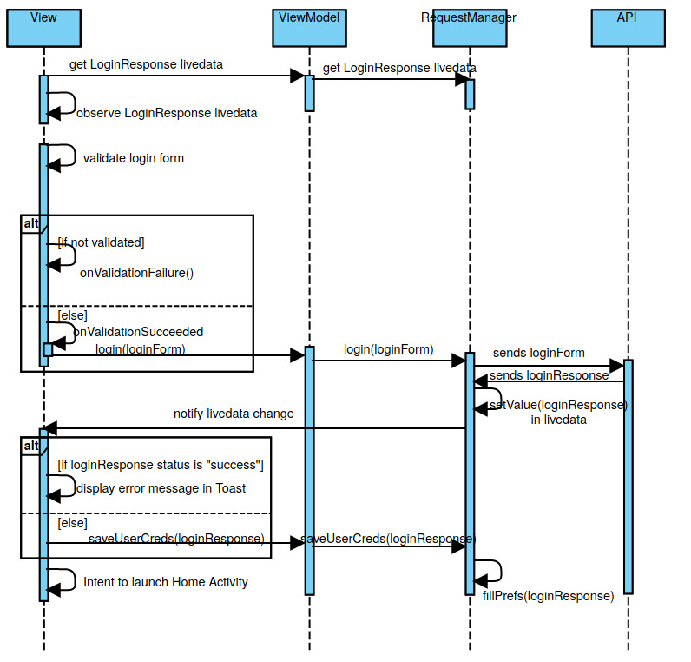
Login sequence diagram
15

Slide 16
Product Demo
Play it on Teams
16

Slide 17
04
What next?
Development prospects
Deployment
Partnerships
17

Slide 18
User experience
Design enhancement
Search bar
Filtering
Scanning bar codes
Product reporting
Instant messaging
18

Slide 19

Food education
https://fr.openfoodfacts.org/
“I'd love to know the nutrition facts about the products I order!”
19

Slide 20
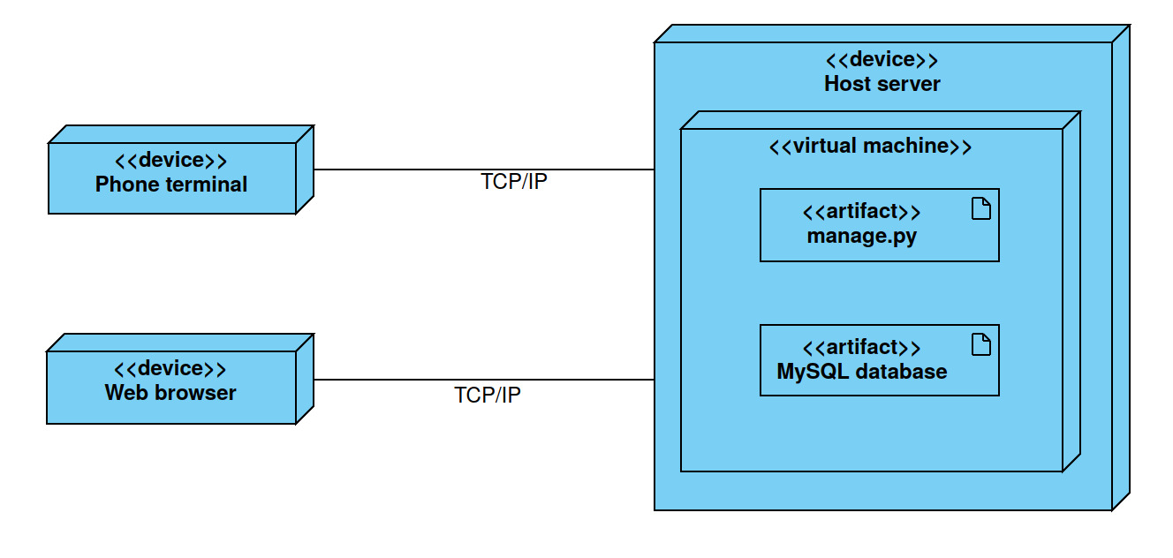
Deployment diagram
20

Slide 21

Server deployment process
Hosting
Packaging
Mapping
Deployment
Creation of a VM
Package the code of the API on the VM
Map an IP address to a DNS name
Ready to start deploying CShare
21

Slide 22

App distribution process
Dev account
App listing
Testing
Distribution
25€ account to publish apps
Fill in details such as logo, pricing and privacy
Beta version with mailing list
Upload APK file
22

Slide 23


Partnership
Impact’s contribution
Get a professional logo
Get a design charter
Server hosting within the ViaRézo infrastructure
Communication plan when the application is released
23

Slide 24
Conclusion: CShare’s added value
Customer
Our work team
Creating a link between students
Reduce food wastage
Handy for spontaneous needs
Learn some good dev practices
Get familiar with Android
Get in touch with third parties
24

Slide 25
Thanks!
Do you have any questions?
clara.gros@student-cs.fr
babacar.toure@student-cs.fr
Please keep this slide for attribution.
25

